Slide 1
Ontario Colposcopy
Clinical Guidance 2016
Version 1 – January XX, 2016

Slide 2
Background
This slide presentation provides an overview of Cancer Care Ontario’s Clinical Guidance: Recommended Best Practices for Delivery of Colposcopy Services, which was released in Ontario in June 2016
These slides can be accessed at cancercare.on.ca/pcs/screening/cervscreening/hcpresources

Slide 3
Purpose and Goal
See page 1‡
Aims to promote adoption of evidence-informed clinical best practices and alignment of organizational best practices
Goal: To optimize the quality of colposcopy services for eligible women with an abnormal cervical screening test by:
  Defining clinical criteria for entry to, management in and exit from colposcopy
  Supporting equitable access to appropriate and consistently high-quality care in colposcopy
  Creating a framework to guide the organization of colposcopy services and their integration with cervical screening to ultimately enable system-wide performance management and improvements
‡Page numbers refer to the full Colposcopy Clinical Guidance document, which is available at cancercare.on.ca/common/pages/UserFile.aspx?fileId=361450

Slide 4
Overview
See pages 2, 9 and 10‡
The document encompasses the spectrum of colposcopy care in 5 pathways for management of women referred for colposcopy after abnormal cervical screening
  Workup and treatment: SIL referral in women > 25
  Conservative SIL management of women > 25 in whom child bearing is of concern
  Post-treatment SIL management, regardless of age
  Management of women ages 21–24 with SIL
  Workup, treatment and management of AGC/AIS referral
Target audience: Colposcopists and the entire team of health care providers involved in colposcopy services (e.g., primary care providers, nurses, pathologists, administrators)
‡Page numbers refer to the full Colposcopy Clinical Guidance document, which is available at cancercare.on.ca/common/pages/UserFile.aspx?fileId=361450

Slide 5
Overview, Con’t
See page 7‡
The clinical pathways include the following components:
Referral criteria and investigation strategies
Indications for treatment and preferred therapies
Follow-up algorithms for treated and untreated women
Criteria for exit from colposcopy and screening intervals following discharge from colposcopy
Relevant clinical considerations and guiding principles for colposcopy in special populations (e.g., pregnant women, immune-compromised women and women under age 24)
‡Page numbers refer to the full Colposcopy Clinical Guidance document, which is available at cancercare.on.ca/common/pages/UserFile.aspx?fileId=361450

Slide 6
Highlights
HPV testing provides objective risk assignment to guide management
  HPV testing for risk stratification‡
      At entry for ASCUS and LSIL
      At exit to inform subsequent screening intervals
Pathways where HPV testing not available is also provided
For young women and women interested in future pregnancies, conservative management preferred whenever possible
Management and follow-up for AIS is clarified
‡Current evidence does not support HPV testing in women under age 30

Slide 7
Key Practice Changes
HPV testing is available:
At entry, women over age 30 with low-grade cytologic abnormalities who test negative for HPV can be discharged to primary care for routine, triennial screening
At discharge, treated women of any age or untreated women over 30 with low-grade cytologic abnormalities who test:
  Negative for HPV can be discharged to primary care for routine, triennial screening
  Positive for HPV can be discharged to primary care for annual surveillance
Women treated after an AGC/AIS referral should be followed in colposcopy for a 5-year period. If all tests are negative during 5-year follow-up, screen annually

Slide 8
Key Practice Changes, Con’t
HPV testing not available:
At discharge, untreated women with negative colposcopies at 2 follow-up visits and treated women with negative colposcopies at 3 follow-up visits are at population risk and can be discharged to primary care
  If 3 negative Paps → screen triennially
  If any combination of negative and low-grade cytology (< LSIL) → screen annually

Slide 9
Best Practice Pathways
The following slides show the detailed pathways and are only meant to provide a high level overview. For more detail, please refer to the full Colposcopy Clinical Guidance document (see slide footnotes).

Slide 10
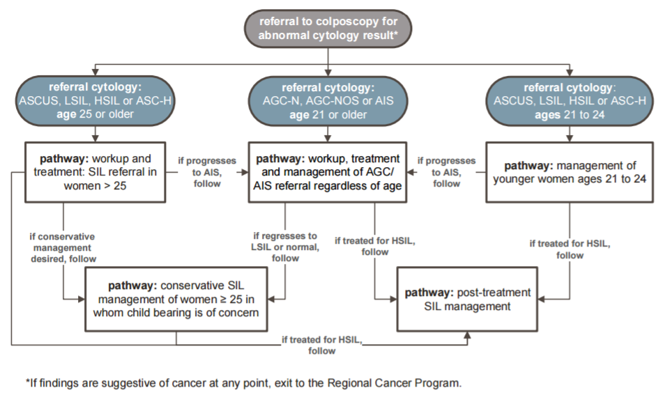
Patient Entry and Flow Across Pathways
See page 11‡
‡Page numbers refer to the full Colposcopy Clinical Guidance document, which is available at cancercare.on.ca/common/pages/UserFile.aspx?fileId=361450

Slide 11
Untreated Women:
Workup and Treatment: SIL Referral for Women > 25
See page 15‡
‡Page numbers refer to the full Colposcopy Clinical Guidance document, which is available at cancercare.on.ca/common/pages/UserFile.aspx?fileId=361450

Slide 12
Untreated Women:
Conservative SIL Management of Women > 25
See page 18‡
‡Page numbers refer to the full Colposcopy Clinical Guidance document, which is available at cancercare.on.ca/common/pages/UserFile.aspx?fileId=361450

Slide 13
Treated Women:
Post-Treatment SIL Management
See page 21‡
‡Page numbers refer to the full Colposcopy Clinical Guidance document, which is available at cancercare.on.ca/common/pages/UserFile.aspx?fileId=361450

Slide 14
Management of Women Ages 21–24
See page 24‡
‡Page numbers refer to the full Colposcopy Clinical Guidance document, which is available at cancercare.on.ca/common/pages/UserFile.aspx?fileId=361450

Slide 15
Workup, Treatment and Management
AGC/AIS Referral
See page 27‡
‡Page numbers refer to the full Colposcopy Clinical Guidance document, which is available at cancercare.on.ca/common/pages/UserFile.aspx?fileId=361450

Slide 16
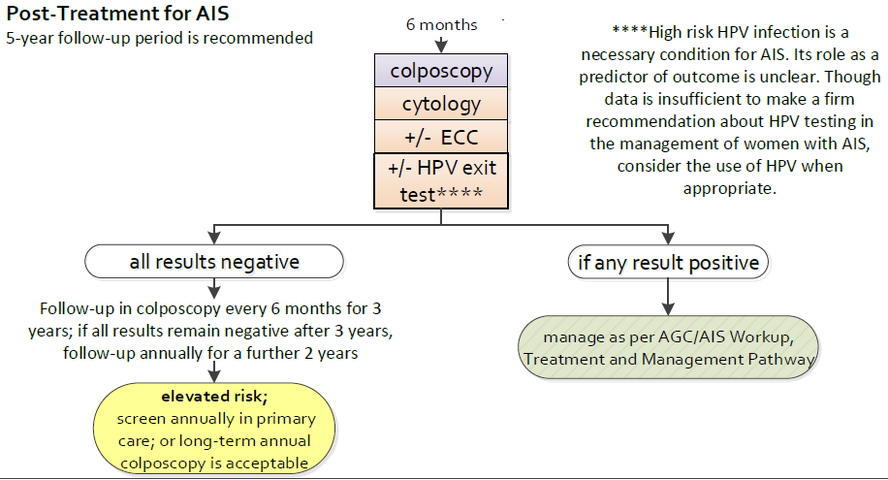
Workup, Treatment and Management AGC/AIS Referral:
5-Year Follow-Up
See page 27‡
‡Page numbers refer to the full Colposcopy Clinical Guidance document, which is available at cancercare.on.ca/common/pages/UserFile.aspx?fileId=361450

Slide 17
Comparison of Pathways with and Without HPV Testing

Slide 18
Untreated Women:
Workup and Treatment: SIL Referral for Women > 25
See pages 15 and 30‡
Pathway with HPV testing
Pathway without HPV testing
‡Page numbers refer to the full Colposcopy Clinical Guidance document, which is available at cancercare.on.ca/common/pages/UserFile.aspx?fileId=361450

Slide 19
Untreated Women:
Conservative SIL Management of Women > 25
See pages 18 and 33‡
Pathway with HPV testing
Pathway without HPV testing
1
1
2
‡Page numbers refer to the full Colposcopy Clinical Guidance document, which is available at cancercare.on.ca/common/pages/UserFile.aspx?fileId=361450

Slide 20
Treated Women:
Post-Treatment SIL Management
See pages 21 and 36‡
Pathway with HPV testing
Pathway without HPV testing
1
1
2
2
3
‡Page numbers refer to the full Colposcopy Clinical Guidance document, which is available at cancercare.on.ca/common/pages/UserFile.aspx?fileId=361450

Slide 21
Tools and Resources
The Colposcopy Clinical Guidance document and Q&A for providers available at https://www.cancercareontario.ca/en/guidelines-advice/types-of-cancer/43336
The Organization of Colposcopy Services in Ontario: Recommended Framework available at https://www.cancercareontario.ca/en/guidelines-advice/types-of-cancer/2096
Regional Cervical Screening / Colposcopy Leads (CSCLs) are also a resource available to you to support and answer your clinical questions
Join the Colposcopy Community of Practice (CoP) by emailing ColposcopyCoP@cancercare.on.ca

