Slide 1
Prevention System Quality Index 2020
October 2020
cancercareontario.ca/PSQI

Slide 2
Prevention System Quality Index Background
Report on indicators of system-level policies and programs to address cancer risk factors
Provides evidence and data to help governments, nongovernmental organizations and local public health agencies implement cancer prevention policies and programs in Ontario

Slide 3
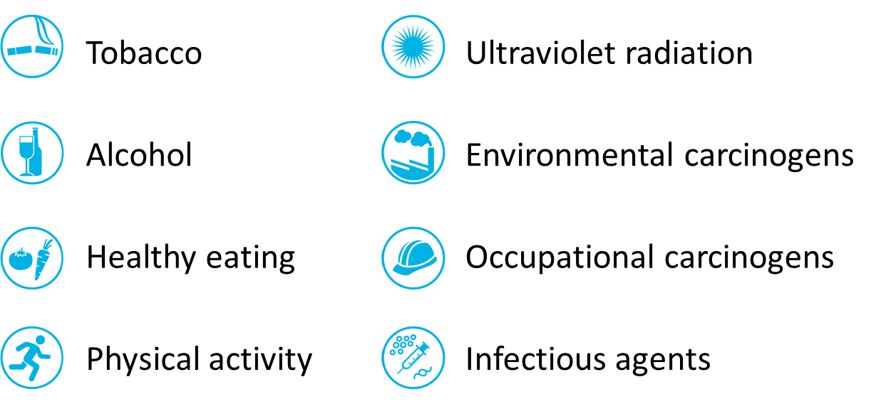
Prevention System Quality Index 2020
Cancer risk factor and exposure domains in the 2020 report:
Developed with guidance from an Advisory Committee and Expert Panel
Report, Highlights, Supplementary Tables, Technical Appendix and Slideshow are available at cancercareontario.ca/PSQI

Slide 4
Prevention System Quality Index 2020 Chapter structure
Risk factor or exposure link to cancers
Burden of risk factor (prevalence, attributable cancers, economic costs)
Review of effective policies and programs with indicators of implementation in Ontario where data are available
Opportunities to reduce risk factor or exposure in Ontario
What’s new
  Brief highlight of cancer prevention in Indigenous populations

Slide 5

Tobacco smoking (1)
Tobacco taxation
The World Health Organization recommends that tobacco taxes make up 75% or more of the total retail price of tobacco.
In 2018, taxes made up 65.3% of the average total retail price of cigarettes in Ontario.
Opportunity: Increase tobacco taxes to at least 75% of the retail price.

Slide 6
Tobacco taxes as a percentage of average total retail price per carton of 200 cigarettes, by province or territory, 2018
Province or territory | Pre-tax price ($) | Total taxes ($) | Average total retail price ($) | Tax as a percentage of total retail price (%)
British Columbia | 36.31 | 92.67 | 128.97 | 71.9
Manitoba | 40.74 | 98.92 | 139.66 | 70.8
Nova Scotia | 41.66 | 96.97 | 138.64 | 69.9
Saskatchewan | 39.79 | 90.79 | 130.58 | 69.5
Quebec | 29.28 | 66.07 | 95.35 | 69.3
Newfoundland and Labrador | 39.79 | 89.75 | 129.53 | 69.3
Prince Edward Island | 42.08 | 91.24 | 133.32 | 68.4
New Brunswick | 45.60 | 92.96 | 138.56 | 67.1
Ontario | 39.20 | 73.80 | 113.01 | 65.3
Alberta | 43.52 | 79.72 | 123.24 | 64.7
Yukon | 49.68 | 90.53 | 140.21 | 64.6
Nunavut | 54.42 | 90.76 | 145.18 | 62.5
Northwest Territories | 57.73 | 91.77 | 149.50 | 61.4
Notes:
Sources: Total taxes retrieved from provincial and territorial government websites for the tobacco taxes in effect or announced in 2018. Average Annual Retail Price (after tax) of Cigarette Cartons, custom report (Statistics Canada).
Notes: Data are presented in Supplementary Table S2. Total retail price data represent a simple standardized unit price of cigarette cartons across geographies recorded by the Consumer Price Index. Users are advised to exercise caution when comparing to the official (weighted) average prices table released by Statistics Canada because the calculation methods are different. Average prices should not be used as a measure of pure price change through time because the product and outlet sample can vary from month to month.

Slide 7
Tobacco smoking (2)
Second-hand smoke exposure
There is no safe level of second-hand smoke exposure. Smoke-free laws and policies protect people from second-hand smoke.
In 2015–2016, 14.6% of adults and 29.7% of adolescents reported exposure to second hand smoke every day or almost every day in public places in the past month.
Opportunity: Increase awareness and enforcement of the Smoke-Free Ontario Act and promote broader implementation of smoke-free policies.

Slide 8
Tobacco smoking (3)
Smoke-free policies in social housing
People who live in multi-unit housing (in particular, social housing) may be more likely to be exposed to second-hand smoke than people who live in single detached homes.
As of January 2020, 8 out of 13 social housing providers with 1,500 or more residential units had a smoke-free policy, providing protection for about 96,600 out of 225,200 residents.
Opportunity: Increase smoke-free policies in social and other multi-unit housing.

Slide 9
Smoke-free policies in local housing corporations with 1,500 or more residential units, Ontario, 2020
Local housing corporation (approximate number of units) | Approximate number of residents | Has the local housing corporation implemented a smoke-free policy for all properties?
Toronto Community Housing Corporation (60,000) | 110,000 | No
Ottawa Community Housing Corporation (15,000) | 32,000 | Yes: Ottawa Community Housing No-Smoking Policy. Effective May 31, 2014.
Peel Living (6,900) | 15,600 | Yes: Peel Living Smoke-Free Living Policy. Effective November 1, 2018.
CityHousing Hamilton (7,100) | 14,000 | Yes: CityHousing Hamilton Corporation Smoke-Free Living Policy. Effective January 1, 2020.
Windsor Essex Community Housing Corporation (4,700) | 12,000 | Yes: Smoke-free policy Windsor Essex Community Housing Corporation. Effective January 1, 2018.
Waterloo Region Housing (2,720) | 11,800 | Yes: Waterloo Region Housing Smoke-Free Policy. Effective April 1, 2010.
London & Middlesex Community Housing (3,280) | 5,000 | No
Niagara Regional Housing (2,840) | 5,000 | No
The District of Thunder Bay Social Services Administration Board (2,480) | 5,000 | Yes: The District of Thunder Bay Social Services Administration Board Housing Services Smoke-Free Policy. Effective September 1, 2015.
Greater Sudbury Housing Corporation (1,850) | 4,500 | No
Halton Community Housing Corporation (2,190) | 4,100 | No
Housing York Inc. (2,600) | 4,000 | Yes: Smoke-Free Policy for Housing York Inc. Effective November 1, 2014.
Simcoe County Housing Corporation (1,600) | 2,200 | Yes: Simcoe County Housing Corporation Non-Smoking Policy. Effective November 13, 2018.
Notes:
Sources: Local housing corporations
Notes: Details about the smoke-free policies are presented in Supplementary Table S5. The presence of a smoke-free policy at each local housing corporation was determined by reviewing their websites and contacting the corporation to verify what was found.

Slide 10
Tobacco smoking (4)
Smoking cessation
A provincial-level focus on increasing the number of smokers who try to quit, and their number of quit attempts, may help increase the smoking cessation rate.
In 2017, 48.1% of adult smokers made 1 or more quit attempts in the past 12 months.
During 2015–2017, 51.5% of adults reporting past daily or occasional smoking, quit smoking completely at least 1 year ago.
Opportunity: Increase mass media campaigns to support quit attempts and expand funding for smoking cessation programs to ensure free access to counselling supports and pharmacotherapy.

Slide 11
Percentage of adults (age 20+) reporting past daily or occasional smoking, who stopped smoking completely at least 1 year ago, by public health unit, Ontario, 2015–2017 combined
Notes:
Source: Canadian Community Health Survey, 2015–2017 (Statistics Canada)
Notes: Data are presented in Supplementary Table S7. Estimates are adjusted to the age distribution of the 2011 Canadian population.

Slide 12

Alcohol (1)
Minimum price of alcohol
To achieve substantial reductions in drinking in Ontario, it is estimated that the minimum price for alcohol sold in retail stores should be $1.75 per standard drink (2019 dollars).
As of March 2019, the minimum prices per standard drink for alcohol sold in retail stores ranged from $1.06 for beer to $1.55 for spirits.
Opportunity: Increase the minimum price of alcohol sold in retail stores to $1.75 per standard drink (2019 dollars).

Slide 13
Alcohol (2)
Alcohol availability
Privatization of alcohol retail stores and increasing the number of alcohol retail stores faster than the growth of a population in a given area may result in increased alcohol drinking.
In 2019, 79.3% of alcohol retail stores were privately owned, which was an increase from 75.9% in 2015.
In 2019, there were 2.5 alcohol retail stores for every 10,000 people ages 15 and older compared to 2.3 in 2015.
Opportunity: Identify an appropriate limit for privatized alcohol retail stores and the number of alcohol retail stores based on the size of the population.

Slide 14
Number of alcohol retail stores per 10,000 people (age 15+), by public health unit, Ontario, January 2019
Notes:
Sources: The Beer Store, Alcohol and Gaming Commission of Ontario, Liquor Control Board of Ontario. Population estimates, Ministry of Finance, 2019 (Statistics Canada).
Notes: Data are presented in Supplementary Table S12. Alcohol retail stores are also called off-premises alcohol outlets and are places where people buy alcohol to drink elsewhere. Alcohol retail stores include publicly and privately owned stores.

Slide 15

Healthy eating (1)
Household food insecurity
Food insecurity reduces a household’s ability to afford adequate food. Households with the lowest income are much more likely to experience food insecurity than households with the highest income.
In 2017, 15.0% of households experienced some level of food insecurity.
Opportunity: Implement provincial poverty reduction policies, including increasing the minimum wage and income supports to reduce household food insecurity.

Slide 16
Percentage of households that were food insecure in the past year, overall (marginal, moderate and severe combined), by level of food insecurity and by sex, Ontario, 2017
Notes:
Source: Canadian Community Health Survey, 2017 (Statistics Canada)
Notes: Data are presented in Supplementary Table S15. Estimates are adjusted to the age distribution of the 2011 Canadian population.

Slide 17
Healthy eating (2)
Food literacy development in secondary schools
Food literacy development in schools – including learning how to choose and prepare healthy foods – can increase healthy eating among children and youth, shaping lifelong health.
From 2005/06 to 2012/13, only about 1/3 of students who started Grade 9 in each of these school years completed 1 or more credits that included food literacy during their secondary school education.
Opportunity: Include at least 1 required credit that has a food literacy component as part of the Ontario secondary school curriculum.

Slide 18

Physical activity (1)
Active transportation in adults and adolescents
People who regularly walk, bicycle or use other forms of active transportation report higher levels of overall physical activity.
In 2015–2017, 48.0% of adults and 78.7% of adolescents ages 12 to 17 reported using active transportation in the past week.
Opportunity: Continue to develop provincial and municipal infrastructure, policies and plans that support active transportation.

Slide 19
Percentage of adults (age 18+) who reported use of active transportation in the previous week, by public health unit, 2015–2017 combined
Notes:
Source: Canadian Community Health Survey, 2015–2017 (Statistics Canada)
Notes: Data are presented in Supplementary Table S19. Estimates are adjusted to the age distribution of the 2011 Canadian population. Active transportation: active ways, like walking or cycling, to get to places such as school, the bus stop, the shopping centre, work or to visit friends.

Slide 20
Percentage of adolescents (ages 12 to 17) who reported use of active transportation in the previous week, by frequency of use and by public health unit, 2015–2017 combined
Notes:
Source: Canadian Community Health Survey, 2015–2017 (Statistics Canada)
Notes: Data are presented in Supplementary Table S22. Estimates are adjusted to the age distribution of the 2011 Canadian population. Active transportation: active ways, like walking or cycling, to get to places such as school, the bus stop, the shopping centre, work or to visit friends.

Slide 21
Physical activity (2)
Health and physical education specialist teachers in schools
Physical education specialists can improve the quality of physical education classes and increase the time students spend being physically active during class time.
In the 2016/17 school year, 21.7% of elementary schools and 20.3% of secondary schools reported having at least 1 health and physical education specialist teacher.
Opportunity: Increase the percentage of schools that have a health and physical education specialist teacher.

Slide 22
Percentage of publicly funded elementary and secondary schools in Ontario with at least 1 full or part-time specialist teacher assigned to teach health and physical education, 2006/07 to 2016/17 school years
Notes:
Source: Ontario School Information System, 2006/07 to 2016/17 (Ministry of Education)
Notes: Data are presented in Supplementary Table S24. Full time means ≥1.0 full-time equivalent (FTE). Note that ≥1.0 FTE does not necessarily mean there are one or more full-time specialist teachers because two or more part-time specialist teachers may account for ≥1.0 FTE. Part time means >0 and <1.0 FTE.

Slide 23
Physical activity (3)
Enrolment in health and physical education courses
Physical education classes can increase overall physical activity in children and adolescents and address a decrease in physical activity that occurs during adolescence.
In the 2016/17 school year, 86.3% of students in Grade 9 took a health and physical education course credit, compared to 28.2% of students in Grade 12.
Opportunity: Require health and physical education credits in every grade of secondary school.

Slide 24

Ultraviolet radiation (1)
Shade policies
Built structures and dense tree canopies can provide shade and protect people from UVR exposure more reliably than sunscreen.
As of 2019, 3 local municipalities with a population of 100,000 or more have strong shade policies in their planning policy documents, which state that shade should be provided for a broad range of sites. The number of municipalities with a strong shade policy is unchanged from 2016.
From 2016 to 2019, 5 local municipalities added moderate shade policies to their planning policy documents, which state that shade should be provided for a few types of sites.
Opportunity: Strengthen municipal shade policies, and monitor the implementation and impact of these policies.

Slide 25
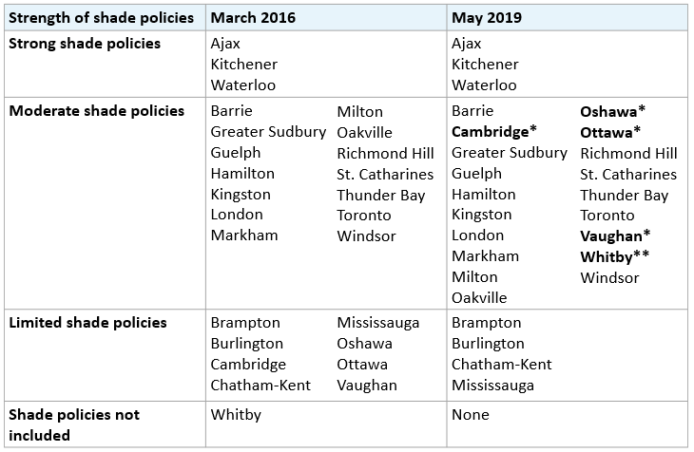
Strength of shade policies in the planning policy documents of local municipalities in Ontario with populations of 100,000 or more, 2016 and 2019
*Shade policy of the municipality improved from limited to moderate since the 2016 review.
**Shade policy of the municipality was not previously included and improved to moderate since the 2016 review.
Notes:
Sources: Municipal planning policy documents (e.g., official plans, urban design guidelines, site plan control bylaws) posted on the web or in additional documents sent by email from the municipality for each of the 26 Ontario local municipalities with populations of 100,000 or greater.
Note: The shade policies assessed and information about whether they were verified by the municipality can be found in Supplementary Table S30.

Slide 26
Ultraviolet radiation (2)
Tanning bed use in Ontario students in Grade 7 to 12
In 2014, the Ontario government enacted the Skin Cancer Prevention Act (Tanning Beds) to ban the sale and marketing of tanning services to youth under age 18.
The results of a survey conducted 1 year after the Skin Cancer Prevention Act came into effect showed no changes in tanning bed use for students in Grades 7 to 12 compared to the results of a similar survey conducted before the act came into effect (7.9% in 2015 vs 6.9% in 2014).
Opportunity: Monitor tanning bed use in youth and increase enforcement of the Skin Cancer Prevention Act (Tanning Beds).

Slide 27

Environmental carcinogens
PM_{2.5} concentrations in outdoor air
Fine particulate matter (PM_{2.5}) in outdoor air pollution increases the risk of lung cancer. There is no known safe level of exposure to PM_{2.5}.
In 2017, annual average PM_{2.5} concentrations ranged from 4.1 to 8.5 μg/m³ at monitoring stations in Ontario. All average PM_{2.5} concentrations were lower than the current Canadian Ambient Air Quality Standard of 8.8 μg/m³.
Opportunity: Continue to reduce emissions from homes, the transportation sector and industrial facilities.

Slide 28
Annual average ambient fine particulate matter (PM_{2.5}) concentrations (μg/m3) in Ontario, by monitoring station, 2013 to 2017
Monitoring station | 2013 | 2014 | 2015 | 2016 | 2017
Barrie | 7.5 | 7.6 | 7.6 | 6.5 | 7.0
Belleville | 6.9 | 6.8 | 6.6 | 5.5 | 5.8
Brampton | 8.5 | 8.9 | 8.4 | 6.8 | 7.0
Brantford | 8.5 | 9.2 | 8.7 | 7.3 | 7.2
Burlington | 8.7 | 9.6 | 9.4 | 7.6 | 7.0
Chatham | 8.1 | 8.6 | 8.1 | 6.6 | 6.4
Cornwall | 7.7 | 7.0 | 6.9 | 6.4 | 5.9
Dorset | 5.4 | 5.3 | 5.6 | 4.6 | 4.6
Grand Bend | 7.3 | 8.1 | 7.7 | 6.0 | 5.1
Guelph | 8.1 | 8.9 | 8.4 | 6.9 | 6.8
Hamilton Downtown | 10.1 | 10.8 | 10.2 | 8.2 | 8.5
Hamilton Mountain | 9.2 | 9.4 | 9.0 | 7.2 | 7.4
Hamilton West | 9.6 | 9.9 | 9.9 | 7.9 | 7.5
Kingston | 6.5 | 6.8 | 6.3 | 5.8 | 5.3
Kitchener | 8.7 | 9.3 | 8.8 | 7.3 | 7.0
London | 9.1 | 8.8 | 8.3 | 7.1 | 7.0
Mississauga | 7.9 | 8.7 | 8.5 | 7.2 | 6.8
Morrisburg | 6.7 | 7.0 | N/A | N/A | N/A
Newmarket | 7.3 | 7.3 | 7.1 | 6.0 | 5.9
North Bay | 5.2 | 5.3 | 5.3 | 4.6 | 4.6
Monitoring station | 2013 | 2014 | 2015 | 2016 | 2017
Oakville | 8.0 | 8.5 | 8.3 | 7.0 | 6.9
Oshawa | 7.4 | 7.7 | 7.5 | 5.9 | 5.9
Ottawa Central | 7.1 | 6.8 | 6.9 | 5.6 | 5.8
Ottawa Downtown | 7.0 | 7.0 | 6.9 | 5.9 | 5.9
Parry Sound | 5.8 | 5.8 | 5.7 | 4.8 | 4.6
Petawawa | 4.8 | 4.7 | 4.8 | 4.4 | 4.1
Peterborough | 7.4 | 6.9 | 6.8 | 5.8 | 5.8
Port Stanley | 7.4 | 8.2 | 8.0 | 6.5 | 6.3
Sarnia | 8.5 | 9.0 | 8.4 | INS | 7.0
Sault Ste. Marie | 5.6 | 6.0 | 5.9 | 4.9 | 5.0
St. Catharines | 8.5 | 8.8 | 8.4 | 6.9 | 7.0
Sudbury | 5.7 | 6.0 | 6.3 | 5.4 | 5.0
Thunder Bay | 6.3 | 6.6 | 6.5 | 5.8 | 5.1
Tiverton | 5.8 | 6.5 | 6.4 | 5.1 | 5.1
Toronto Downtown | 8.3 | 8.7 | 8.4 | 7.0 | 7.4
Toronto East | 8.2 | 8.9 | 8.5 | 7.0 | 7.4
Toronto North | 8.3 | 9.2 | 9.4 | 7.3 | 7.4
Toronto West | 8.8 | 9.1 | 8.5 | 7.0 | 7.4
Windsor Downtown | 9.2 | 10.1 | 9.3 | 8.1 | 7.8
Windsor West | 10.0 | 10.7 | 9.9 | 8.5 | 8.5
Bolded values exceed 8.8 μg/m³, the PM_{2.5} reference level set by the Canadian Ambient Air Quality Standards, effective in 2020.
Notes:
Source: Air Quality in Ontario, 2013 to 2017 (Ministry of the Environment, Conservation and Parks)
Notes: Data are presented in Supplementary Table S32. Bolded values exceed 8.8 μg/m³, the PM_{2.5} reference level set by the Canadian Ambient Air Quality Standards, effective in 2020. INS: insufficient data in any one quarter to calculate a valid average ambient concentration. N/A: PM_{2.5} not monitored in that year.

Slide 29

Occupational carcinogens (1)
Industrial nickel use
Nickel compounds are a known cause of lung, nasal and sinus cancers. Nickel compounds are commonly found in fumes from welding.
The number of facilities that reported using nickel to the Toxics Reduction Program and the total amount of nickel used decreased from 2013 to 2016. However, the total number of employees working at industrial facilities that reported using nickel increased during this same time period.
Opportunity: Introduce ventilation requirements in Ontario Occupational Health and Safety legislation for welding activities.

Slide 30
Amount of nickel used (in tonnes) and number of employees working at facilities using nickel in Ontario, 2013 to 2016
Year | Use (tonnes) | Number of employees | Number of facilities
2013 | 869,915 | 40,890 | 131
2014 | 870,027 | 40,889 | 125
2015 | 869,235 | 43,358 | 125
2016 | 864,027 | 44,147 | 123
Notes:
Source: Ontario Toxics Reduction Program, 2013 to 2016 (Ministry of the Environment, Conservation and Parks)
Notes: Data are presented in Supplementary Table S33. Excludes facilities that are exempt from the Ontario Toxics Reduction Program (i.e., that use or release nickel in quantities below the legislated thresholds). Nickel use (tonnes) is estimated by selecting the mid-point value for each facility's reported range of use and summing these values across all facilities for each sector.

Slide 31
Occupational carcinogens (2)
Industrial formaldehyde use
Formaldehyde exposure can cause cancer of the nasopharynx and leukemia, and may be a cause of sinus cancer.
The amount of formaldehyde use reported in Ontario was lower in 2016 than in the previous 3 years.
The number of employees and the number of facilities reporting formaldehyde use were about the same from 2013 to 2016.
Opportunity: Reduce the ceiling limit for formaldehyde to 0.3 parts per million, as recommended by the Canadian Labour Code and the American Conference of Governmental Industrial Hygienists.

Slide 32
Amount of formaldehyde used (in tonnes) and number of employees working at facilities using formaldehyde in Ontario, 2013 to 2016
Year | Use (tonnes) | Number of employees | Number of facilities
2013 | 10,330 | 28,544 | 32
2014 | 20,246 | 30,382 | 29
2015 | 18,897 | 29,242 | 31
2016 | 9,054 | 30,925 | 32
Notes:
Source: Ontario Toxics Reduction Program, 2013 to 2016 (Ministry of the Environment, Conservation and Parks)
Notes: Data are presented in Supplementary Table S34. Excludes facilities that are exempt from the Ontario Toxics Reduction Program (i.e., they use or release formaldehyde in quantities below the legislated thresholds). Formaldehyde use (tonnes) is estimated by selecting the mid-point value for each facility's reported range of use and summing these values across all facilities for each sector.

Slide 33

Infectious agents
School-based human papillomavirus (HPV) and hepatitis B vaccination coverage
Publicly funded school-based vaccination programs for HPV and the hepatitis B virus are offered to students in Grade 7 in Ontario.
At the end of the 2017/18 school year:
  59.9% of 12-year-old children received two doses of the HPV vaccine through the school-based program.
  69.2% of 12-year-old children received two doses of the hepatitis B vaccine through the school-based program.
Opportunity: Support local public health agencies in increasing education for parents and students on the benefits and safety of vaccinations.

Slide 34
Up-to-date human papillomavirus vaccination coverage (%) in 12-year-old students in Ontario, by public health unit, 2017/18 school year
Notes:
Source: Digital Health Immunization Repository, 2017/2018 (Ministry of Health and Long-Term Care) in: Ontario Agency for Health Protection and Promotion (Public Health Ontario). Immunization coverage report for school pupils in Ontario: 2016–17 school year. Toronto, ON: Queen’s Printer for Ontario; 2018.
Notes: Data are presented in Supplementary Table S35.

Slide 35
Prevention System Quality Index Website and contact
cancercareontario.ca/PSQI
Contact:
Maria Chu, Prevention System Quality Index Lead
cancerprevention@ontariohealth.ca

