Slide 2
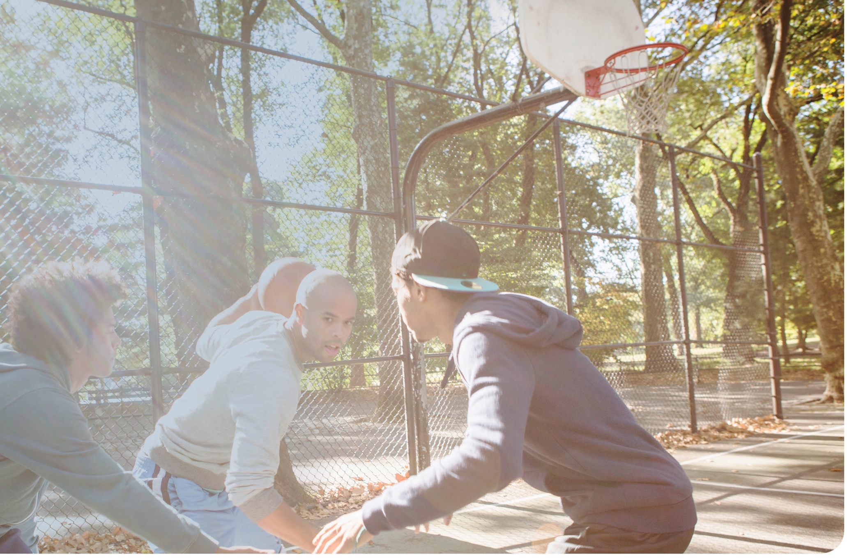
Introduction

Slide 3
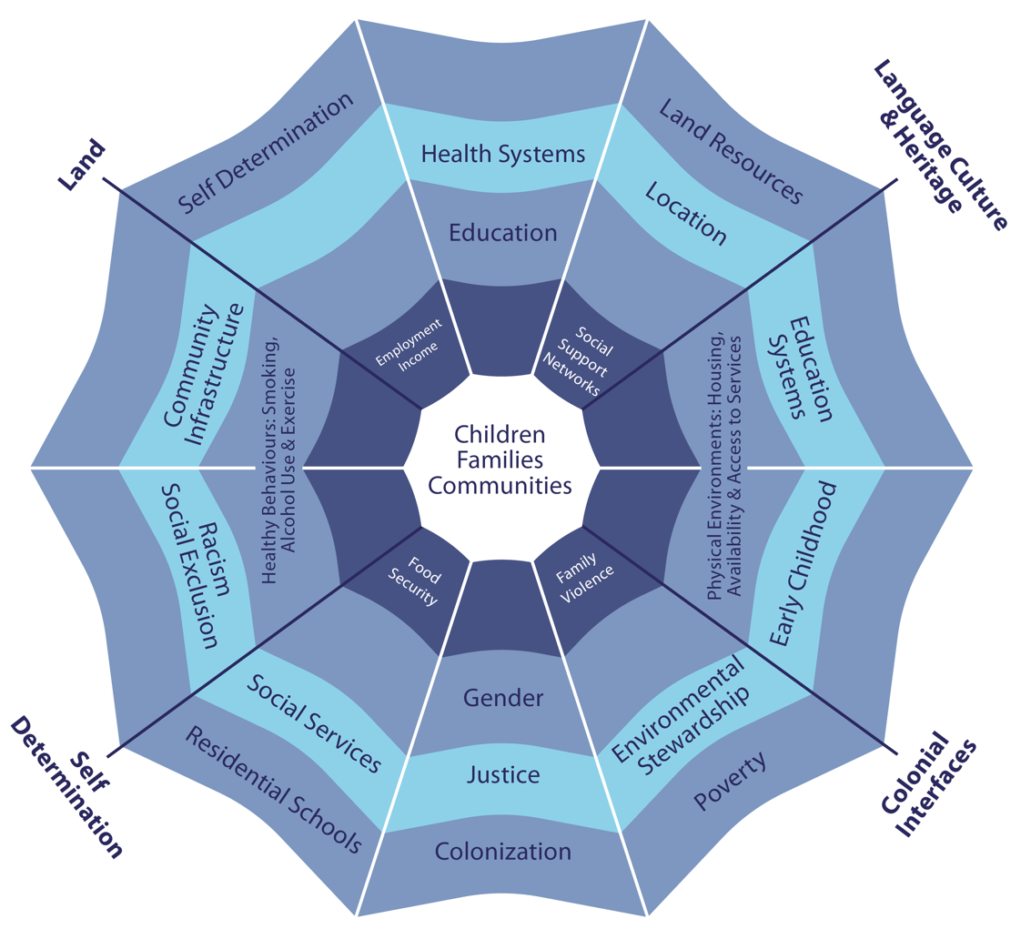
Web of Being: Social determinants and Indigenous people’s health
SOURCE: Dr. Margo Greenwood, National Collaborating Centre for Aboriginal Health (NCCAH) 2009.

Slide 4
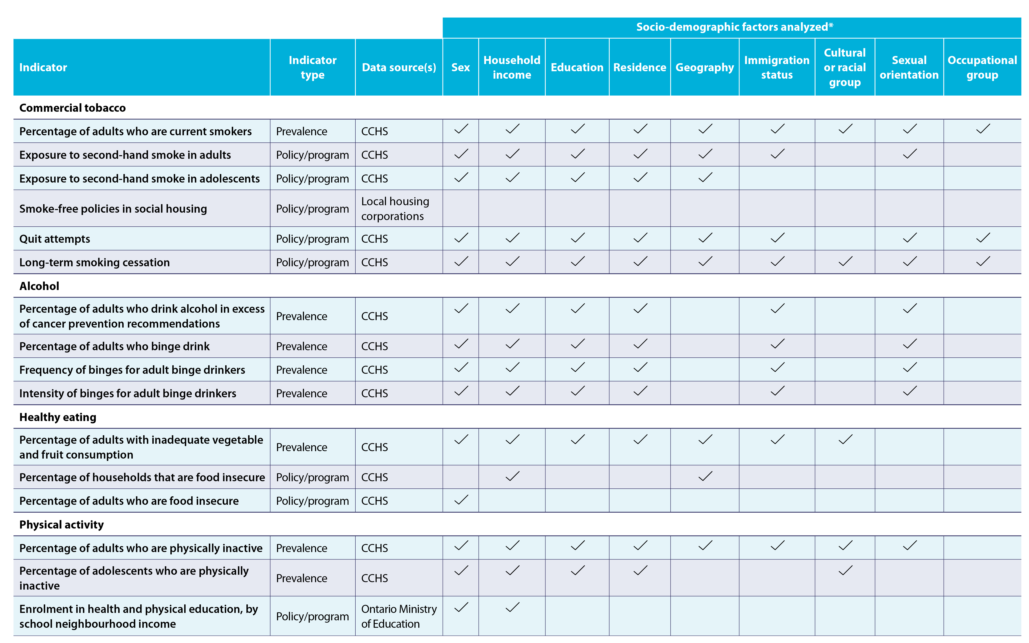
Ontario population: Indicators, data sources and socio-demographic factors included in the report

Slide 5
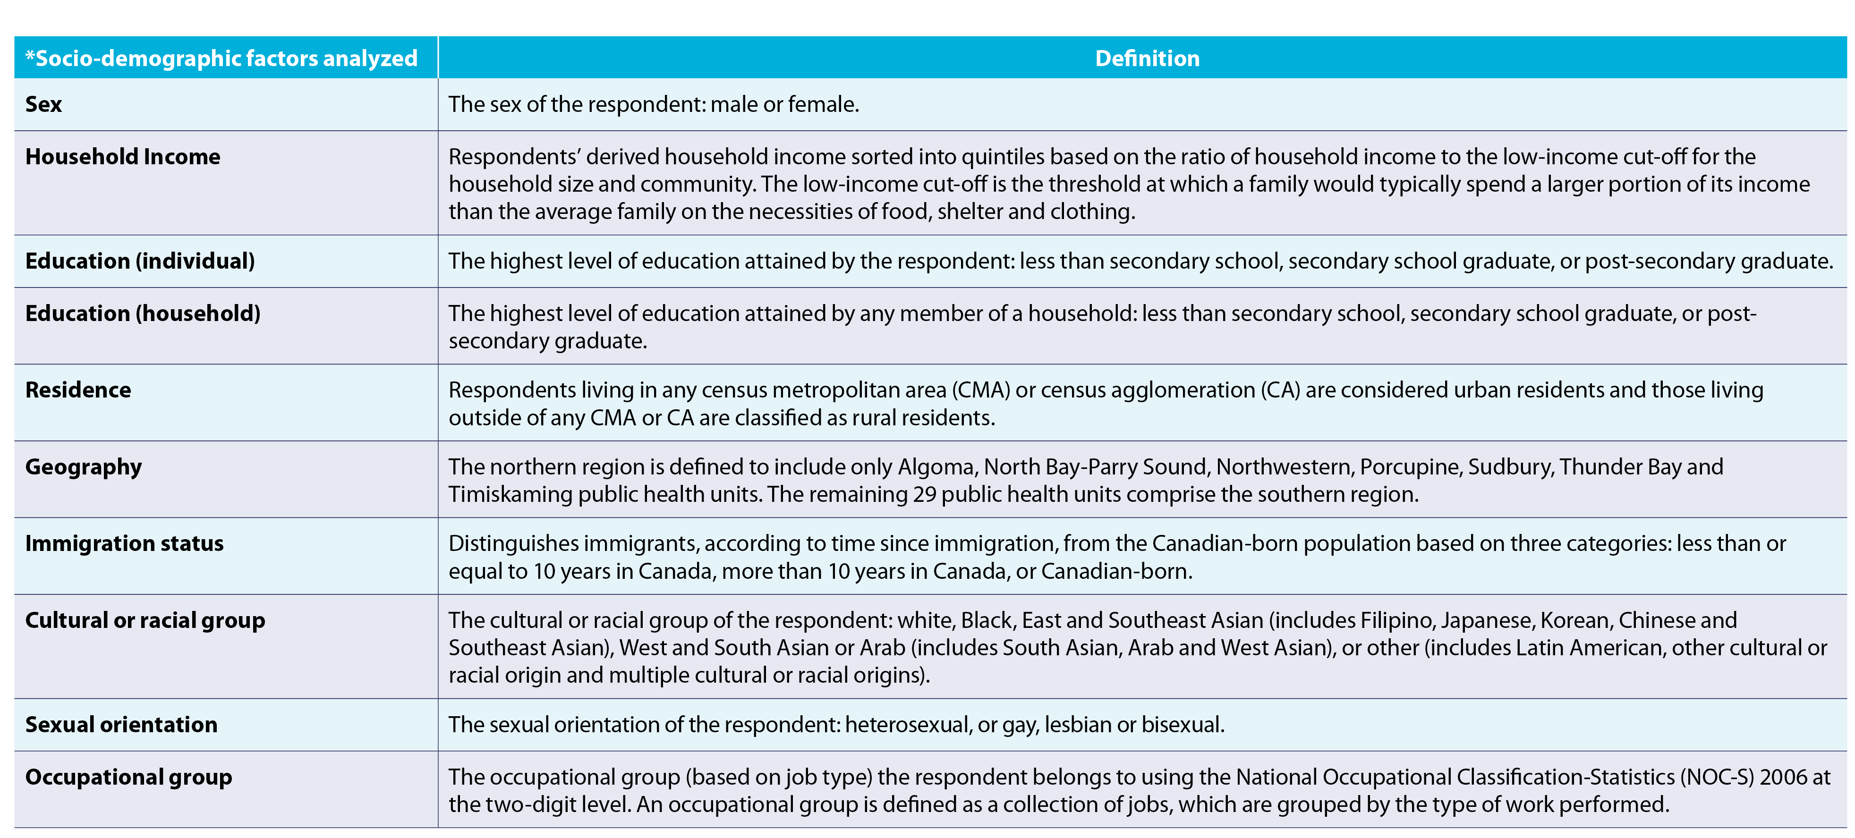
Ontario population: Indicators, data sources and socio-demographic factors included in the report (cont’d)
Notes:
NOTES: Socio-demographic factors used for the stratification of indicators are based on self-reported data. • For each indicator, results for analyses by socio-demographic factors are generally only discussed in the text of the report when significant differences were found.

Slide 6
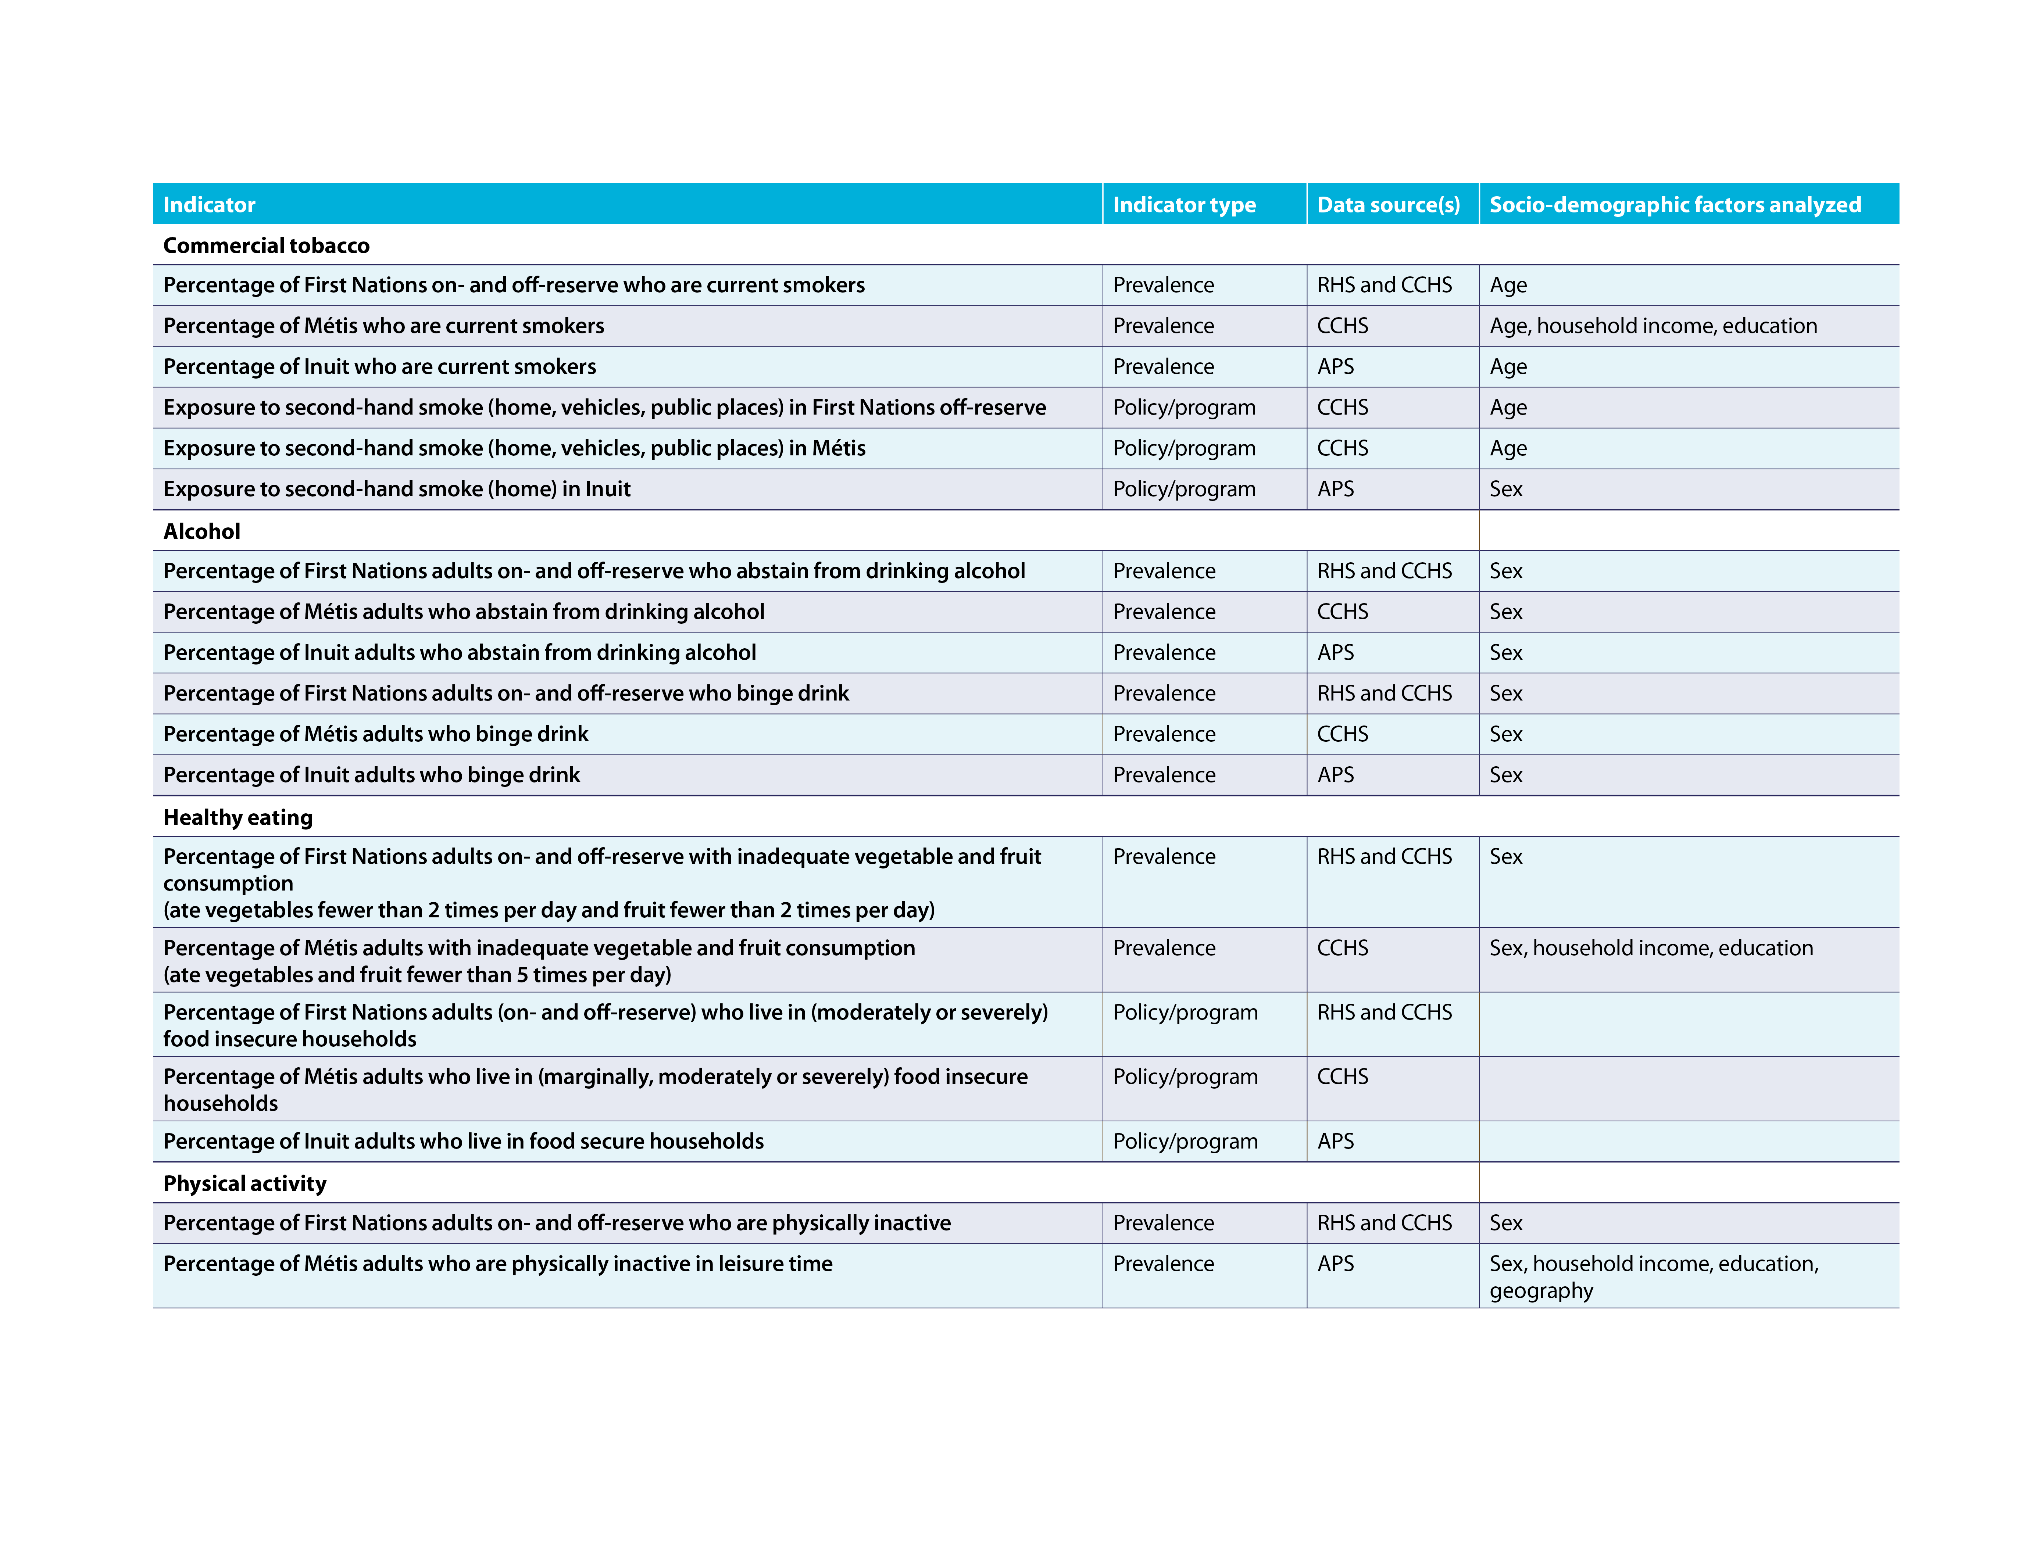
First Nations, Inuit and Métis populations: Indicators, data sources and socio-demographic factors included in the report
RHS: First Nations Regional Health Survey
CCHS: Canadian Community Health Survey
APS: Aboriginal Peoples Survey

Slide 7
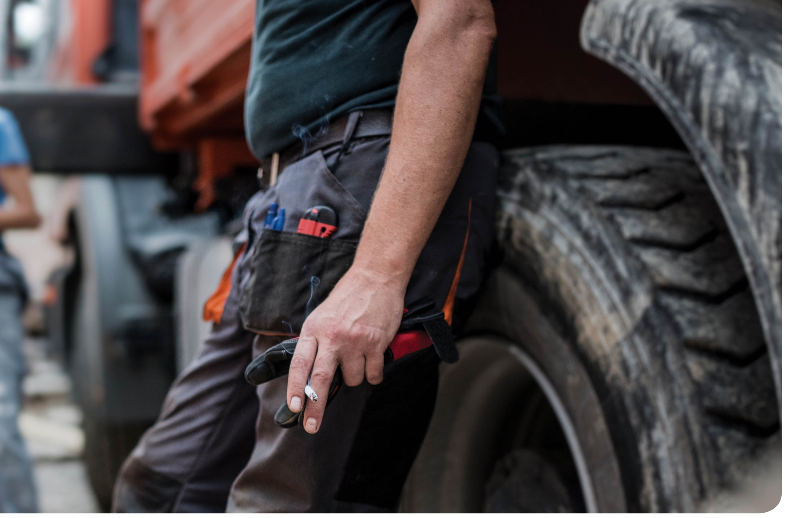

Commercial
tobacco

Slide 8
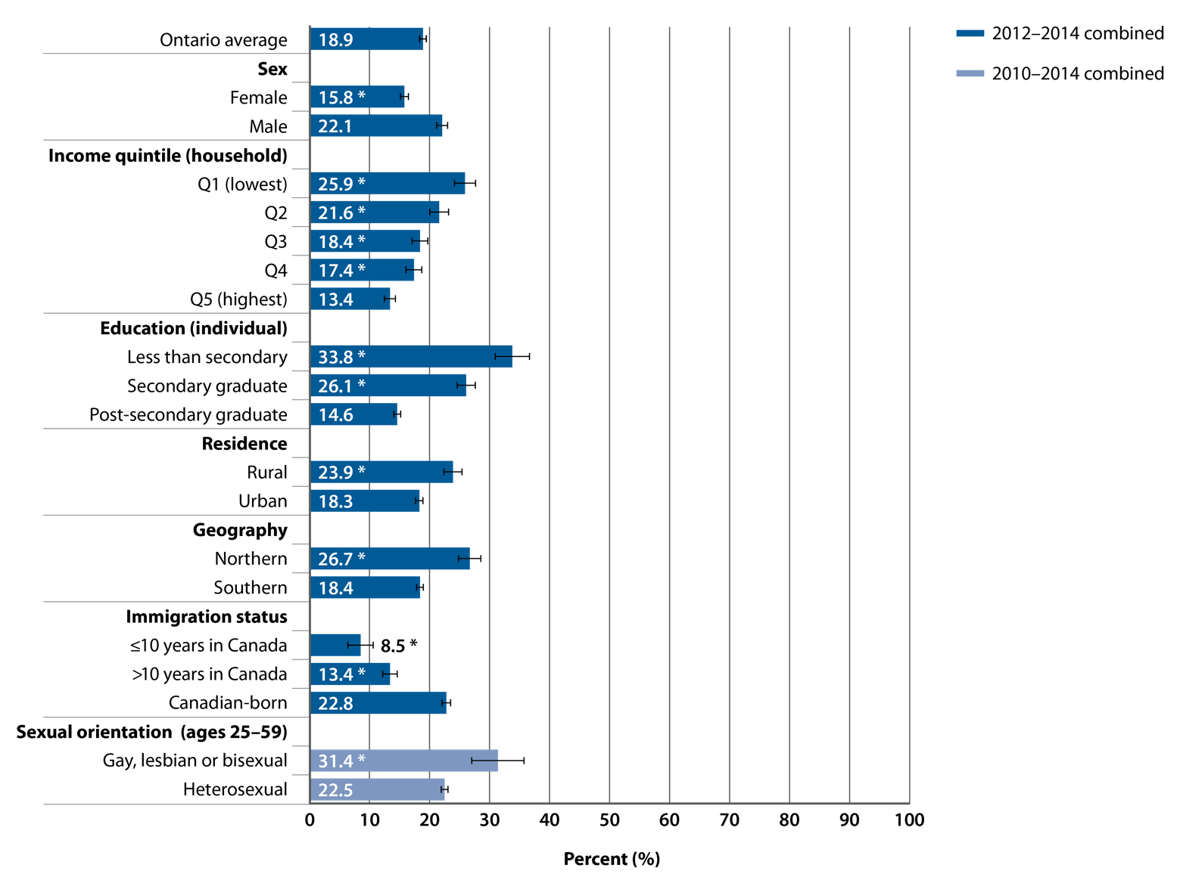
Percentage of adults (age 25+) reporting current smoking, by selected socio-demographic factors, Ontario, 2010–2014 combined
SOURCE: Canadian Community Health Survey (CCHS), 2010–2014 (Statistics Canada)
PREPARED BY: Cancer Care Ontario, Prevention and Cancer Control (Population Health and Prevention)
Notes:
NOTES: Estimates are adjusted to the age distribution of the 2011 Canadian population. • |––| represents 95% confidence intervals. • Current smoking: smoking cigarettes daily or occasionally. • Combined data from the 2010–2014 CCHS were used to increase the sample size for analyses by sexual orientation. Combined data from the 2012–2014 CCHS were used for analyses by all other socio-demographic factors shown in this figure. • Analyses by sexual orientation include only ages 25–59, due to CCHS age restrictions for this variable. Analyses by all other socio-demographic factors shown in this figure include ages 25+.• * Estimate is significantly different from the rates in the following reference categories: male for analyses by sex; quintile 5 (Q5) for analyses by income; post-secondary graduate for analyses by education; urban for analyses by residence; southern for analyses by geography; Canadian-born for analyses by immigration status; heterosexual for analyses by sexual orientation. • Additional analyses by occupational group and cultural or racial group are presented in Supplementary Tables S1 and S2.

Slide 9
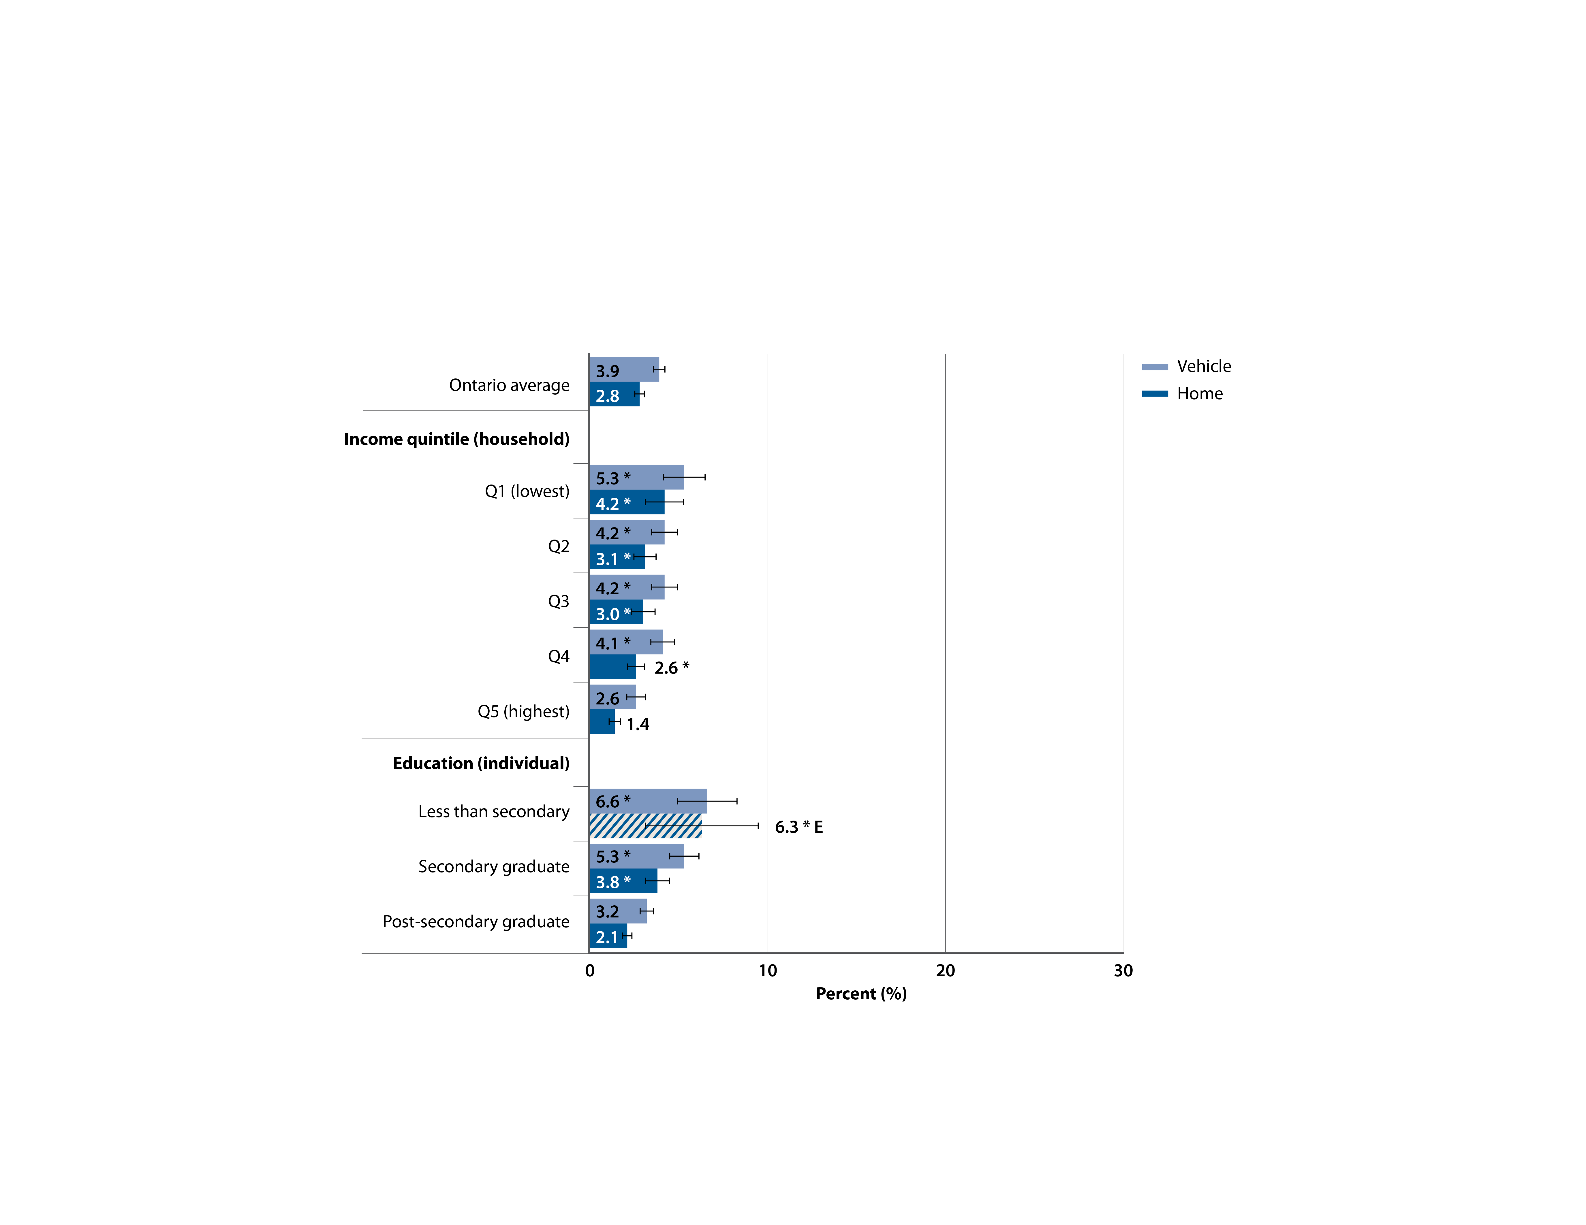
Percentage of non-smoking adults (age 25+) who were exposed to second-hand smoke in the past month, by location of exposure and by selected socio-demographic factors, Ontario, 2012–2014 combined
SOURCE: Canadian Community Health Survey (CCHS), 2012–2014 (Statistics Canada)
PREPARED BY: Cancer Care Ontario, Prevention and Cancer Control (Population Health and Prevention)
Notes:
NOTES: Estimates are adjusted to the age distribution of the 2011 Canadian population.
• |––| represents 95% confidence intervals. • E: interpret cross-hatched estimates with caution due to high sampling variability. • * Estimate is significantly different from the rates in the following reference categories: quintile 5 (Q5) for analyses by income; post-secondary graduate for analyses by education. • These data and additional analyses by sex, residence, geography, immigration status and sexual orientation are presented in Supplementary Tables S3–S6.

Slide 10
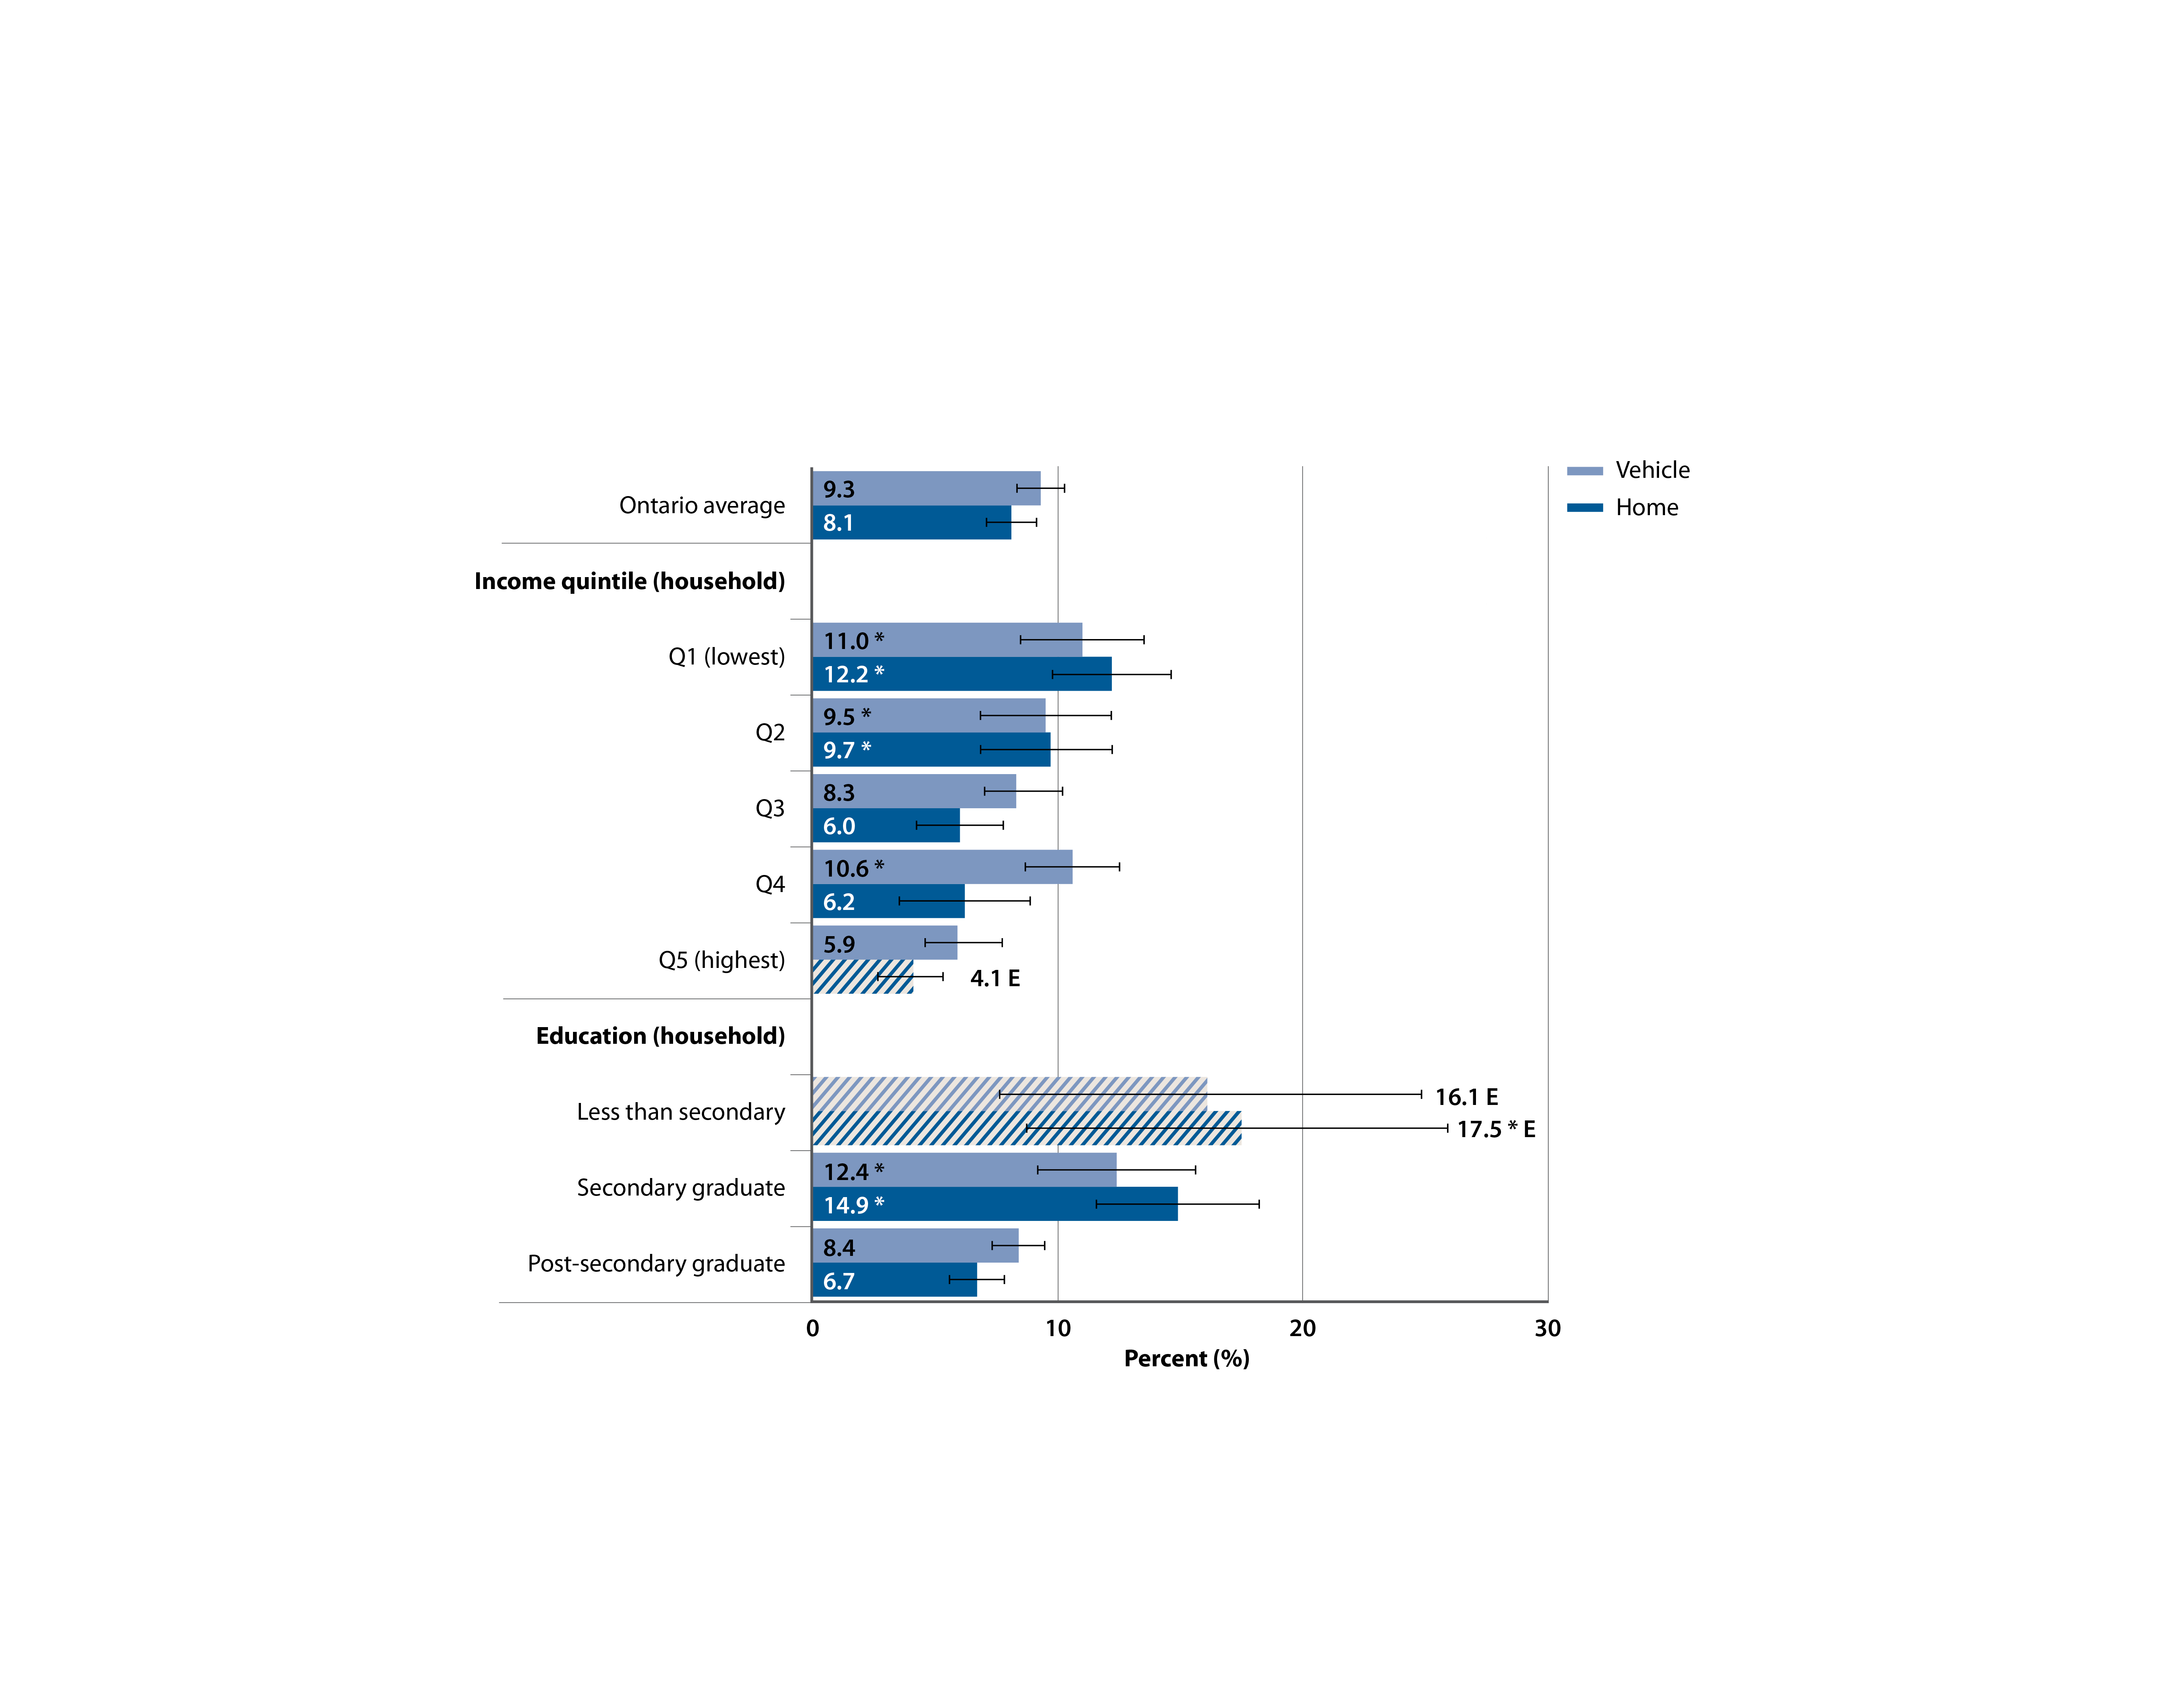
Percentage of non-smoking adolescents (ages 12–19) who were exposed to second-hand smoke in the past month, by location of exposure and by selected socio-demographic factors, Ontario, 2012–2014 combined
SOURCE: Canadian Community Health Survey (CCHS), 2012–2014 (Statistics Canada)
PREPARED BY: Cancer Care Ontario, Prevention and Cancer Control (Population Health and Prevention)
Notes:
NOTES: |––| represents 95% confidence intervals. • E: interpret cross-hatched estimates with caution due to high sampling variability. • * Estimate is significantly different from the rates in the following reference categories: quintile 5 (Q5) for analyses by income; post-secondary graduate for analyses by household education. • These data and additional analyses by sex, residence and geography are presented in Supplementary Tables S9 and S10.

Slide 11
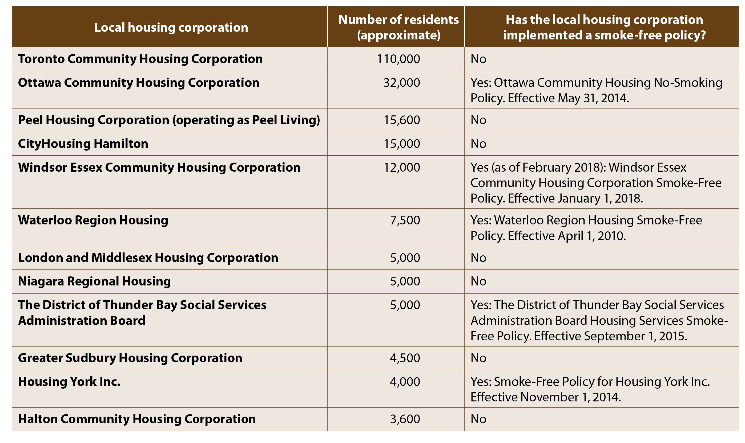
Smoke-free policies in social housing providers in Ontario, as of May 2017
SOURCES: Local housing corporations
PREPARED BY: Cancer Care Ontario, Prevention and Cancer Control (Population Health and Prevention)
Notes:
NOTES: The presence of a smoke-free policy at each of the 12 local housing corporations was determined by reviewing their website and contacting the corporation to verify what was found. • Details about the smoke-free policies are presented in Supplementary Table S12.

Slide 12
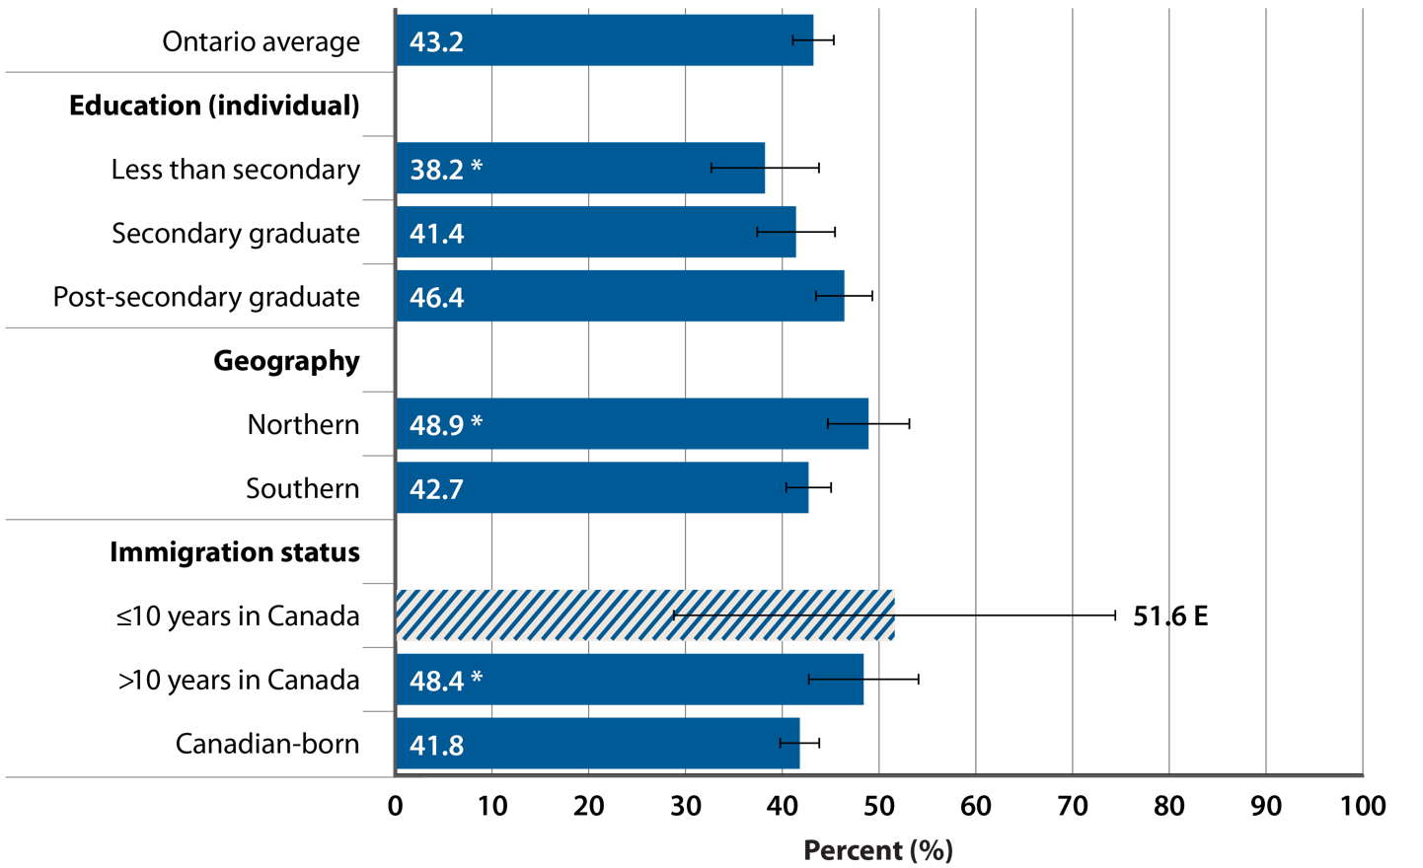
Percentage of current smokers (age 25+) who have tried to quit for at least 24 hours in the past 12 months, by selected socio-demographic factors, Ontario, 2013–2014 combined
SOURCE: Canadian Community Health Survey (CCHS), 2013–2014 (Statistics Canada)
PREPARED BY: Cancer Care Ontario, Prevention and Cancer Control (Population Health and Prevention)
Notes:
NOTES: Estimates are adjusted to the age distribution of the 2011 Canadian population. • |––| represents 95% confidence intervals. • E: interpret cross-hatched estimates with caution due to high sampling variability. • * Estimate is significantly different from the rates in the following reference categories: post-secondary graduate for analyses by education; southern for analyses by geography; Canadian-born for analyses by immigration status. • These data and additional analyses by sex, income, residence, occupational group and sexual orientation are presented in Supplementary Tables S13–S15.

Slide 13
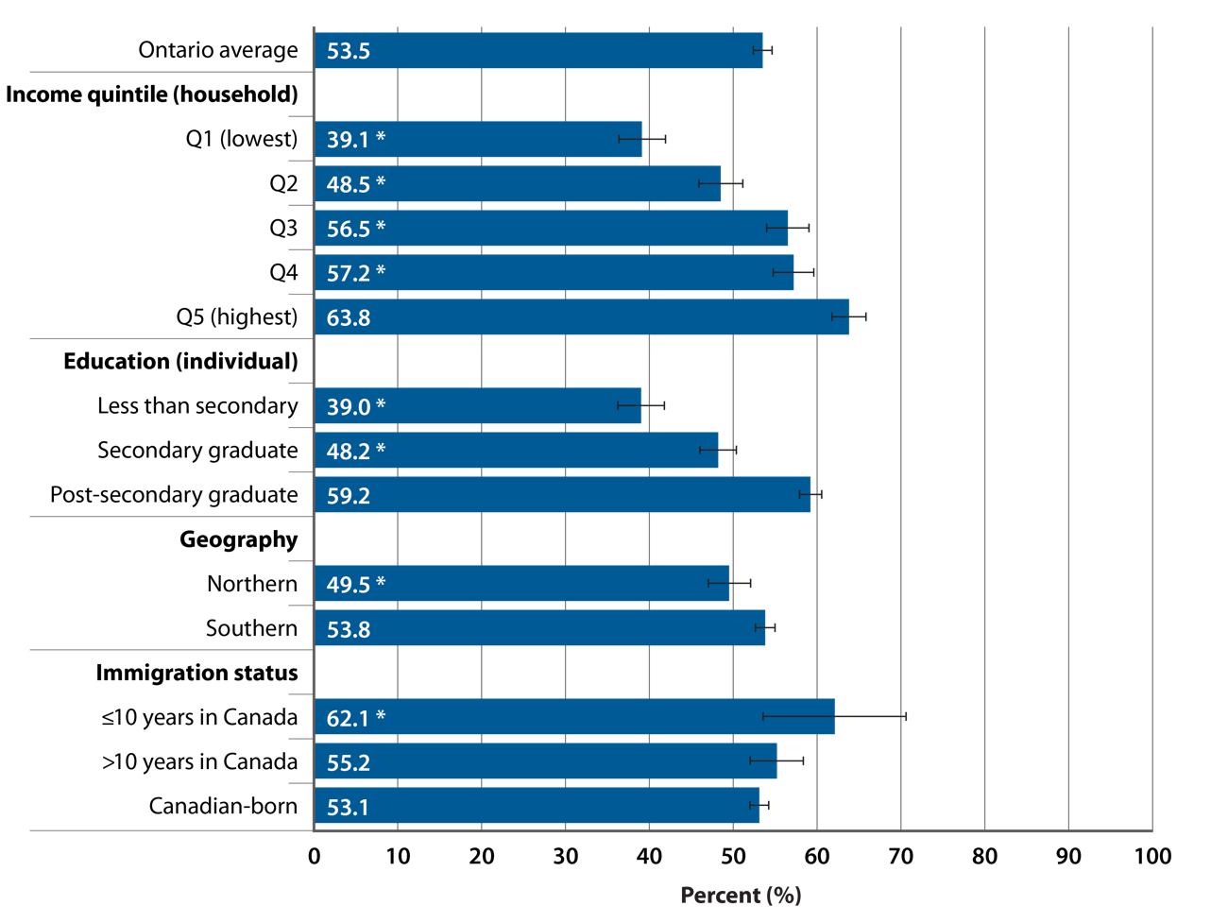
Percentage of ever-smoking adults (age 25+) who quit smoking completely at least 1 year ago, by selected socio-demographic factors, Ontario, 2012–2014 combined
SOURCE: Canadian Community Health Survey (CCHS), 2012–2014 (Statistics Canada)
PREPARED BY: Cancer Care Ontario, Prevention and Cancer Control (Population Health and Prevention)
Notes:
NOTES: Estimates are adjusted to the age distribution of the 2011 Canadian population.
• |––| represents 95% confidence intervals. • Ever-smoking adults: adults who ever smoked cigarettes daily or occasionally. • This definition of long-term smoking cessation differs from that used for the 2016 Prevention System Quality Index long-term smoking cessation indicator, which measured the percentage of adult recent daily smokers (daily smokers one to two years ago) who have quit smoking completely for at least one year. • * Estimate is significantly different from the rates in the following reference categories: quintile 5 (Q5) for analyses by income; post-secondary graduate for analyses by education; southern for analyses by geography; Canadian-born for analyses by immigration status. • These data and additional analyses by sex, residence, occupational group, sexual orientation and cultural or racial group are presented in Supplementary Tables S16–S19.

Slide 14
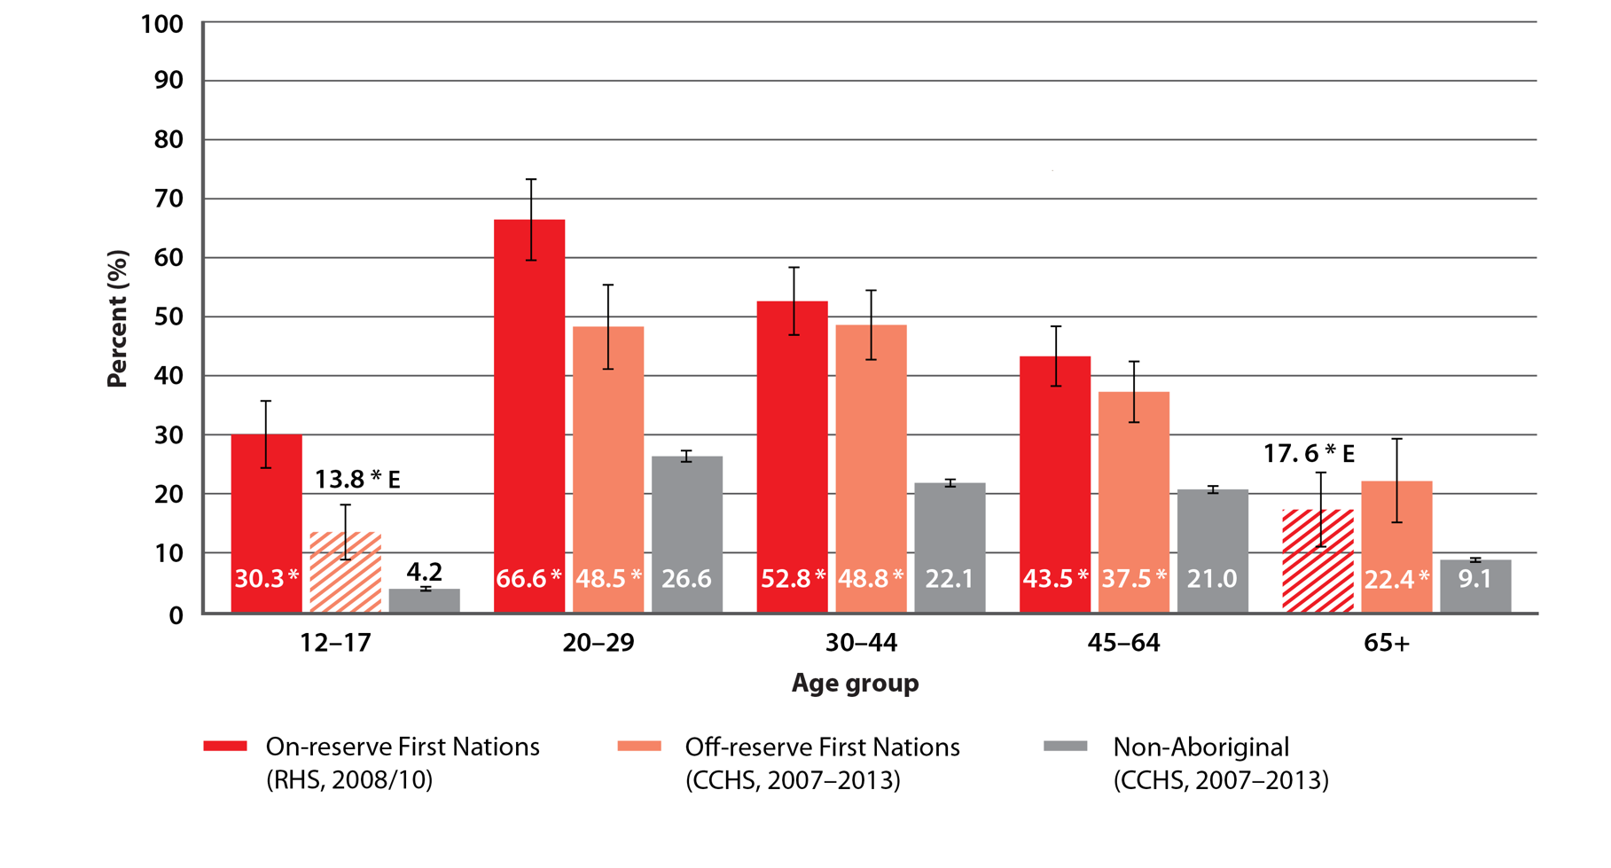
Percentage of First Nations and non-Aboriginal people who were current smokers, by age, Ontario, 2007–2013 combined
SOURCES: Canadian Community Health Survey (CCHS), 2007–2013 (Statistics Canada); First Nations Regional Health Survey (RHS) Phase 2, 2008/10 (First Nations Information Governance Centre)
PREPARED BY: Cancer Care Ontario, Prevention and Cancer Control (Aboriginal Cancer Control Unit)
Notes:
NOTES: |––| represents 95% confidence intervals. • E: interpret cross-hatched estimates with caution due to high sampling variability. • * Indicates that group is significantly different from the reference category (non-Aboriginal).

Slide 15
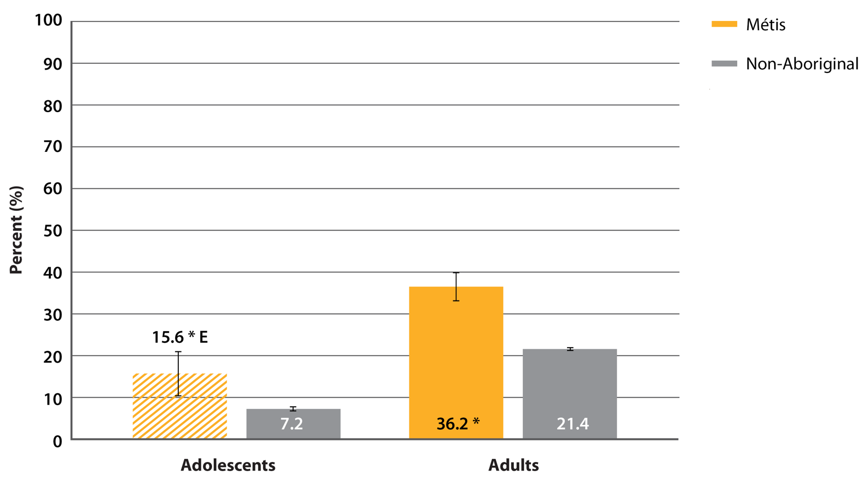
Percentage of Métis and non-Aboriginal adolescents (ages 12–19) and adults (age 20+) who were current smokers, Ontario, 2007–2014 combined
SOURCE: Canadian Community Health Survey (CCHS), 2007–2014 (Statistics Canada)
PREPARED BY: Cancer Care Ontario, Prevention and Cancer Control (Aboriginal Cancer Control Unit)
Notes:
NOTES: Estimates are adjusted to the age distribution of the 2006 Ontario Aboriginal identity population. • |––| represents 95% confidence intervals. • E: interpret cross-hatched estimates with caution due to high sampling variability. • * Indicates that group is significantly different from the reference category (non-Aboriginal).

Slide 16
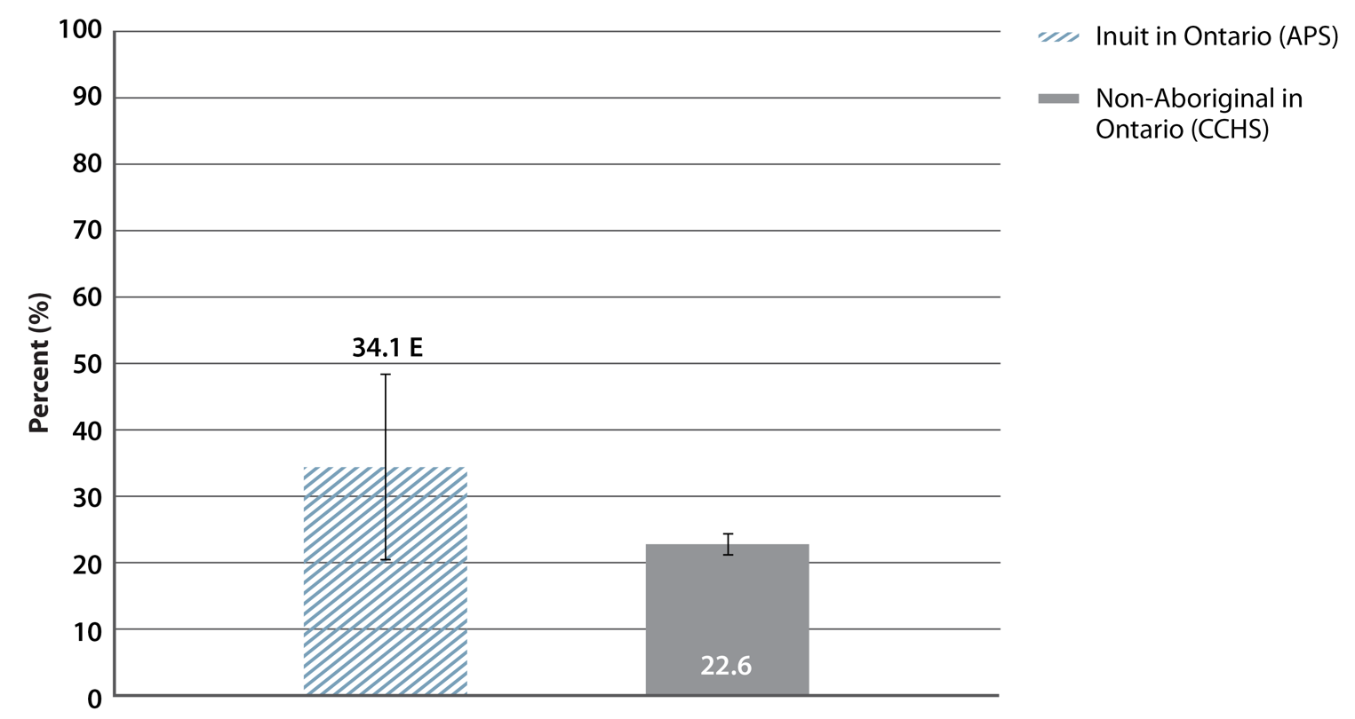
Percentage of Inuit and non-Aboriginal adults (age 20+) who were current smokers, Ontario, 2012
SOURCES: Aboriginal Peoples Survey (APS), 2012 (Statistics Canada); Canadian Community Health Survey (CCHS), 2012 (Statistics Canada)
PREPARED BY: Cancer Care Ontario, Prevention and Cancer Control (Aboriginal Cancer Control Unit)
Notes:
NOTES: Estimates are adjusted to the age distribution of the 2006 Inuit population outside Inuit Nunangat. • |––| represents 95% confidence intervals. • E: interpret cross-hatched estimates with caution due to high sampling variability.

Slide 17
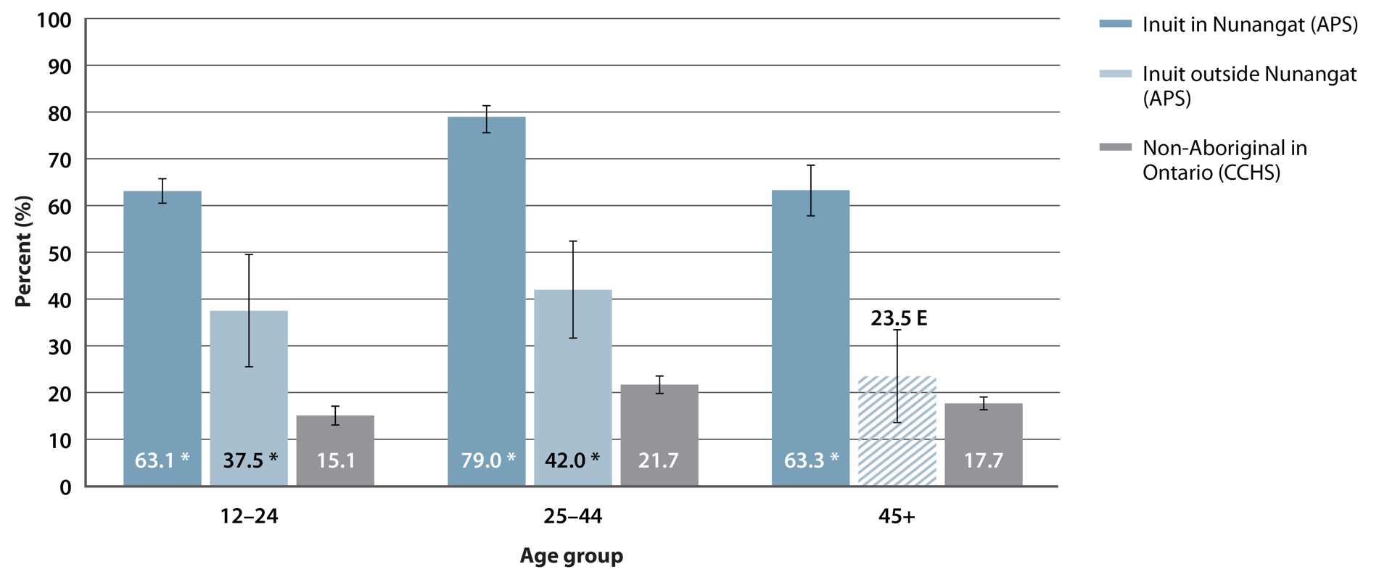
Percentage of Inuit in Canada and non-Aboriginal people in Ontario who were current smokers, by age group, 2012
SOURCES: Aboriginal Peoples Survey (APS), 2012 (Statistics Canada); Canadian Community Health Survey (CCHS), 2012 (Statistics Canada)
PREPARED BY: Cancer Care Ontario, Prevention and Cancer Control (Aboriginal Cancer Control Unit)
Notes:
NOTES: |––| represents 95% confidence intervals. • E: interpret cross-hatched estimates with caution due to high sampling variability. • * Indicates that group is significantly different from the reference category (non-Aboriginal).

Slide 18
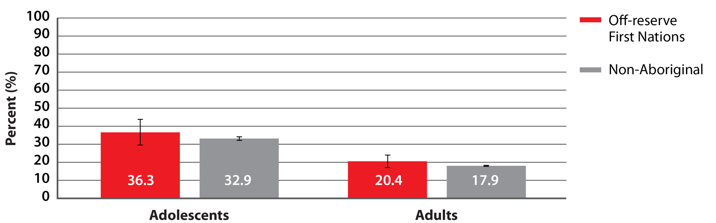
Percentage of non-smoking First Nations and non-Aboriginal adolescents (ages 12–19) and adults (age 20+) exposed to second-hand smoke, Ontario, 2007–2012 combined
SOURCE: Canadian Community Health Survey (CCHS), 2007–2012 (Statistics Canada)
PREPARED BY: Cancer Care Ontario, Prevention and Cancer Control (Aboriginal Cancer Control Unit)
Notes:
NOTES: Estimates are adjusted to the age distribution of the 2006 Ontario Aboriginal identity population. • |––| represents 95% confidence intervals. • Data are presented in Supplementary Table S20.

Slide 19
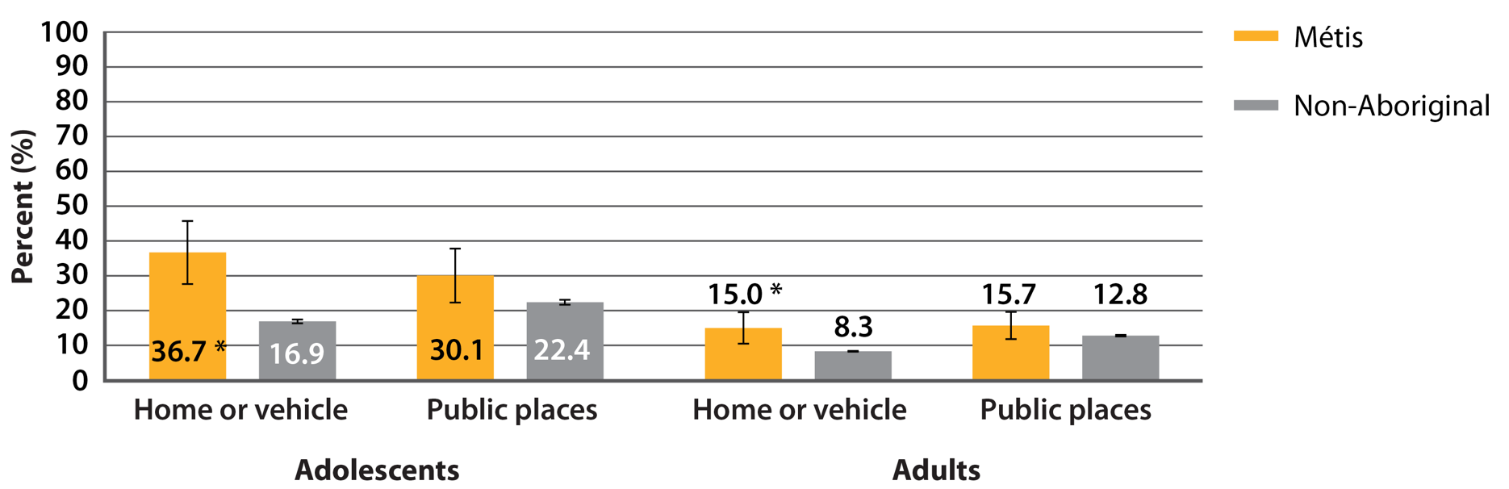
Percentage of non-smoking Métis and non-Aboriginal adolescents (ages 12–19) and adults (age 20+) exposed to second-hand smoke, by location, Ontario, 2007–2014 combined
SOURCE: Canadian Community Health Survey, 2007–2014 (Statistics Canada)
PREPARED BY: Cancer Care Ontario, Prevention and Cancer Control (Aboriginal Cancer Control Unit)
Notes:
NOTES: Estimates are adjusted to the age distribution of the 2006 Ontario Aboriginal identity population. • |––| represents 95% confidence intervals. * Indicates that group is significantly different from the reference category (non-Aboriginal). • Data are presented in Supplementary Table S21.

Slide 20
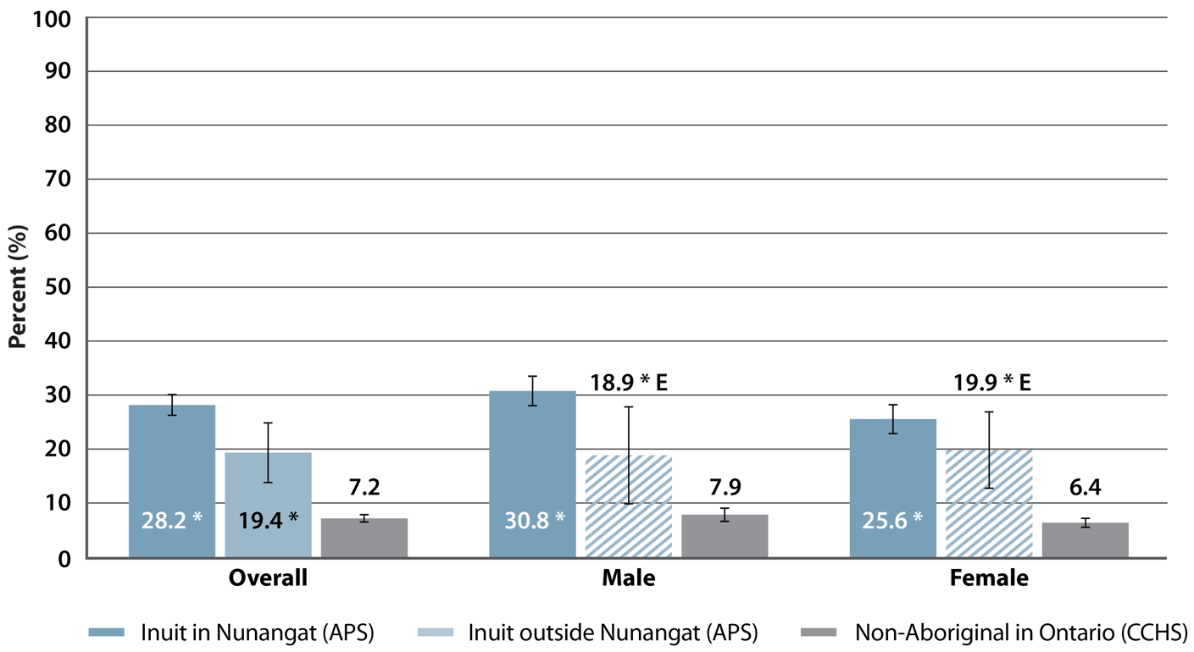
Percentage of non-smoking Inuit in Canada and non-Aboriginal people in Ontario (age 15+) exposed to second-hand smoke at home, by sex, 2012
SOURCES: Aboriginal Peoples Survey (APS), 2012 (Statistics Canada); Canadian Community Health Survey (CCHS), 2012 (Statistics Canada)
PREPARED BY: Cancer Care Ontario, Prevention and Cancer Control (Aboriginal Cancer Control Unit)
Notes:
NOTES: Estimates are adjusted to the age distribution of the 2006 Inuit population outside Inuit Nunangat. • |––| represents 95% confidence intervals. • E: interpret cross-hatched estimates with caution due to high sampling variability. • * Indicates that group is significantly different from the reference category (non-Aboriginal). • Data are presented in Supplementary Table S22.

Slide 21
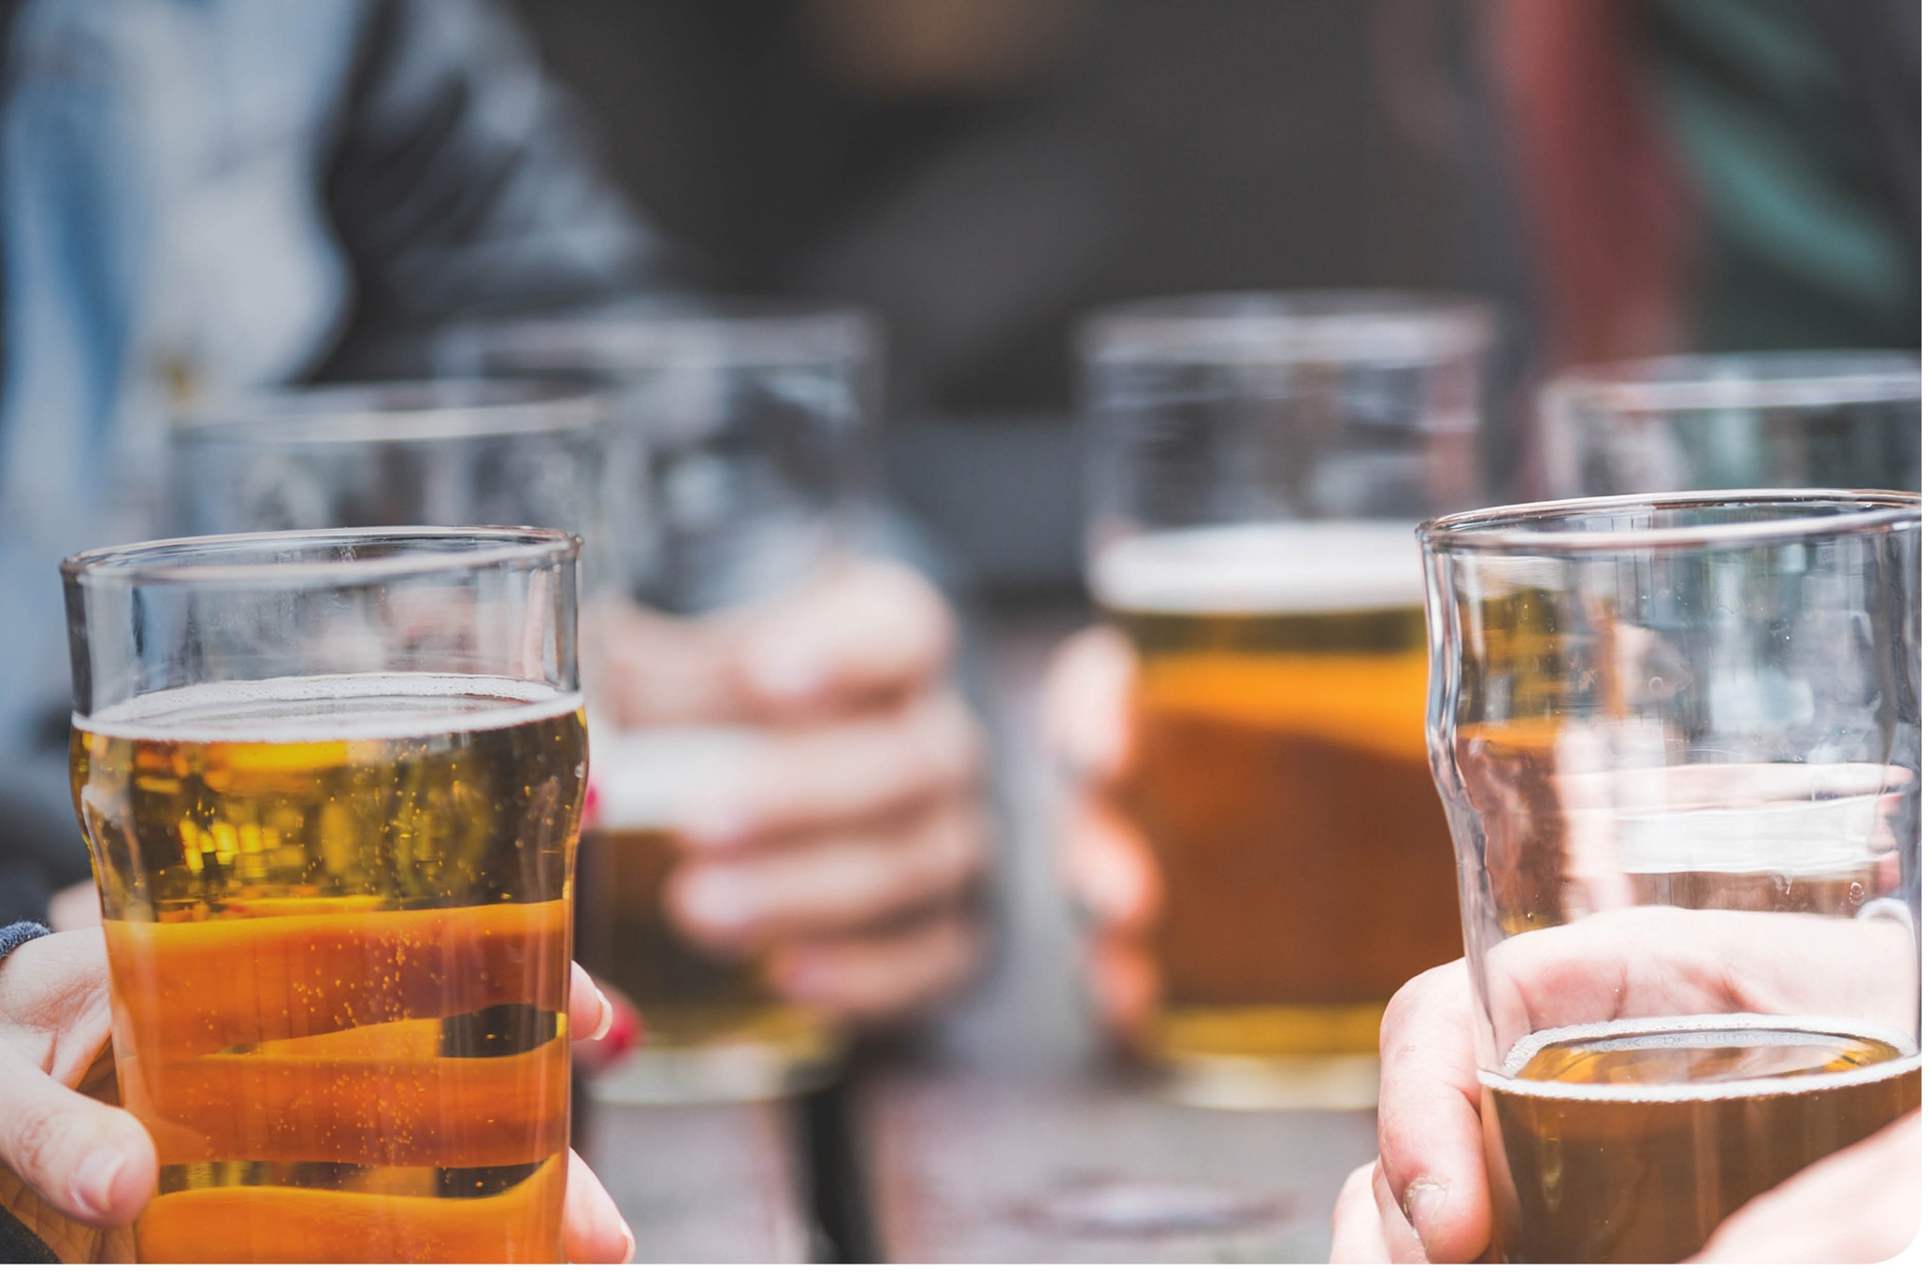

Alcohol

Slide 22
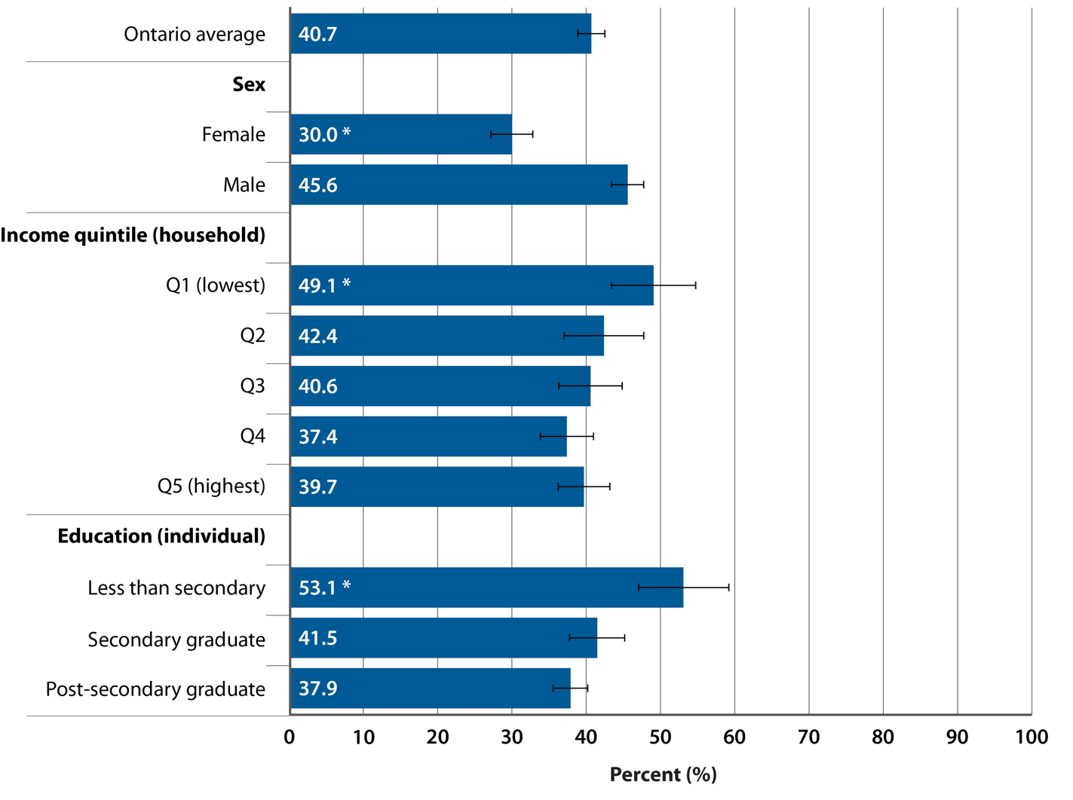
Percentage of adult binge drinkers (age 25+) who reported binge drinking once a week or more, by selected socio-demographic factors, Ontario, 2012–2014 combined
SOURCE: Canadian Community Health Survey (CCHS), 2012–2014 (Statistics Canada)
PREPARED BY: Cancer Care Ontario, Prevention and Cancer Control (Population Health and Prevention)
Notes:
NOTES: Estimates are adjusted to the age distribution of the 2011 Canadian population. • |––| represents 95% confidence intervals. • Ontario average: average among all binge drinkers ages 25+. • Binge drinkers: females who drank 4+ drinks or males who drank 5+ drinks on one occasion at least once per month in the past 12 months. • * Estimate is significantly different from the rates in the following reference categories: male for analyses by sex; quintile 5 (Q5) for analyses by income; post-secondary graduate for analyses by education. • These data and additional analyses by residence, immigration status and sexual orientation are presented in Supplementary Tables S27 and S28.

Slide 23
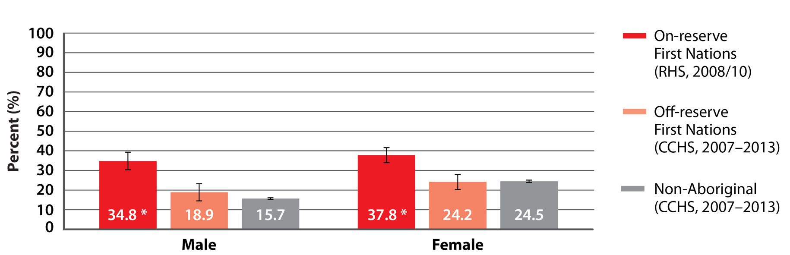
Percentage of First Nations and non-Aboriginal men and women (age 19+) who abstained from drinking alcohol in the previous 12 months, Ontario, 2007–2013 combined
SOURCES: Canadian Community Health Survey (CCHS), 2007–2013 (Statistics Canada); First Nations Regional Health Survey (RHS) Phase 2, 2008/10 (First Nations Information Governance Centre)
PREPARED BY: Cancer Care Ontario, Prevention and Cancer Control (Aboriginal Cancer Control Unit)
Notes:
NOTES: Estimates are adjusted to the age distribution of the 2006 Ontario Aboriginal identity population. • |––| represents 95% confidence intervals. • * Indicates that group is significantly different from the reference category (non-Aboriginal).

Slide 24
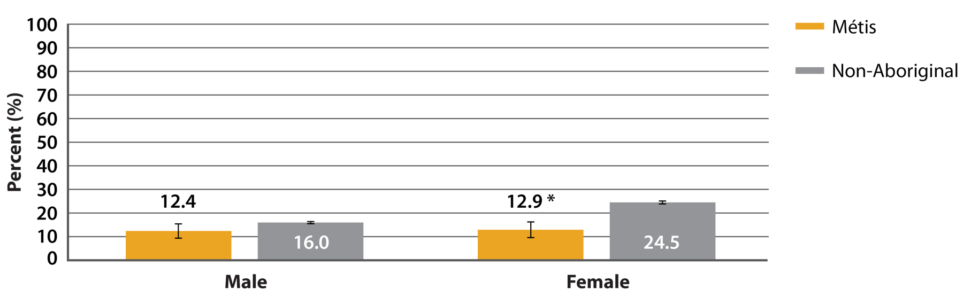
Percentage of Métis and non-Aboriginal men and women (age 19+) who abstained from drinking alcohol in the previous 12 months, Ontario, 2007–2012 combined
SOURCE: Canadian Community Health Survey, 2007–2012 (Statistics Canada)
PREPARED BY: Cancer Care Ontario, Prevention and Cancer Control (Aboriginal Cancer Control Unit)
Notes:
NOTES: Estimates are adjusted to the age distribution of the 2006 Ontario Aboriginal identity population. • |––| represents 95% confidence intervals. • * Indicates that group is significantly different from the reference category (non-Aboriginal).

Slide 25
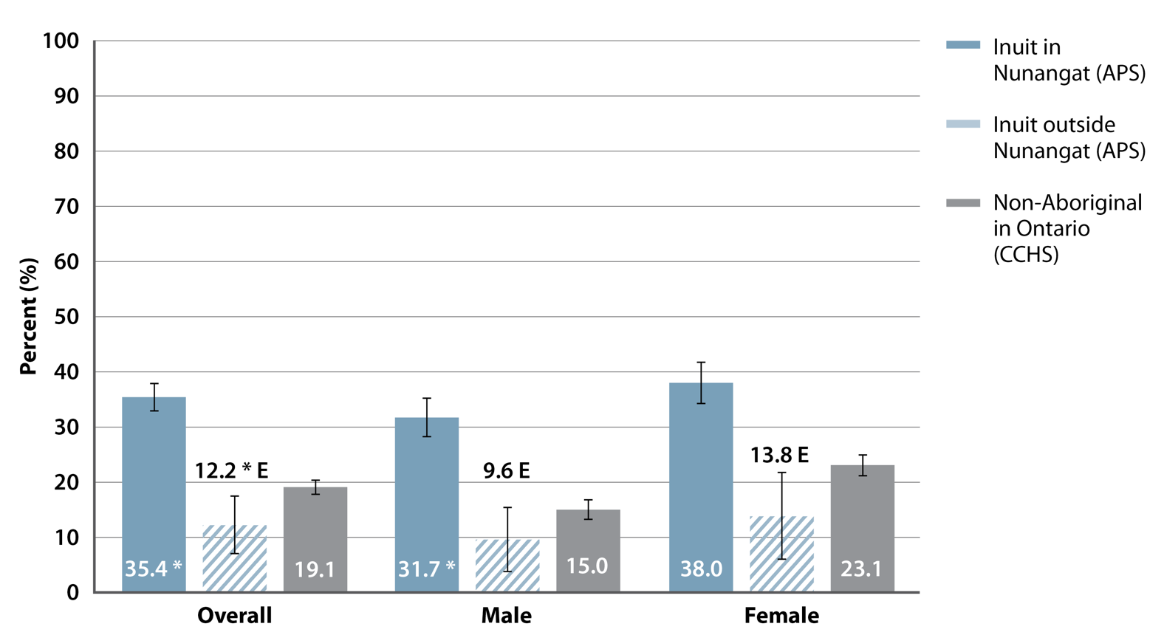
Percentage of Inuit adults in Canada and non-Aboriginal adults in Ontario (age 19+) who abstained from alcohol in the previous 12 months, by sex, 2012
SOURCES: Aboriginal Peoples Survey (APS), 2012 (Statistics Canada); Canadian Community Health Survey (CCHS), 2012 (Statistics Canada)
PREPARED BY: Cancer Care Ontario, Prevention and Cancer Control (Aboriginal Cancer Control Unit)
Notes:
NOTES: Estimates are adjusted to the age distribution of the 2006 Inuit population outside Inuit Nunangat. • |––| represents 95% confidence intervals. • E: interpret cross-hatched estimates with caution due to high sampling variability. • * Indicates that group is significantly different from the reference category (non-Aboriginal).

Slide 26
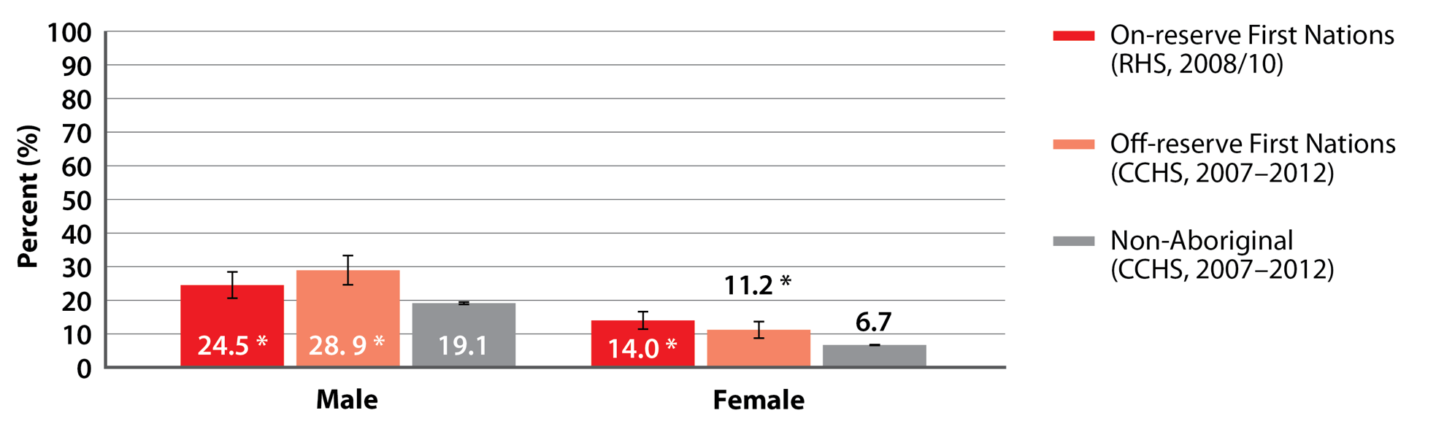
Percentage of First Nations and non-Aboriginal men and women (age 19+) who had 5 or more alcoholic drinks on 1 occasion at least
2 to 3 times a month in the past year, Ontario, 2007–2013 combined
SOURCES: Canadian Community Health Survey (CCHS), 2007–2012 (Statistics Canada); First Nations Regional Health Survey (RHS) Phase 2, 2008/10 (First Nations Information Governance Centre)
PREPARED BY: Cancer Care Ontario, Prevention and Cancer Control (Aboriginal Cancer Control Unit)
Notes:
NOTES: Estimates are adjusted to the age distribution of the 2006 Ontario Aboriginal identity population. • |––| represents 95% confidence intervals. • * Indicates that group is significantly different from the reference category (non-Aboriginal).

Slide 27
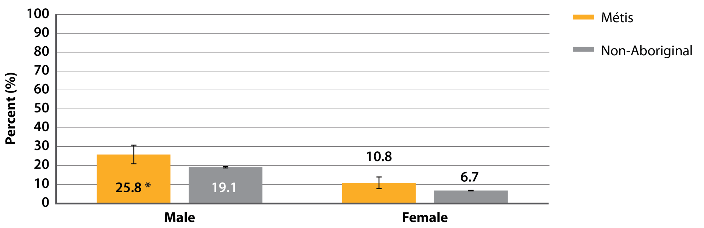
Percentage of Métis and non-Aboriginal men and women (age 19+) who had 5 or more alcoholic drinks on 1 occasion at least 2 to 3 times a month in the past year, Ontario, 2007–2013 combined
SOURCE: Canadian Community Health Survey, 2007–2013 (Statistics Canada)
PREPARED BY: Cancer Care Ontario, Prevention and Cancer Control (Aboriginal Cancer Control Unit)
Notes:
NOTES: Estimates are adjusted to the age distribution of the 2006 Ontario Aboriginal identity population. • |––| represents 95% confidence intervals. • * Indicates that group is significantly different from the reference category (non-Aboriginal).

Slide 28
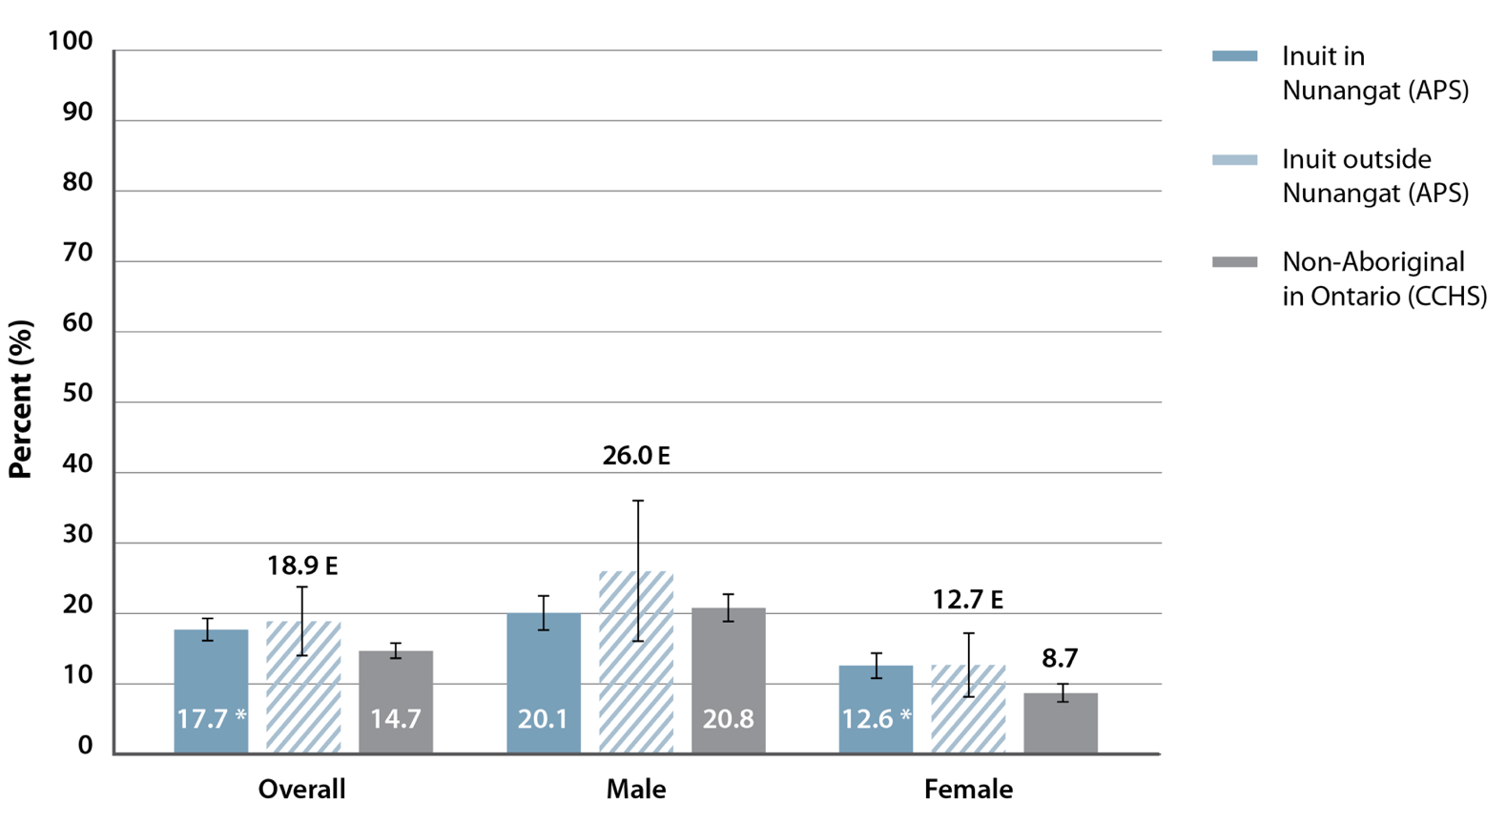
Percentage of Inuit adults in Canada and non-Aboriginal adults in Ontario (age 19+) who had 5 or more alcoholic drinks on 1 occasion at least 2 to 3 times per month in the past year, by sex, 2012
SOURCES: Aboriginal Peoples Survey (APS), 2012 (Statistics Canada); Canadian Community Health Survey (CCHS), 2012 (Statistics Canada)
PREPARED BY: Cancer Care Ontario, Prevention and Cancer Control (Aboriginal Cancer Control Unit)
Notes:
NOTES: Estimates are adjusted to the age distribution of the 2006 Inuit population outside Inuit Nunangat. • |––| represents 95% confidence intervals. • E: interpret cross-hatched estimates with caution due to high sampling variability. • * Indicates that group is significantly different from the reference category (non-Aboriginal).

Slide 29
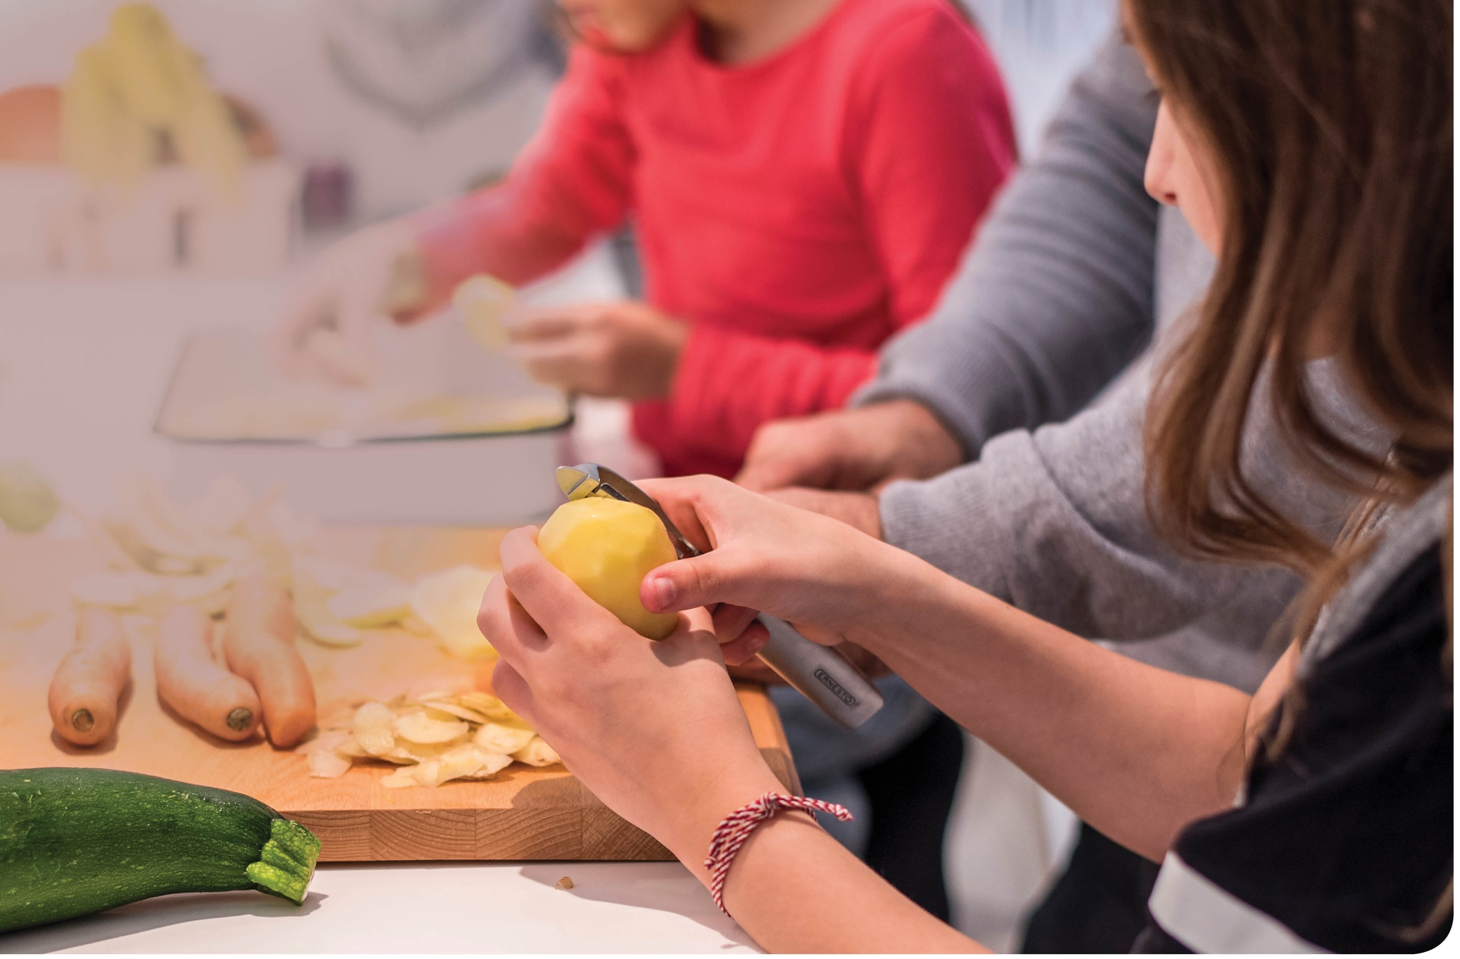

Healthy
eating

Slide 30
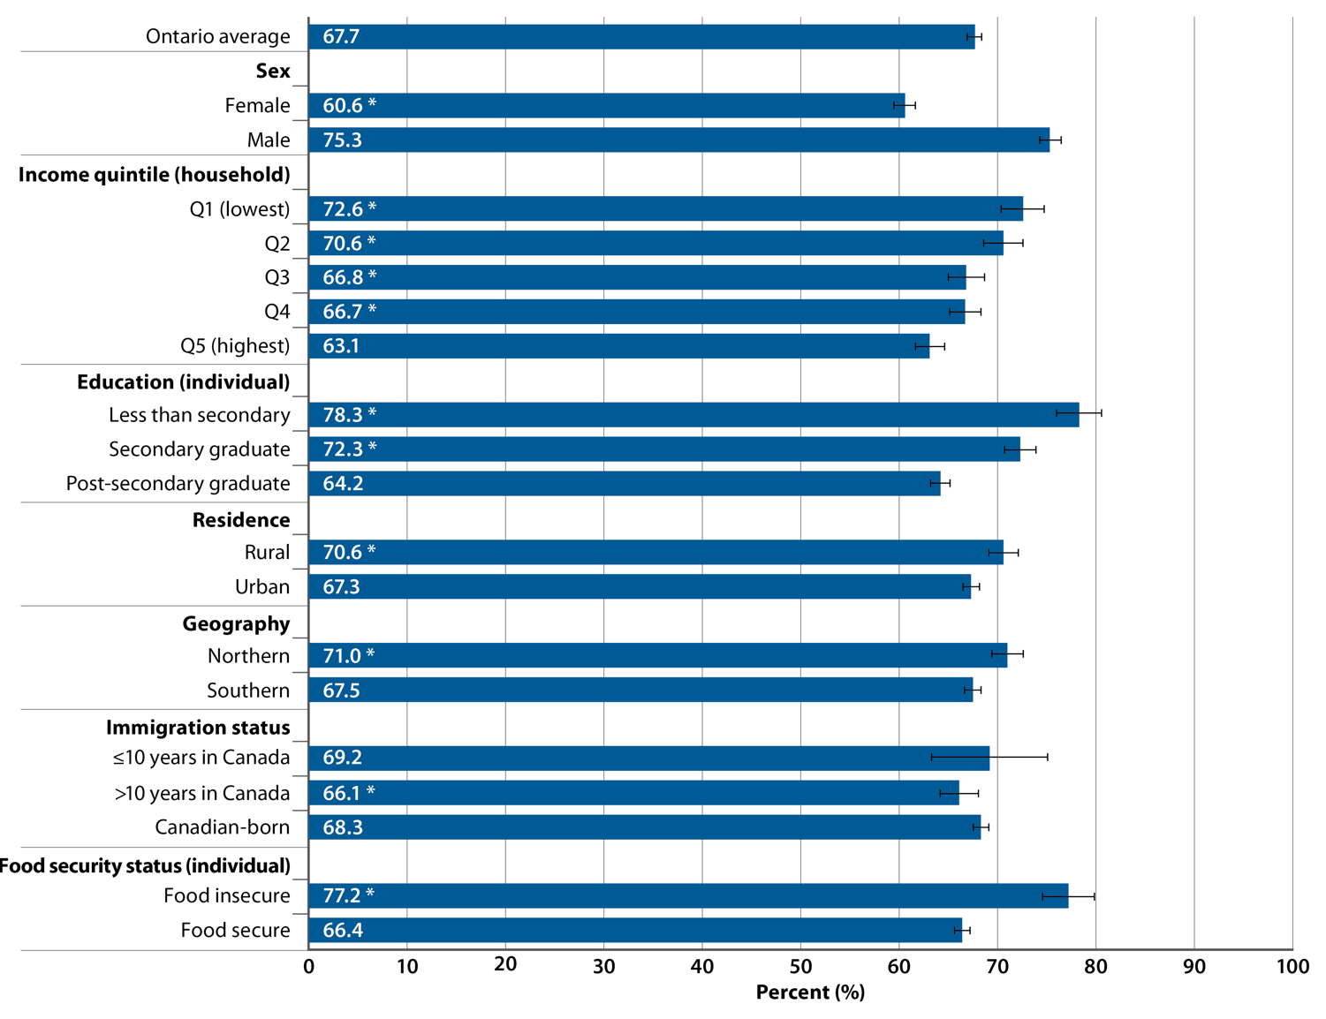
Percentage of adults (age 25+) reporting inadequate vegetable and fruit consumption, by selected socio-demographic factors, Ontario, 2012–2014 combined
SOURCE: Canadian Community Health Survey (CCHS), 2012–2014 (Statistics Canada)
PREPARED BY: Cancer Care Ontario, Prevention and Cancer Control (Population Health and Prevention)
Notes:
NOTES: Estimates are adjusted to the age distribution of the 2011 Canadian population.• |––| represents 95% confidence intervals. • Inadequate vegetable and fruit consumption: consuming vegetables (excluding potatoes) and fruit fewer than five times per day. • * Estimate is significantly different from the rates in the following reference categories: male for analyses by sex; quintile 5 (Q5) for analyses by income; post-secondary graduate for analyses by education; urban for analyses by residence; southern for analyses by geography; Canadian-born for analyses by immigration status; food secure for analyses by food security status.• An additional analysis by cultural or racial group is presented in Supplementary Table S31.

Slide 31
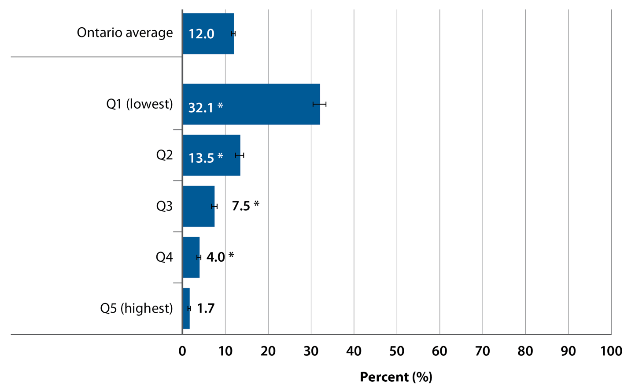
Percentage of Ontario households that were food insecure (marginal, moderate or severe), by household income quintile, 2012–2014 combined
SOURCE: Canadian Community Health Survey (CCHS), 2012–2014 (Statistics Canada)
PREPARED BY: Cancer Care Ontario, Prevention and Cancer Control (Population Health and Prevention)
Notes:
NOTES: |––| represents 95% confidence intervals. • * Estimate is significantly different from the percentages in the following reference category: quintile 5 (Q5). • These data and an additional analysis by geography are presented in Supplementary Table S32.

Slide 32
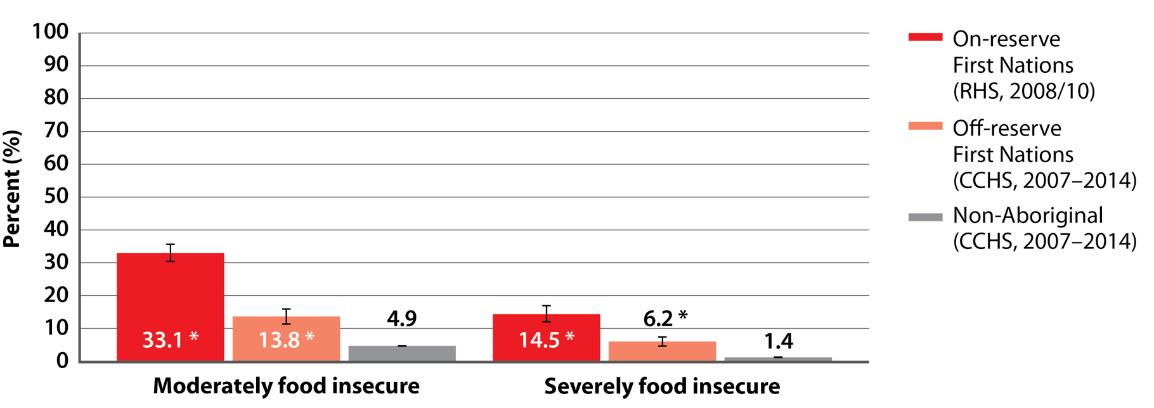
Percentage of First Nations and non-Aboriginal adults living in households that were moderately or severely food insecure, Ontario, 2007–2014 combined
SOURCES: First Nations Regional Health Survey (RHS) Phase 2 (2008/10) Ontario Region Final Report
(First Nations Information Governance Centre); Canadian Community Health Survey (CCHS), 2007–2014 (Statistics Canada)
PREPARED BY: Cancer Care Ontario, Prevention and Cancer Control (Aboriginal Cancer Control Unit)
Notes:
NOTES: |––| represents 95% confidence intervals. • * Indicates that group is significantly different from the reference category (non-Aboriginal). • Data are presented in Supplementary Table S35.

Slide 33
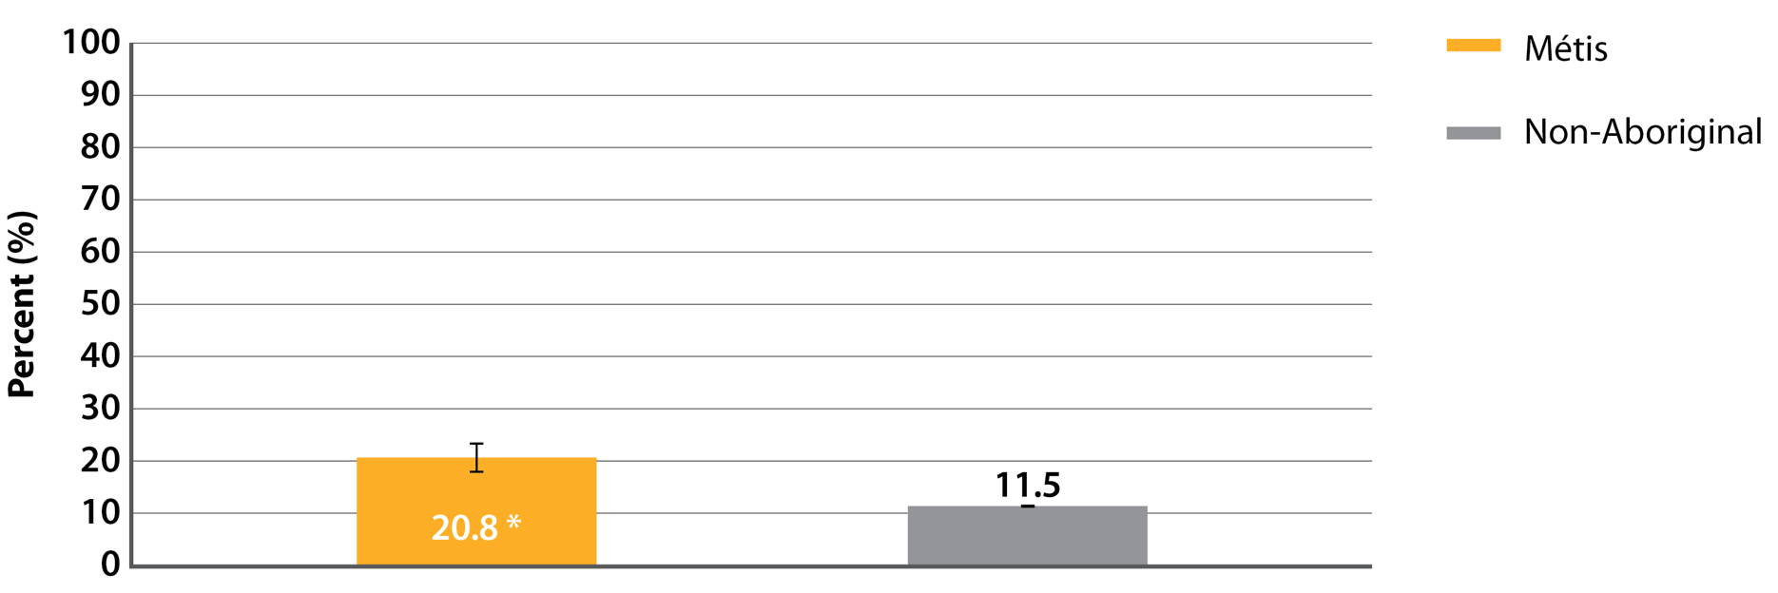
Percentage of Métis and non-Aboriginal households that were marginally, moderately or severely food insecure, Ontario, 2007–2014 combined
SOURCE: Canadian Community Health Survey, 2007–2014 (Statistics Canada)
PREPARED BY: Cancer Care Ontario, Prevention and Cancer Control (Aboriginal Cancer Control Unit)
Notes:
NOTES: |––| represents 95% confidence intervals. • * Indicates that group is significantly different from the reference category (non-Aboriginal). • Data are presented in Supplementary Table S36.

Slide 34
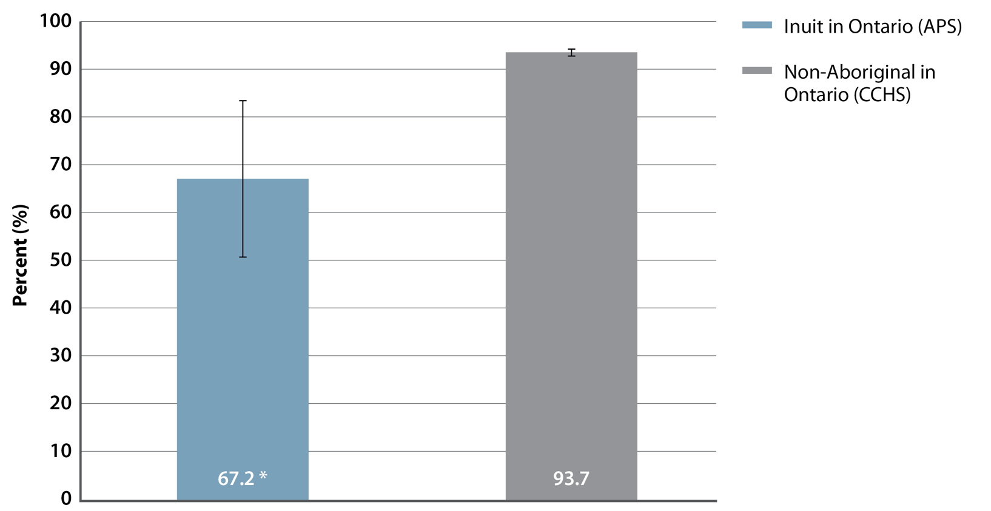
Percentage of Inuit and non-Aboriginal adults living in food secure households, Ontario, 2012
SOURCES: Aboriginal Peoples Survey (APS), 2012 (Statistics Canada); Canadian Community Health Survey (CCHS), 2012 (Statistics Canada)
PREPARED BY: Cancer Care Ontario, Prevention and Cancer Control (Aboriginal Cancer Control Unit)
Notes:
NOTES: Estimates are adjusted to the age distribution of the 2006 Inuit population outside Inuit Nunangat. • |––| represents 95% confidence intervals. • * Indicates that group is significantly different from the reference category (non-Aboriginal). • Data are presented in Supplementary Table S37.

Slide 35
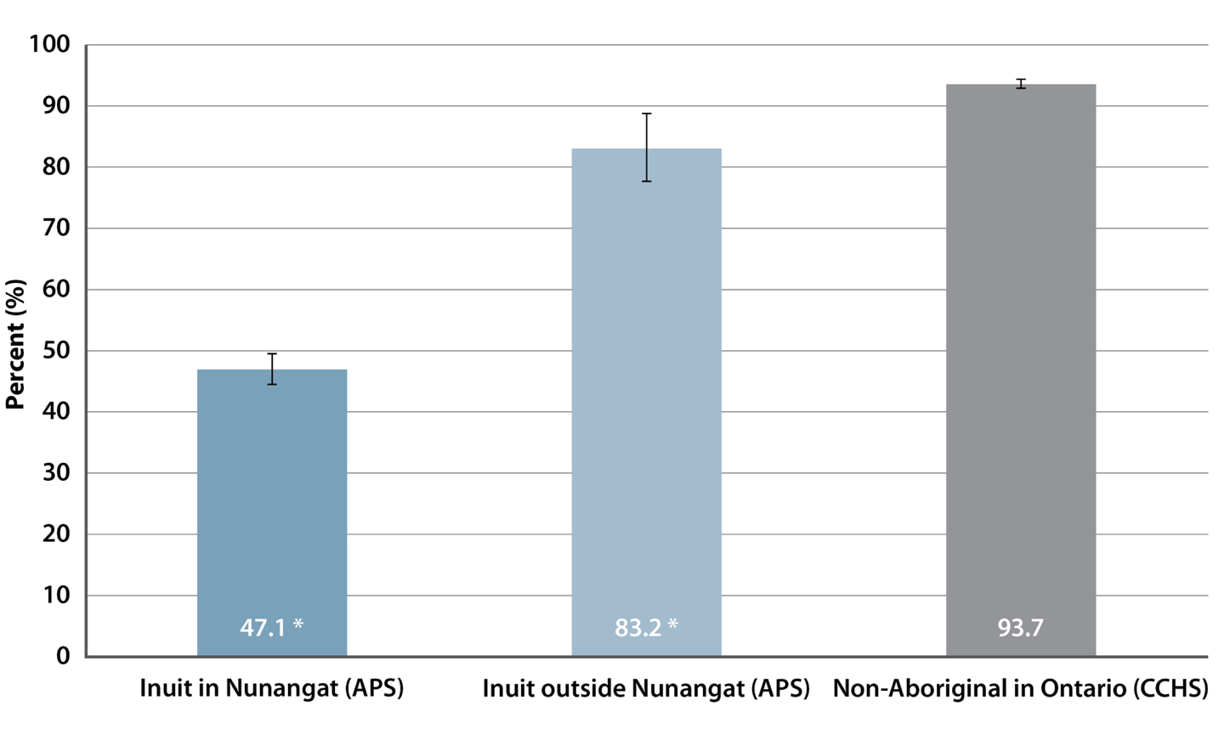
Percentage of Inuit adults in Canada and non-Aboriginal adults in Ontario living in food secure households, 2012
SOURCES: Aboriginal Peoples Survey (APS), 2012 (Statistics Canada); Canadian Community Health Survey (CCHS), 2012 (Statistics Canada)
PREPARED BY: Cancer Care Ontario, Prevention and Cancer Control (Aboriginal Cancer Control Unit)
Notes:
NOTES: Estimates are adjusted to the age distribution of the 2006 Inuit population outside Inuit Nunangat. • |––| represents 95% confidence intervals. • * Indicates that group is significantly different from the reference category (non-Aboriginal). • Data are presented in Supplementary Table S38.

Slide 36
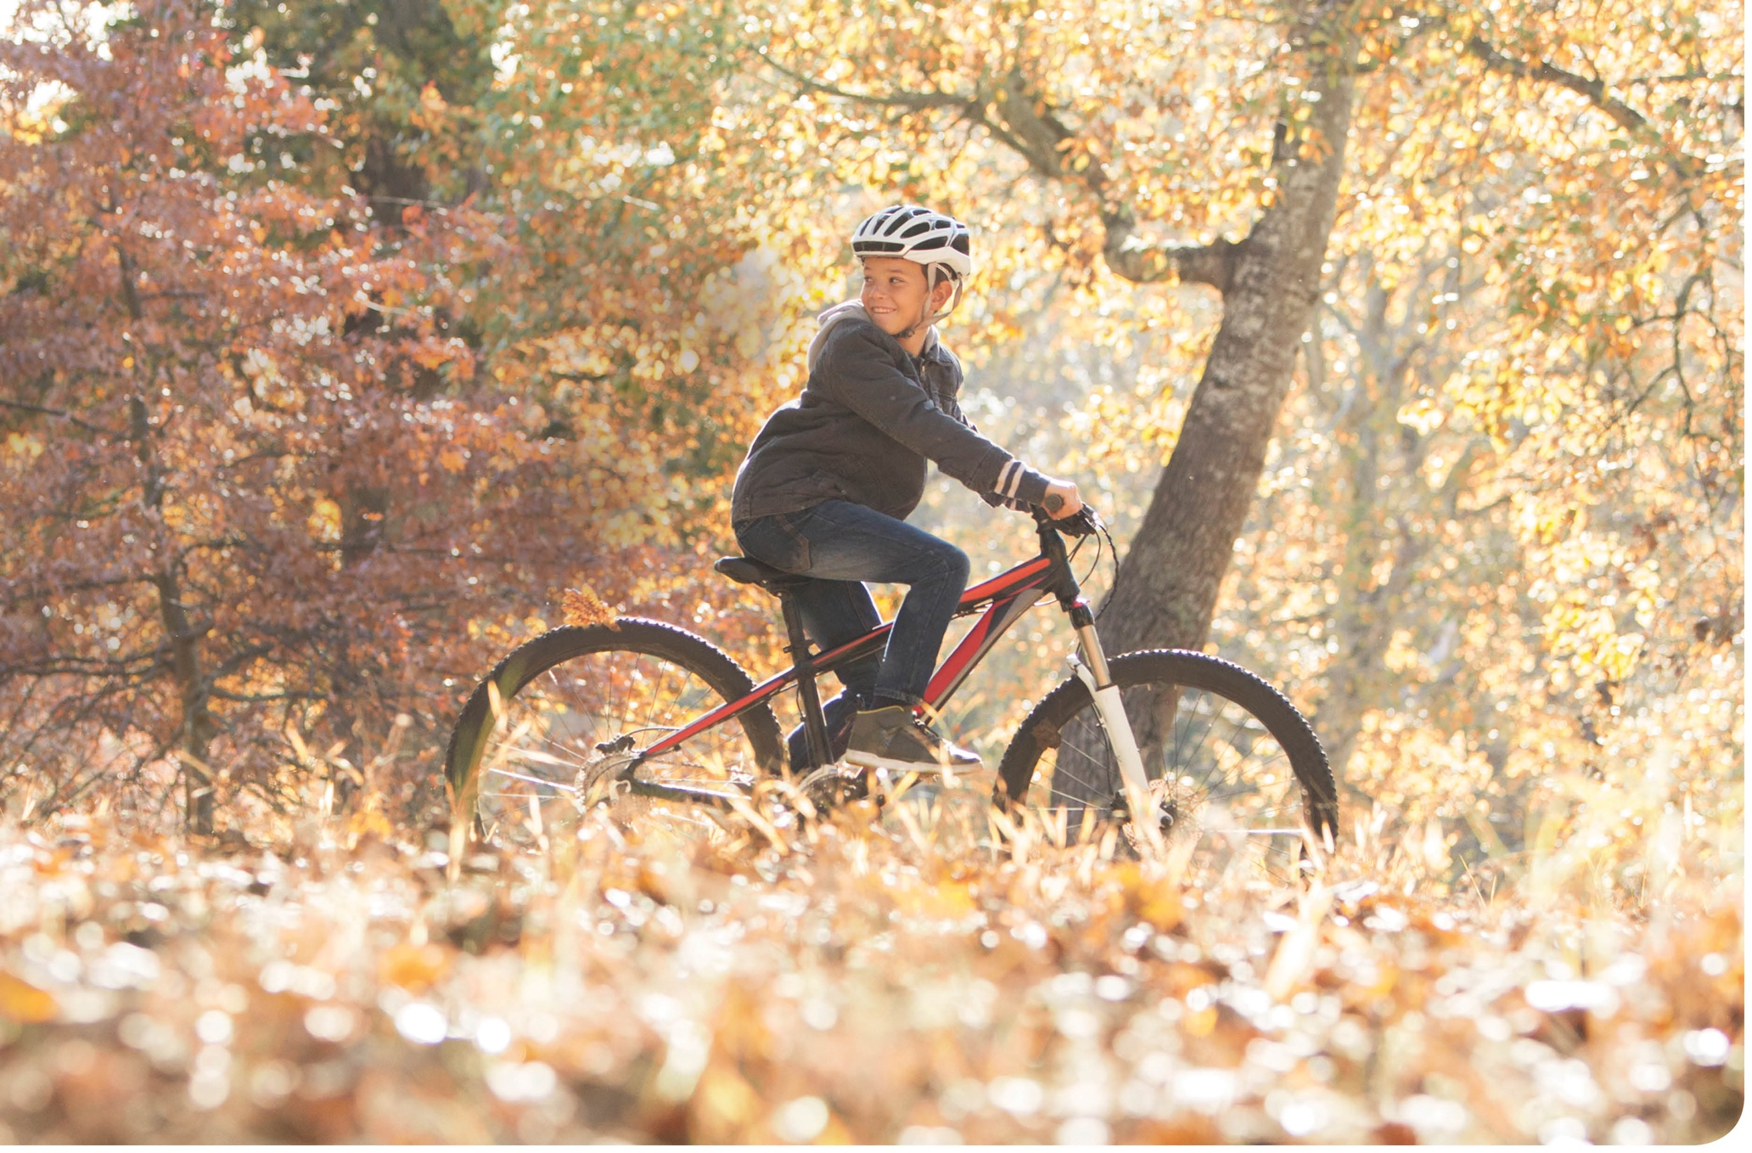
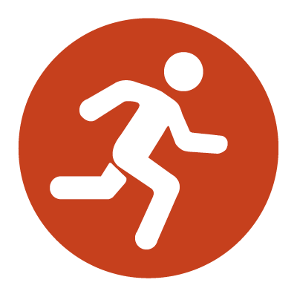
Physical
activity

Slide 37
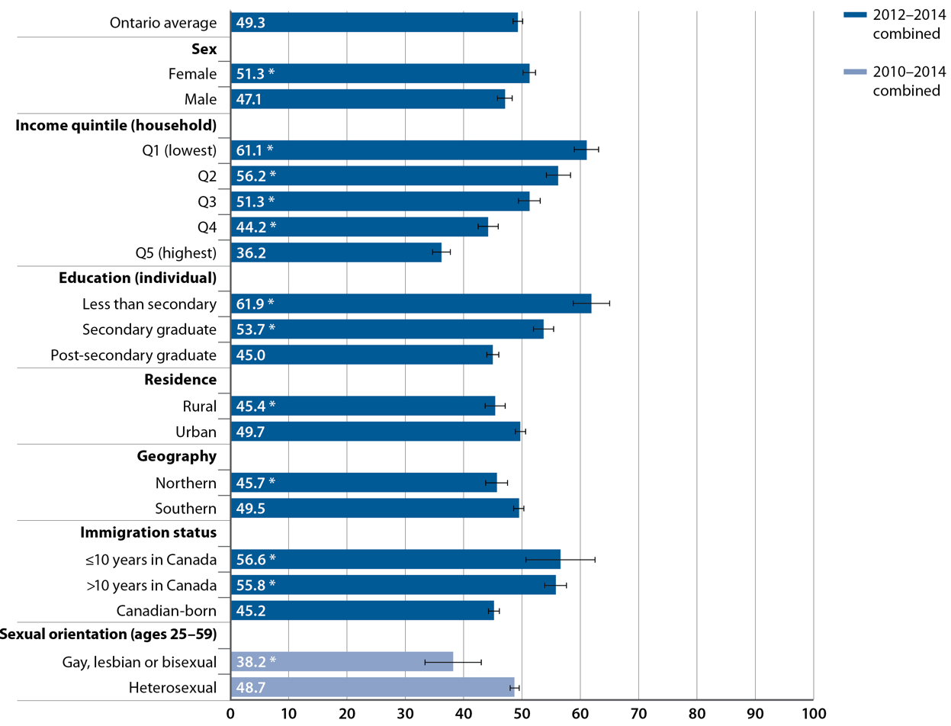
Percentage of adults (age 25+) reporting that they were not moderately active or active during leisure time, by selected socio-demographic factors, Ontario, 2010–2014 combined
SOURCE: Canadian Community Health Survey (CCHS), 2010–2014 (Statistics Canada)
PREPARED BY: Cancer Care Ontario, Prevention and Cancer Control (Population Health and Prevention)
Notes:
NOTES: Estimates are adjusted to the age distribution of the 2011 Canadian population. • |––| represents 95% confidence intervals. • Not moderately active or active during leisure time: reporting an average daily energy expenditure during leisure time physical activities in the past three months of less than 1.5 kcal/kg/day. • Combined data from the 2010–2014 CCHS were used to increase the sample size for analyses by sexual orientation. Combined data from the 2012–2014 CCHS were used for analyses by all other socio-demographic factors shown in this figure. • Analyses by sexual orientation include only ages 25–59, due to CCHS age restrictions for this variable. Analyses by all other socio-demographic factors shown in this figure include ages 25+. • * Estimate is significantly different from the rates in the following reference categories: male for analyses by sex; quintile 5 (Q5) for analyses by income; post-secondary graduate for analyses by education; urban for analyses by residence; southern for analyses by geography; Canadian-born for analyses by immigration status; heterosexual for analyses by sexual orientation.• An additional analysis by cultural or racial group is presented in Supplementary Table S39.

Slide 38
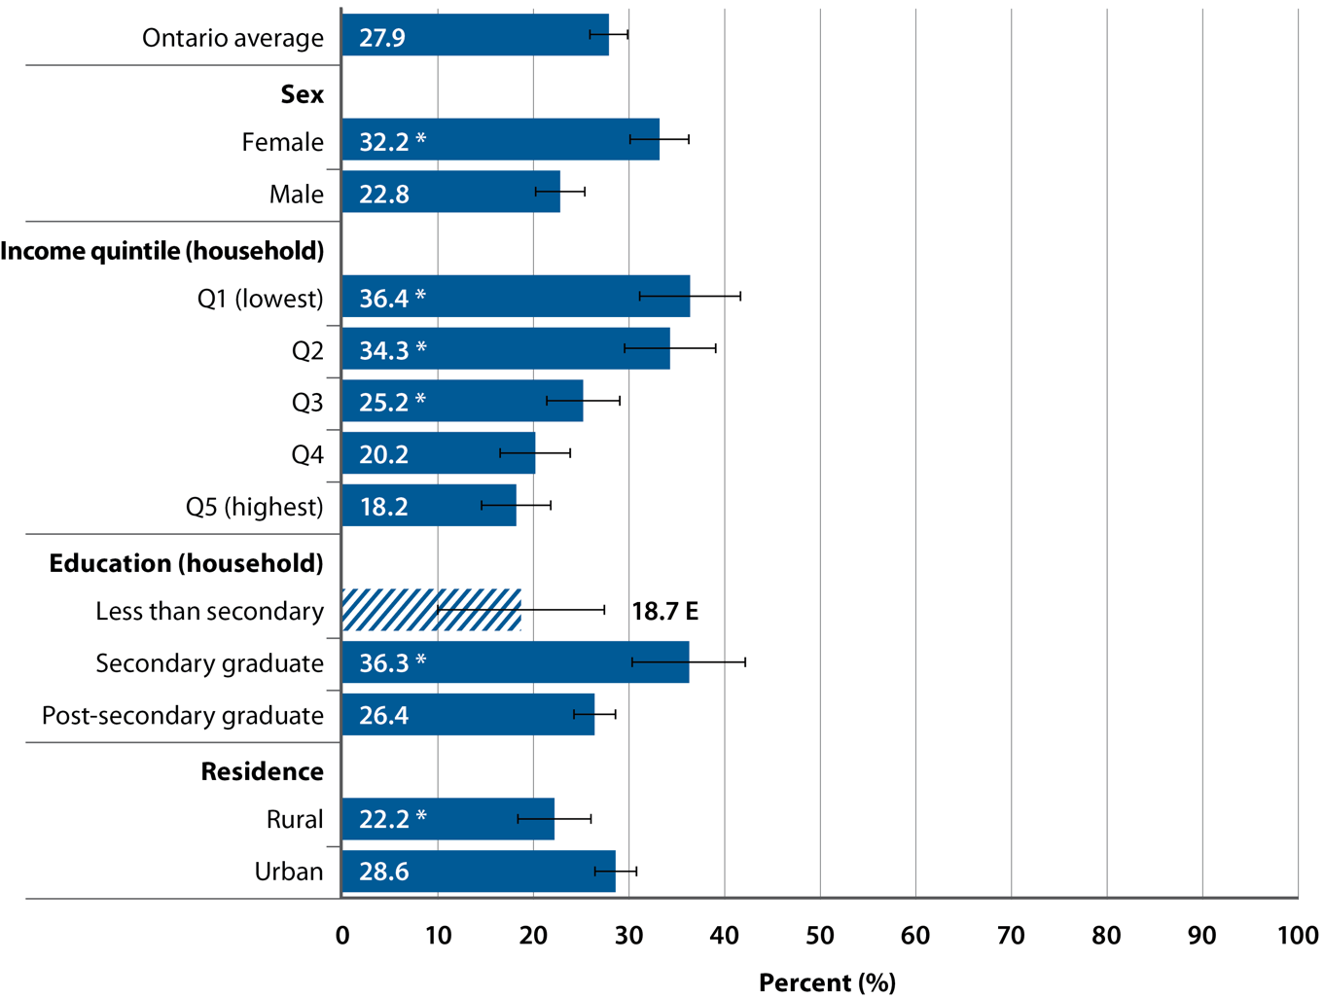
Percentage of adolescents (ages 12–17) reporting that they were not moderately active or active during leisure time, by selected socio-demographic factors, Ontario, 2012–2014 combined
SOURCE: Canadian Community Health Survey (CCHS), 2012–2014 (Statistics Canada)
PREPARED BY: Cancer Care Ontario, Prevention and Cancer Control (Population Health and Prevention)
Notes:
NOTES: |––| represents 95% confidence intervals. • E: interpret cross-hatched estimates with caution due to high sampling variability. • Not moderately active or active during leisure time: reporting an average daily energy expenditure during leisure time physical activities in the past three months of less than 1.5 kcal/kg/day. • * Estimate is significantly different from the rates in the following reference categories: male for analyses by sex; quintile 5 (Q5) for analyses by income; post-secondary graduate for analyses by household education; urban for analyses by residence. • An additional analysis by cultural or racial group is presented in Supplementary Table S40.

Slide 39
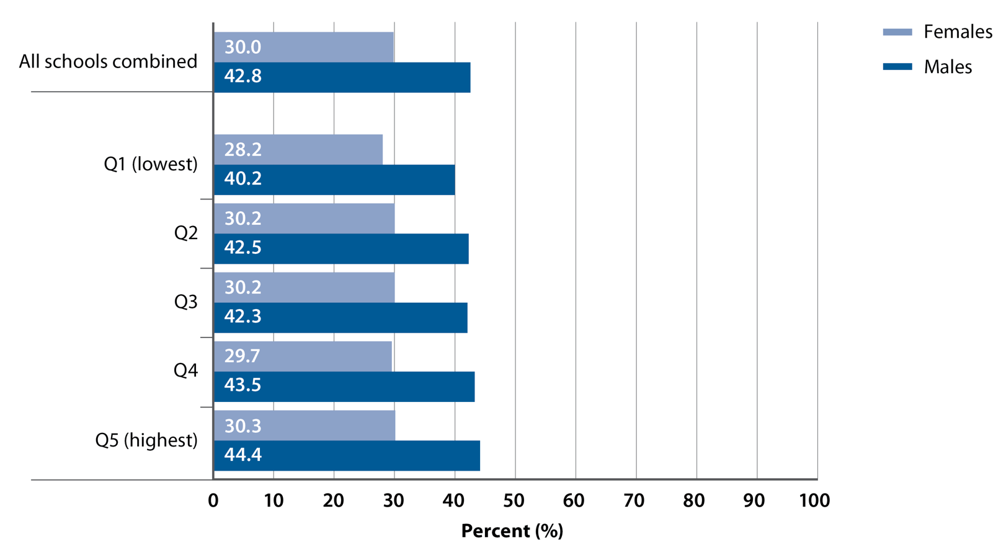
Percentage of students (Grades 10–12) in publicly funded secondary schools who earned a credit in 1 or more health and physical education course, by sex and median income of school neighbourhood, Ontario, 2013/2014 school year
SOURCES: Ontario School Information System, 2013/14 (Ministry of Education); Census of Population, 2011 (Statistics Canada)
PREPARED BY: Cancer Care Ontario, Prevention and Cancer Control (Population Health and Prevention)
Notes:
NOTES: For all schools combined, females were significantly less likely to earn a credit in one or more health and physical education courses than males. • Significant association between income quintile and the percentage of students who earned a credit in one or more health and physical education course for males (p <0.05). • Data are presented in Supplementary Table S41.

Slide 40
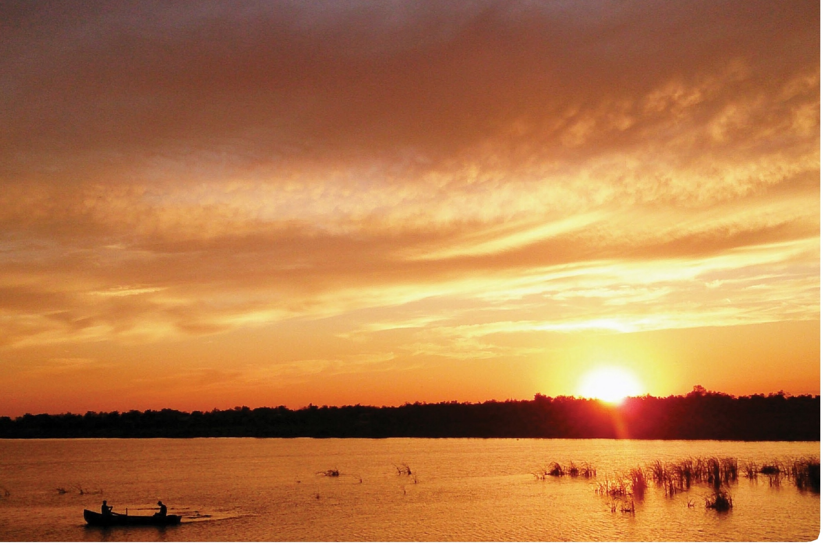
Conclusion

Slide 41
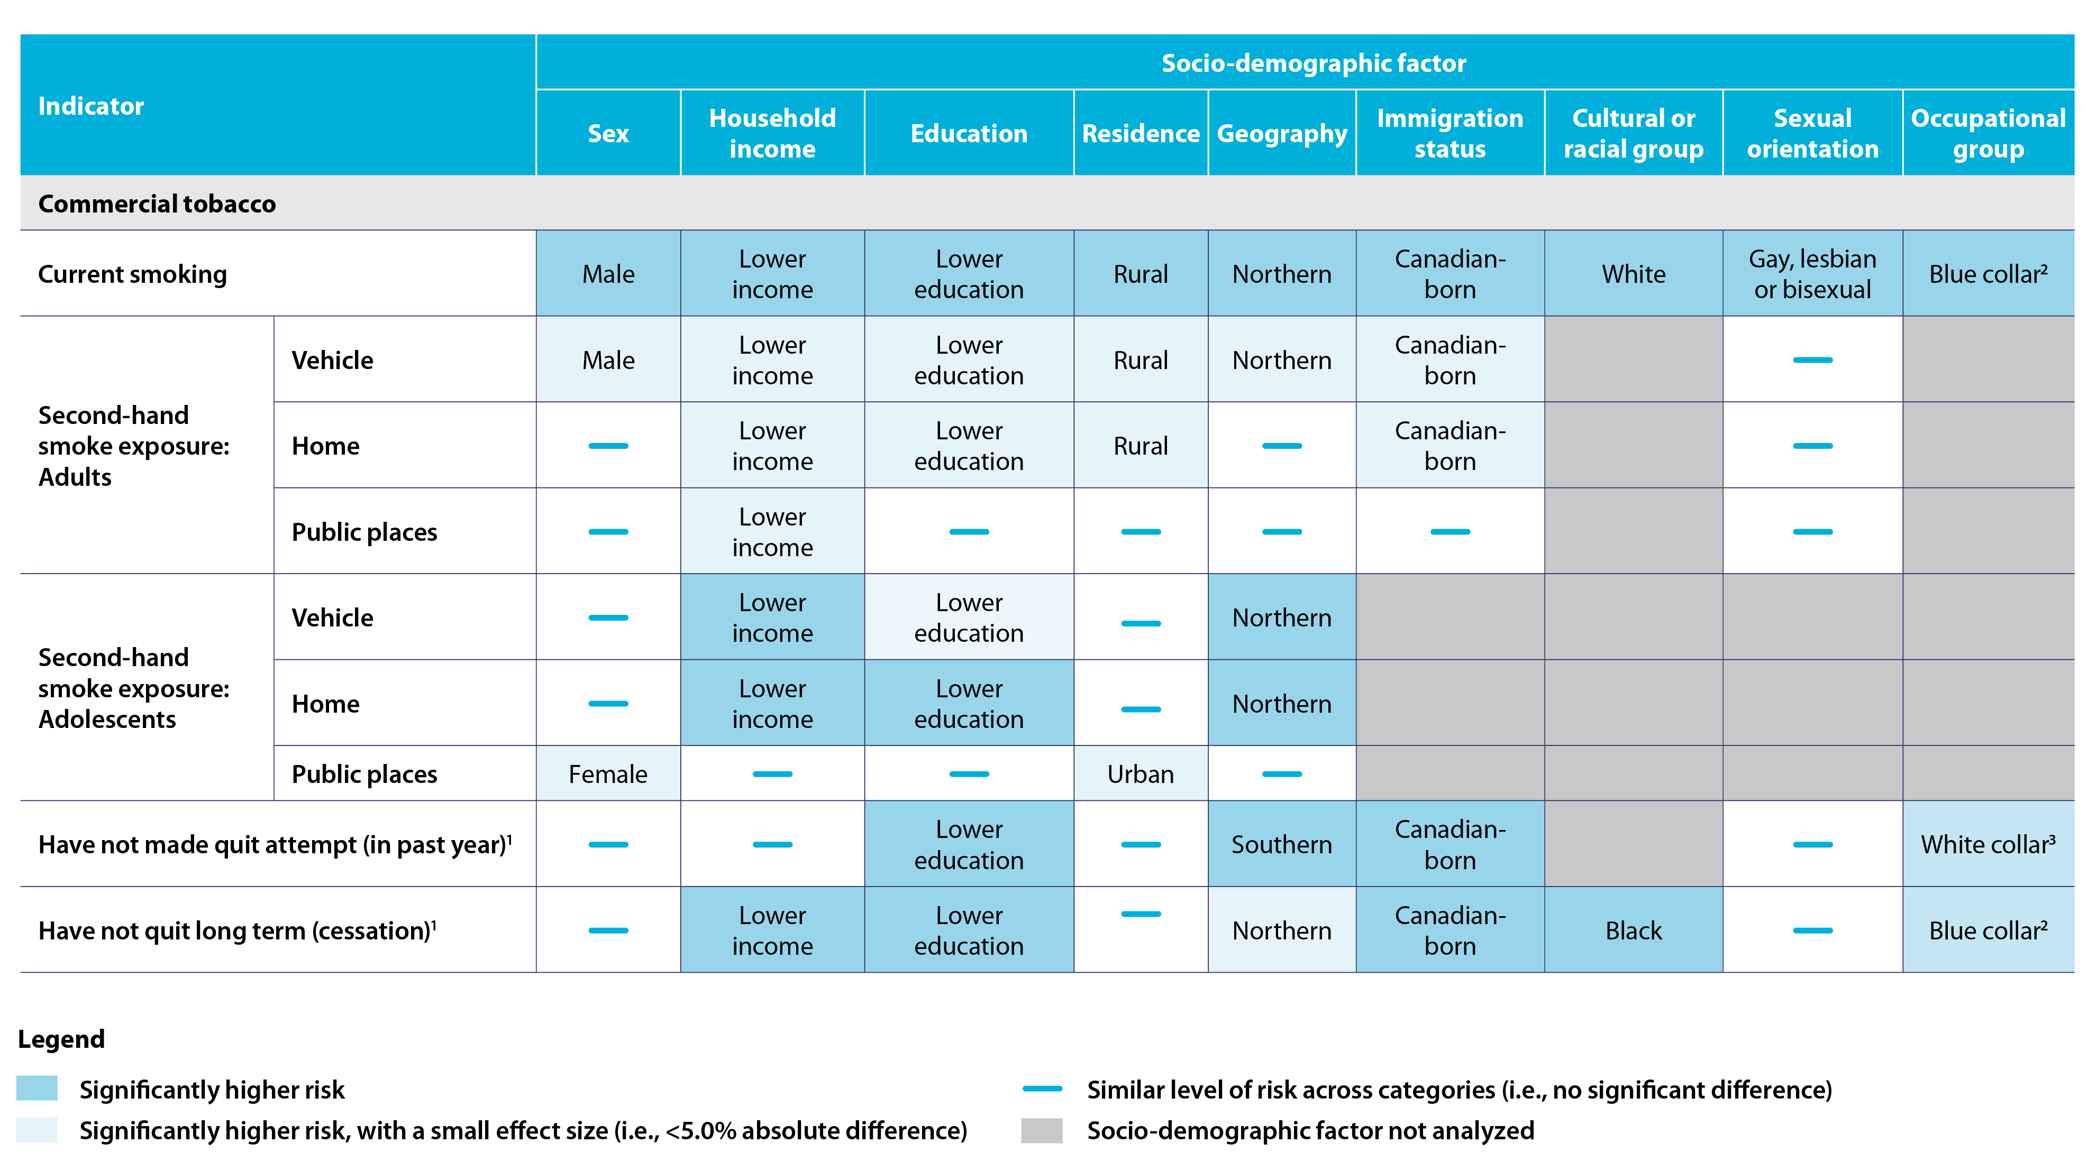
Sub-populations that were at higher risk related to commercial tobacco, Ontario, 2010–2014
Notes:
NOTES: 1. In the full report, these indicators are presented in a positive direction (e.g., percentage that made a quit attempt). 2. Blue-collar occupation groups at increased risk: Trades, transport, equipment operators and related. 3. White-collar occupational groups at increased risk: Management; and Business, finance and administration.

Slide 42
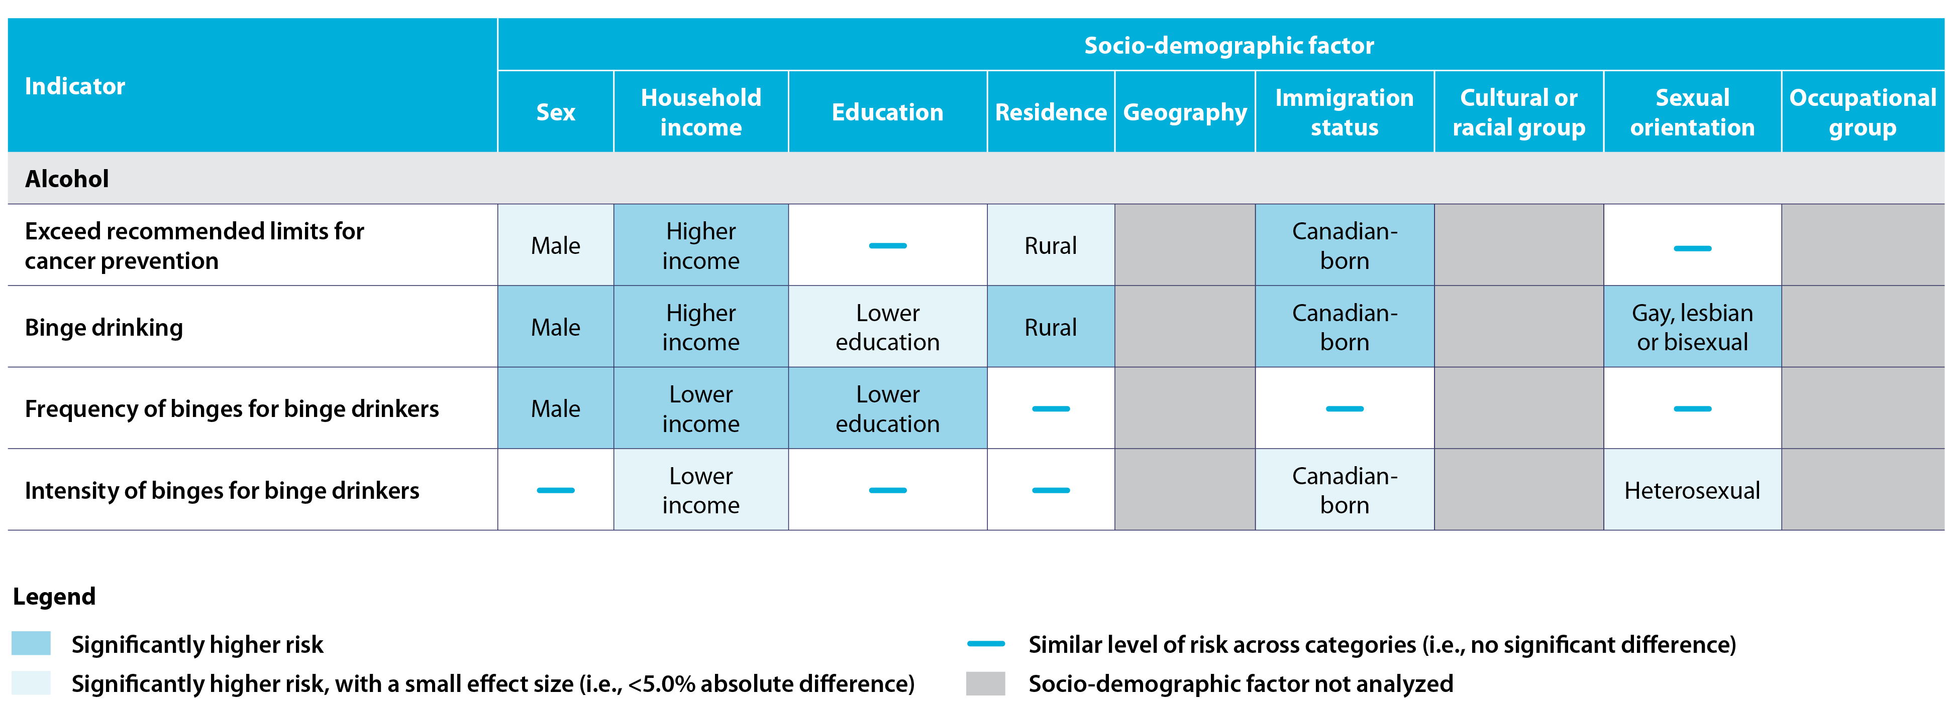
Sub-populations that were at higher risk related to alcohol, Ontario, 2010–2014

Slide 43
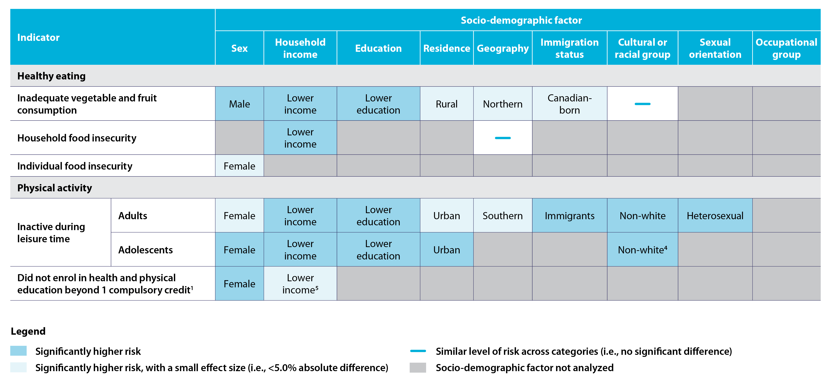
Sub-populations that were at higher risk related to healthy eating and physical activity, Ontario, 2010–2014
Notes:
NOTES: 1. In the full report, these indicators are presented in a positive direction (e.g., percentage that made a quit attempt. 4. Cultural or racial groups at increased risk: West and South Asian or Arab; and East and Southeast Asian. 5. Refers to median income quintile of school neighbourhood for this indicator.

Slide 44
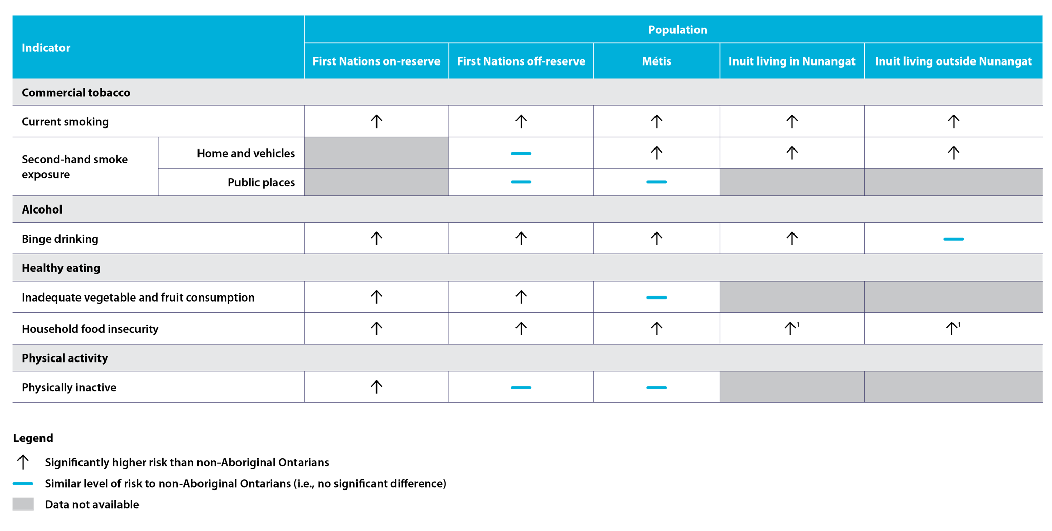
Risk of commercial tobacco use, alcohol consumption, unhealthy eating and physical inactivity in First Nations, Inuit and Métis adults, compared to non-Aboriginal Ontarians, Ontario, 2007–2014
Notes:
NOTES: 1. As measured by lower food security

