Slide 1
7
Cancer prevalence
Ontario Cancer Statistics 2018
Chapter 7: Cancer prevalence

Slide 2
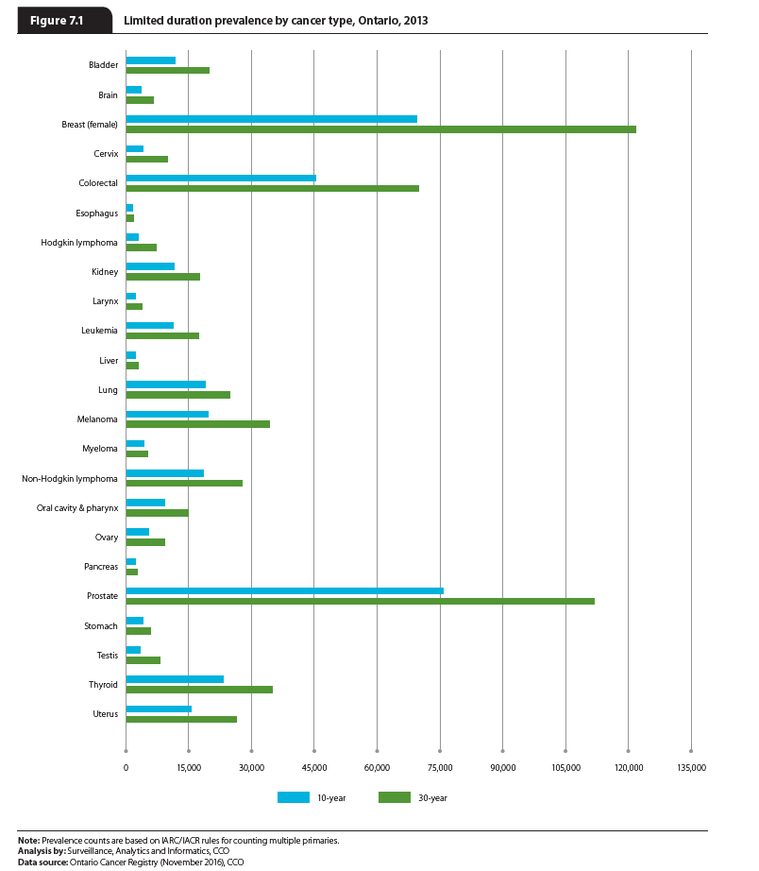
Notes:
Prostate cancer was the largest contributor to 10-year prevalence, accounting for 75,610 prevalent cases. This reflects the high incidence and survival of prostate cancer. Female breast (69,412) and colorectal (45,346) cancers were the next most prevalent types. Lung cancer, despite being the third most commonly diagnosed cancer, only ranked sixth in prevalence; it was superseded by higher-survival thyroid cancer and melanoma.
Slightly different patterns were observed in 30-year prevalence. Breast cancer was the leading contributor to 30-year prevalence, accounting for 121,658 cases, followed by prostate (111,759) and colorectal (69,966) cancers. In the context of 30-year prevalence, lung cancer fell even further down the rankings, with other cancers (non-Hodgkin lymphoma and uterine cancer) being more prevalent despite the higher incidence of lung cancer.

Slide 3
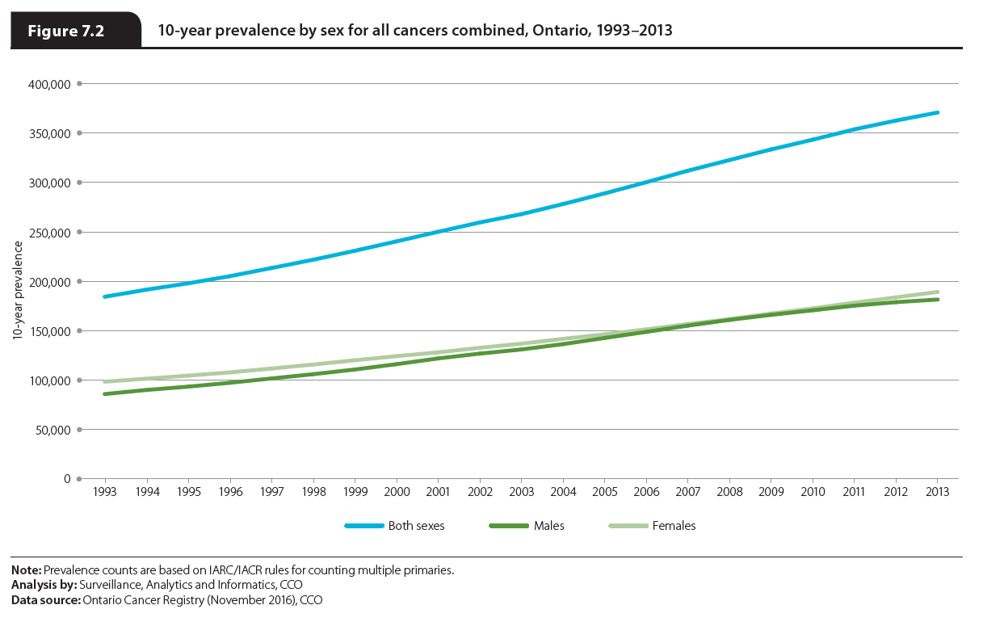
Notes:
The 10-year prevalence of cancer has been increasing over time. At the end of 1993, there were 184,309 people alive who had been diagnosed with cancer in the previous 10 years. By the end of 2013 this number had more than doubled to 370,713. The increase was greater for males (111.4%) than females (92.2%). While prevalence was higher in females than males during every year from 1993 to 2013, the difference between the sexes narrowed from 2007 to 2009 and then expanded again.

