Slide 1
1
Estimated current cancer incidence
Ontario Cancer Statistics 2018
Chapter 1: Estimated current cancer incidence

Slide 2
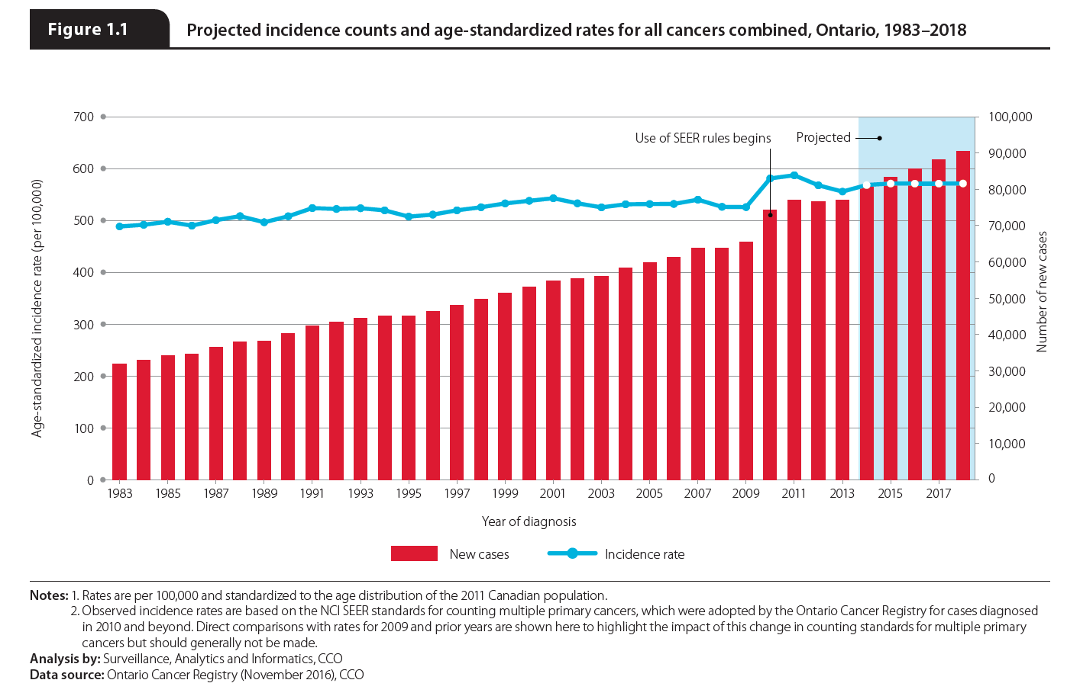
Notes:
In 2018 an estimated 90,483 new cases of malignant cancer (excluding non-melanoma skin cancer) are expected to be diagnosed in Ontario, resulting in an age-standardized incidence rate (ASIR) of 571.1 cases per 100,000 people. The abrupt increase in the count and incidence rate seen in 2010 is a result of the Ontario Cancer Registry’s adoption of the National Cancer Institute (NCI) Surveillance, Epidemiology and End Results (SEER) Program’s rules for counting multiple primaries. Those rules were applied starting in diagnosis year 2010, which means the higher numbers observed that year do not reflect a true increase in the incidence of cancer.

Slide 3
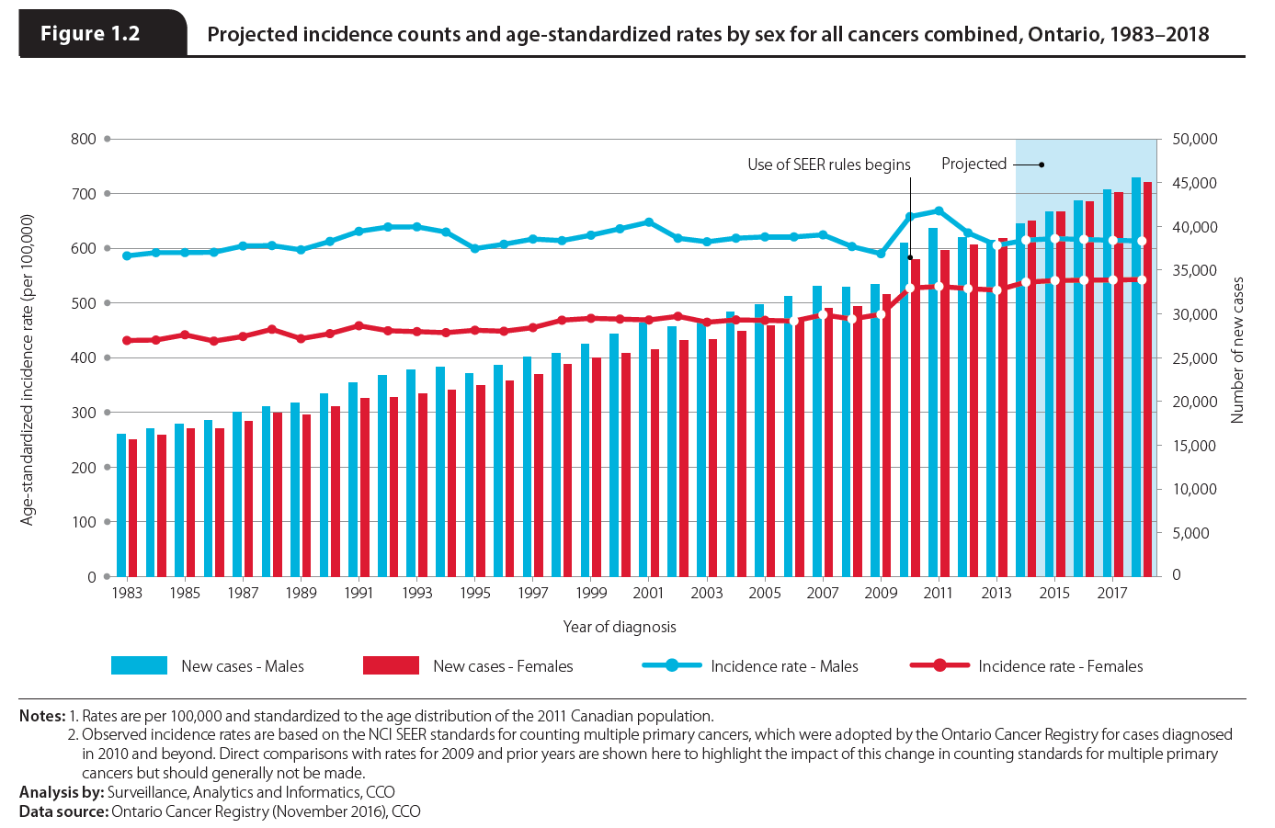
Notes:
Among males, 45,518 cases of cancer are expected to be diagnosed in 2018 for an ASIR of 613.2 per 100,000. The temporary decrease in the count and rate after 2011 can be attributed to the declining rate of prostate cancer, resulting from recommendations from the U.S. Preventive Services Task Force against using prostate-specific antigen (PSA) testing for the routine screening of healthy males. The numbers are expected to be lower for females, with 44,965 cases diagnosed for an ASIR of 542.7 per 100,000. The incidence rate has been higher for males than females for every year since 1983. This sex difference has been observed in many different jurisdictions and is not unique to Ontario. Higher rates of cancer among males have been attributed to behavioural, immunity and hormonal differences between the sexes; however, for some cancer types the mechanism underlying the difference is still unknown.

Slide 4
4
Cancer incidence rates and trends
Ontario Cancer Statistics 2018
Chapter 4: Cancer incidence rates and trends

Slide 5
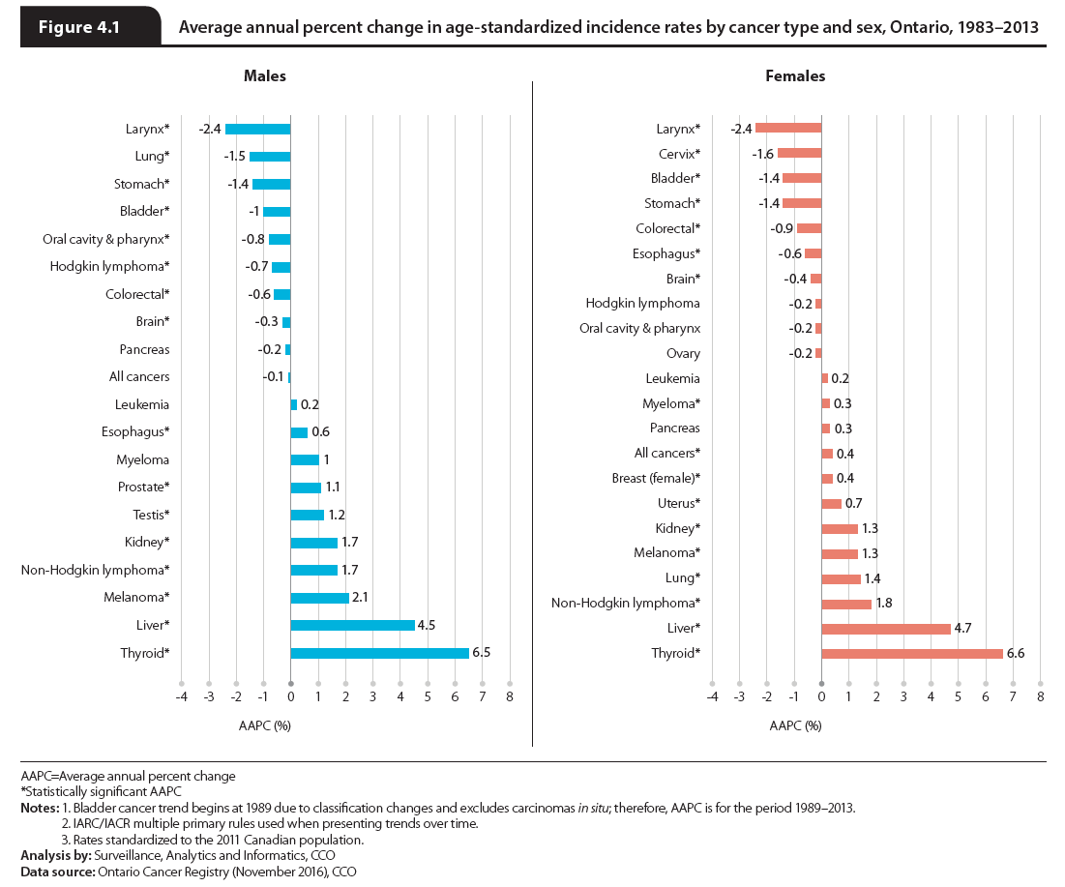
Notes:
Over the last thirty years (1983 to 2013) the average annual percent change (AAPC) in ASIR for males:
decreased most for laryngeal (2.4% per year), lung (1.5%) and stomach (1.4%) cancers;
increased most for thyroid (6.5%) and liver (4.5%) cancers and melanoma (2.1%); and
remained stable for pancreatic cancer, leukemia and myeloma.
For females, the AAPC:
decreased most for laryngeal (2.4% per year), cervical (1.6%), bladder (1.4%) and stomach (1.4%) cancers;
increased most for thyroid (6.6%) and liver (4.7%) cancers as well as non-Hodgkin lymphoma (1.8%); and
remained stable for oral cavity & pharynx, ovarian and pancreatic cancers as well as Hodgkin lymphoma and leukemia.

Slide 6
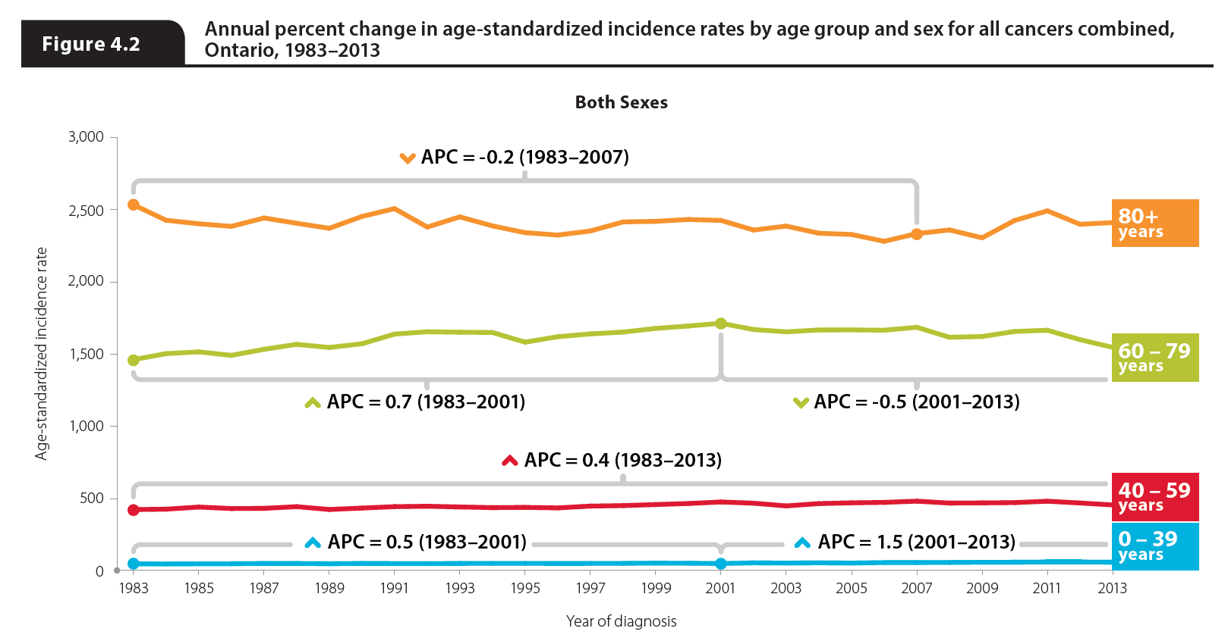
Notes:
NOTE: Male and female figures on the next slide
Over the past 30 years, cancer incidence rates have been increasing among younger and middle-aged people and decreasing among the elderly.
Among people under the age of 39, the cancer incidence rate increased by 0.5% per year from 1983 to 2001 and then by 1.5% per year from 2001 to 2013. Differential trends were seen in males and females. Among males, the rate increased from 1983 to 1990, remained stable until 2005 and then increased until 2013; for females, the rate was stable from 1983 to 1993 and then increased from 1993 to 2013. This increase in incidence among females is probably due to their increased rates of thyroid cancer, which is the second most common cancer in this age group.
Among people ages 40 to 59, the rate of cancer increased by 0.4% per year from 1983 to 2013. While the trend among females was the same, the male rate decreased by 1.9% per year after 2008.
For those ages 60 to 79, the rate increased by 0.7% per year from 1983 to 2001 and then declined by 0.5% per year from 2001 to 2013. The rate among males was similar, although the increase ceased in 1992 and the rate did not begin to decline until 2007. Females in this age group had no decrease in incidence; their rate increased by 0.6% per year from 1983 to 1999, and then remained stable from 1999 to 2006 before rising again from 2006 to 2013 at a rate of 0.8% per year.
In the oldest age group (those 80 and older), the incidence rate declined slightly by 0.2% per year until 2007, after which it remained stable. While the male rate declined steadily throughout the time period, the female rate has been increasing slowly since 1987 following five years of stability.

Slide 7
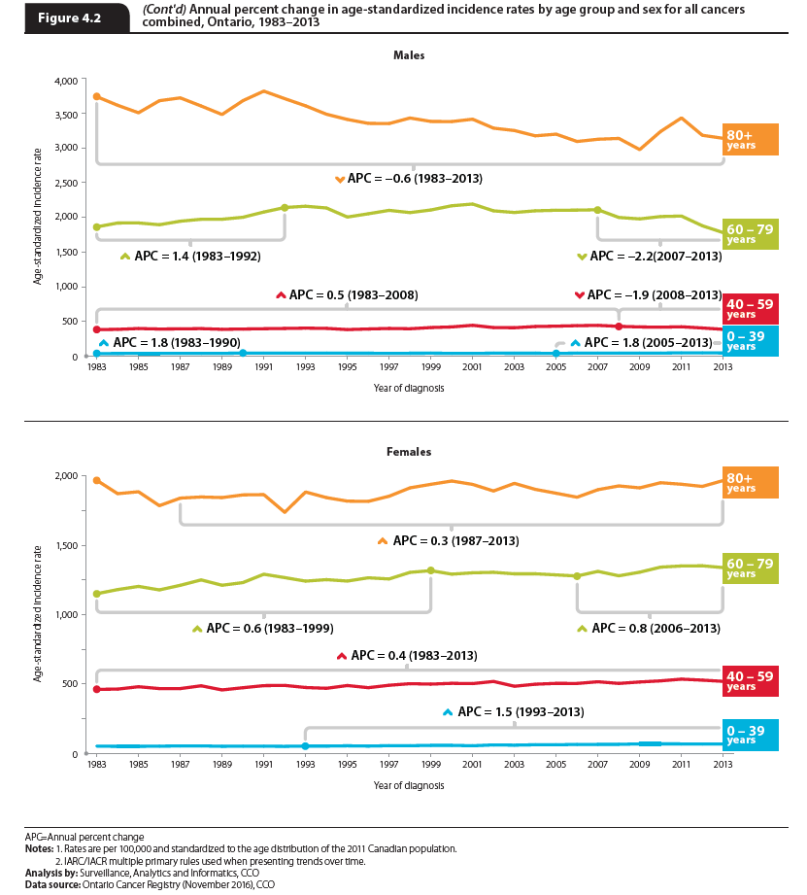
Notes:
Over the past 30 years, cancer incidence rates have been increasing among younger and middle-aged people and decreasing among the elderly.
Among people under the age of 39, the cancer incidence rate increased by 0.5% per year from 1983 to 2001 and then by 1.5% per year from 2001 to 2013. Differential trends were seen in males and females. Among males, the rate increased from 1983 to 1990, remained stable until 2005 and then increased until 2013; for females, the rate was stable from 1983 to 1993 and then increased from 1993 to 2013. This increase in incidence among females is probably due to their increased rates of thyroid cancer, which is the second most common cancer in this age group.
Among people ages 40 to 59, the rate of cancer increased by 0.4% per year from 1983 to 2013. While the trend among females was the same, the male rate decreased by 1.9% per year after 2008.
For those ages 60 to 79, the rate increased by 0.7% per year from 1983 to 2001 and then declined by 0.5% per year from 2001 to 2013. The rate among males was similar, although the increase ceased in 1992 and the rate did not begin to decline until 2007. Females in this age group had no decrease in incidence; their rate increased by 0.6% per year from 1983 to 1999, and then remained stable from 1999 to 2006 before rising again from 2006 to 2013 at a rate of 0.8% per year.
In the oldest age group (those 80 and older), the incidence rate declined slightly by 0.2% per year until 2007, after which it remained stable. While the male rate declined steadily throughout the time period, the female rate has been increasing slowly since 1987 following five years of stability.

Slide 8
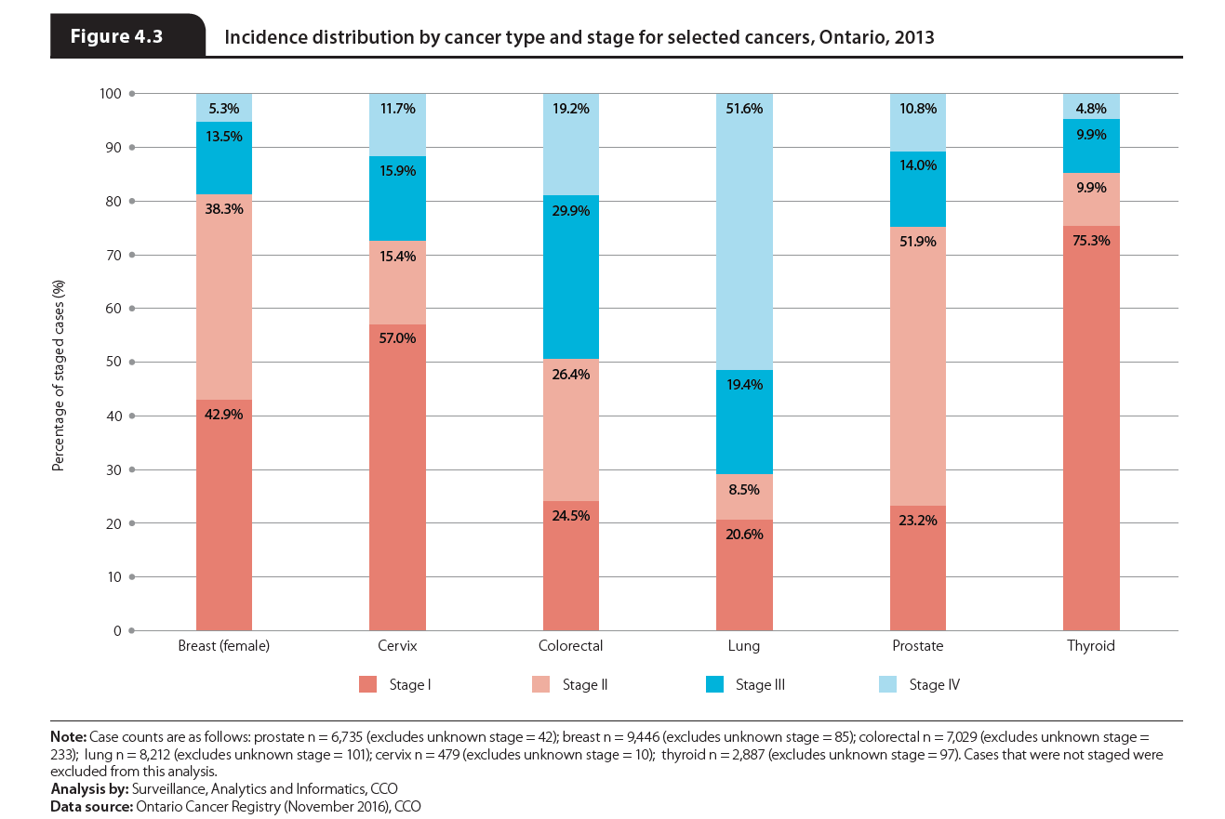
Notes:
Stage at diagnosis data for Ontario are currently available for six cancers: female breast, prostate, colorectal, lung, cervix and thyroid. The majority of breast, colorectal, prostate, cervical and thyroid cancers were diagnosed at stage I or II. This may partly be the result of the availability of screening for breast, colorectal and cervical cancers, which increases the likelihood of detecting these cancers at early stages. More specifically:
The majority of staged breast cancer cases were diagnosed at stage I (42.9%) or stage II (38.3%) in 2013.
Cervical cancer was even more likely to be diagnosed at stage I (57.0%) than breast cancer. Despite the successes of screening programs in decreasing cervical cancer incidence and mortality, 11.7% of cases were still not diagnosed until stage IV. Females who are diagnosed at a later stage are less likely to have been routinely screened.
The majority of staged colorectal cancer cases were diagnosed at stage II (26.4%) or stage III (29.9%).
Prostate cancer cases were most likely to be diagnosed at stage II (51.9%) followed by stage I (23.2%).
Lung cancer cases were the most likely to be diagnosed at stage IV, accounting for 51.6% of all staged lung cancer cases.
Thyroid cancer was the most likely to be diagnosed at stage I with 75.3% of staged cases diagnosed at this early stage. Only 4.8% of thyroid cases were diagnosed at stage IV.

