Slide 2
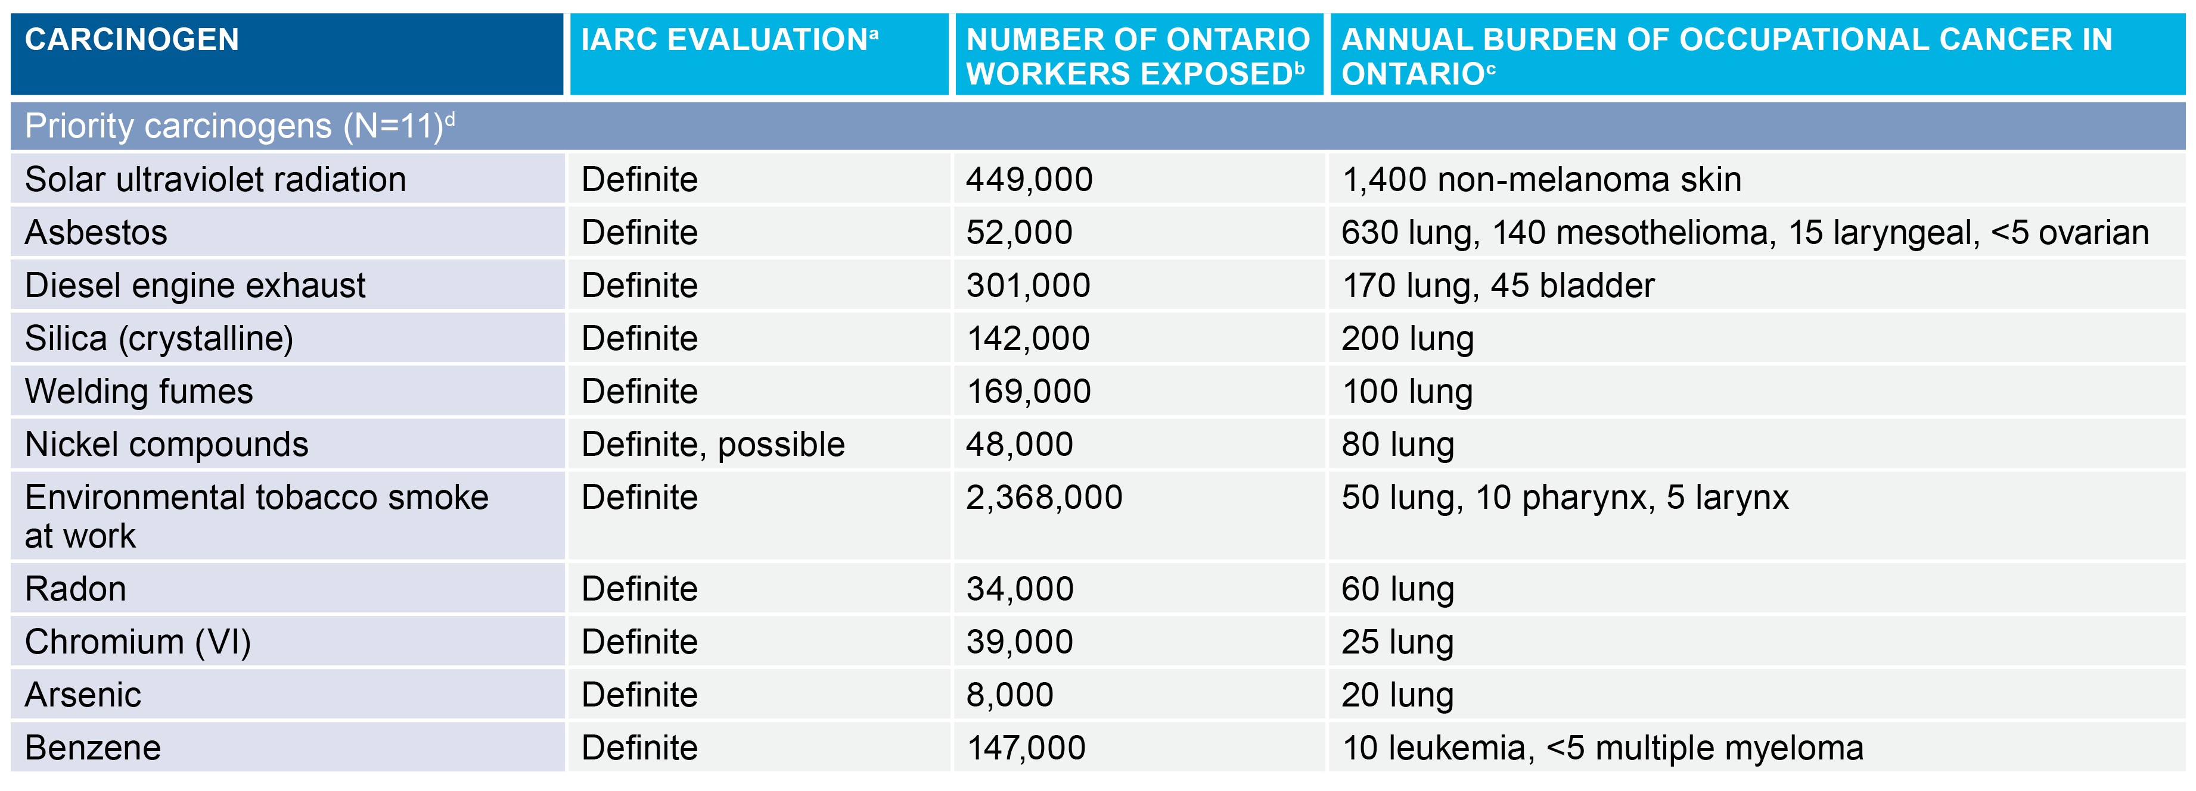
Carcinogens selected for inclusion in this report
NOTES:
ªThe IARC Monographs program routinely evaluates carcinogenic risks to humans and categorizes agents as one of the following: (1) Group 1: definite human carcinogen; (2A) Group 2A: probable human carcinogen; (2B) Group 2B: possible human carcinogen; (3) Group 3: not classifiable; (4) Group 4: not carcinogenic to humans.
^{b}All exposure estimates except for welding fumes and ETS were provided by CAREX Canada.
^{c}Burden of occupational cancer in Ontario based on results from the national (Canadian) study, reported as the estimated number of cancer cases attributable to occupational exposure to the respective carcinogen. The range in estimated annual number of occupational cancer cases can be found at: www.cancercare.on.ca/occupationreport.
^{d}Priority carcinogens selected based on accounting for 10 or more occupational cancer cases in Ontario.
Introduction
Burden of Occupational Cancer in Ontario 2

Slide 3
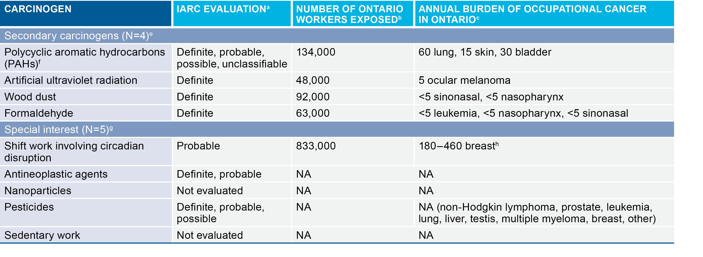
Carcinogens selected for inclusion in this report (continued)
NOTES:
ªThe IARC Monographs program routinely evaluates carcinogenic risks to humans and categorizes agents as one of the following: (1) Group 1: definite human carcinogen; (2A) Group 2A: probable human carcinogen; (2B) Group 2B: possible human carcinogen; (3) Group 3: not classifiable; (4) Group 4: not carcinogenic to humans.
^{b}All exposure estimates except for welding fumes and ETS were provided by CAREX Canada.
^{c}Burden of occupational cancer in Ontario based on results from the national (Canadian) study, reported as the estimated number of cancer cases attributable to occupational exposure to the respective carcinogen. The range in estimated annual number of occupational cancer cases can be found at: www.cancercare.on.ca/occupationreport.
^{e}Secondary carcinogens selected based on accounting for fewer than 10 estimated occupational cancer cases in Ontario.
^{f}Polycyclic aromatic hydrocarbons (PAHs) included as secondary carcinogens because they are a heterogeneous group of compounds with different carcinogenic classifications.
^{g}Special interest carcinogens selected based on scientific and policy importance, emerging issue, high known or possible prevalence of exposure in Ontario workers, and/or incalculable burden estimate in Canada/Ontario.
^{h}A range was generated because shift work is a probable carcinogen.
Carcinogens with "NA" indicate that CAREX Canada exposure estimates or occupational burden of cancer results are not available.
Introduction
Burden of Occupational Cancer in Ontario 3

Slide 4
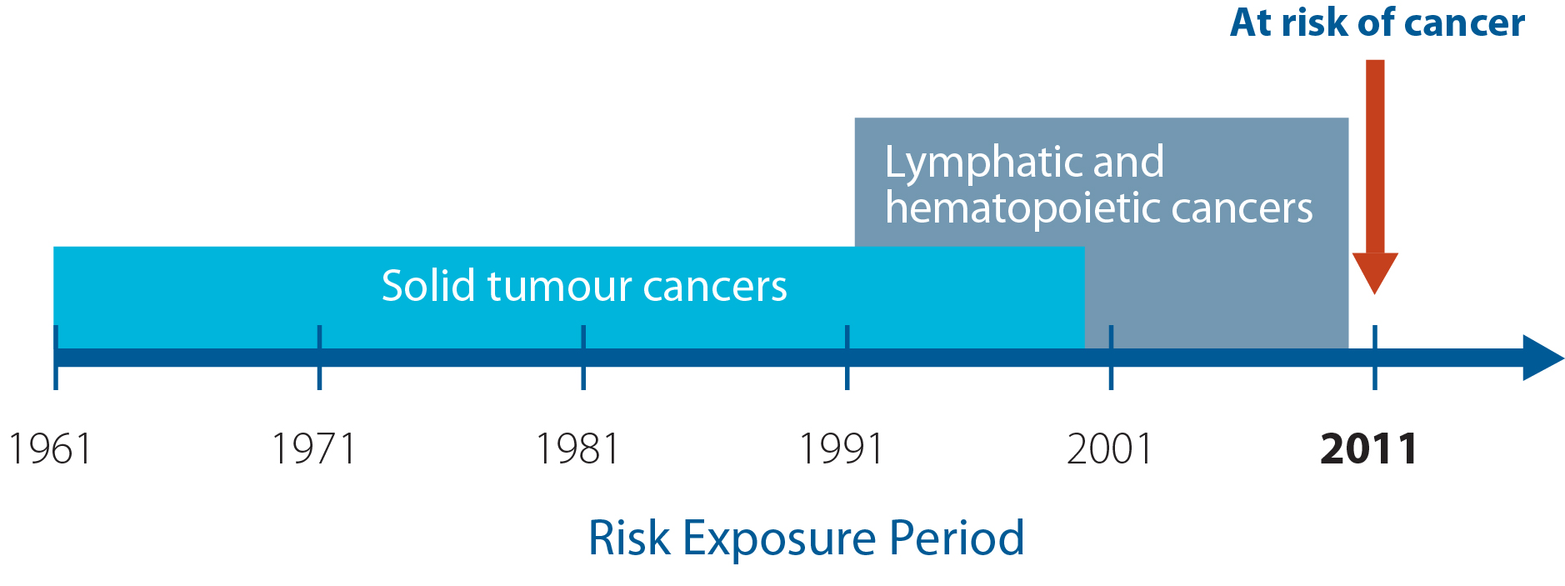
The risk exposure period
Approach
Burden of Occupational Cancer in Ontario 4

Slide 5
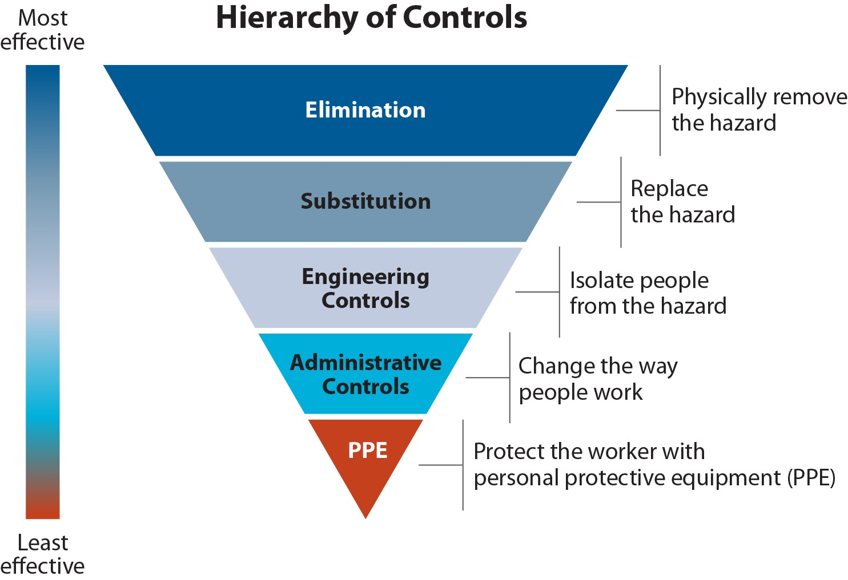
Hierarchy of hazard controls
Guidance for understanding the results
Burden of Occupational Cancer in Ontario 5

Slide 6
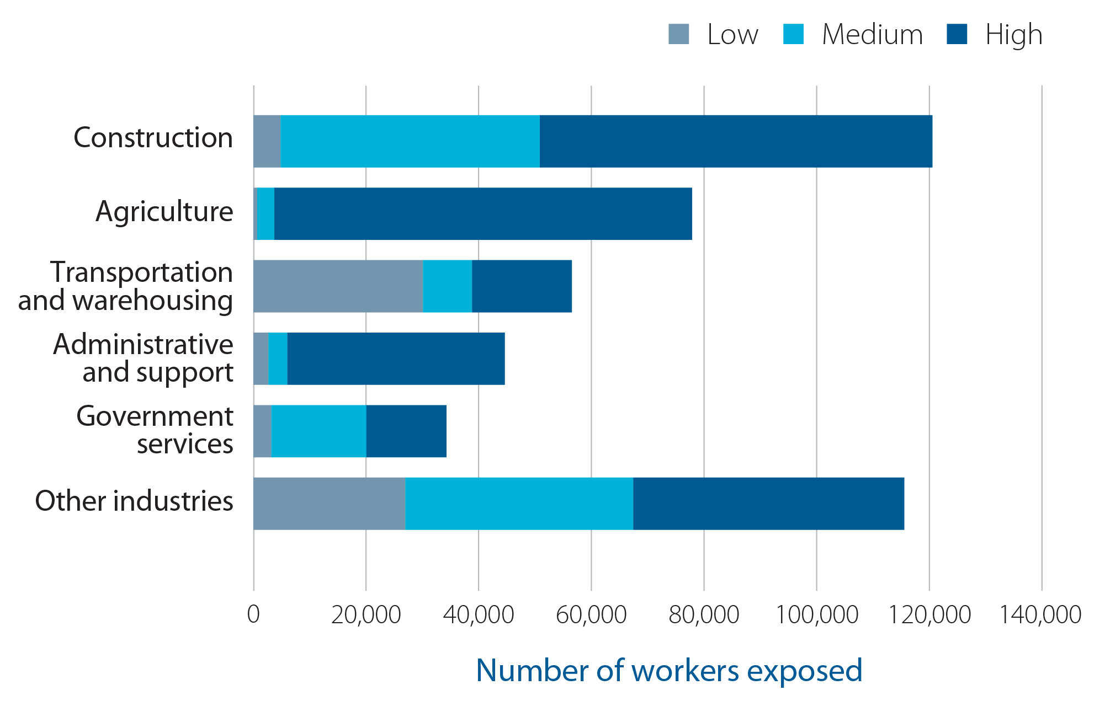
Number of workers occupationally exposed to solar ultraviolet (UV) radiation by level of exposure and industry in Ontario
Burden of Occupational Cancer in Ontario 6

Slide 7
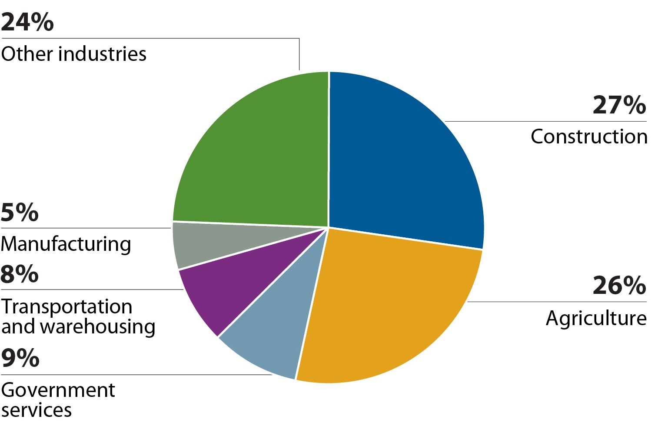

Industry breakdown of non-melanoma skin cancers (NMSCs) attributed to occupational solar ultraviolet (UV) radiation exposure
NOTES:
AF: attributable fraction
Burden of Occupational Cancer in Ontario 7

Slide 8
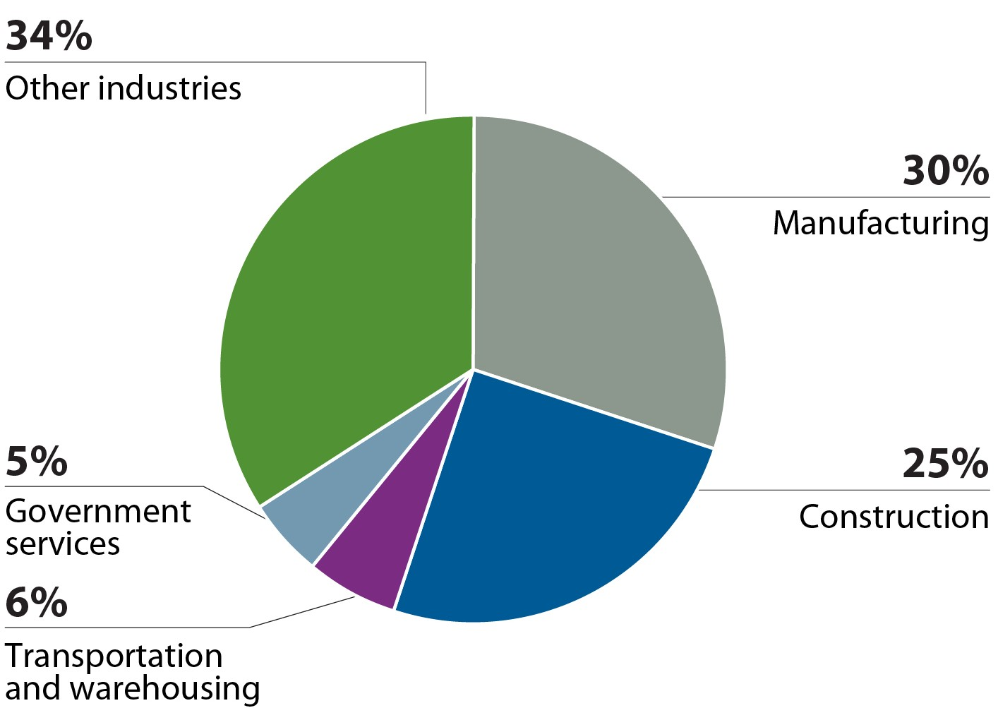




Industry breakdown of total lung cancers and mesotheliomas attributed to occupational asbestos exposure
NOTES:
* Includes an estimated five cases of mesothelioma attributed to para-occupational asbestos exposure. AF: attributable fraction
Burden of Occupational Cancer in Ontario 8

Slide 9
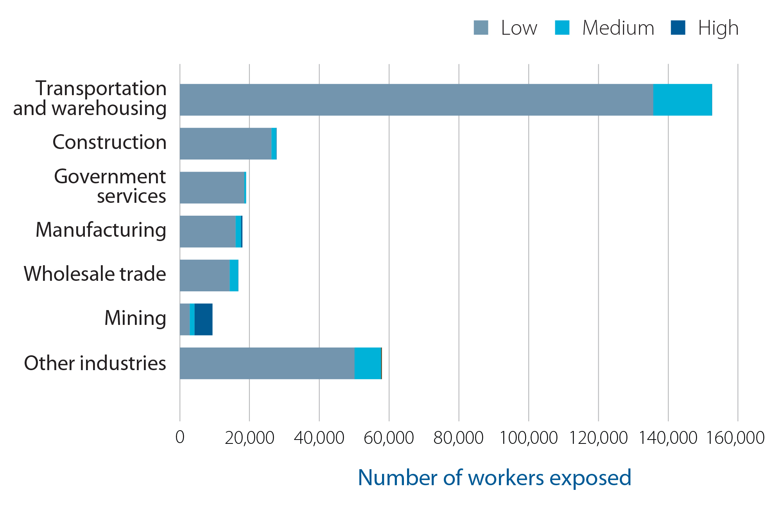
Number of workers occupationally exposed to diesel engine exhaust (DEE) by level of exposure and industry in Ontario
Burden of Occupational Cancer in Ontario 9

Slide 10
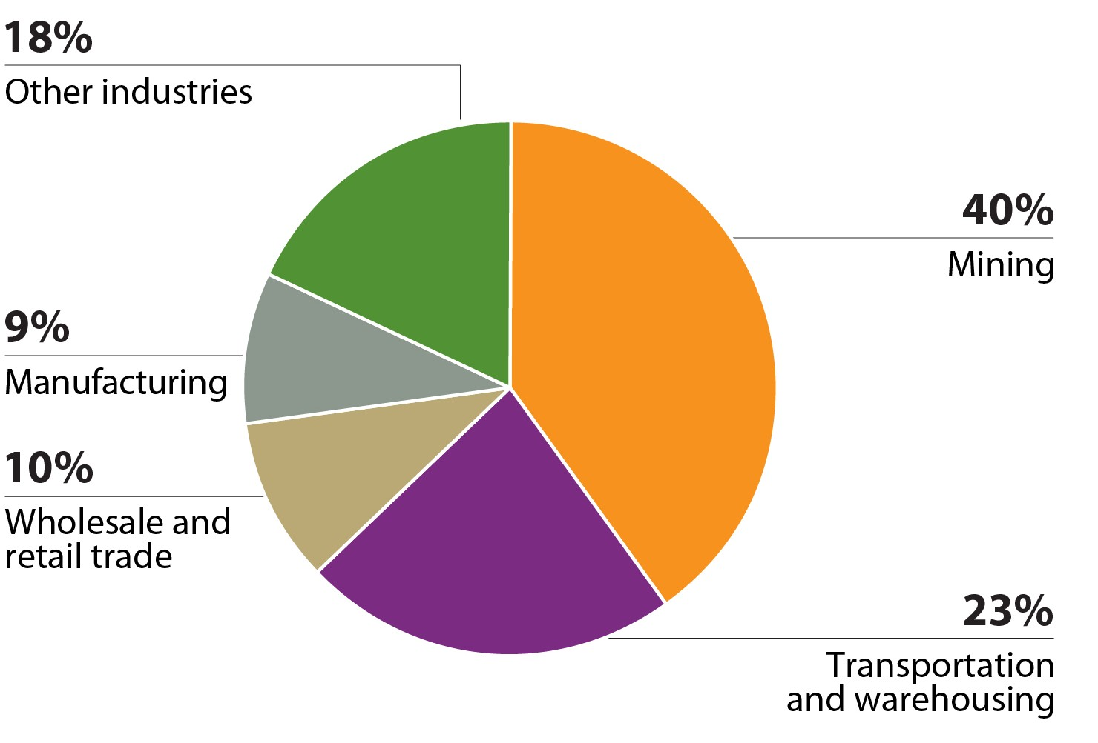
Industry breakdown of total lung cancers attributed to occupational diesel engine exhaust (DEE) exposure
NOTES:
AF: attributable fraction
Burden of Occupational Cancer in Ontario 10

Slide 11
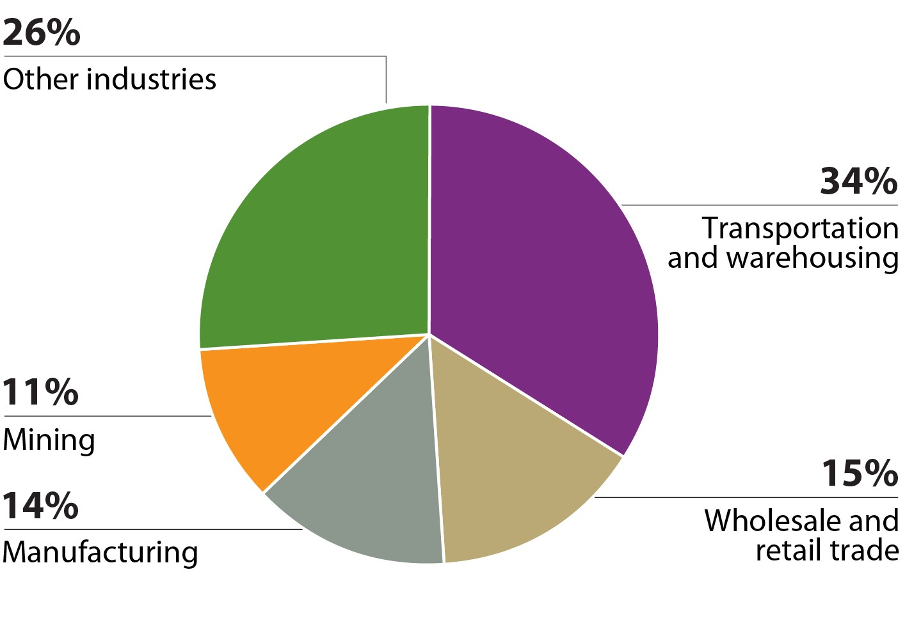

Industry breakdown of total bladder cancers that may be attributed to occupational diesel engine exhaust (DEE) exposure
NOTES:
AF: attributable fraction

Slide 12
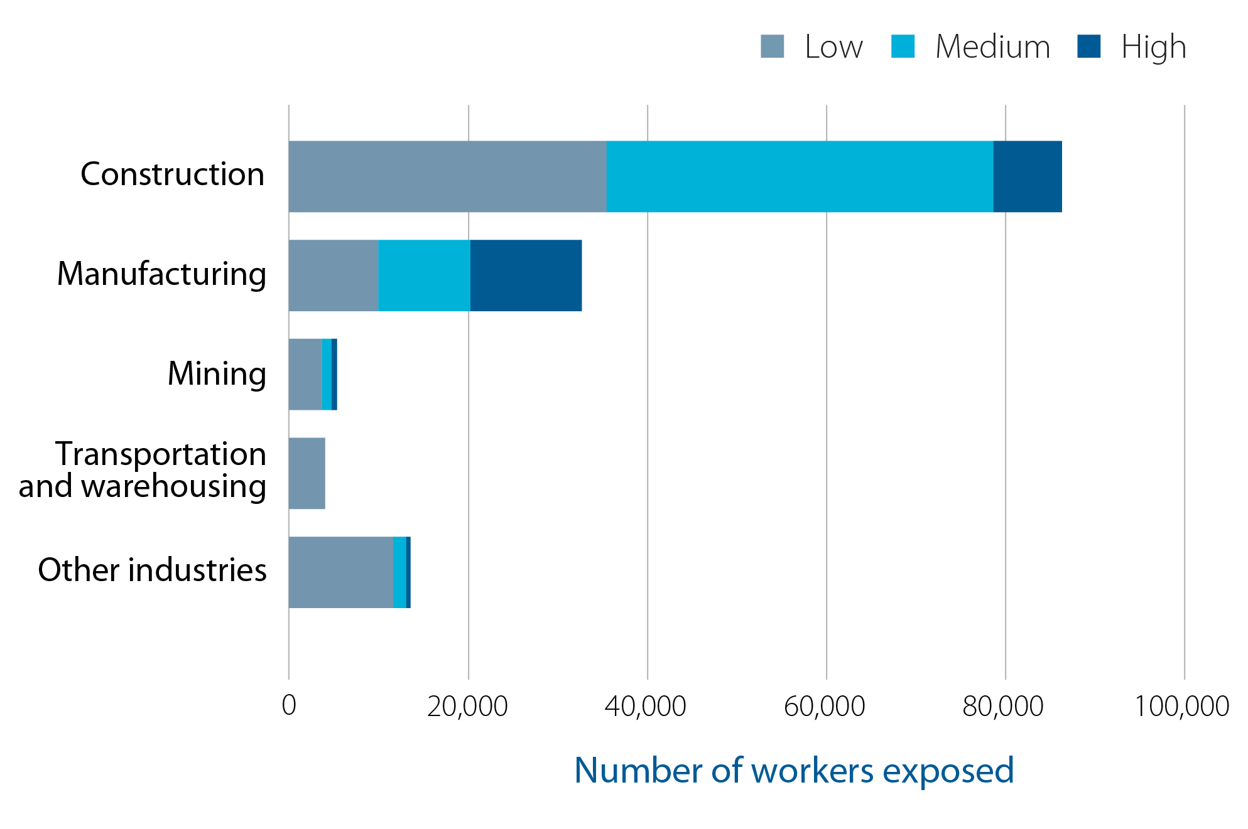
Number of workers occupationally exposed to crystalline silica by level of exposure and industry in Ontario

Slide 13
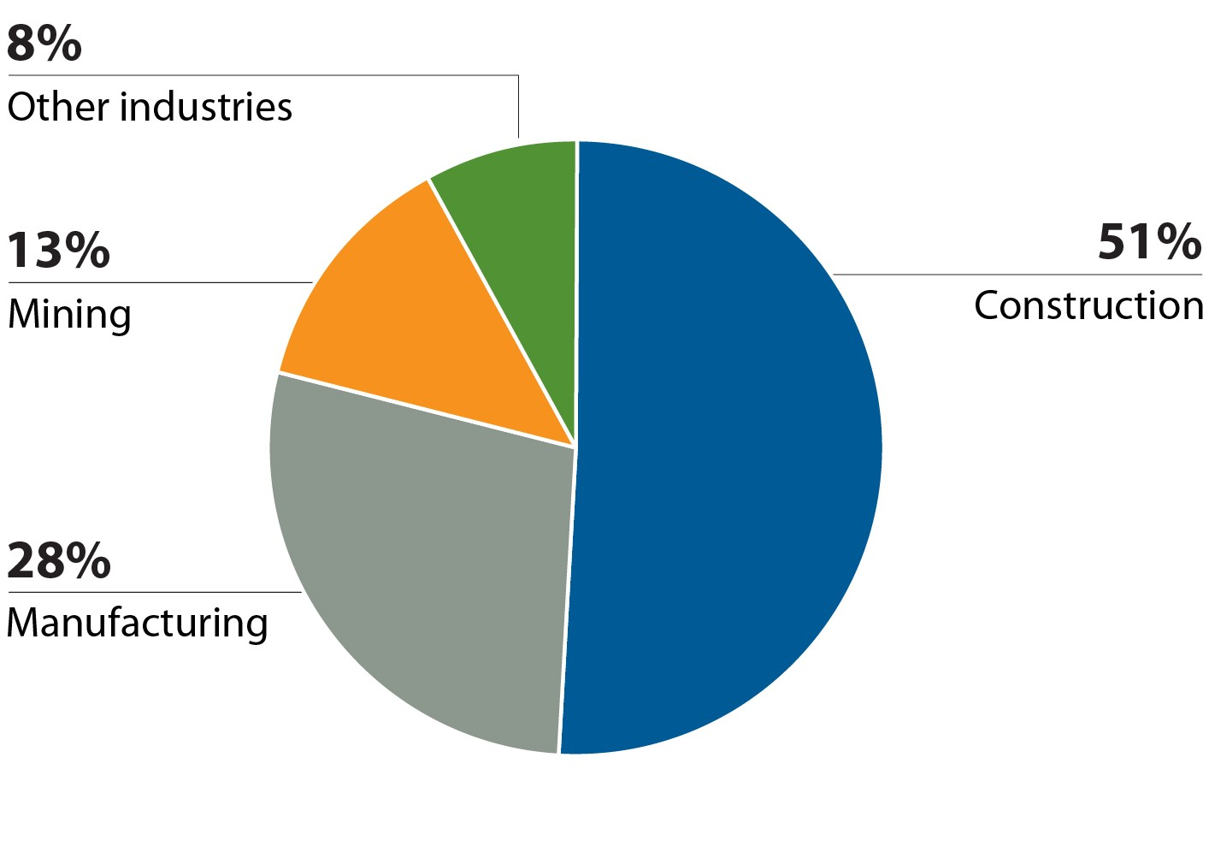
Industry breakdown of total lung cancers attributed to occupational crystalline silica exposure
NOTES:
AF: attributable fraction

Slide 14
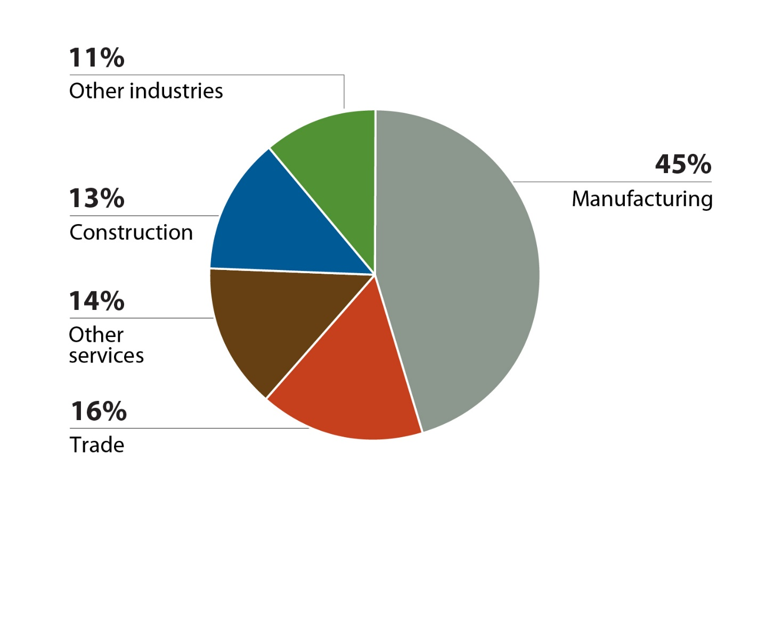
Industry breakdown of total lung cancers attributed to occupational welding fume exposure
NOTES:
AF: attributable fraction

Slide 15
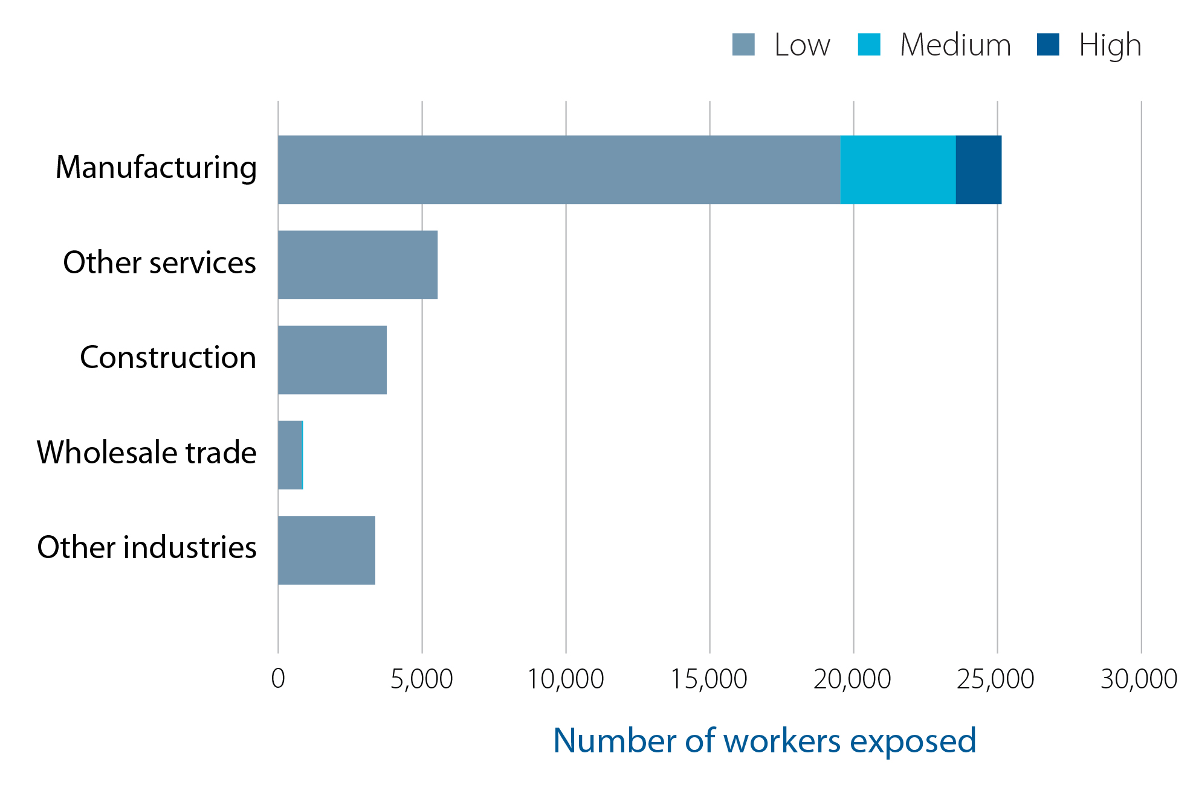
Number of workers occupationally exposed to chromium (VI) compounds by level of exposure and industry in Ontario

Slide 16
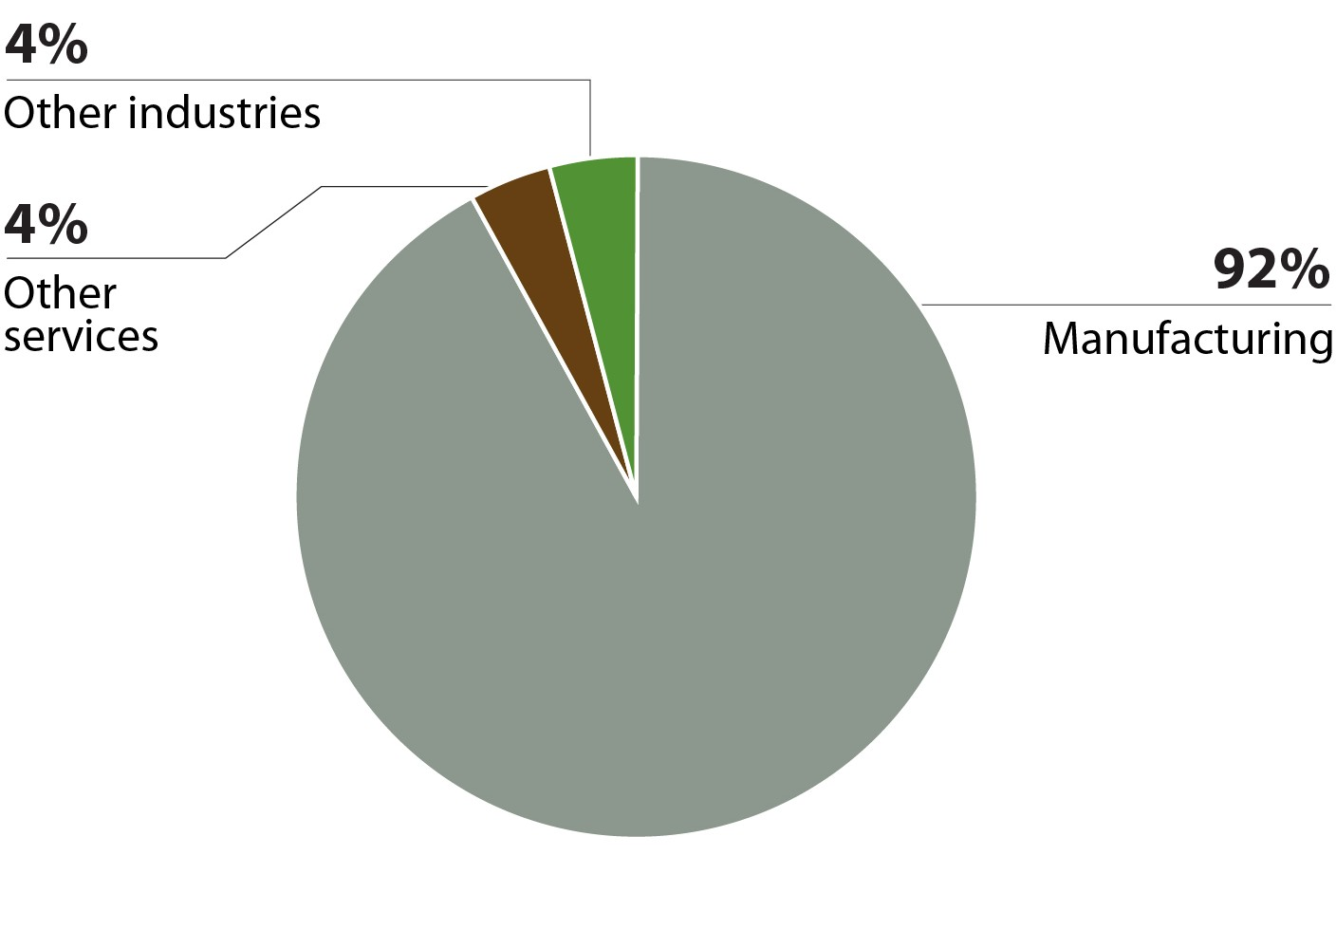
Industry breakdown of total lung cancers attributed to occupational exposure to chromium (VI) compounds
NOTES:
AF: attributable fraction

Slide 17
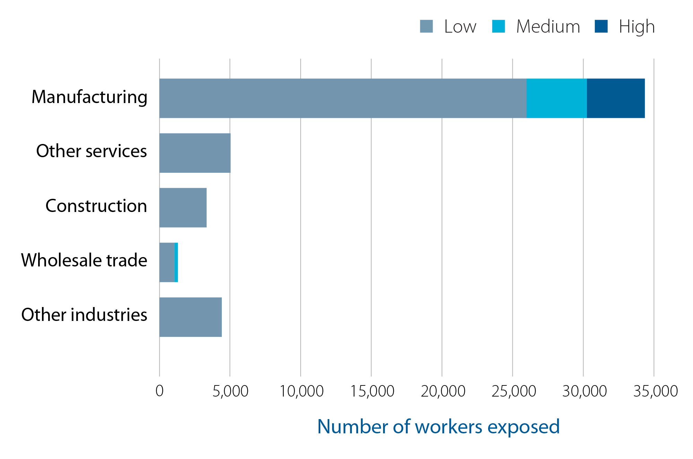
Number of workers occupationally exposed to nickel by level of exposure and industry in Ontario

Slide 18
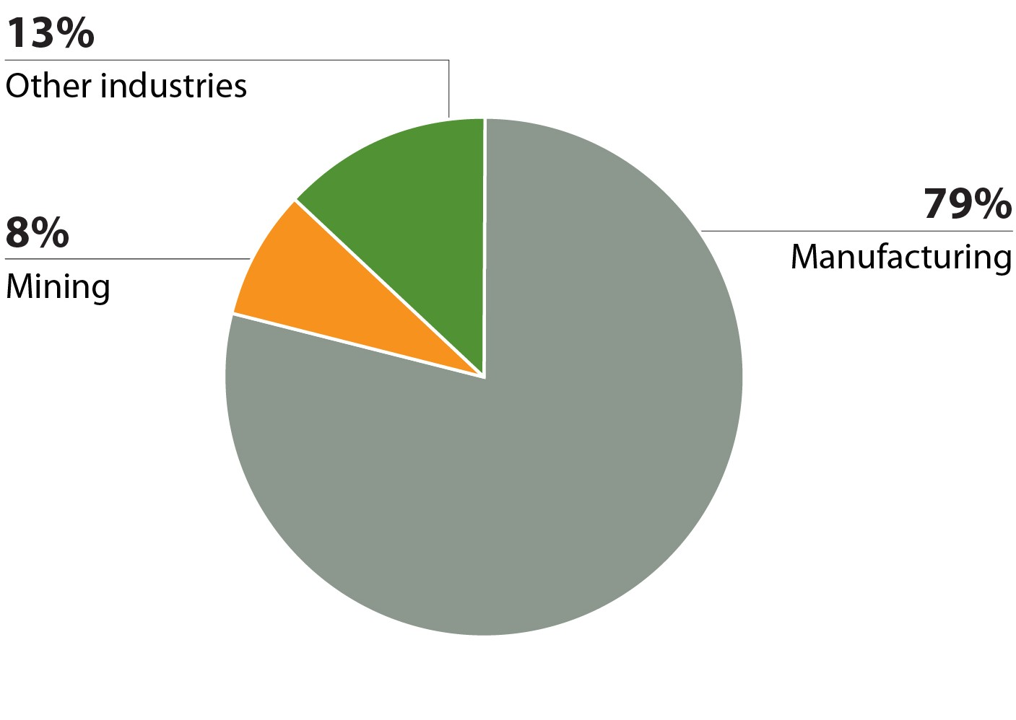
Industry breakdown of total lung cancers attributed to occupational exposure to nickel compounds
NOTES:
AF: attributable fraction

Slide 19
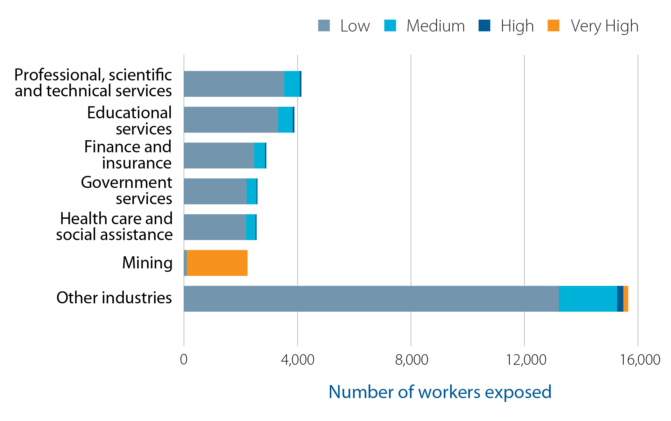
Number of workers occupationally exposed to radon by level of exposure and industry in Ontario

Slide 20
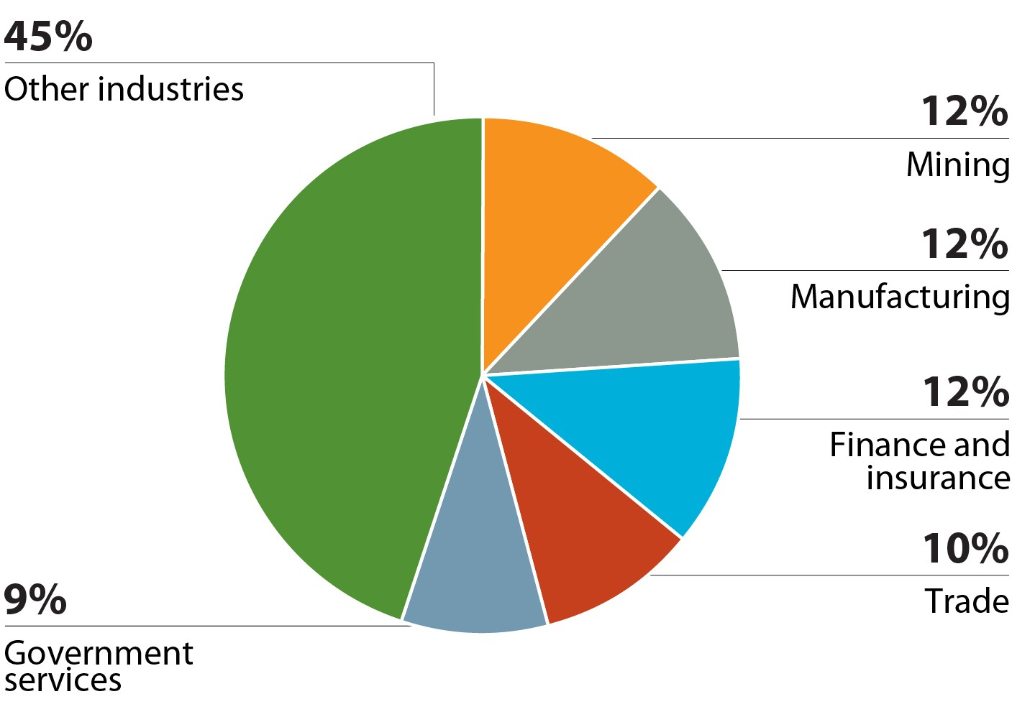
Industry breakdown of total lung cancers attributed to occupational radon exposure
NOTES:
AF: attributable fraction
Burden of Occupational Cancer in Ontario 20

Slide 21
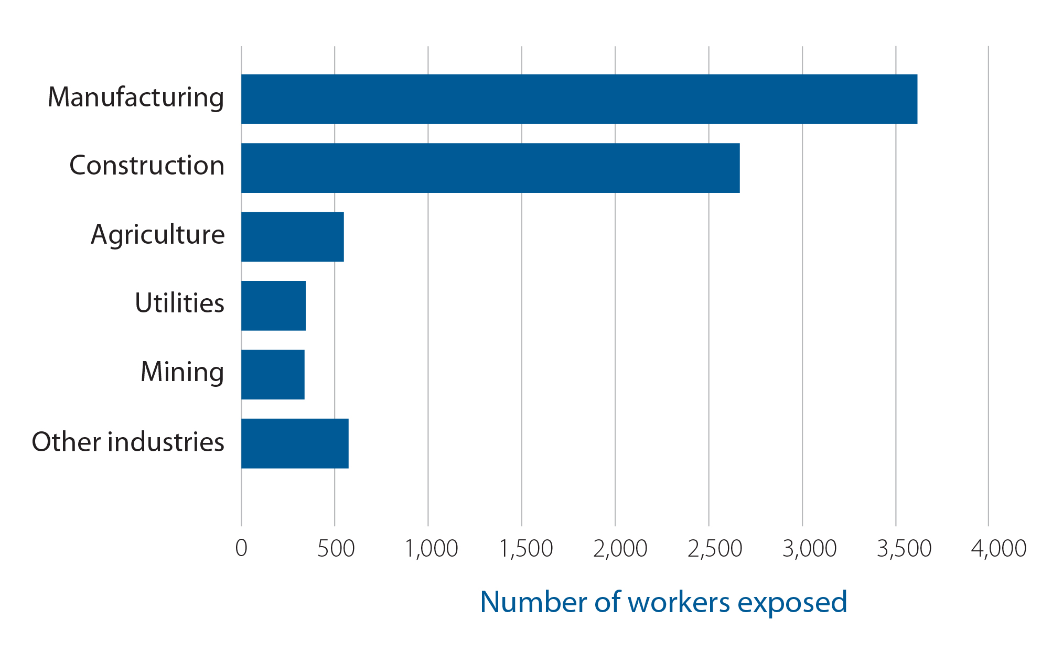
Number of workers occupationally exposed to arsenic by industry in Ontario

Slide 22
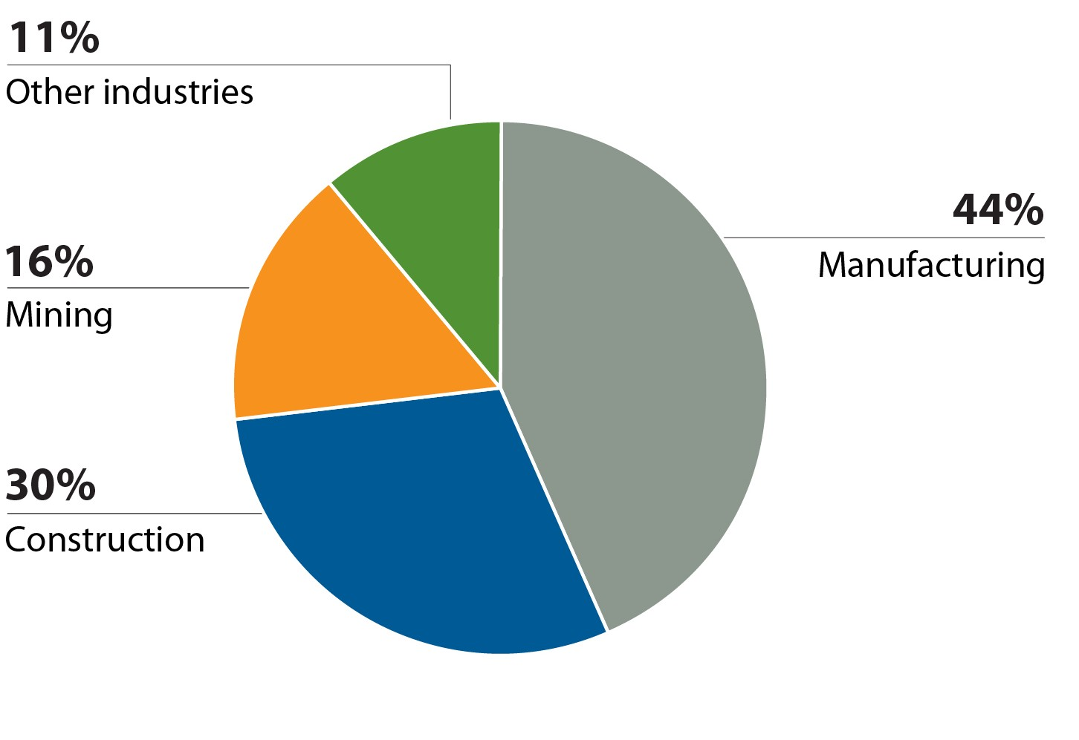
Industry breakdown of total lung cancers attributed to occupational arsenic exposure
NOTES:
AF: attributable fraction

Slide 23
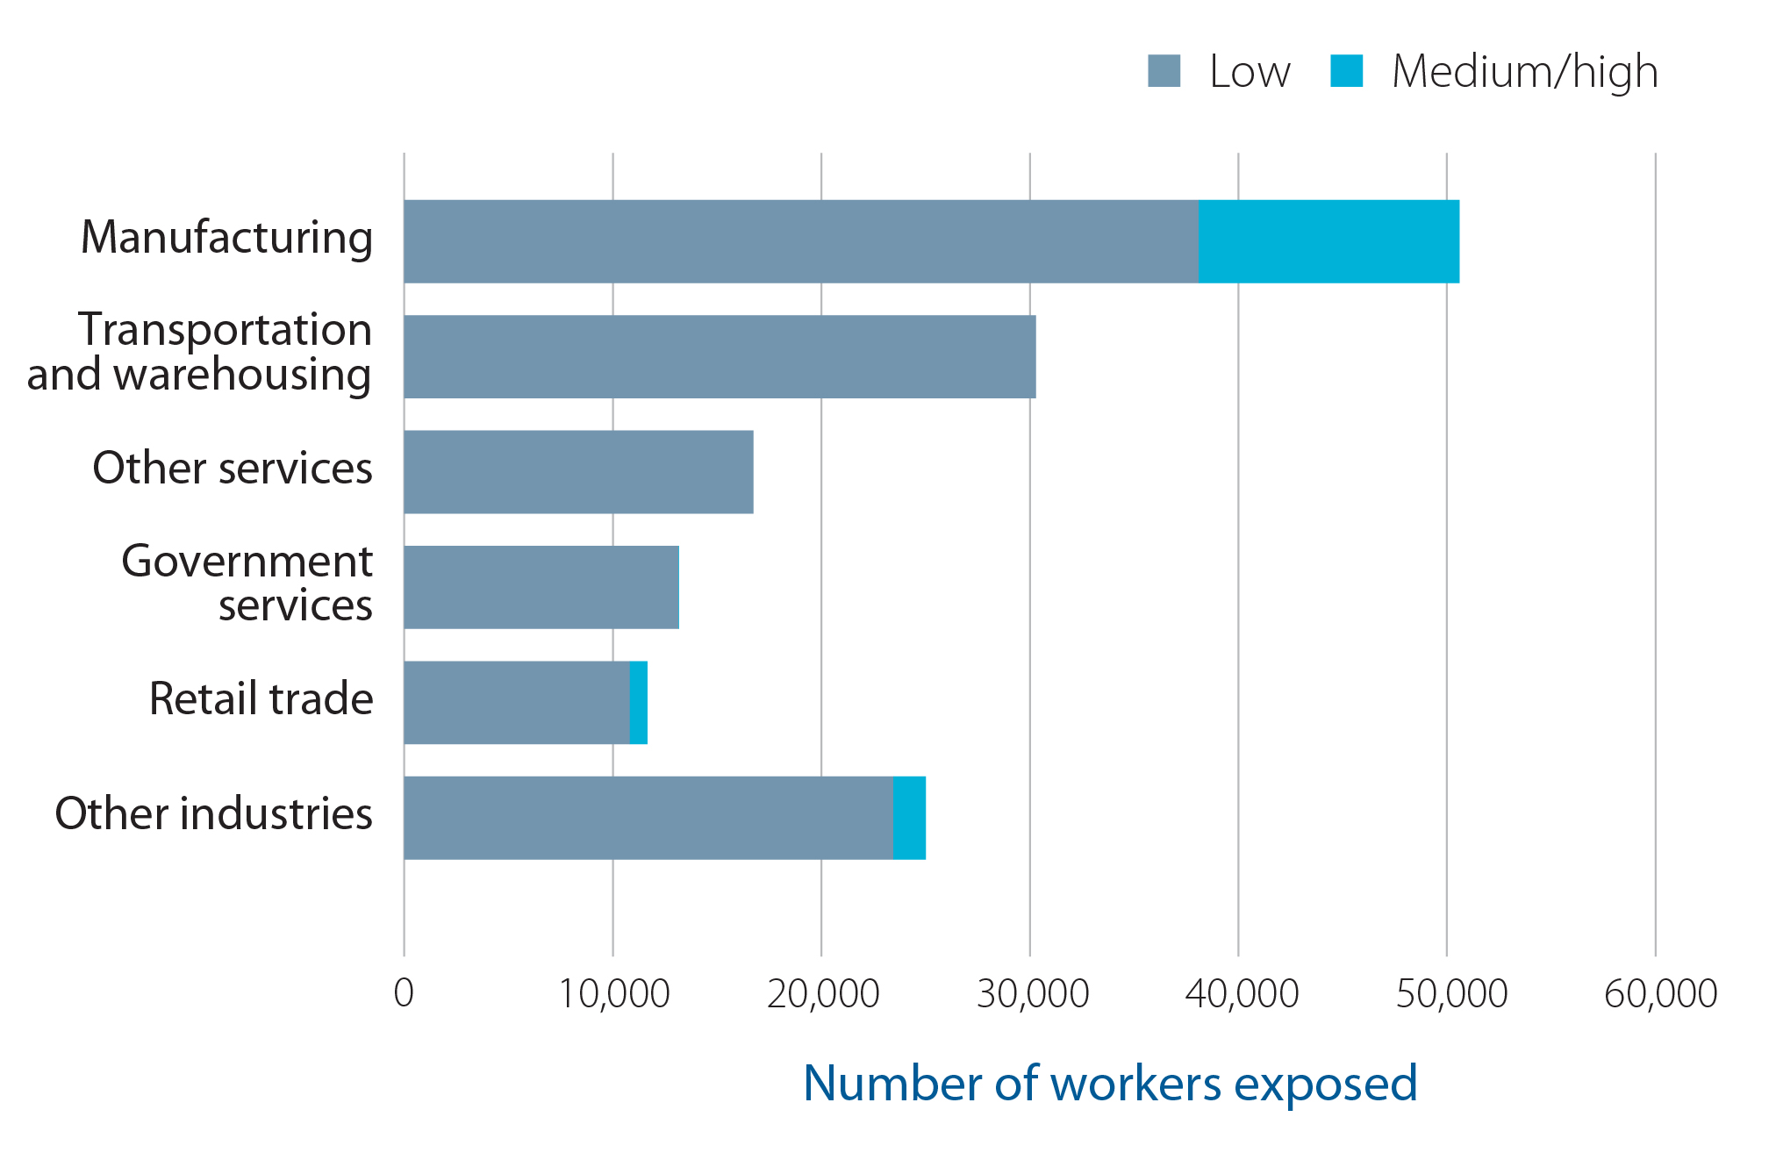
Number of workers occupationally exposed to benzene by level of exposure and industry in Ontario

Slide 24
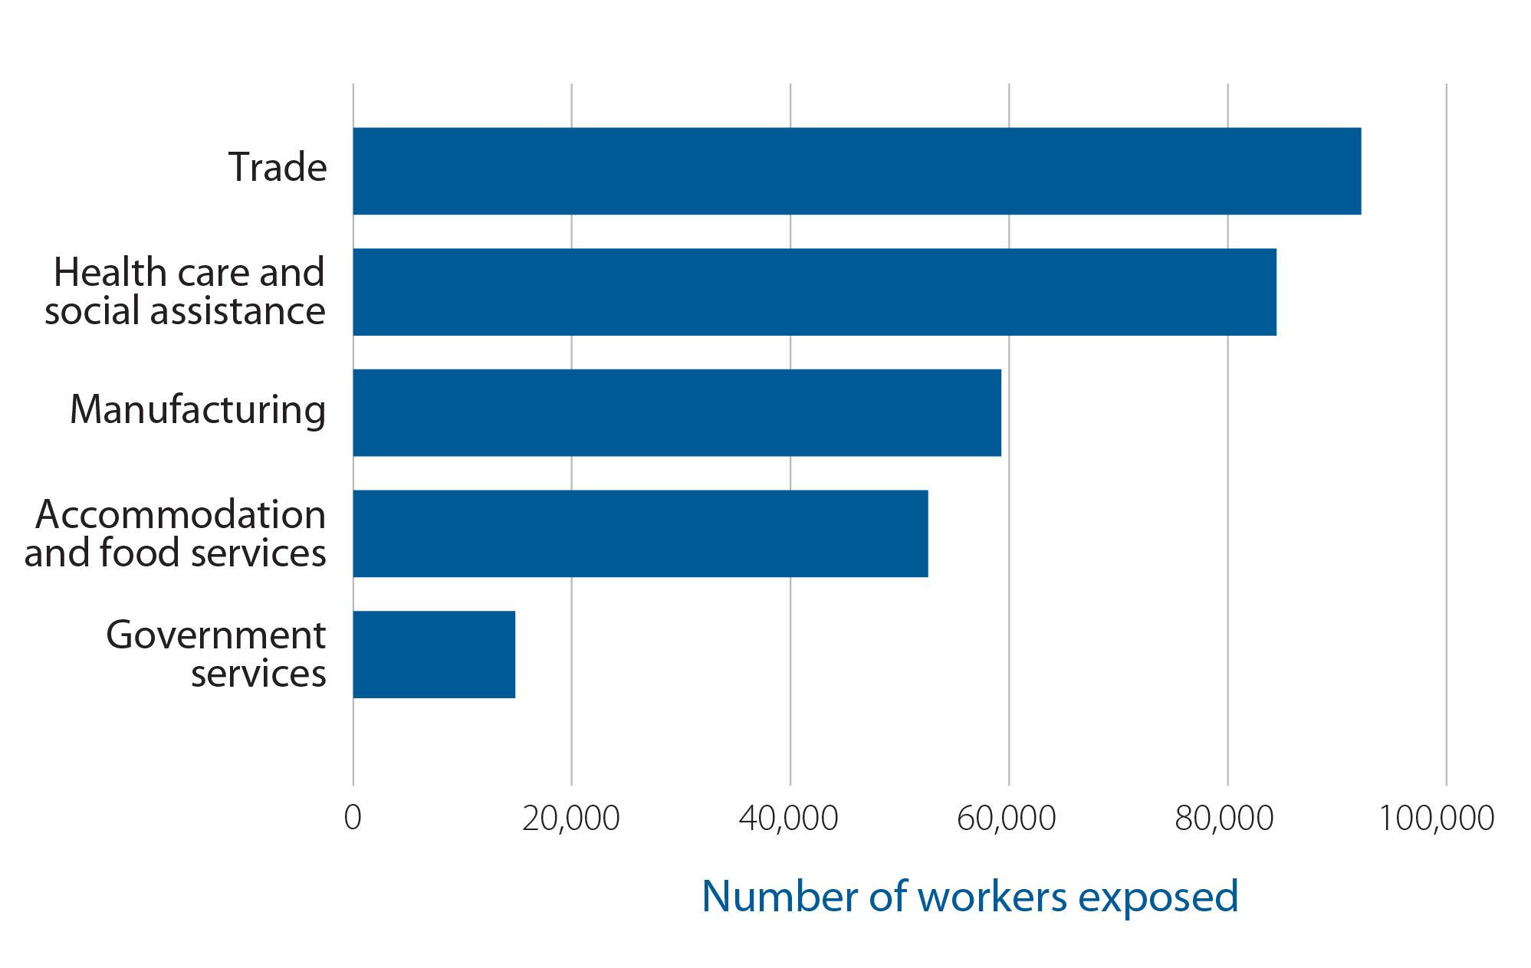
Number of female workers in the top regular night and rotating shift work industries in Ontario
Carcinogens of special interest

Slide 25
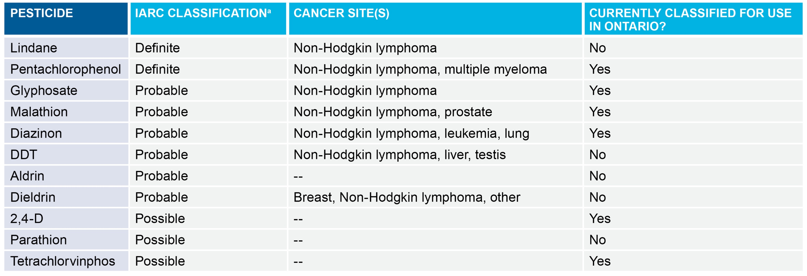
Summary of results of recent evaluations (2015–2016) of pesticide carcinogenicity by the International Agency for Research on Cancer (IARC)
NOTES:
ªDefinite human carcinogen = IARC Group 1, probable human carcinogen = IARC Group 2A, possible human carcinogen = IARC Group 2B
Carcinogens of special interest

Slide 26
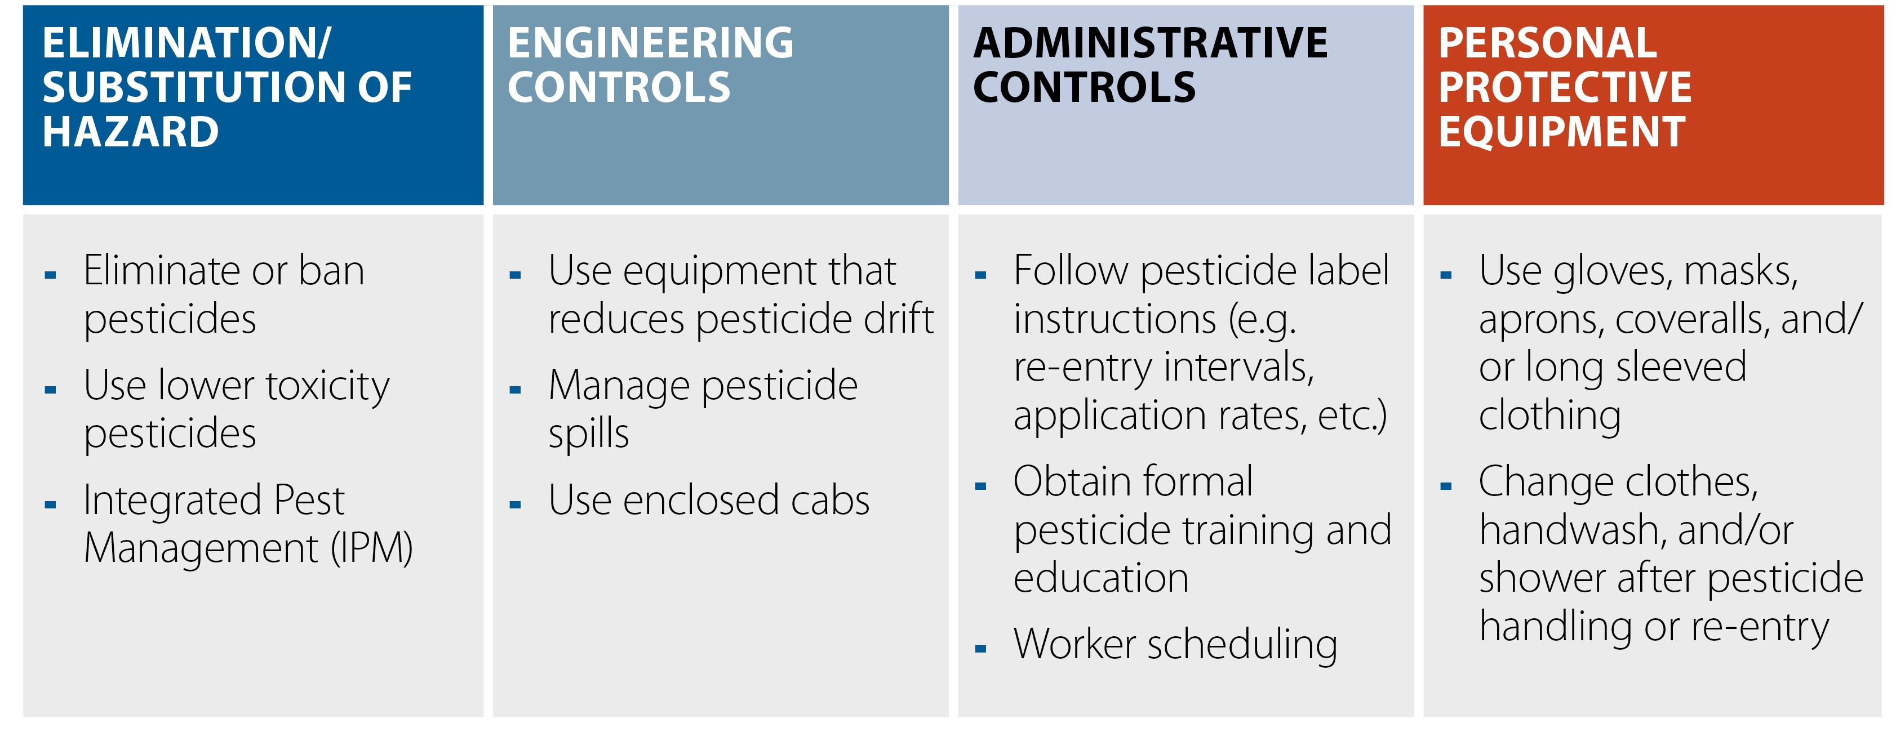
Hierarchy of controlling occupational exposure to pesticides
Carcinogens of special interest

