Slide 1
Volunteer Training Resource
Your Symptoms Matter
March 2023
Please note that this resource is meant to support volunteers at sites that are only offering Your Symptoms Matter –General Symptoms+, Your Symptoms Matter – Prostate, and Your Symptoms Matter – Daily Activities. Sites that are offering PHQ-9 or Your Symptoms Matter – Head and Neck may need to provide additional guidance to their volunteers and can email OH-CCO_SymptomManagement@ontariohealth.ca with any questions.

Slide 2
Symptom Screening
Importance and Purpose of Symptom Screening
Cancer patients can experience many symptoms related to their cancer, that can have a significant impact on their quality of life
Symptom screening is an important way for patients to communicate how they are feeling to their healthcare team
Symptom screening tools are created based on scientific evidence that enables patients to rate their symptom severity across common cancer symptoms
Symptom screening can help patients:
  Communicate about their symptoms with their healthcare team
  Let their healthcare team know when they have symptoms that need urgent support
  Create a plan with their healthcare team to manage their symptoms
  Monitor the changes in their symptoms over time

Slide 3




Your Symptoms Matter (YSM)
Collection of Symptom Screening Responses
YSM is a symptom screening tool that asks about common cancer symptoms to find out how patients are feeling
Depending on the Cancer Centre, patients may be asked to complete YSM through one of the following methods:
Kiosk/Tablet in Clinic
(English & French)
Paper in Clinic (30+ Languages)
Electronic Medical Record (EMR) with Healthcare Provider
Personal Device at Home or Elsewhere

Slide 4
Your Symptoms Matter
Health Provider Response to Symptom Screening
Patients complete YSM on a kiosk, computer, tablet, paper, or personal device either in clinic or at home, prior to their appointment
The symptom scores may be viewed electronically or on paper by the healthcare provider before or during the patient's appointment
Healthcare providers use the symptom scores to identify symptoms of concern, facilitate communication with the patient, and support symptom management

Slide 5



Your Symptoms Matter – Remote/Home
How patients can fill out symptom screening remotely or from home
Patients receive a link to the home channel URL from their care team (e.g., via patient education materials, posters, emails)
Patients report their YSM scores on a personal device 24-48 hours prior to their clinic appointment
Patient scores are viewable via the EMR

Slide 6
Your Symptoms Matter Screening Tools
When logging into Your Symptoms Matter, patients will be prompted to complete one or more of the following screening tools, depending on their symptoms and treatment type (i.e., chemotherapy):
  Your Symptoms Matter – General Symptoms + (ESAS-r +, formerly ESAS-r)
  Your Symptoms Matter – Prostate Cancer (EPIC)
    For prostate cancer patients not undergoing IV chemotherapy
  Your Symptoms Matter – Daily Activities (PFRS)

Slide 7
Frequently Asked Questions (FAQs) for Your Symptoms Matter
If I complete the Prostate Cancer symptom screening tool, do I also have to complete the General Symptoms +?
No, if you complete the prostate cancer screening tool, you do not need to complete Your Symptoms Matter-General Symptoms + if you choose not to.
Why do I not fill in the Prostate Cancer symptom screening tool at each visit?
Depending on your visit frequency, it is not necessary to fill in the prostate cancer symptom screening tool at every visit. The system will prompt you to fill in the screening tool at certain intervals. Should you have any symptoms and want to fill in the screening tool, you can always request one for completion.

Slide 8
FAQs for Your Symptoms Matter
Do I mention only cancer symptoms? What if I have back pain from arthritis?
Please mention all symptoms and concerns. If you are experiencing other symptoms that are not mentioned on the screening tool, please mention them to your health care provider.
How long will this take?
The symptom screening tool will take less than five minutes to complete.
Why do I need to do this?
Completing Your Symptoms Matter can help you:
Communicate about your symptoms with your healthcare team
Let your healthcare team know when you have symptoms that need urgent support
Create a plan with your healthcare team to manage your symptoms
Monitor the changes in your symptoms over time

Slide 9
Your Symptoms Matter –
Self-selection Questions

Slide 10
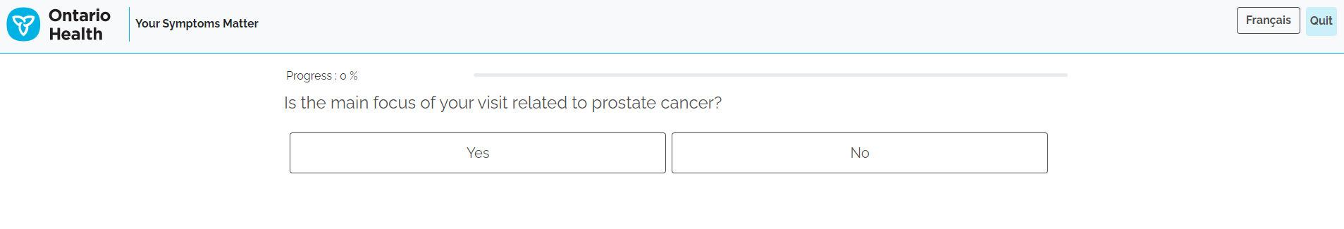
Your Symptoms Matter
Self selection Questions
When a patient arrives at the kiosk, those who identify as an assigned male at birth will be presented with a set of questions to ensure they are receiving the correct screening tool; the system has built-in logic for this process
Why are only people who identify as an assigned male at birth asked the self-selection questions?
The prostate cancer screening tool does not apply to those who do not identify as being assigned male at birth, and/or who do not currently have a prostate. The self-selection questions are designed to ensure patients get the right screening tools. Those who are flagged as an assigned female at birth will get the General Symptoms+ screening tool. The question will appear as follows:
If patients select NO, they will get Your Symptoms Matter – General Symptoms +
If patients select YES, they will be prompted with a follow-up question

Slide 11
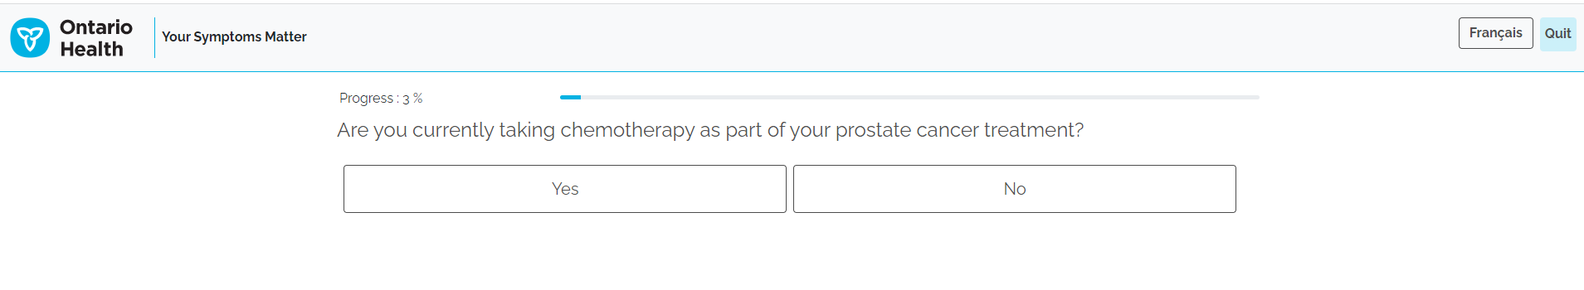
Your Symptoms Matter
Self selection Questions
For a response to the previous question as “Yes”, the following question will appear:
If patients select NO, they will be directed to Your Symptoms Matter – Prostate Cancer (EPIC)
If patients select YES, they will be directed to Your Symptoms Matter – General Symptoms +
These symptom screening tools will be explained in the following slides

Slide 12
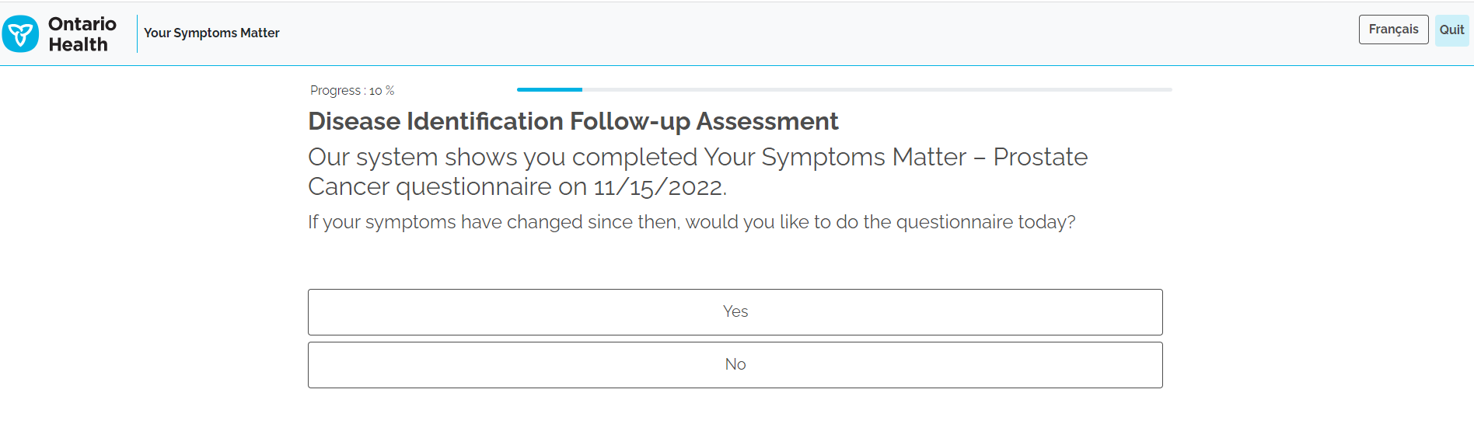
Your Symptoms Matter
Self selection Questions
Should patients qualify to complete Your Symptoms Matter – Prostate Cancer (EPIC) symptom screening tool, they may be prompted with a third and final question that allows them to skip the screening tool if their symptoms have not changed from a recent visit (within 13 days of last completed screening):

Slide 13
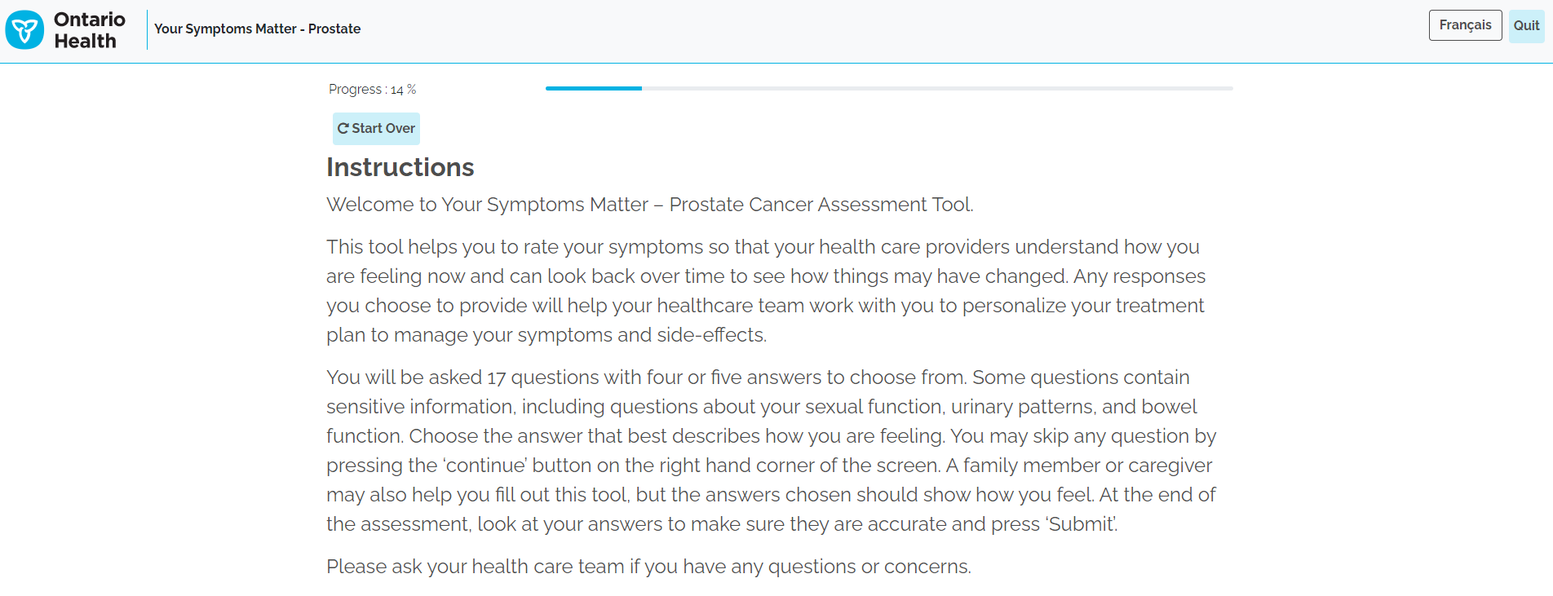
Your Symptoms Matter
How can you help patients with the self selection questions?
Explain to patients why these questions are in place:
  It is important that they are aware that these questions help to provide patients with the correct screening tool and the one most relevant to them
  Listen to their concerns and questions and assist in clarifying any terminology
It is possible to go backwards if a question is selected incorrectly
There is a ‘Start Over’ button available if the wrong screening tool is selected

Slide 14
Your Symptoms Matter – General Symptoms + (ESAS-r +)

Slide 15
Your Symptoms Matter - General Symptoms +
Most patients will complete Your Symptoms Matter – General Symptoms + (ESAS-r +) screening tool (formerly ESAS-r).
  There are 13 multiple choice questions, with each symptom rated on a scale of “0 to 10”
  For each symptom, the patient will choose a number between 0 and 10 that best describes how they are feeling
  A score of “0" means they do not have the symptom, whereas a score of "10" means that their symptom is at its very worst
  It is important for patients to answer the questions from their own perspective. Refrain from offering your own perspective (e.g., giving an example that stubbing your toe might be worth a 3)
The YSM - General Symptoms + symptom screening tool is also available in paper form in over 30 different languages

Slide 16
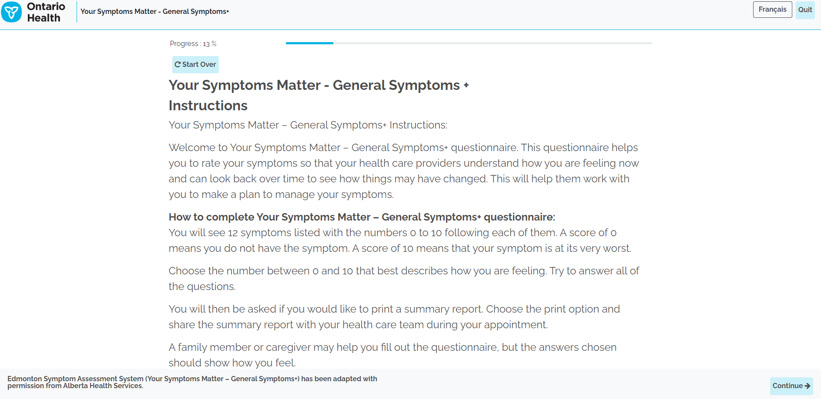
Your Symptoms Matter - General Symptoms +
Screenshots: Your Symptoms Matter – General Symptoms +
Instructions Page

Slide 17
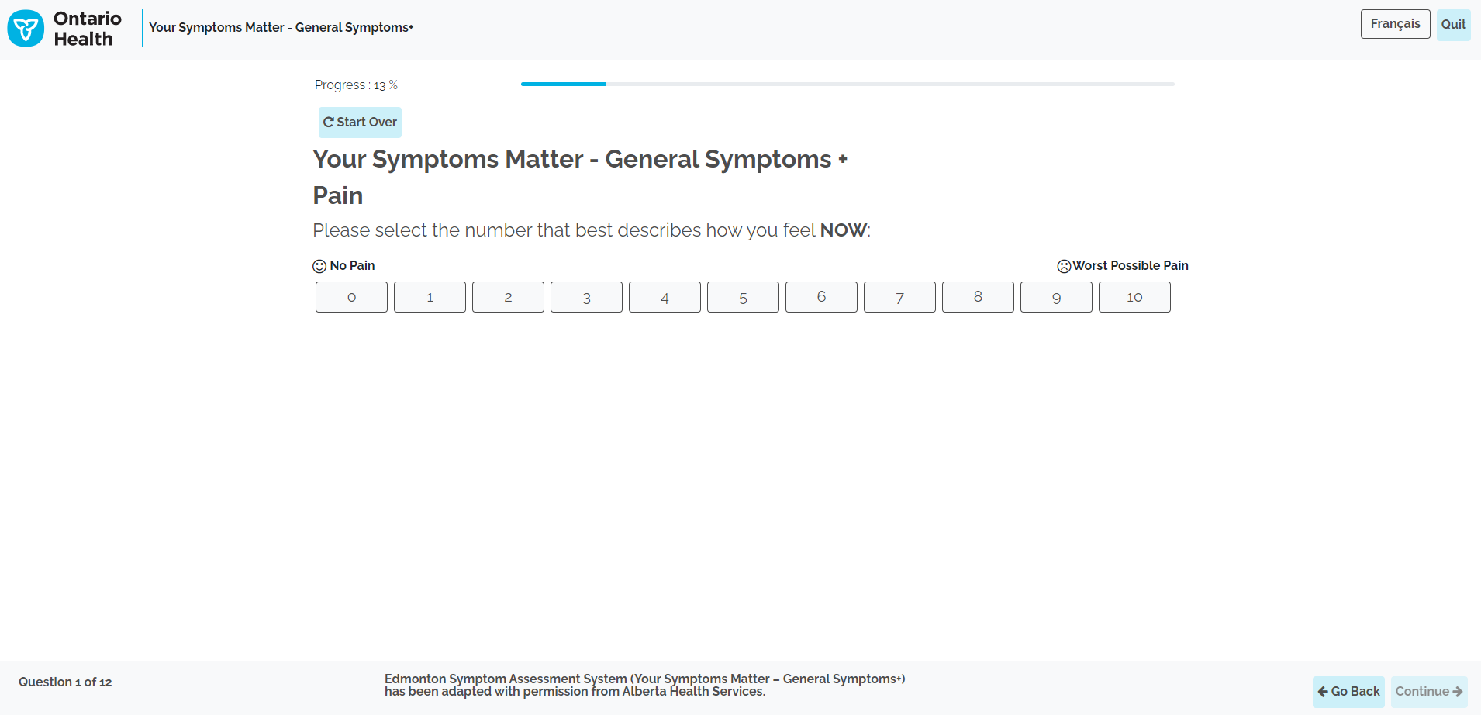
Your Symptoms Matter - General Symptoms +
Screenshots: Your Symptoms Matter – General Symptoms +
Question Example

Slide 18
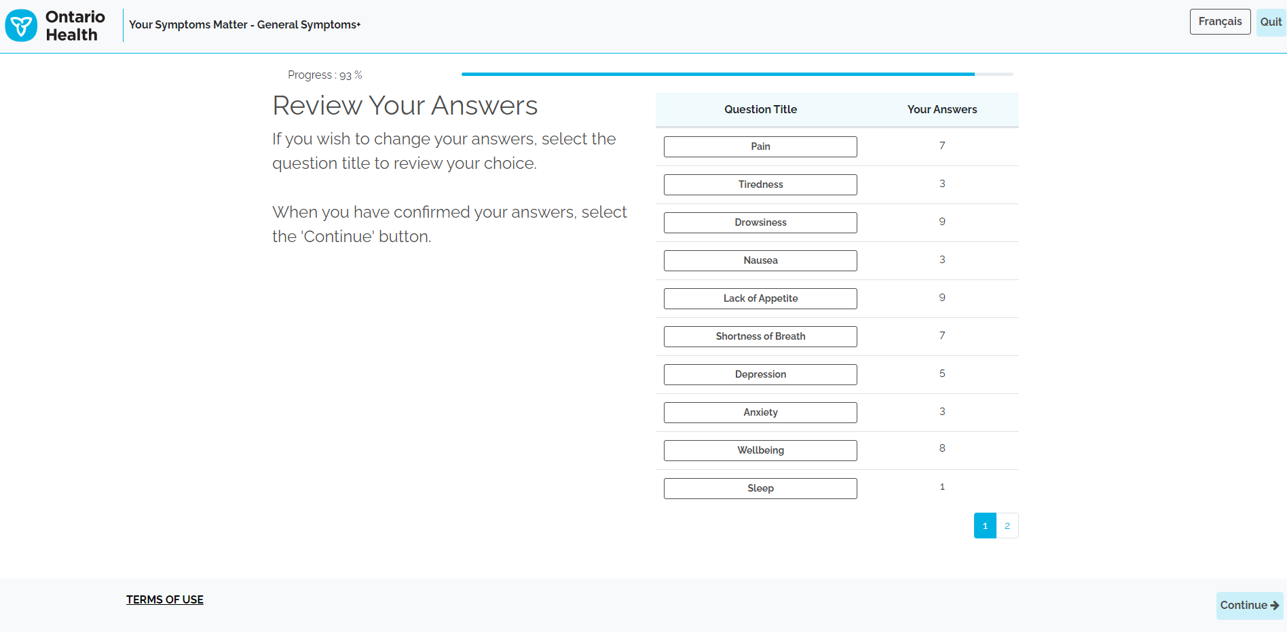
Your Symptoms Matter - General Symptoms +
Screenshots: Your Symptoms Matter – General Symptoms +
Summary Page Example

Slide 19
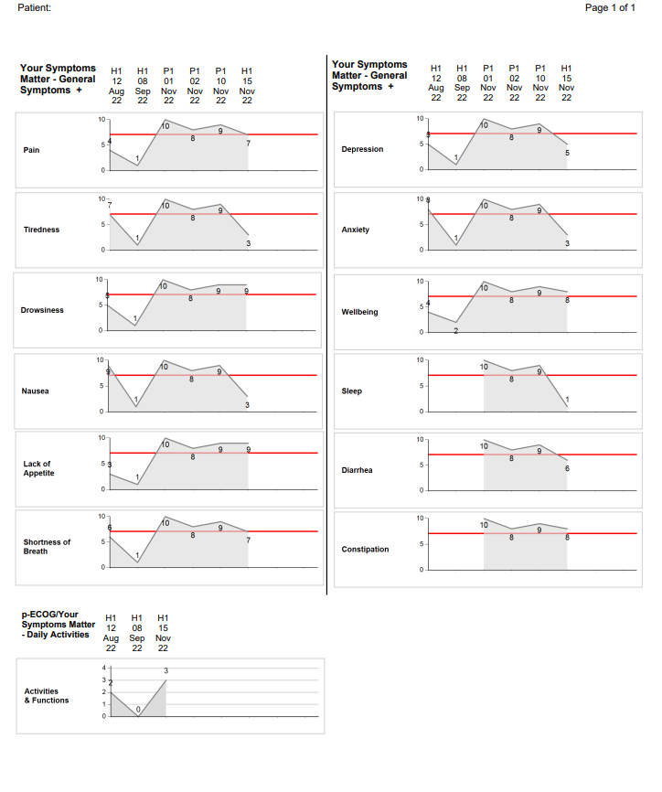
Your Symptoms Matter - General Symptoms +
Screenshots: Your Symptoms Matter – General Symptoms +
The report file will be saved in the patient’s file and should be reviewed with their healthcare team. The healthcare team can access the report through the clinic’s EMR
If the ‘print report’ function is enabled for the kiosk, the report can be printed out at a local printer and shared with the patient and healthcare team
Report Output

Slide 20
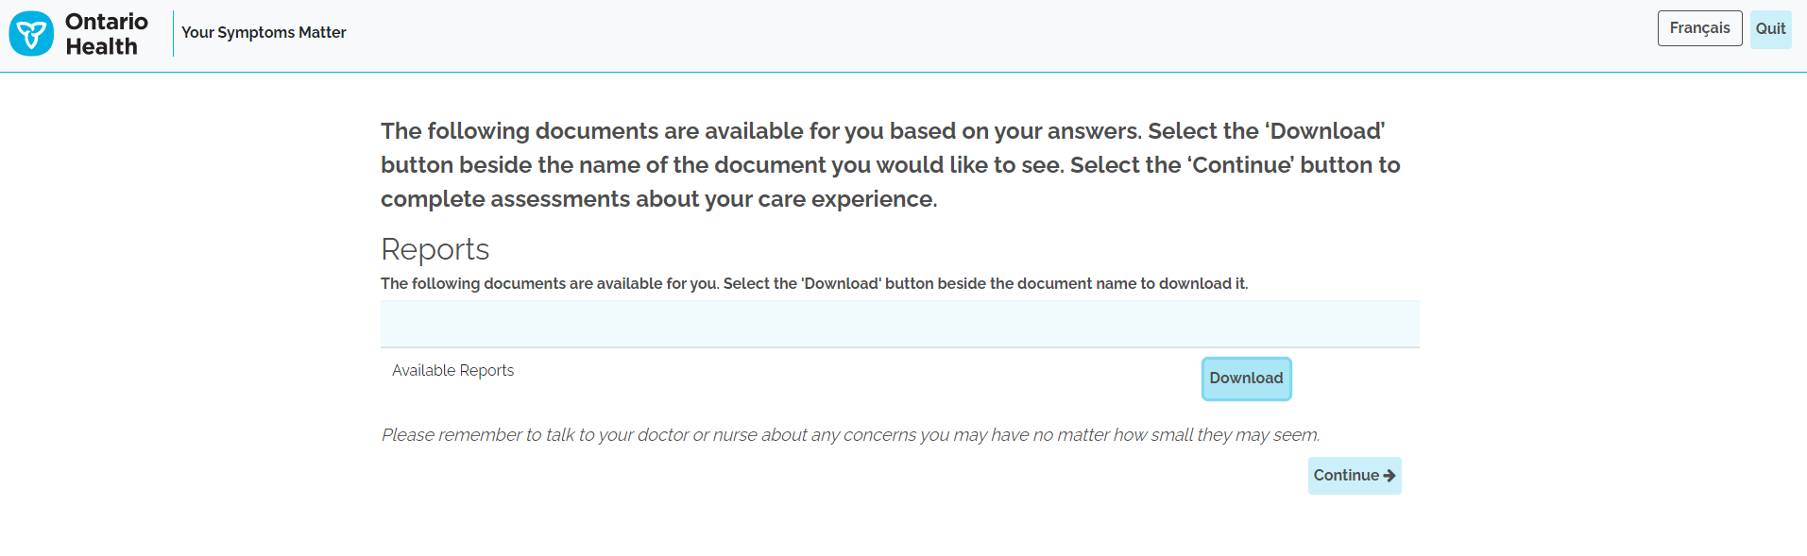
Your Symptoms Matter - General Symptoms +
Home/Remote Completion
Once patients complete Your Symptoms Matter General Symptoms + via home/remotely, a report will be available for the patient to download onto their own personal device or computer.
The report file will also be saved in the patient’s file and should be reviewed with their healthcare team. The healthcare team can access the report through the clinic’s EMR to review at the patient’s appointment.
Download Report

Slide 21
Your Symptoms Matter - Prostate Cancer (EPIC)

Slide 22
Your Symptoms Matter - Prostate Cancer
Through the self-selection questions described previously, people who identify as an assigned male at birth with early-stage prostate cancer will be selected to complete the Your Symptoms Matter – Prostate Cancer (EPIC) symptom screening tool
  There are a total of 17 multiple choice questions with four or five possible answers
The symptom screening tool discusses symptoms in the following domains:
  Bowel symptoms
  Urinary irritation/obstruction symptoms
  Urinary incontinence symptoms
  Vitality/hormone symptoms
  Sexual function symptoms
The Prostate Cancer symptom screening tool (EPIC) is also available in paper form in over 35 different languages

Slide 23
Your Symptoms Matter - Prostate Cancer
Sensitive nature of some questions
Since the prostate cancer screening tool addresses sensitive topics like sexual function and vitality/hormone symptoms, it is important to be aware of the content of these questions
These questions cover topics such as:
  Orgasms
  Erections
  Hot flashes
  Urinary incontinence
It is important to be mindful that patients may feel uncomfortable having anyone close by while filling in the symptom screening tool
Patients may also feel uncomfortable asking questions

Slide 24
Your Symptoms Matter - Prostate Cancer
Sensitive nature of some questions
While these are sensitive topics, they are also very common experiences among people with prostate cancer
It is important for patients and health care teams to have the opportunity to discuss them
Without being too specific, you can help normalize some of these symptom for patients by saying something along these lines:
  “These symptoms are common for patients with prostate cancer. Some of the questions are personal. Do your best to answer the questions honestly. There is an option to skip a question if you wish. I’m going step away to give you some privacy.”

Slide 25
Your Symptoms Matter - Prostate Cancer
Sensitive nature of some questions
Tips about assisting patients with the Your Symptoms Matter – Prostate Cancer symptom screening tool:
  Offer support and comfort
  Do not read the question out loud
  Bring the patient aside to explain what the question is asking
  If patients are concerned with privacy, there are paper copies of the questionnaire available in 35 languages. They can fill this out on their own or with their healthcare provider

Slide 26
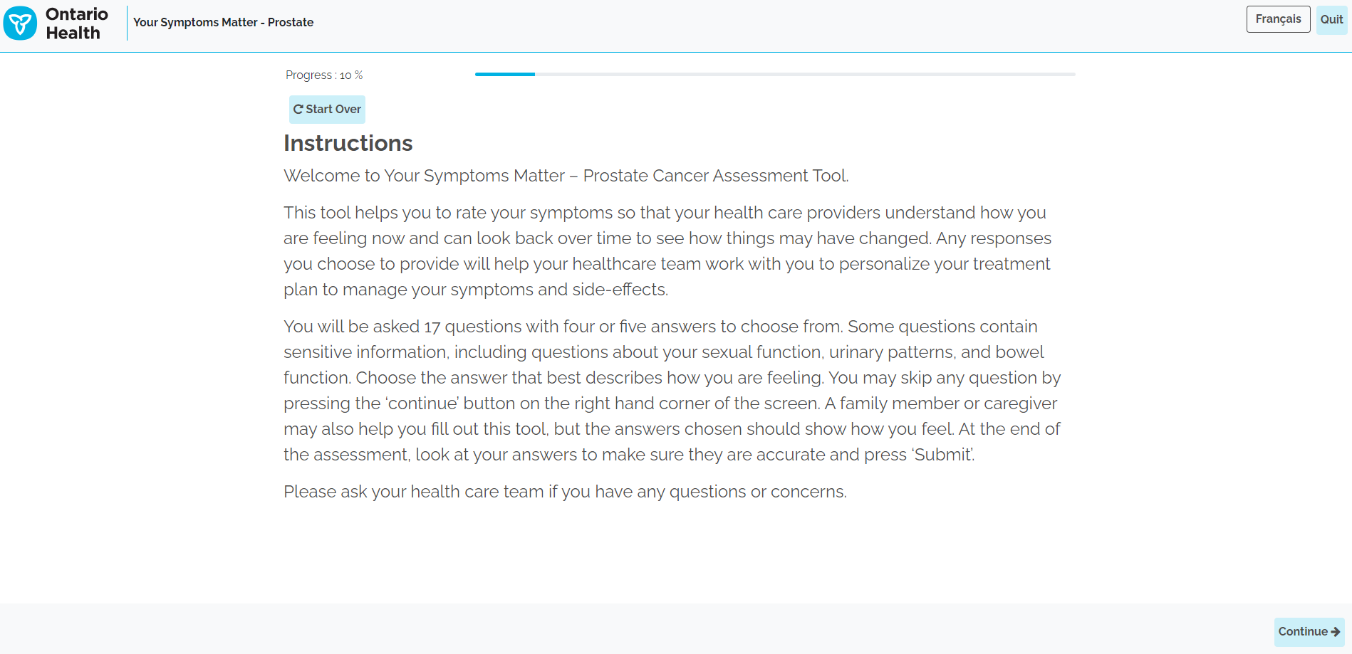
Your Symptoms Matter - Prostate Cancer
Screenshots:
Instructions Page

Slide 27
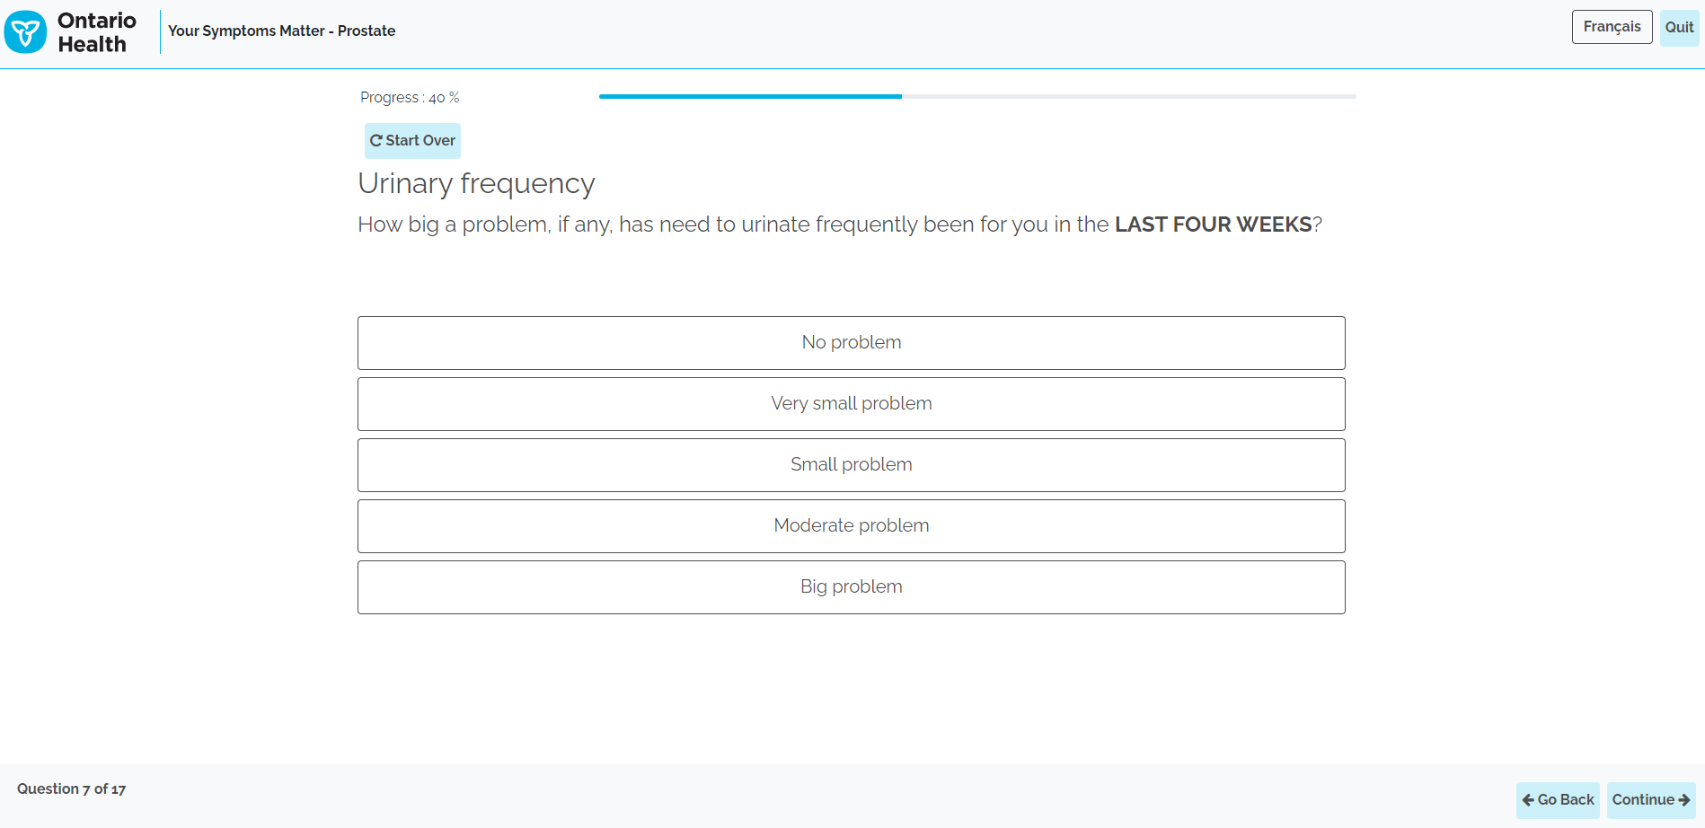
Your Symptoms Matter - Prostate Cancer
Screenshots:
Please note, should patients realize that the incorrect screening tool was selected, the Start Over button is available with all questions
Example of Question

Slide 28
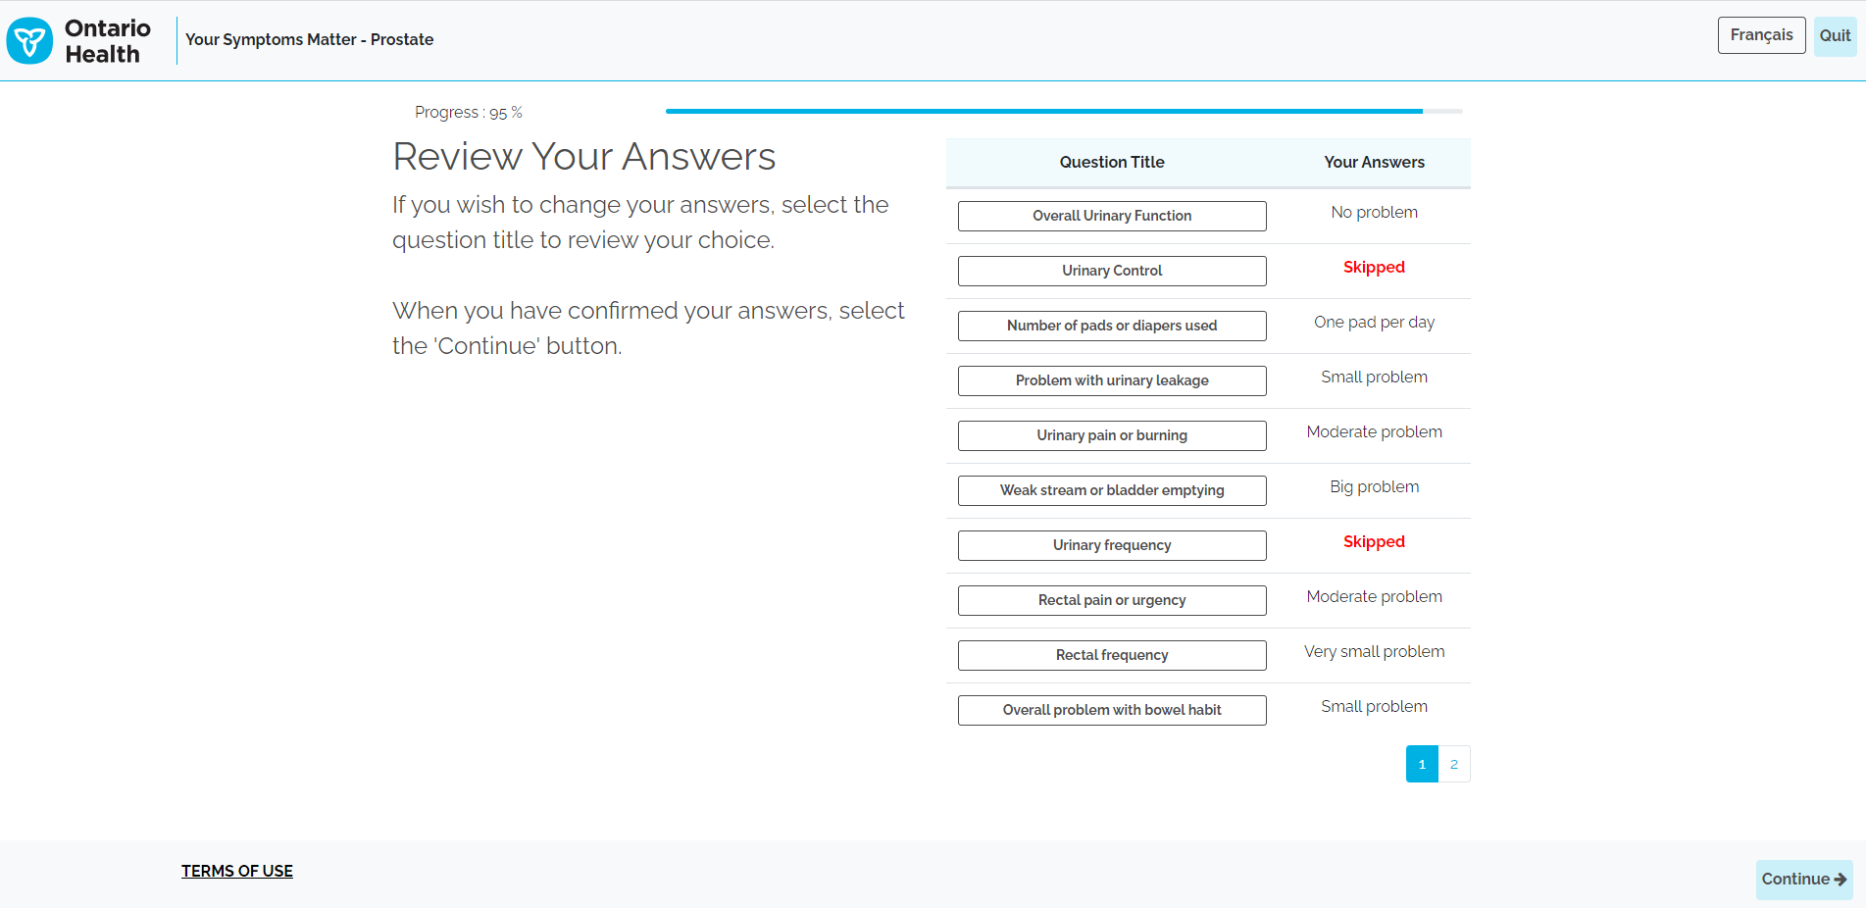
Your Symptoms Matter - Prostate Cancer
Screenshots:
Example of Summary Page

Slide 29
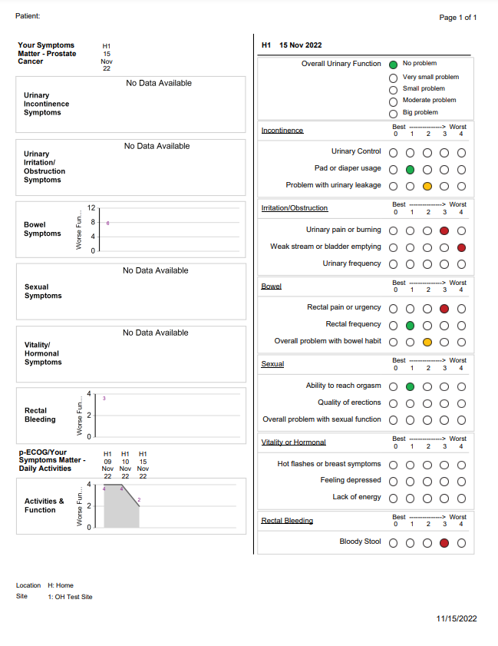
Your Symptoms Matter - Prostate Cancer
Screenshots:
The report file will be saved in the patient’s file and should be reviewed with their healthcare team. The healthcare team can access the report through the clinic’s EMR
If the ‘print report’ function is enabled for the kiosk, the report can be printed out at a local printer and shared with the patient and healthcare team
Report Output

Slide 30
Your Symptoms Matter- Daily Activities (PRFS)

Slide 31
Your Symptoms Matter - Daily Activities (PRFS)
All patients will be asked to complete Your Symptoms Matter – Daily Activities (PFRS)
This screening tool will be probed at the end of Your Symptoms Matter – General Symptoms + (ESAS-r +) and Your Symptoms Matter – Prostate Cancer (EPIC)
This screening tool consists of one question and asks patients to rate their daily functions and activity levels

Slide 32
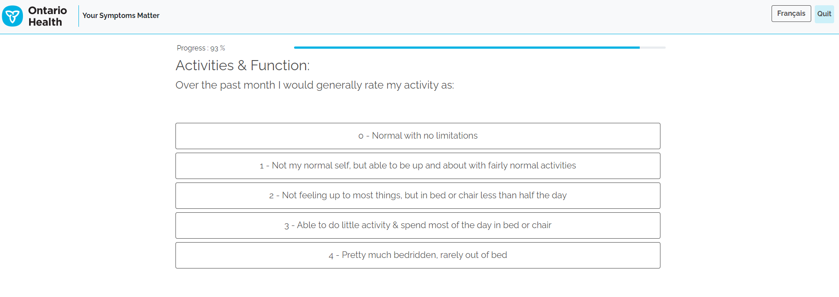
Your Symptoms Matter - Daily Activities (PRFS)
Question

Slide 33
Your Symptoms Matter:
Volunteer Role

Slide 34
Your Symptoms Matter - Volunteer Role
Your Symptoms Matter is completed by patients prior to their appointments, with volunteer assistance as required
Your role is to help patients complete the assessment by providing support and education
Symptom scores are flagged for patients who need extra assistance

Slide 35
Your Symptoms Matter - Volunteer Role
How to be a good listener
EMPATHIZE: Put yourself in the other person’s shoes, this is different then sympathy
STAY IN THE MOMENT: Focus on listening vs. formulating your response
MAKE UNDERSTANDING YOUR GOAL: Allow people to elaborate and explain themselves as needed. Focus on understanding what the patient/family is saying, meaning and feeling and why it is important to them
LISTEN ACTIVELY: Check your understanding by repeating back the main points as you’ve heard them
BE AWARE of ASSUMPTIONS: Avoid assuming, check it out
LISTEN FOR WHAT IS MISSING: What information or emotion has been left out that could give you a clearer picture?

Slide 36
Your Symptoms Matter - Volunteer Role
How to be a good listener
DON’T RUSH IN TO soothe, fix, or advise
BE AWARE OF YOUR IMPACT: Notice patient’s responses to your interactions and feedback and adapt accordingly
DON’T offer false reassurance (e.g., everything will be all right…), or defend (e.g., but Dr./Nurse/Social Worker X is very skilled)
DON’T tell people what to do or how to feel (e.g., Think positive, Don’t worry)

Slide 37
Your Symptoms Matter - Ensuring Privacy
All volunteers assisting in Your Symptoms Matter are trained
Avoid situations of reading questions out loud (provide paper forms or direct to kiosk/tablet)
Offer a private room where possible
Ensure there is a privacy barrier for patients to feel safe and comfortable, if possible

Slide 38
Your Symptoms Matter - Accessing Kiosks
Patients check in with reception and are directed to the kiosks.
Greet patients by the computer and introduce Your Symptoms Matter.
  ‘Your Symptoms Matter helps your health care team know how you are feeling’.
Patients will then swipe their health card at the kiosk, where patients who identify as an assigned male at birth will be directed to the self-selection process, and all other patients are directed to Your Symptoms Matter - General Symptoms + (ESAS-r +)

Slide 39
Completion of Your Symptoms Matter
Remind patients to take their printout or scores to their health care provider (if print out is available)
Remind patients to not forget their health card
Offer hand sanitizer to maintain cleanliness of area

