Slide 1
Appendix C
Lung Module

Slide 2
Disclaimer
This learning module was created as starting point for each cancer centre to implement as part of IGRT Education in their radiation department.
The material included may not be suitable in every clinical environment.
This module is designed to be adjusted to include your centre’s site specific policies and procedures.
This material was developed by members of the Radiation Therapy Community of Practice – IGRT Education Group.

Slide 3
Introduction
IGRT is a method used on the treatment units to improve the delivery of radiation treatment (Conventional, IMRT and VMAT plans)
Allows better targeting of the tumor location while avoiding nearby healthy tissue immediately prior to radiation treatment each day

Slide 4
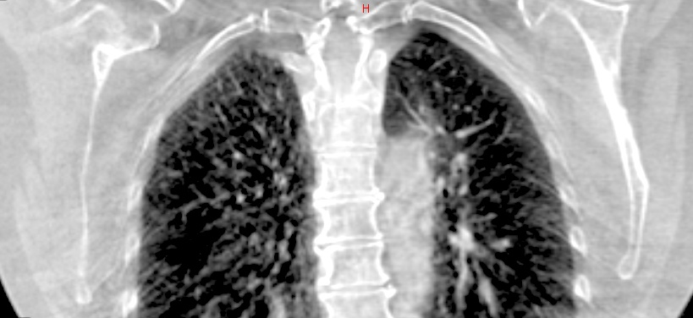
Cross Sectional Anatomy
Left lung
Right lung
Trachea
Carina
Esophagus
Spinal cord
Aorta
Inferior Vena Cava
Superior Vena Cava
Right and left atrium
Right and left ventricles
Ribs
T1-T12
Clavicles
Body of sternum
Xiphoid process
Brachial Plexus
Diaphragm
Thoracic Lymph Nodes
Notes:
Selected these from Appendix A: Cross Sectional Anatomy Review. there are so many structures in the thorax, we can delete some

Slide 5
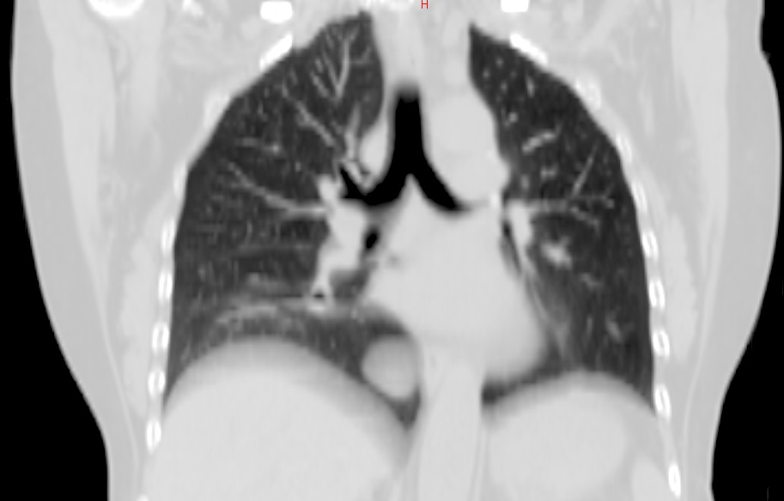
Region of Interest
Lung
Contralateral lung
Spinal canal/cord
Heart
Esophagus
Carina
Sternum
Ribs
Thoracic Lymph Nodes
Brachial Plexus
Notes:
Will check lymphatics textbook at home

Slide 6
Machine Parameters
Varian
kV imaging
CBCT
Elekta
kV imaging
CBCT

Slide 7
Machine Parameters - Varian
KV/KV matching
Orthogonal images taken using KV imager
CBCT matching
Full Scan vs Half Scan, using KV source & detector
Bowtie Filter
The type of imaging used for lung is centre specific, usually daily KVs or daily CBCT. MV imaging would most likely only be used if no other imaging modality is available

Slide 8
kV Imaging-Varian
Depending on the centre, a possible option is daily orthogonals with or without a weekly CBCT
2D/2D matching can be done using the dynamic or optimized filter to best view the anatomy
Matching to bony anatomy

Slide 9
CBCT Imaging- Varian
Depending on the centre, a possible option is daily CBCT or a weekly CBCT combined with kVs
3D matching is used, a half fan or full fan can be used depending on what anatomy needs to be visualized
Matching to bony anatomy and soft tissue (centre-specific)

Slide 10
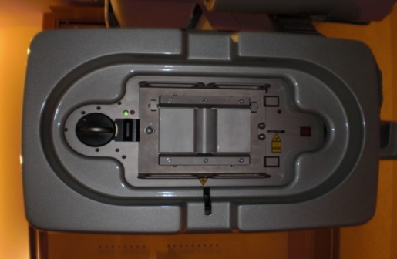
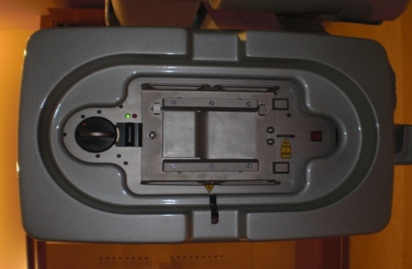
CBCT Imaging Parameters-Varian
There are 2 types of scans and filters:
Full scan: 360 ° with half bowtie filter (gantry starts at 178 ° or 182 °, creates a smaller field of view, kV imaging panel is central
Half scan: 200 ° with full bowtiefilter(gantry starts at 22° or 182 °), creates a larger field of view, kV panel is offset 14.8 cm laterally
Full Bowtie Filter
Half Bowtie Filter

Slide 11
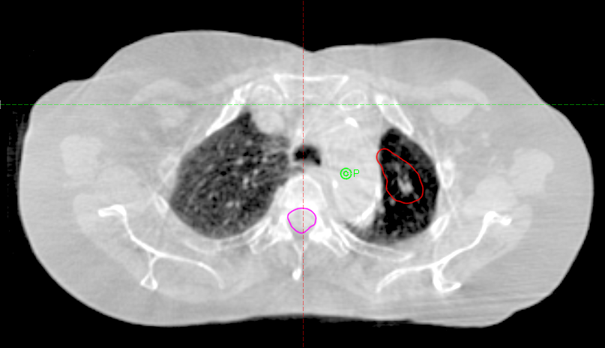
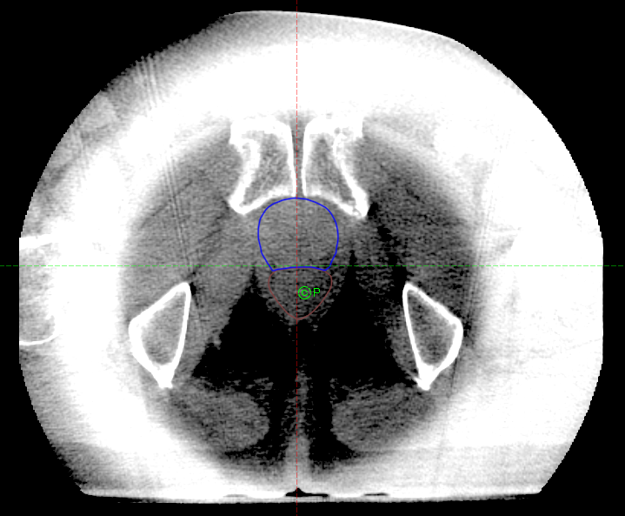
CBCT Imaging Parameters- Varian
The type of CBCT scan used will vary from centre to centre depending on the anatomy that needs to be visualized. A full scan of the thorax will produce better visualization of any peripheral structures, while a half scan captures a smaller, central area of interest and has a ring artifact peripherally
Half scan, full bowtie: Prostate, note the ring artifact caused by the steep dose gradient from the x-ray beam is going through two areas on the filter
Full scan, half bowtie: Lung, able to visualize the peripheral PTV (red) and spinal canal (pink)
Notes:
I don’t have access to a lung that was scanned with a full fan as our centre’s protocol is to use a half fan only, so I had to put a picture of a prostate

Slide 12
CBCT Imaging Parameters-Varian
One of the available CBCT presets can be used for the CBCT scan
Low-Dose Thorax is a possible option:
half filter
full 360 ° scan
dose of 0.47cGy/scan
slice thickness centre-specific
Depending on the centre, a manual or automatic match (usually to the spine) with a clipbox can be done

Slide 13
A clip box can be used for an automatic match to outline the area of interest that will be matched. The settings for the clipbox will be centre specific. This example is an auto-match to the spine, setting the clipbox around the spine in all three dimensions.

Slide 14
Machine Parameters- Elekta
kV/kV matching
Orthogonal images taken using kV imager
CBCT matching
Full Scan vs. half Scan, using kV source & detector
Various filters and collimators can be used.
The type of imaging used for lung is centre specific usually daily kVs or daily CBCT. MV imaging would most likely only be used if no other imaging modality is available

Slide 15
kV Imaging-Elekta
Depending on the centre, a possible option is daily orthogonal images with or without a weekly CBCT
2D/2D matching can be done using template matching with iView software
Matching to bony anatomy

Slide 16
CBCT Imaging- Elekta
Daily CBCT imaging is the preferred option, allowing for soft tissue visualization and daily verification of patient positioning
Full scans allow for improved image quality. Scans can be sped up (1 minute vs. 2 minutes) to reduce dose to patient and time required to scan patient
Matching to bony anatomy and soft tissue (centre-specific)

Slide 17
CBCT Imaging Parameters-Elekta
Filters
F0: no filter
F1: bowtie filter (decreases dose to patient)
Centre-specific

Slide 18
CBCT Imaging Parameters-Elekta
Collimators: determine the Field of View (FOV) and axial field length to be scanned
FOV: small (S), medium (M), large (L)
Panel positioning depends on FOV chosen
Lengths: machine specific: 10, 15 or 20 represent lengths of 10cm, 15cm, 20cm

Slide 19
CBCT Imaging Parameters-Elekta
XVI requires users to create a
1) Clipbox: to define the 3D volume to be registered. This can be around the spine or another area of interest.
2) Correction reference point
3) Alignment method: Bone or Grey Value

Slide 20
Matching Considerations
Organs at Risk
- Lung, Esophagus, Spinal canal/cord, heart, brachial plexus
Priorities and Special Considerations (center/case-specific)
- Bony match to spine (CBCT or kV)
Soft tissue match (CBCT)
Isodose lines (i.e. 4500cGy isodose line > 3mm away from the spinal canal)

Slide 21
Matching Considerations
CBCT matching: soft tissue and or bony match
Auto or manual match to spine or soft tissue can be done
Window levels can be set to bone or lung depending on what needs to be visualized
An auto match can also measure the rotation of the patient which can be useful when matching
Isodose lines can be visualized to check proximity to OARs
Contours can be visualized on CBCT (i.e. to ensure the target is within the PTV contour)
Any changes to the target volume can be seen and reported
The color blend overlay is an excellent matching tool to assess for changes

Slide 22
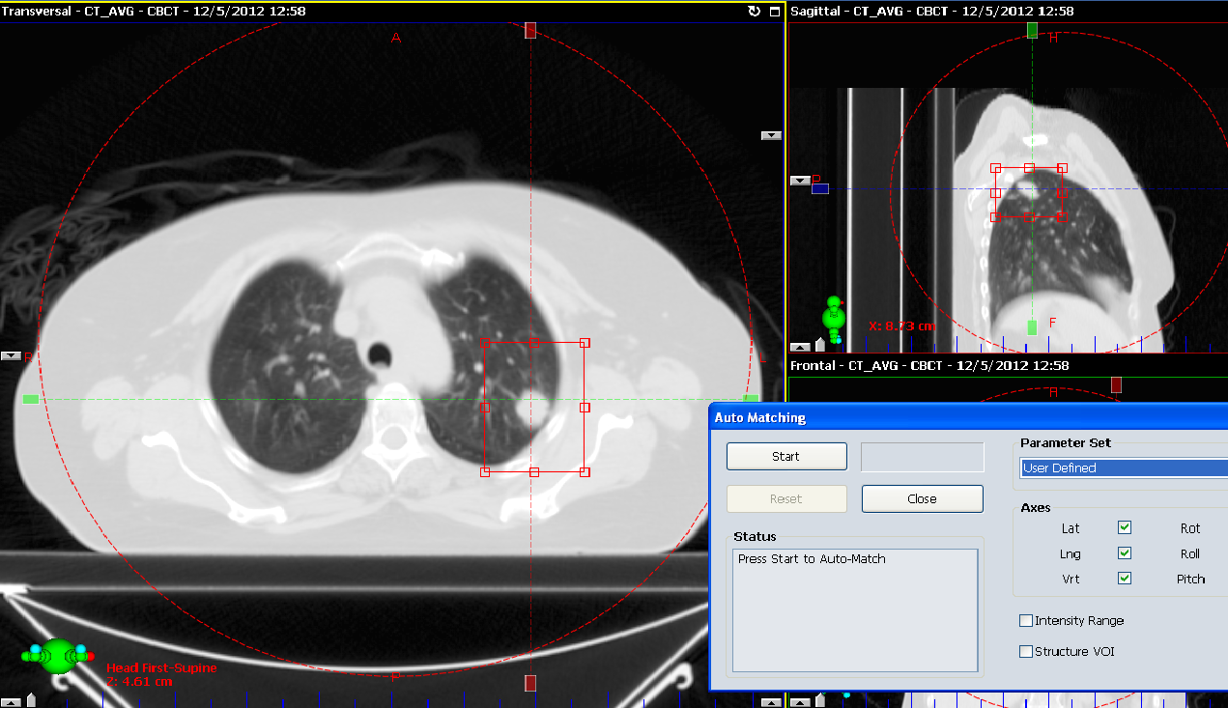
Examples:
Matching to soft tissue:
Auto-match with clipbox placed around soft tissue in all dimensions
Important to verify all auto-matches have been done correctly

Slide 23
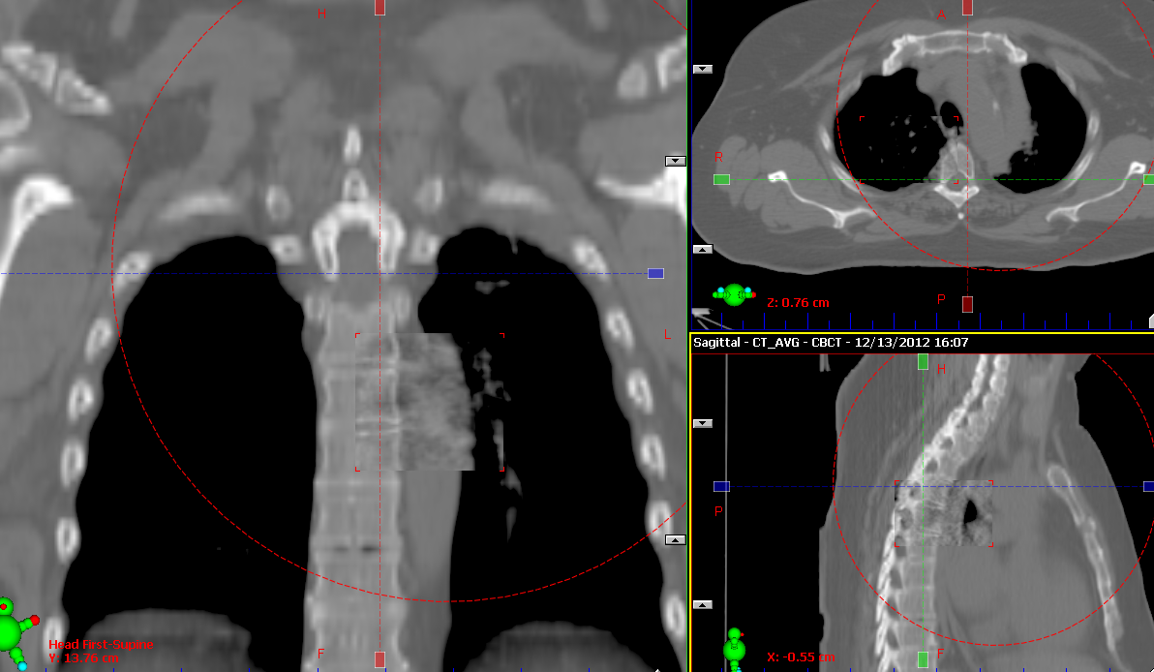
Examples:
Bony match to spine:
After matching to the spine, an option is to ensure the soft tissue target is within PTV
Important to verify you are at the correct level in the sup/inf direction as many of the vertebral bodies can look similar, this can be verified by the carina
Manual bony match to the spine using the moving window tool

Slide 24
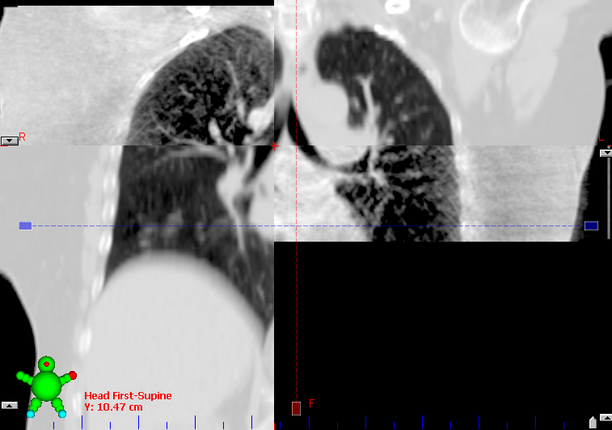
Assessing the carina using the split window tool to verify the superior/inferior level to ensure image registration is correct

Slide 25
Matching Considerations
kV image matching: bony match only
A bony match to the spine can be performed if CBCT is not an option
Vertebral bodies and intervertebral spaces can be used to assess the matchy superiorly and inferiorly, anteriorly and posteriorly
Pedicles and spinous processes can be used to assess the match laterally

Slide 26
Trouble Shooting
Common issues when imaging lung patients:
Patient rotation
Soft tissue mass is outside of the PTV
Change in lung volume
Automatch errors and correcting the clipbox

Slide 27
Patient Rotation
Rotations can be seen in the green/purple setting as solid green or solid purple
Centers must determine rotation tolerances, if these tolerances are reached patients must be re-positioned and another CBCT scan completed.
Rotations can affect PTV coverage and dose to critical structures
This example shows a different neck position and hip position

Slide 28
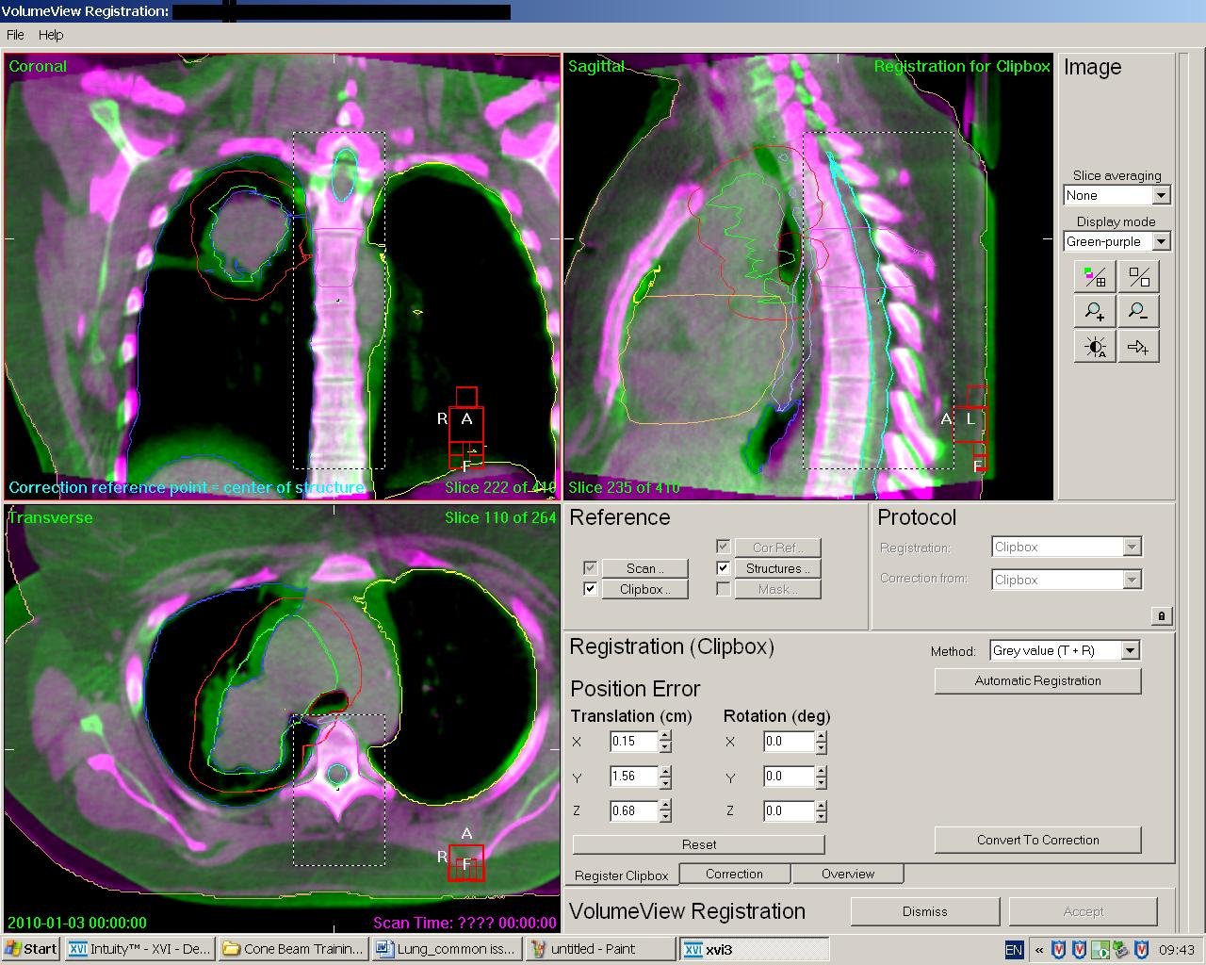
Rotation and Tumour Growth
This case demonstrates rotation in the spine throughout the volume
The tumour had grown (seen by the solid green) and was accompanied by some collapse
This patient required a new plan due to inadequate PTV coverage.

Slide 29
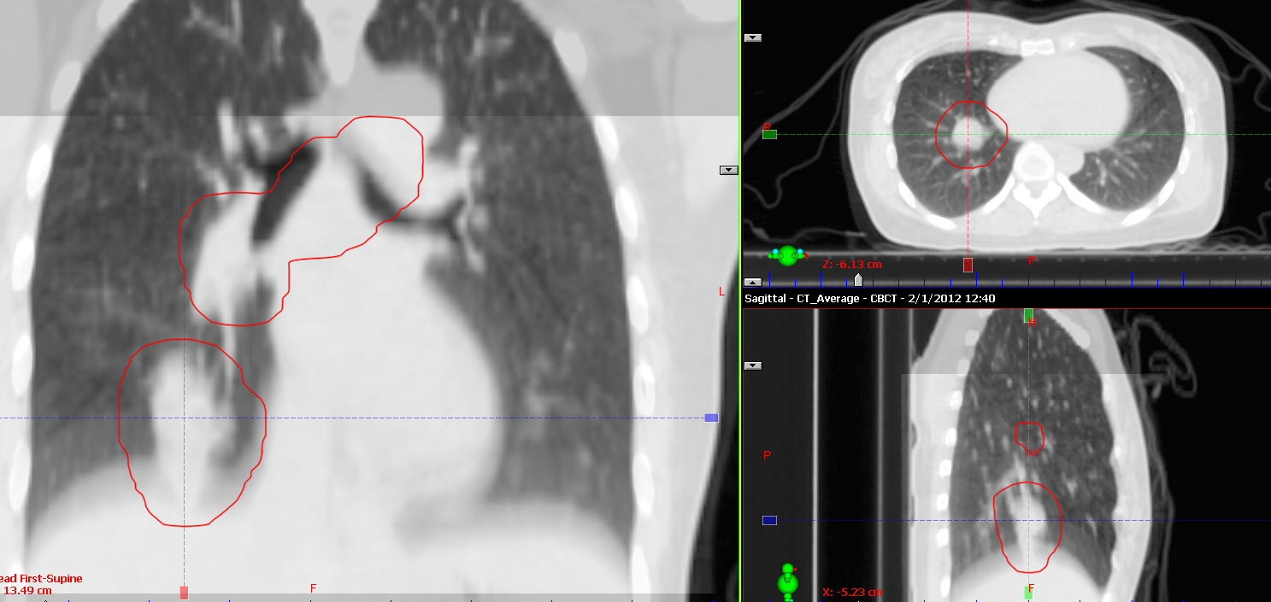
Mass Outside of PTV
Mass is encompassed by PTV on CT from CT Sim

Slide 30
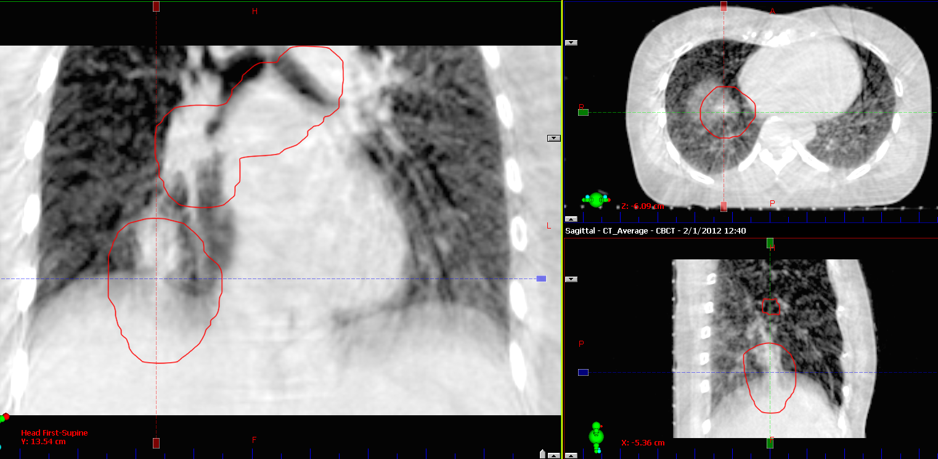
Mass is now outside of PTV on daily CBCT
Suggested course of action:
Centre-specific
Radiation oncologist notified

Slide 31
Change in Lung Volume
CT Sim, CTV shown in blue
Lung volume changed significantly from CT Sim to day 1 CBCT
Day 1 CBCT
Notes:
RO concluded that the tumour grew AND partial lung collapsed. Pt was never treated.

Slide 32
Change in Lung Volume
Suggested course of action:
Centre-specific
For this specific case the radiation oncologist was notified and treatment was not given, the radiation oncologist concluded that the tumour grew and the lung partially collapsed.

