Slide 1
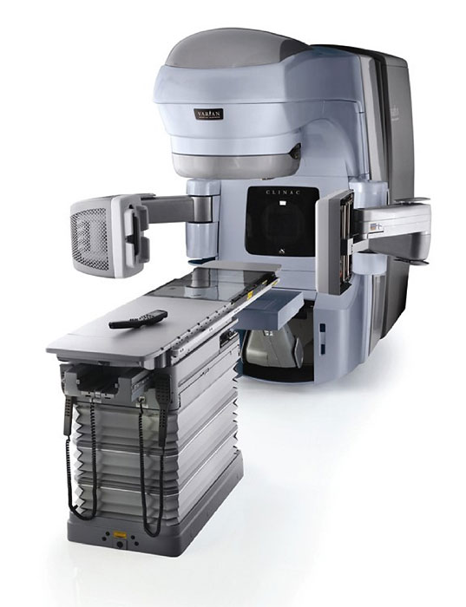
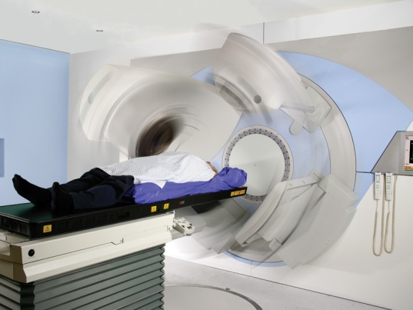
Introduction to Image-Guided Radiation Therapy & Cone Beam Computerized Tomography
Radiation Therapy Community of Practice
IGRT Education Group
January 2013
www.elekta.com
www.varian.com

Slide 2
Disclaimer
This learning module was created as starting point for each cancer centre to implement as part of IGRT Education in their radiation department.
The material included may not be suitable in every clinical environment.
This module is designed to be adjusted to include your centre’s site specific policies and procedures.
This material was developed by members of the Radiation Therapy Community of Practice – IGRT Education Group.

Slide 3
Objectives
Definition and use of IGRT
Introduction of CBCT
Introduction to the Imaging Systems (Varian & Elekta)
Use of Filters
Understand the Role of CBCT in Radiation Therapy
Determining Matching Priorities
Delineating the Region of Interest for Registration
Automatic Matching
Matching Verification Tools available

Slide 4
Definition of Image-Guided Radiation Therapy (IGRT)
“IGRT can be understood as a procedure that refines the delivery of therapeutic radiation by applying image-based target relocalization to allow proper patient repositioning for the purpose of ensuring accurate treatment and minimizing the volume of normal tissue exposed to ionizing radiation.” ASTRO & ACR Pratical Guidelines for IGRT, 2010

Slide 5
Why use IGRT?
With tightly defined dose distributions (rapid dose fall off outside of tumour volume), the patient’s position is very critical to the delivery of a precisely planned treatment.
Inaccurate alignment of the isocenter and treatment fields with the patient can lead to:
  The tumour can receive a reduced dose (leading to a loss in tumour control).
  Adjacent critical organs can receive a higher dose (leading to normal tissue complications – short and/or long term side effects).

Slide 6
What is a Cone Beam Computed Tomography (CBCT)?
A CBCT is obtained of the patient in the treatment position on the treatment couch right before the radiation treatment is delivered.
This is accomplished by a kV imaging system (kV source and panel) that is mounted orthogonally (90 degrees) to that of the MV therapy beam.
It is reconstructed in minutes and then compared/registered with the reference planning CT scan to match the patient’s internal anatomy.

Slide 7
Patient Motion
Interfraction Motion:
  Changes in the patient’s anatomy between treatments
  e.g. weight loss, swelling, tumour shrinkage, organ fillings (empty/full bladder/rectum)
Intrafraction Motion:
  Change in the patient’s anatomy during a treatment
  e.g. organ motion (breathing), uncooperative patient (patient in a lot of pain and moving)

Slide 8
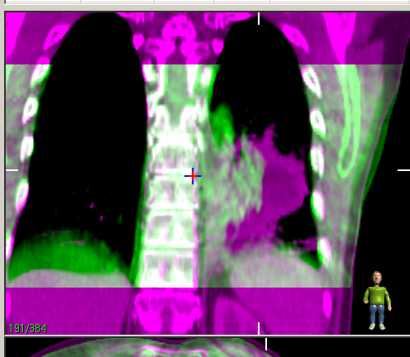
Advantages & Role of the CBCT
Assess interfractional motion by matching the patient’s internal anatomy before treatment delivery
Improve radiation treatment accuracy (ensures that target volume is adequately treated and normal tissue avoided)
  Monitor changes that can occur during a course of treatment, e.g. tumour response

Slide 9
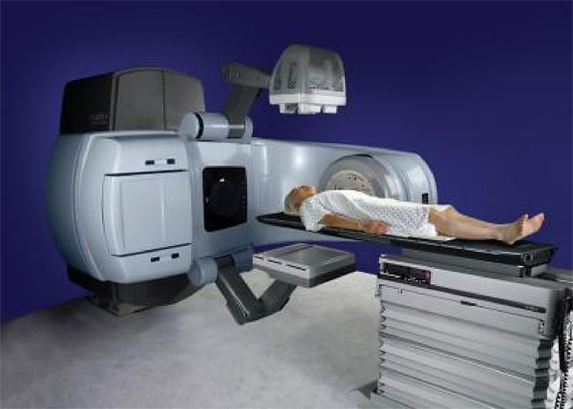
Varian Imaging System
OBI: diagnostic kV Source
Portal Vision (MV)
OBI: Flat Panel Detector
www.varian.com

Slide 10
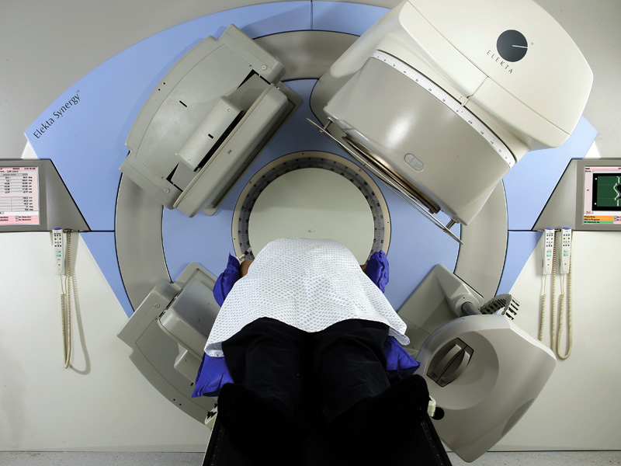
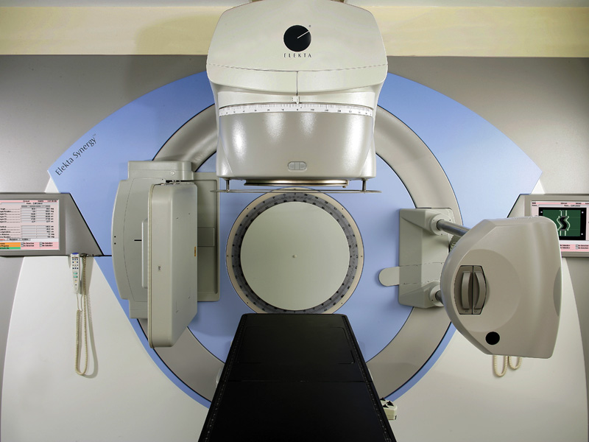
Elekta Imaging System
Portal Imager
MV Head
www.elekta.com

Slide 11
Detector Panel
kV Head
www.elekta.com

Slide 12
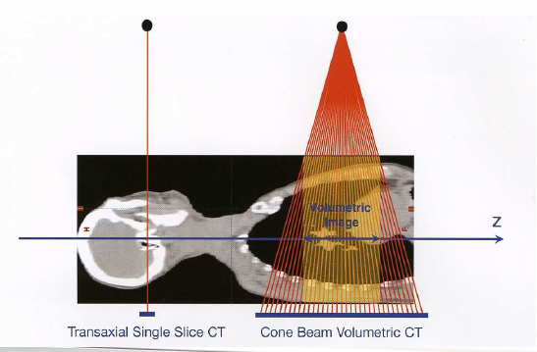
Helical CT vs CBCT
www.sasro.ch
With a CBCT, the x-ray beam is cone beam shaped (e.g. FOV 18 cm) as opposed to a fan beam in conventional CT (e.g. 2.5 mm slices).

Slide 13
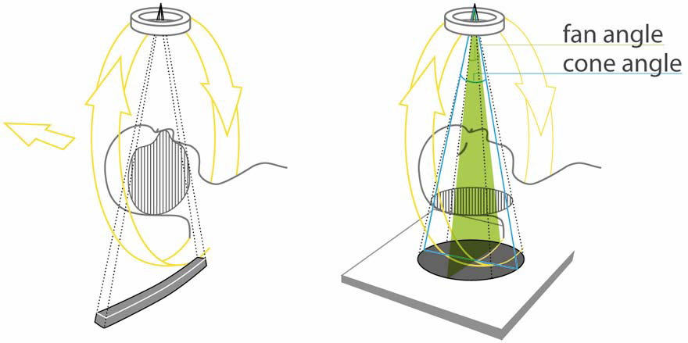
Helical CT Acquisition
Conventional CT captures thin slices as the patient indexes through bore.

Slide 14
CBCT Acquisition
Using a wider cone beam in the superior/inferior direction allows for a whole volume scan in one rotation.

Slide 15
How are the CBCT images acquired?
The x-ray beam is cone beam shaped
A 360º (full scan) or 200º (half scan) rotation is done around the patient
The x-ray beam is pulsed as it rotates and acquires a number of CT projections (330-720 frames)
Image acquisition time is ~ 1-2 minutes

Slide 16
Available Scanning Presets
There are a number of scanning presets available on the imaging systems at your disposal.

Slide 17
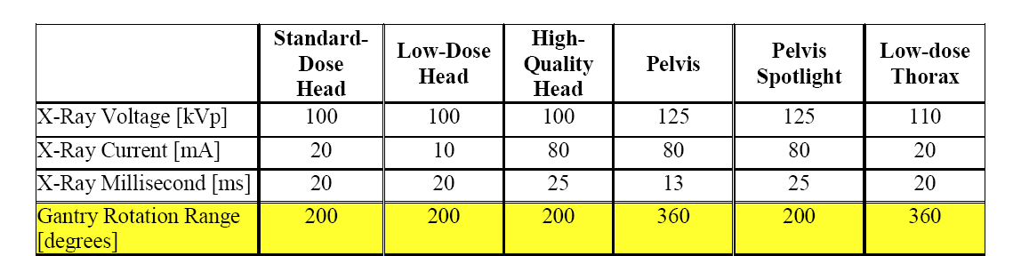
Varian: Scanning Presets

Slide 18
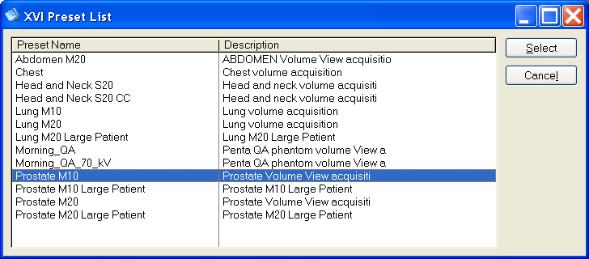
Elekta: Scanning Presets
Manufacturer presets can be added and changed (ie clockwise vs counterclockwise) by department (at Odette Cancer Centre)

Slide 19
Field of View (FOV)
FOV is defined by the panel size.
For a small FOV the patient needs only a 180/200 degree scan.
The detector panel remains centered.
www.elekta.com

Slide 20
Field of View (FOV)
A large FOV is created by shifting the panel.
A 360 degree scan is completed (180 degrees for each half of the patient).
www.elekta.com

Slide 21
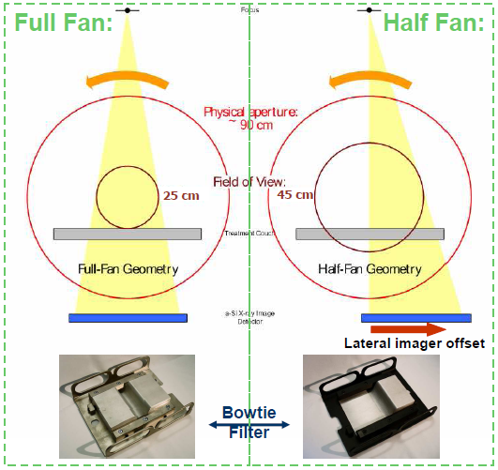
Full Fan vs Half Fan
Full Fan:
(for small separations, i.e. head)
Head Fan (above neck)
Half Scan (200˚ rotation)
Full Bowtie filter
Half Fan:
(for large separations, i.e. pelvis)
Body Fan (below neck)
Full Scan (360˚ rotation)
1/2 Bowtie filter
www.sasro.ch

Slide 22
Use of Filters
Filters are required on both the Varian and Elekta imaging systems
The type of filter is different depending on the imaging technique required.
Objectives of filters:
  Improves the Image Quality
  Reduces x-ray scattering
  Reduces the patient dose

Slide 23
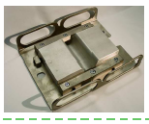
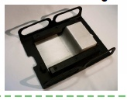
Varian Filters
Full Bow-Tie Filter: Used in Full Fan Mode (half scan)
Half Bow-Tie Filter: Used in Half Fan Mode (full scan)

Slide 24
Elekta Filters
• Various filters are used to define the superior/inferior extent of the scan volume.
www.elekta.com
Notes:
For each FOV s, m and lg, filters (collimators) exist for defining the sup/inf extent of the volume either approximately 10cm or 20cm i.e. M10, M20, S20.
These are slid into the kV head of the machine.

Slide 25
How do we use the CBCT images?
The CBCT is giving us 3D information that we can use to match to the planning CT (reference image)
Manual or Automatic corrections can be used
There are various tools available: contours, color overlay, split window, etc . . .
Once images are matched: Couch shifts in x, y and z planes (translations) are calculated to correct the patient’s position for treatment
Rotation information can also be calculated (pitch, roll and yaw)

Slide 26
CBCT Implementation
“Applications of various IGRT systems may be tumor-specific and/or site-specific depending not only on the properties of the imaging modality but also on the type of tumor and its anatomical relation with the surrounding healthy tissues.” ASTRO & ACR Guidelines for IGRT, 2010
Different imaging procedures may be used:
  Depending on treatment site
  Patient specific

Slide 27
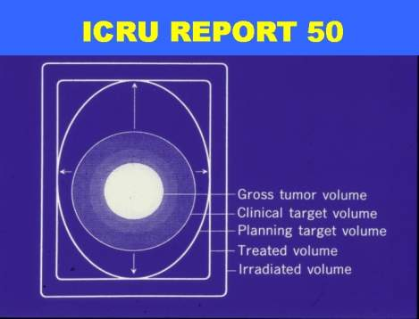
Contours for Image Matching and/or Verification
GTV: Gross tumor volume
CTV: GTV + subclinical microscopic disease
PTV: CTV + margin to account for uncertainties (geometrical variations and inaccuracies)
ITV: Internal Target Volume (includes tumour motion, delineated from 4D CT, or PET scan)
OAR: Organs at risk (e.g. Rectum, spinal cord, kidneys)
PRV: Planning organ at risk volume (OAR + margin, e.g. spinal cord with 5 mm margin)
Isodoses can also be contoured for verification during image matching

Slide 28
Determining Matching Priorities
Determining the matching priorities depends on treatment site, target volume and surrounding organs at risk
Target volume vs Surrogate
Surrogate must represent a stable part of the anatomy:
  that will best fit the target position, if the target is not well visualized (e.g. mediastinal disease)
  Represent the organ at risk (e.g. vertebral bodies for spinal cord)

Slide 29
Matching Using Target Volume
Examples of using the target volume for matching:
  Prostate
  ITV (Internal Target Volume)
  CTVp (Primary Clinical Target Volume)
  Bladder
  etc

Slide 30
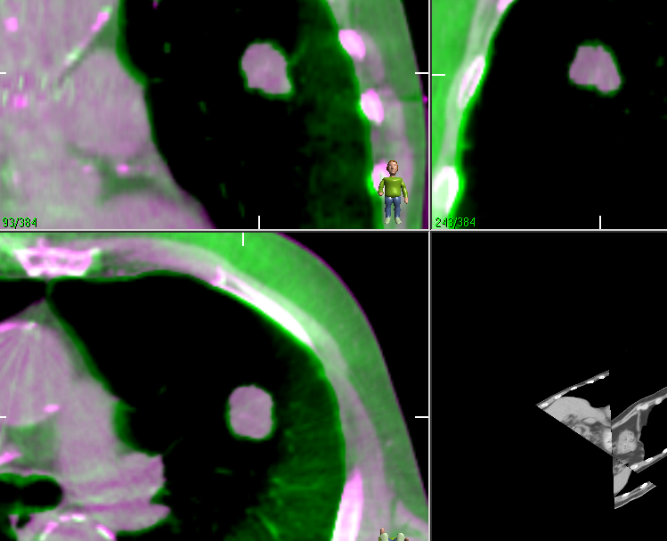
Matching Using Target Volume
Example: Small peripheral lung mass away from spinal cord
Matching priority used: Lung GTV/ITV

Slide 31
Matching Using Surrogates
Examples of using a surrogates as a matching priority:
  Bones (vertebral bodies, sella turcica)
  Surgical clips
  Stents
  Kidneys
  etc.

Slide 32
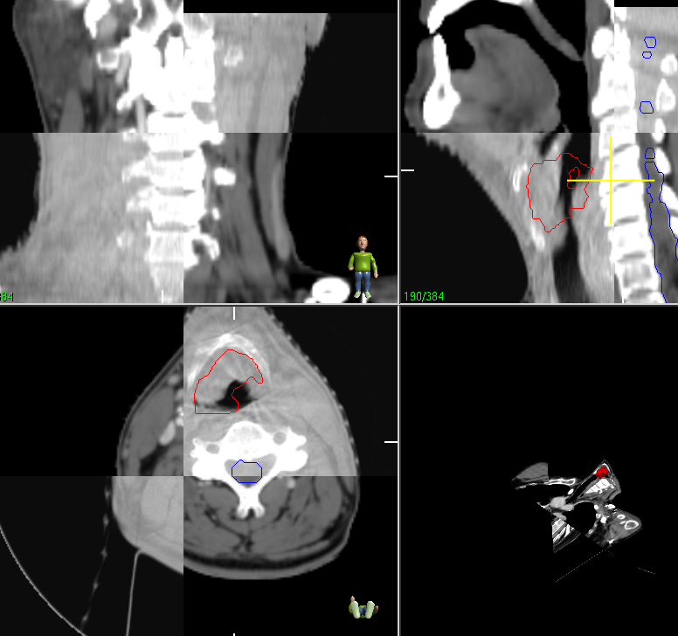
Matching Using Surrogates
Example: H&N - OAR = Spinal cord
Surrogate used would be vertebral bodies at the level of the highest spinal cord dose.

Slide 33
Using Automatic Image Registration
Using the automatic image registration software can reduce time and inter-observer variation, however a manual visual verification must also always follow to ensure the software has performed a correct match.
In order for the registration to work properly, a region of interest (clipbox or lockbox) must be indicated and set.

Slide 34
Delineating the Region of Interest (ROI)
The box must be set within the CBCT boundaries.
It must include the anatomy treated and/or organ at risk used for matching
Leave room on both sides of anatomy to allow for set up displacements (1-2 cm)
Avoid boxes that are too small
Recommended to use standard boxes based on site treated for consistency between users

Slide 35
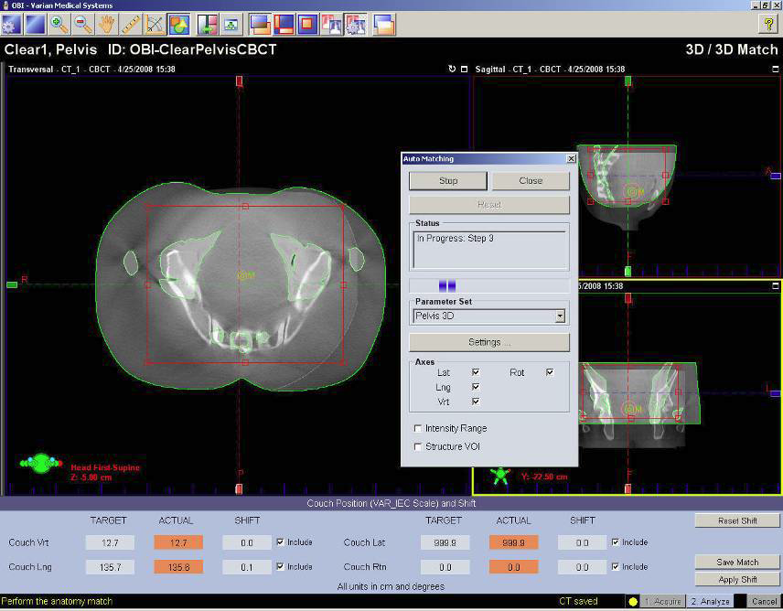
Varian
Clipbox/
Lockbox
Clipbox/
Lockbox

Slide 36
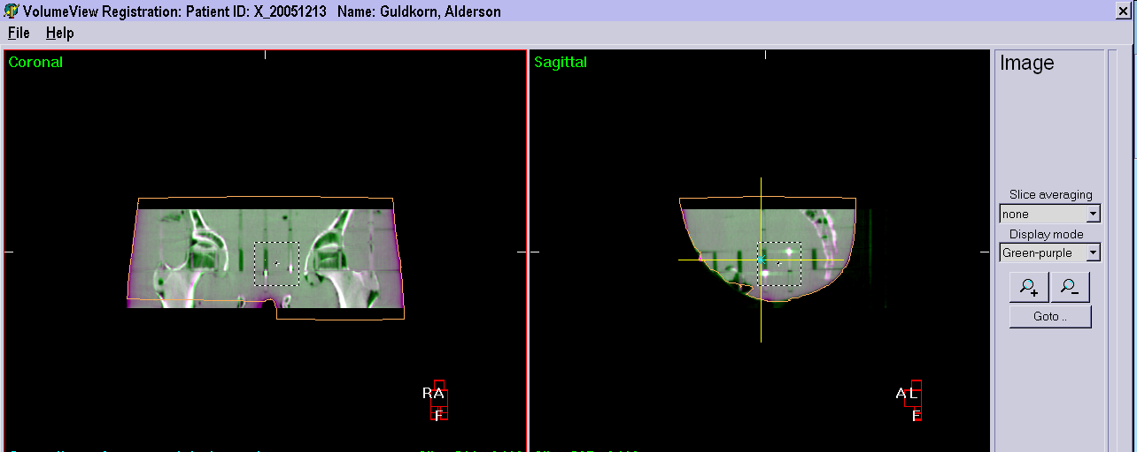
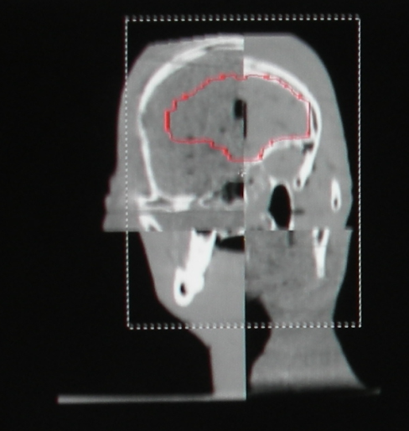
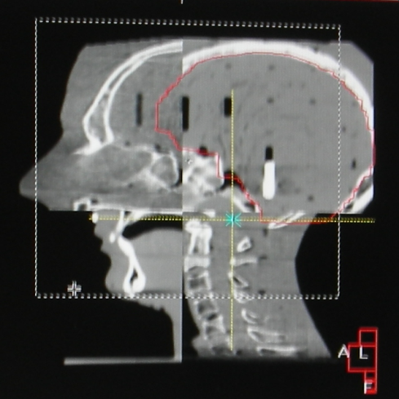
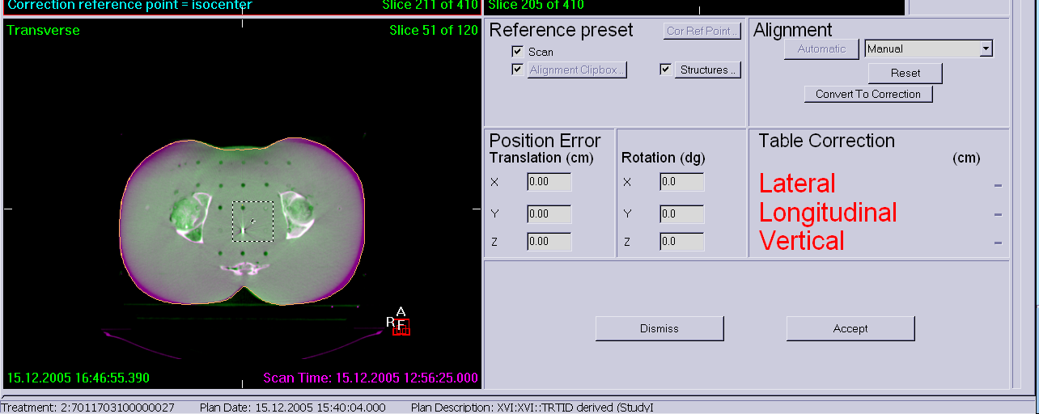
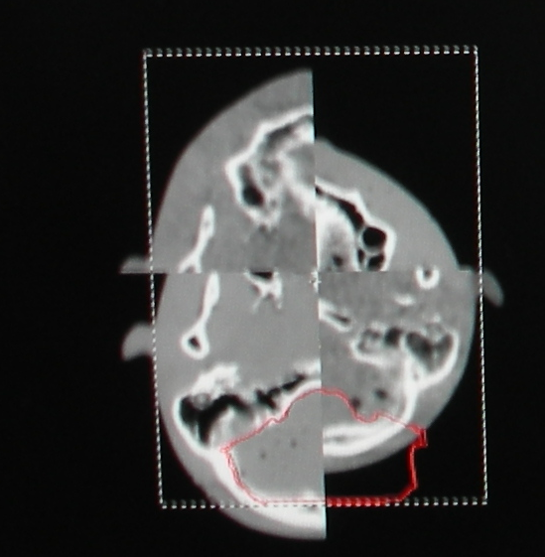
Elekta
• Clipbox delineates the volume of interest for registration.

Slide 37
Automatic Matching - Varian
www.my.varian.com
The system shifts the two superimposed images relative to each other using the Mutual Information Algorithm and calculates the couch correction values within the region of interest (clipbox)
Intensity Range: chose between bone and soft tissue

Slide 38
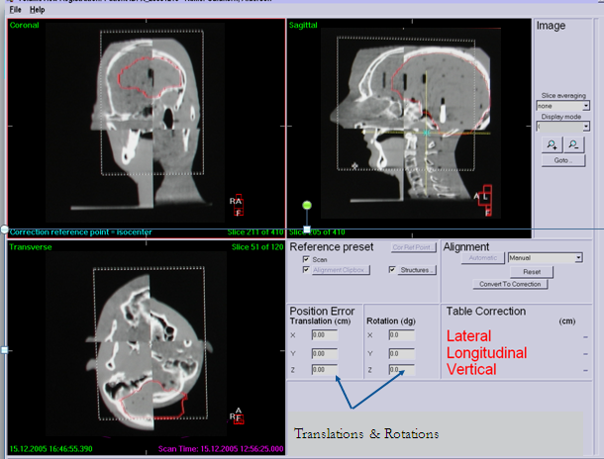
Automatic Matching - Elekta
The system shifts the two superimposed images relative to each other using the Registration Algorithm and calculates the couch correction values within the region of interest (clipbox)
The alignment selections are Bone, Greyscale and Manual.

Slide 39
Image Assessment
Adjusting the Window and Level of your images to increase visibility while assessing the CBCT
  Adjusting contrast
  Using pre-set window levels (e.g. bone, lung)
  **Remember to apply the same window levels to both the CBCT and reference planning CT

Slide 40
Matching Verification Tools
Various matching verification tools exists in the registration software to help with your imaging assessment:
  Contours
  Split Window
  Moving Window
  Color Blending

Slide 41
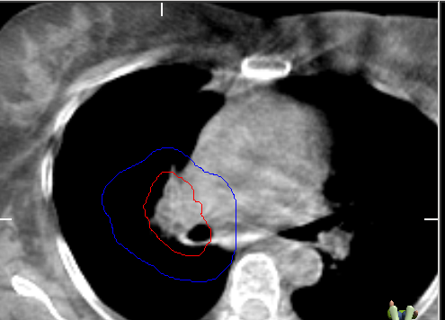
Contours
Contours (from planning reference CT) can be turned on

Slide 42
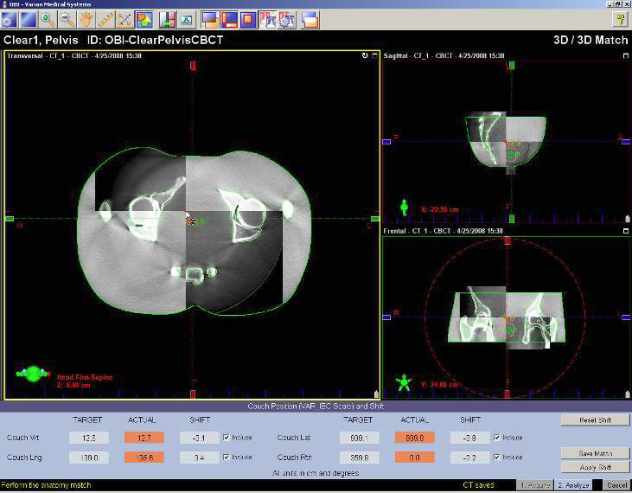
Split Window
• Split Window: For viewing of 50% Reference CT and 50% Cone Beam CT
www.my.varian.com

Slide 43
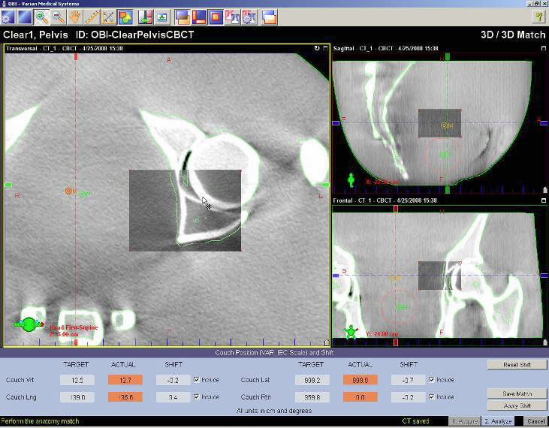
Moving Window
Moving Window: This allows viewing of the acquired Cone Beam CT and of the planning CT in the moveable rectangle
www.my.varian.com

Slide 44
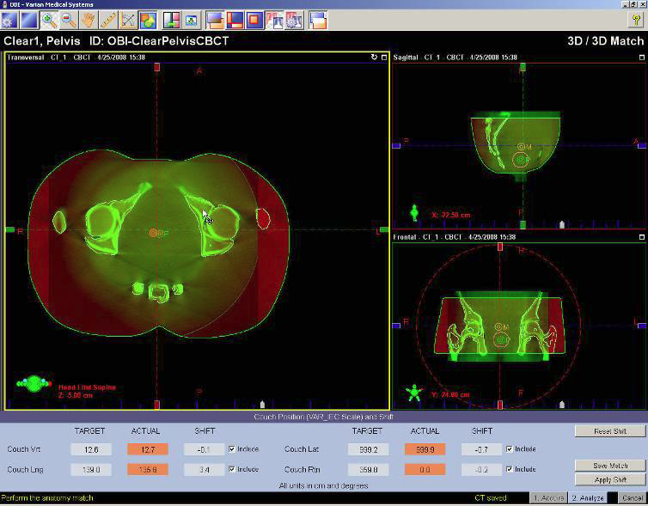
Color Blending
Color Blending: The blend function is used to overlay one image over another and shows the two images in different colors to assist in matching.
www.my.varian.com

Slide 45
Image Assessment & Time
Time is of the essence. It’s important to keep in mind that the validity of your scan varies inversely with time. So the longer you take, the less likely it is that the scan your looking at represents the patients current position.
Aim: 2 minutes or less, remember the acquisition & reconstruction in itself took 1-2 minutes.

Slide 46
“The overall goal of IGRT is to target tumours more accurately while better sparing the normal tissues.”
Xing et al, 2006

Slide 47
References
Xing et al. OVERVIEW OF IMAGE-GUIDED RADIATION THERAPY, Department of Radiation Oncology, Stanford University School of Medicine, Stanford, CA
Potters et al. AMERICAN SOCIETY FOR THERAPEUTIC RADIOLOGY AND ONCOLOGY (ASTRO) AND AMERICAN COLLEGE OF RADIOLOGY (ACR) PRACTICE GUIDELINES FOR IMAGE-GUIDED RADIATION THERAPY (IGRT), Int. J. Radiation Oncology Biol. Phys., Vol. 76, No. 2, pp. 319–325, 2010
Jörg Lehmann, Ph.D., DABR, Cone beam computed tomography (CBCT) for radiation therapy patient positioning; (ppt)
Catheryn Yashar, MD, Role of Modern Radiotherapy in Oncologic Practice, University of California, San Diego, 2007; ppt
Jan-Jakob Sonke, Cone Beam CT guided Radiotherapy, 2006; (ppt)
Jonathan Sykes , Cone Beam CT, Cookridge Hospital, Leeds, December 2004
Calvin Huntzinger, Image Guided Radiation Therapy, Varian Medical Systems, Palo Alto, California, September 2004
Varian, Cone Beam CT Verification Procedure Manual, Training Package; www.varian.com
Ding et al., RADIATION DOSE FROM KILOVOLTAGE CONE BEAM COMPUTED TOMOGRAPHY IN AN IMAGE-GUIDED RADIOTHERAPY PROCEDURE, Nashville, Int. J. Radiation Oncology Biol. ,Phys., Vol. 73, No. 2, pp. 610–617, 2009

Slide 48
References
Korreman et al., THE EUROPEAN SOCIETY OF THERAPEUTIC RADIOLOGY AND ONCOLOGY – EUROPEAN INSTITUTE OF RADIOTHERAPY (ESTRO–EIR) REPORT ON 3D CT-BASED IN-ROOM IMAGE GUIDANCE SYSTEMS: A practical and technical review and guide , Radiotherapy and Oncology 94 , pp. 129-144, 2010

Slide 49
Websites:
www.varian.com
www.my.varian.com
http://www.sasro.ch/SRO/Delivery%20and%20verification%20-%20part%203.pdf
http://ruirodrigues.net/radioterapia/images/stories/equip/icru_50.jpg

