Slide 1
Appendix C
Head & Neck Module

Slide 2
Disclaimer
This learning module was created as starting point for each cancer centre to implement as part of IGRT Education in their radiation department.
The material included may not be suitable in every clinical environment.
This module is designed to be adjusted to include your centre’s site specific policies and procedures.
This material was developed by members of the Radiation Therapy Community of Practice – IGRT Education Group.

Slide 3
Introduction
This module has been created to provide an overview of the anatomy, machine parameters, matching considerations & trouble shooting in regards to IGRT treatments to cancers in the Head & Neck
IGRT is a method used on treatment units to improve the delivery of IMRT & Rapid Arc plans
Allows better targeting of the tumour location while avoiding nearby healthy tissue immediately prior to radiation treatment each day

Slide 4
Cross Sectional Anatomy
Brain
Brainstem
Spinal Cord
Optic Chiasm
Optic Nerve
Clivus
Cervical vertebrae (Atlas, Axis, C3-C7)
Mandible
Maxilla
Hard Palate
Soft Palate
Tongue
Uvula
Epiglottis
Parotid Glands
Nasopharynx
Oropharynx
Hypopharynx
Internal and External Carotid Artery
Internal and External Jugular Vein
Orbits
Lenses

Slide 5
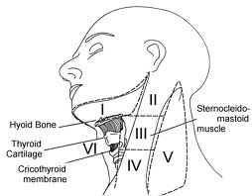
Cross Sectional Anatomy Lymph Nodes
www.cancernetwork.com
www.sciencedirect.com

Slide 6
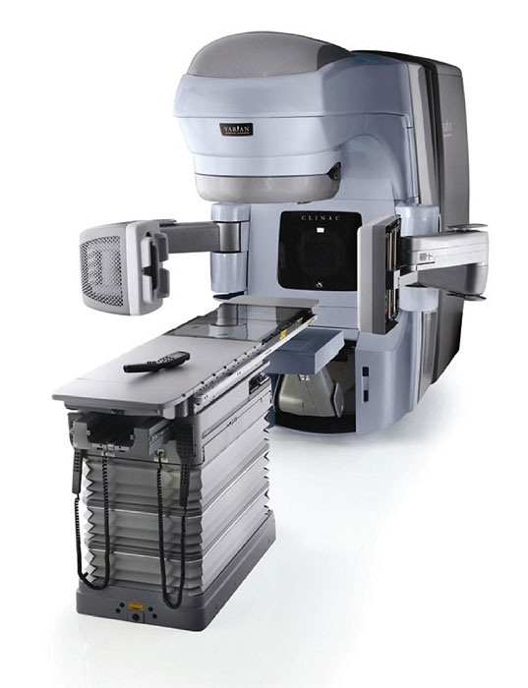
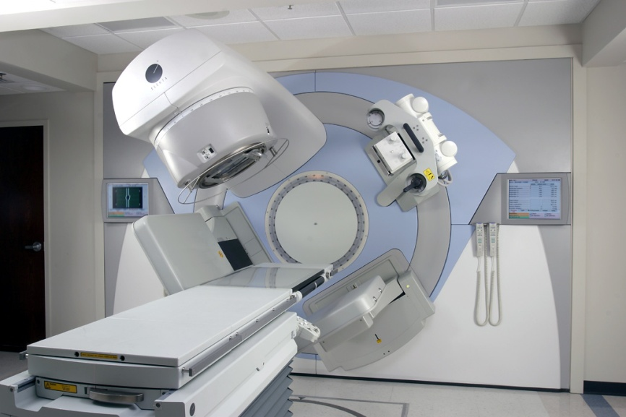
Machine Parameters
Varian
kV imaging
CBCT
Elekta
kV imaging
CBCT

Slide 7
Machine Parameters - Varian
kV/kV matching
Orthogonal images taken using kV imager
CBCT matching
Full scan vs. half scan, using kV source & detector
Bowtie filter
kV source
kV detector
EPI

Slide 8
Machine Parameters - Elekta
kV/kV matching
Orthogonal images taken using kV imager
CBCT matching
Full scan vs. half scan, using kV source & detector
Bowtie filter

Slide 9
kV Imaging
kV radiographs can be used to determine position of bony anatomy

Slide 10
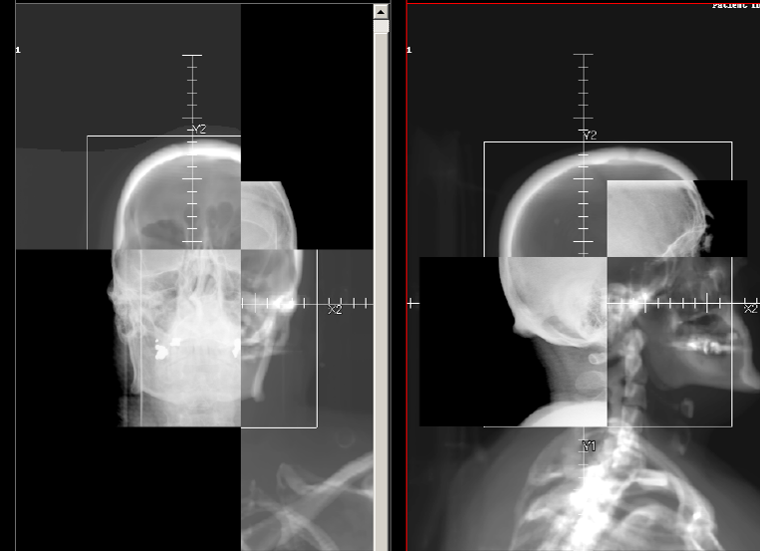
2D/2D kV Image Matching
DRR
DRR
KV
KV

Slide 11
CBCT Imaging Parameters – Varian
Half scan
Counter-clockwise (to avoid lenses)
Filter: Full bowtie
NOTE: Full scan can be used (thorax mode) if lower neck is the area of treatment and image quality is poor due to patient separation (shoulders). Ensure that eyes are below the imaging FOV.

Slide 12
CBCT Imaging Parameters - Elekta
Half scan
Counter-clockwise (to avoid lenses)
Filter:
Small filter
Filter length determined by target volume

Slide 13
Determining Matching Priorities
Determining the matching priorities depends on treatment site, target volume and surrounding organs at risk
Target volume vs. Surrogate
Surrogate must represent a stable part of the anatomy:
that will best fit the target position, if the target is not well visualized (e.g. cartilage around larynx)
Represent the organ at risk (e.g. vertebral bodies for spinal cord)

Slide 14
Matching Considerations
Surrounding Organs at Risk (OAR):
Brain
Brainstem
Spinal cord
Optic chiasm
Optic nerves
Eye
Lens
Parotid glands

Slide 15
Determining Matching Priorities
In most cases of head and neck, a surrogate is used as the primary matching priority due to OARs:
Nasopharynx: Clivus bone/C1-C2 may be used due to proximity of brainstem
Oropharynx/Hypopharynx: Vertebral bodies due to proximity of spinal cord.
Target volume may be used as primary matching priority in some instances where the surrounding OARs are not at risk:
T1 Larynx: Soft tissue/cartilage match

Slide 16
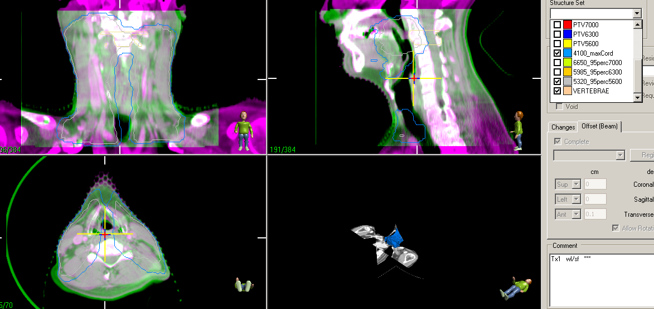
Example: OAR Surrogate Match
T1 SCC Tonsil
Priority #1: MATCH Vertebra level of highest cord dose (contoured)
Priority #2: VERIFY position of all other vertebral bodies near PTV and that maximum cord dose (4100cGy) contour is clear of cord position
Priority #3: VERIFY hard palate and mandible positions
Priority #4: VERIFY anatomy within 95% isodose line contour

Slide 17
Example: Target Volume Match
T1 Larynx Cancer:
Priority #1: MATCH cartilage of larynx
Priority #2: VERIFY match of anatomy within GTVp, CTVp and 95% isod)ose 4845 cGy
Priority #3: VERIFY position of cord (clears maximum cord dose 2700cGy
Priority #4: VERIFY bony anatomy and any misalignment in sup/inf direction

Slide 18
CBCT Matching
CBCT matching: soft tissue and/or bony match
Auto or manual match to bony anatomy can be done (depending on tumour location and centre specific protocols)
Window levels can be set to bone or soft tissue depending on what needs to be visualized
Auto match will measure the rotation of the patient
Contours can be visualized on CBCT (i.e. to ensure the target in within the PTV contour and OARs remain outside of high dose regions)
Accessories can be evaluated (bolus, mouth bite in correct location)
Any changes in patient anatomy/target volume can be seen and reported
Important to review all the anatomy within the treatment area

Slide 19
Clipbox/Lockbox
A clipbox is used for an automatch to outline the region of interest that will be matched.
The settings for the clipbox will be centre and site specific.
The clipbox should include the matching priority and remain within the CBCT boundaries.
Example: If vertebral bodies used as matching surrogate due to OAR (spinal cord), the clipbox would be set to include the vertebral bodies in all planes.

Slide 20
Trouble Shooting
Common issues imaging Head and Neck patients:
Pt position (rotation within mask)
How much rotation is too much?
TBD by centre
Anatomic changes (Adaptive Planning)
How much of a change in depths before you need to act on it?
TBD by centre

Slide 21
Soft Tissue Mismatch
After vertebral match performed, mismatch of soft tissue seen within GTVp contour.
Assess position from planning CT (swallowing motion) or growth??
Evaluate the possibility of changing the matching priority to Soft tissue ??
Red= GTVp contour; Blue=spinal cord

Slide 22
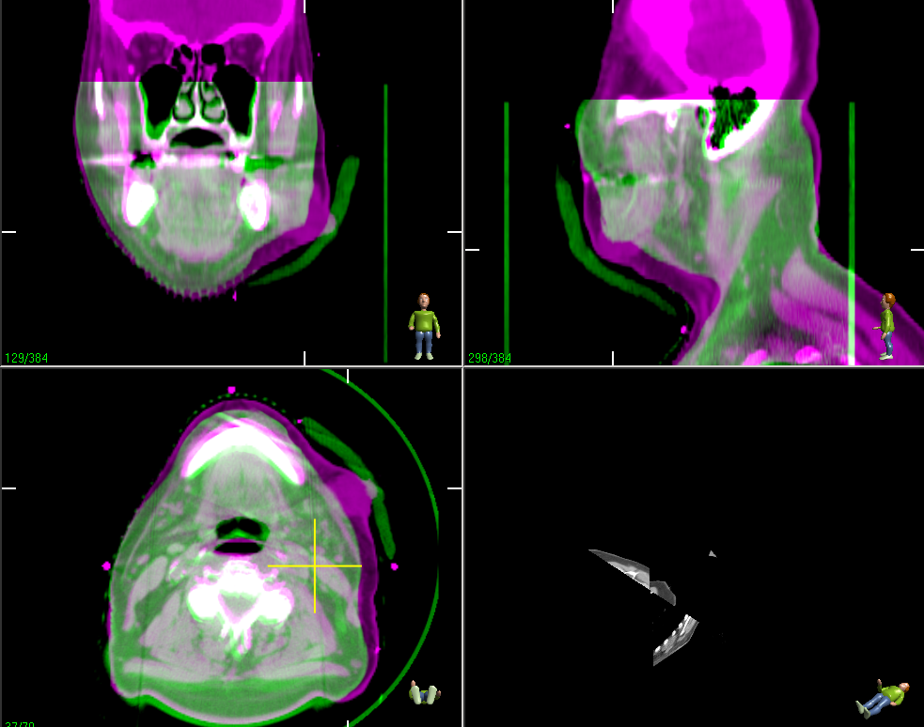
Shrinking Tumour & Bolus Placement
Purple= Planning CT
Green= CBCT
Bolus
Bolus
Planner and Radiation Oncologist would be notified of tumour size change to assess if reCT and/or replanning required.
Bolus placement: bolus to be placed below mask to minimize air gaps.

Slide 23
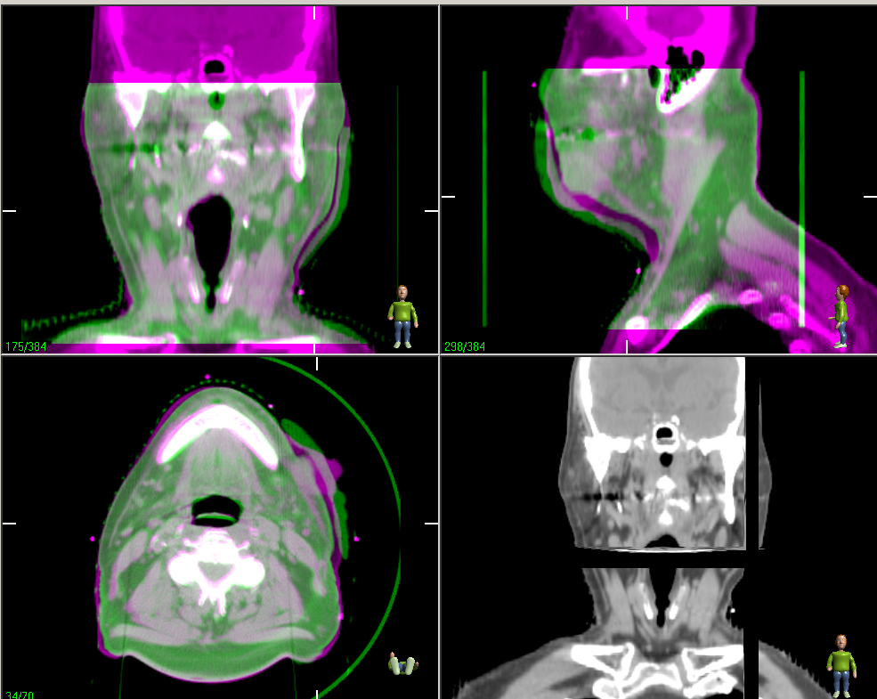
Bolus positioned under mask
Bolus

Slide 24
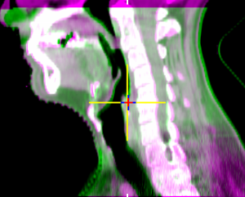
Vertebral Misalignment
Gauze added under head
Verterbral misalignment measured on Day 1. C4-C7 positioned anteriorly by 5 mm.
5 layers of gauze added to headrest at the area of C3 and superiorly.

Slide 25
Weight Loss
Weight loss to be reported to planning and radiation oncologist to assess replanning needs/effect on dose distribution.
Weight loss causing loose fitting mask: assess frequency of imaging (e.g. Daily CBCT)

Slide 26
Mandible Misalignment
Mandible position too posterior
Patient asked to raise chin into the mask.
CBCT repeated

