Slide 1
Sexuality and Cancer
Windsor Regional Cancer Program
Joyce M. McManus
BA, M.Div, BSW, RSW
2016

Slide 2
Today’s session
Discuss intimacy, sexuality and the factors that impact them
Talk about how cancer treatment can impact sexual function
Identify things you can do to help and where you can find support

Slide 3
Goals
Outline 7 sexual health challenges patients with cancer (and their partners) face
Identify and use at least 3 helpful suggestions to improve intimacy and sexual relationships
Discover resources in the community to address sexual health concerns

Slide 4
Intimacy
Sharing of identity, mutual acceptance, closeness, reciprocal rapport, and heart to heart understanding
Closely linked to communication than sexual functioning
Important part of “self”
When a person feels intimately loved, nurtured, cared for and supported, one is likely to be healthier and happier

Slide 5
Sexuality
Important part of the total person
Sexual identity involves both feelings and behaviours
Intimate form of communication that brings comfort

Slide 6
Sexuality (cont’d)
Influenced by cultural beliefs, religious beliefs, stressors, past experiences, and relationships
Intimacy, touch, self-esteem, emotional and social interactions, and communication help capture sexuality (definitions from Sexuality, Intimacy and Cancer: Let’s Talk, LHSC, Tammy Willart, MSW, RSW)

Slide 7
Factors influencing sexuality
Biology/genetics
Developmental status
Culture
Ethnicity
Experiences
Religion/spirituality
Stereotypes

Slide 8
Intimate relationships
Based on trust and the ability to interact with others
Modelled in our childhood homes
Early relationships impact the way persons interact with others emotionally, intellectually, physically and sexually

Slide 9
4 types of intimacy
1. Emotional: is the level of trust, personal bonds, biochemical response and social dimension that follows from physical closeness
2. Intellectual: is the exchange of thoughts, ideas, enjoying similarities and differences of opinions in open and comfortable ways

Slide 10
4 types of intimacy (cont’d)
3. Experiential: is the sharing of mutual activities
4. Physical: touching, holding, hugging, kissing, rubbing a back and sexual activity

Slide 11
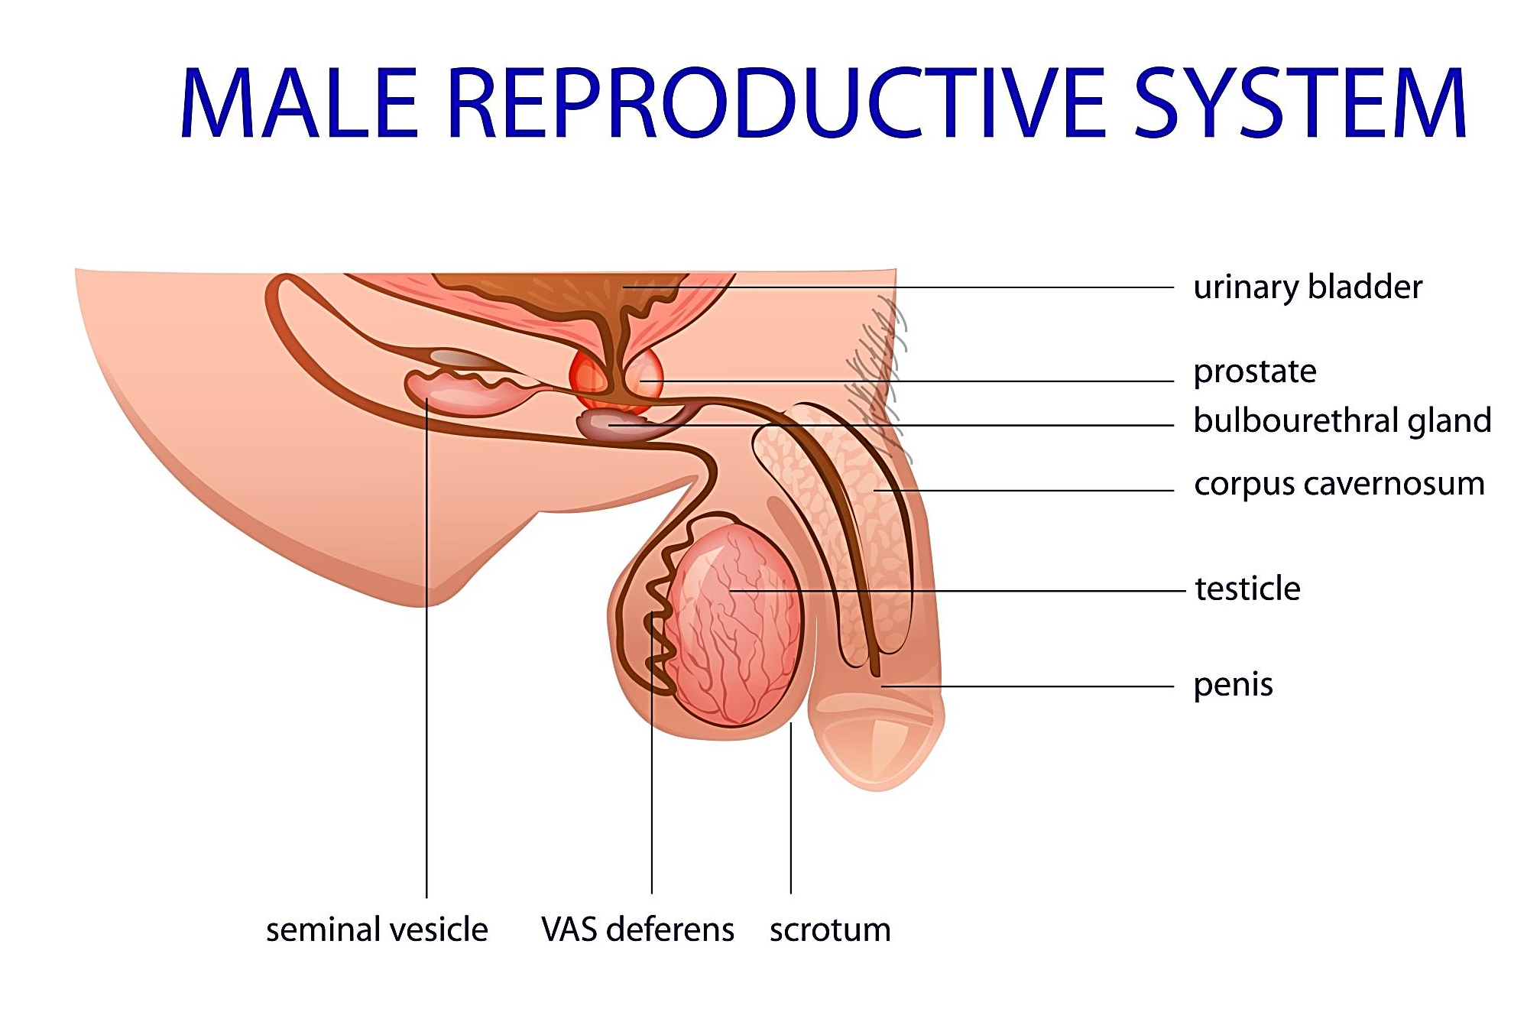

Slide 12
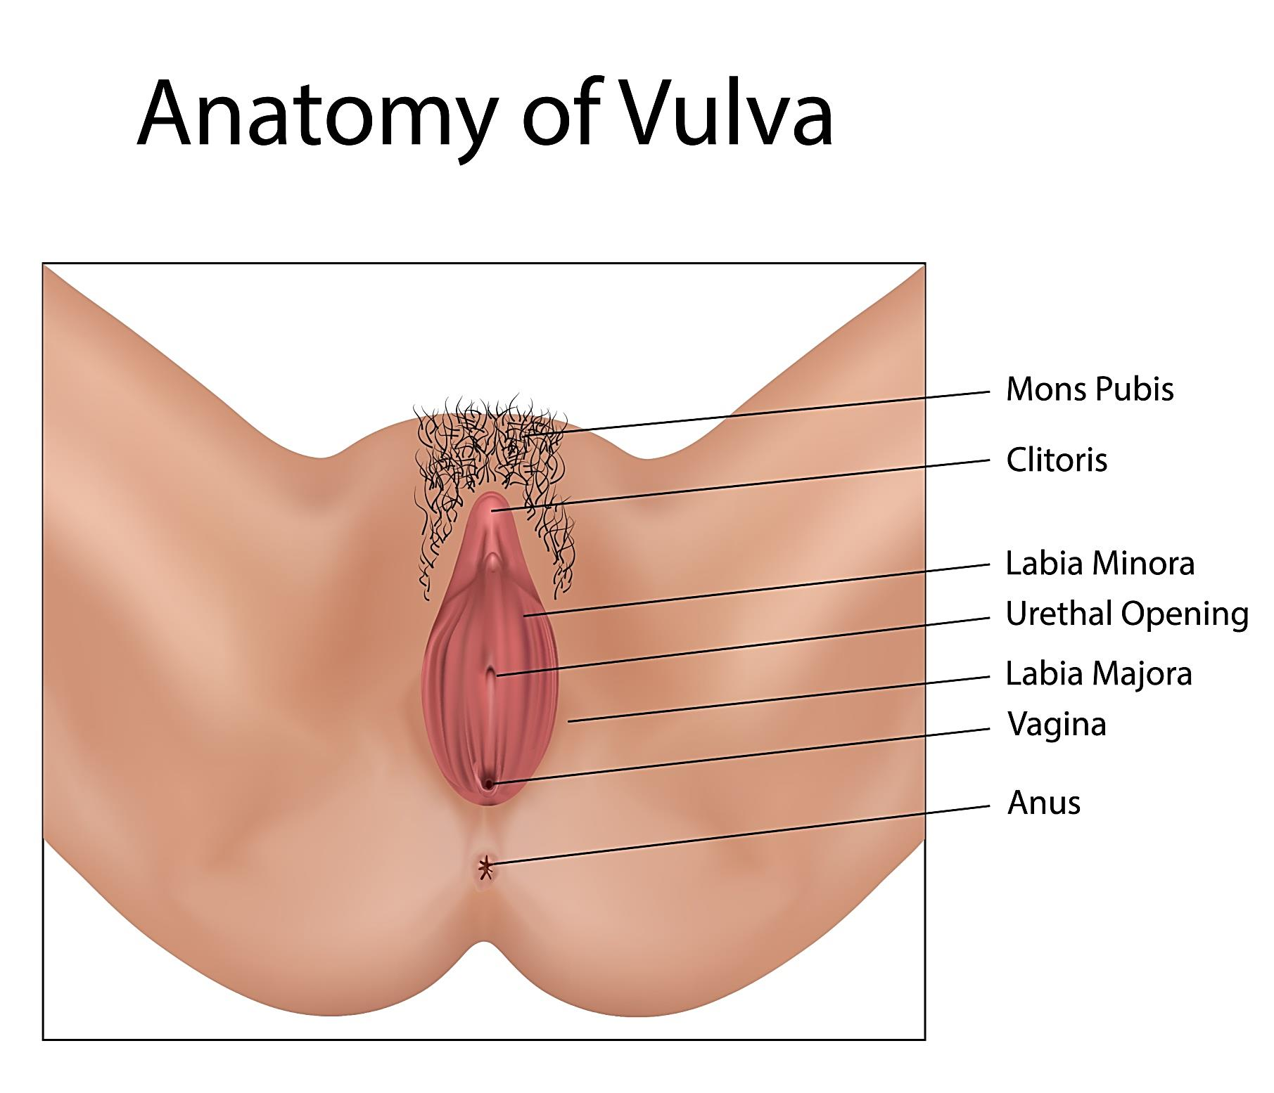

Slide 13
Sexual response cycle
Excitement, plateau, orgasm, resolution (Masters and Johnson, 1970’s)
Desire, excitement, orgasm (Helen Singer Kaplan)
Female response cycle focuses on thoughts and feelings and then sexual arousal happens. Sexual satisfaction can be an orgasm or seeing one’s partner enjoying the experience (Rosemary Basson)

Slide 14
Disease site effects
Each disease site has its own unique issues related to diagnosis, surgery, chemotherapy or radiation treatments
One common fact: there will be a change in sexual function. This can show itself in physical or emotional changes, or both

Slide 15
Physical side effects
1. Body image changes
2. Bowel or urinary problems
3. Decreased sexual desire or libido
4. Fatigue
5. Infertility
6. Orgasmic changes and erectile dysfunction
7. Pain

Slide 16
1. Body image changes
Loss of body part through surgery
Decreased self-esteem
Weight loss or gain
Changes in bodily functions: removal of ovaries, testicle, ostomies, menopause
Infertility issues
Who am I now that I have this cancer diagnosis? Am I a sexual person anymore?

Slide 17
2. Bowel/Urinary changes
Bowel or bladder incontinence
Catheters, nephrostomy tubes, drains
Colostomy, ileostomy, urostomy
Diarrhea, constipation
Odours

Slide 18
3. Decreased sexual desire/libido
Chemotherapy, radiation therapy, surgery, hormonal treatments, medications
Fatigue
Pain
Nausea/vomiting
Other medications: antidepressants, blood pressure medications, pain medications

Slide 19
3. Decreased sexual desire (cont’d)
Depression, anxiety, stress
Body image changes
Infertility issues
Fear of restarting sexual activity
Relationship changes/conflicts

Slide 20
4. Fatigue
Depression
Changes in lifestyle
Medication side effects, pain, anti-nausea, psychiatric drugs
Stress: financial, relationship issues, disability
Surgery, chemo and radiation therapies

Slide 21
5. Infertility issues
Banking of sperm or ova
Decreased sex hormones
Hormonal therapies
Inability to have a child, short term or long term
Changes in how one perceives gender role

Slide 22
6. Orgasmic changes - women
Vaginal dryness
Vulva irritation
Painful intercourse
Lack of desire
Decreased arousal
Injury to pelvic nerves
Decreased clitoral sensitivity
Decreased elasticity of the vagina
Increased sensitivity to touch
Depression

Slide 23
6. Orgasmic changes - men
Erectile dysfunction
Retrograde ejaculation
Injury to pelvic nerves
Depression

Slide 24
6. Orgasmic changes - both
Disruption of the sexual response cycle

Slide 25
7. Pain
Focus on pain issues
Painful intercourse
Side effects of pain medications decrease sexual response cycle
Skin sensitivity may increase or decrease, causing discomfort - so arousal does not happen

Slide 26
What can you do?
Sexuality and sexual functioning are an important part of your Quality of Life
You have the right to talk with your health care team about your sexual concerns
Professional help is available: oncologists, nurses, social workers, urologists and gynecologists

Slide 27
Treating sexual dysfunction
1. Educate yourself on changes in sexual functioning: Canadian Cancer Society pamphlets, Sexuality and Cancer booklet
2. Speak to your care team about concerns and changes in your sexual functioning

Slide 28
Treating sexual dysfunction
3. Talk to your partner about your feelings of loss, fear and changes in your relationship since the cancer diagnosis
4. Get counselling as an individual or with your partner for emotional concerns
5. Learn new ways to communicate sexually with your partner

Slide 29
New ways to communicate
Reduce fear of sex: enjoy non-sexual touch like cuddling, hand-holding, kissing, embracing
Start sensual touch and desire/excitement will follow
Follow your post-treatment care: use of dilators, pelvic floor exercises, medications
Learn new techniques

Slide 30
Other suggestions
Use vaginal moisturizers (e.g., Replens) and vaginal lubricants (e.g., Astroglide), to decrease vaginal dryness
Understand that healing tissues and nerves take time: be patient with your body
Be patient with your partner
Do not use penile pumps or clitoral therapy devices from local sex shops

Slide 31
On-line resources
www.cancer.org
www.livestrong.org
www.cancer.gov
www.cancer.ca
www.wpcsg.com (Prostate Group)

Slide 32
Review
Outlined 7 sexual health challenges patients with cancer (and their partners) face
Identified at least 3 helpful suggestions to improve intimacy and sexual relationships
Discovered several resources in the community that address sexual health concerns
Notes:
Return to goals/objectives as a way to validate that goals/objectives were met in the class.

Slide 33
Questions?
Notes:
Facilitate Q&A.

