Slide 1



Sexual Health and Cancer –
Communication Application
Training for Frontline Workers
2016
Joyce M. McManus
BA, MDiv, BSW, RSW

Slide 2
Today’s session
Normalize sexual health discussions between professionals and with cancer patients and family members
Discuss ways to engage in conversation about sexual health
Engage in role play scenarios:
To experience the interaction
To enhance communication skill and comfort

Slide 3
Goals
Outline 5 steps to approach the communication
Explore 3 case scenarios
Discover, enhance and strengthen this unique type of communication and interaction

Slide 4
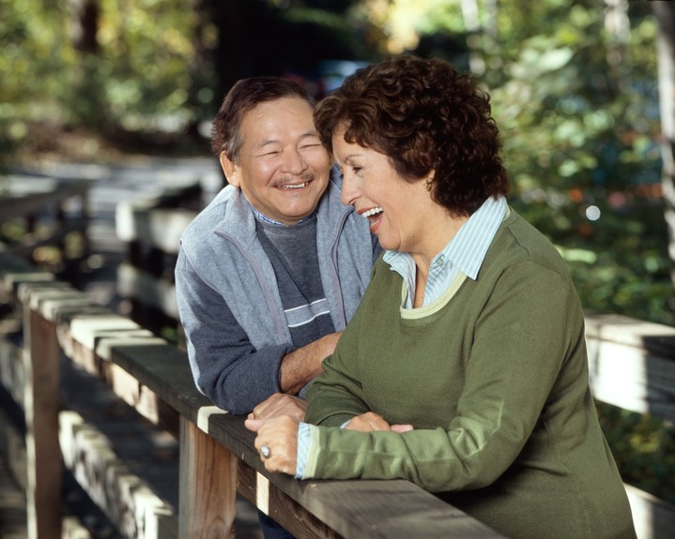
Factors influencing sexual health
Biology/genetics
Developmental status
Culture
Ethnicity
Life experiences
Religion/spirituality
Stereotypes
Photo Source: National Cancer Institute
Creator: Rhoda Baer (Photographer)

Slide 5
Types of intimacy
1. Emotional: trust develops, personal bonds, biochemical response, social dimension to physical closeness
2. Intellectual: sharing of thoughts, ideas, similarities and differences of opinions in open, comfortable ways
3. Experiential: sharing of mutual activities
4. Physical: sensual proximity, touching, holding, hugging, kissing, sexual activity

Slide 6
Adolescence
Establishing sexual identity and self-concept
Personal evaluation of one’s sexual feelings and behaviours
Finding their place on the sexual orientation spectrum
Sexual experimentation
Risk of STI’s

Slide 7
Young adults
Interested in sexual expression
Making love and sex not the same
No “abnormals” in sexual relationships if sexual activities are acceptable to both partners
Looking at future and possibility of a lifetime partner
Possibility of STI’s

Slide 8
Adulthood
Finding a partner and establishing a family
Having children if desired
Establishing a career, financial commitments, parenthood can create stress. This can effect their sexual relationship with their partner
Fatigue, poor communication between partners and differing expectations of the relationship can influence sexual behaviours
Losses in life, including the relationship, cause changes in sexual behaviour and sexual health

Slide 9
Older adults
Social circumstances may change: retirement, death of spouse and friends
Age is not a barrier to sexual expression
Aging causes changes in desire and performance of sexual behaviours
Illnesses causing physical and emotional changes
New partners and risk of STI’s
Loneliness, depression, increase in addictions

Slide 10
Sexual response cycle
Excitement, plateau, resolution (Masters and Johnson, 1970’s)
Desire, excitement, orgasm (Helen Singer Kaplan)
Female response cycle focuses on thoughts and feelings and then sexual arousal happens; sexual satisfaction can be an orgasm or seeing one’s partner enjoying the experience (Rosemary Basson)

Slide 11
Effects of cancer
Physical: diagnosis, treatment, survivorship
Emotional: shock, anxiety, depression
Psychological: preexisting mental health issues, risk of suicide
Sexual: decreased arousal, inability to orgasm
Spiritual: Why me? Who am I now? How do I live with the diagnosis of cancer? Will I die from this disease?

Slide 12
What do patients want?
85% of patients are willing to talk about the changes in their sexual health
  71% believe that their physician (health care team) would not be responsive or helpful or would be uncomfortable if they brought up their sexual health issues (Maverick C. JAMA 1999; 281: 2173-2174)

Slide 13
B-E-T-T-E-R model
Bring up the topic:
“Your treatment may effect your sexual health. I would like to talk to you about some of those possible changes.”
“You have (family member(s), partner, friend) with you today. Are you ok having this discussion in front of them or would you prefer to speak with me in private?”
If unsure of the cultural/religious context of sexual discussions, ask: “I would like to talk to you about how your treatment may effect your sexual health. Can you tell me if that would be ok as I am unsure of how sexual discussions may take place in your culture?

Slide 14
B-E-T-T-E-R model (cont’d)
Explain that sexual health is part of the patient’s Quality of Life:
“We talk to our patients about the potential for changes in their sexuality so that you can be prepared if you find that your sexual performance is changing. This is a quality of life issue.”
This decreases the patient’s possible reluctance to bring up sexual health issues, normalizes changes and suggests that the health team are willing to address his/her sexual health concerns

Slide 15
B-E-T-T-E-R model (cont’d)
Tell patients that resources are available to address their sexual health concerns:
“Our health team has access to services to help you (and your partner) with changes that you may experience in your sexual relationship/health.”
“Your oncologist and myself (RN) are open to you asking questions about sexual health challenges whenever you are here for your appointments. If we can’t provide you with answers, we will certainly find out who can.”

Slide 16
B-E-T-T-E-R model (cont’d)
Timing:
Include sexual health issues as a quality of life issue early in the contact with patient (and partner)
Review at strategic times: during chemo/radiation, part way through treatment, end-of-treatment, recurrence, palliation
When patients ask or are “joking” about their sexual experiences
Remember that sexual health is more than sexual performance - it is an expression of emotional and physical intimacy for patients/partner

Slide 17
B-E-T-T-E-R model (cont’d)
Educate:
About potential sexual side effects
Does not mean they will occur
Provide sexual health handout for the patient’s disease site or sexual issues
Provide suggestions for addressing sexual health challenges
Suggest patient speak to their surgeon, urologist, gynecologist, social worker, family physician, other community resources

Slide 18
Handouts
Sexual Health and Cancer: An Overview
Sexual Health and Fertility
Menopausal Symptoms
Communication
Questions for your Health Care Team
Abdominal-perineal Resection
Breast
Cystectomy

Slide 19
Handouts (cont’d)
Head and Neck
Hysterectomy or Oophorectomy
Orchiectomy
Penectomy
Prostate
Vulva
Amputation
Cervical
Blood Related Cancers

Slide 20
Where to find handouts
WRH Intranet – Cancer Program – Home – “Sexual Health and Cancer”

Slide 21
B-E-T-T-E-R model (cont’d)
Record:
  If it is not recorded, it did not happen
  Keep the recording brief
  State that sexual health issues were discussed and intervention provided

Slide 22
B-E-T-T-E-R model (cont’d)
Record:
If it is not recorded, it did not happen
Keep recording brief
State the sexual health issues were discussed and intervention provided:
  “Patient states she is experiencing vaginal dryness; suggested vaginal lubricant/moisturizer.”
  “Patient states herpes has returned. Suggested he visit his family physician for further treatment.”
  “Patient’s partner expressed her concern about her husband withdrawing sexually. Referred to social work with consent of patient/partner.”

Slide 23
#1 Jason Smith
22 year old young man presents with recurrence of his testicular cancer
He was diagnosed initially at age 18, completed his chemo and radiation
He now has metastases to his lungs and has received his first chemo treatment
Today he is seeing his oncologist in the follow-up clinic
In past, his mother has come with him, but this time there is a young woman with him in the exam room; the nurse enters the room

Slide 24
Jason’s issues
What issues regarding sexual health were presented here?
How did the health care professional engage the patient and his partner?
What interventions were provided?
How did the patient/partner/health care provider feel after the appointment?
Other reflections?

Slide 25
#2 Jennifer Jones
Jennifer is 45 years old and was diagnosed with colon cancer
She had surgery 4 months ago and now has a permanent colostomy
She is part way through her chemo and radiation treatments and is seeing her oncologist today
This visit, her partner, Betty, accompanies Jennifer

Slide 26
Jennifer’s issues
What issues regarding sexual health are presented here?
How did the health care professional engage the patient and partner?
What interventions were provided?
How did the patient/partner/ health care provider feel after the appointment?
Other reflections?

Slide 27
#3 Harold Emery
Harold is 68 years old, widowed, and spends his winters in Florida where he has a girlfriend, Karen
He was diagnosed 7 months ago with prostate cancer; he is finished with radiation treatments
He has difficulty having and keeping an erection
He has not talked to his physician about how long it may be before he will be “back to normal”
He hopes everything will be in “working order” next month when he will be in Florida
A male friend, Paul, accompanies Harold to his appointment

Slide 28
Harold’s issues
What issues regarding sexual health were presented here?
How did the nurse engage the patient (and partner)?
What interventions were provided?
How did the patient/friend/nurse feel after the appointment?
Other reflections?

Slide 29
Conclusions
Patients/partners want to talk about how cancer and its treatment impacts their sexual health
Sexual health discussions depend upon the health care team members initiating the conversation
No member of the health care team has to “do it all” in terms of treating sexual health and sexual relationship issues
Let’s work as a team to provide the information and support that our patients/partners deserve

Slide 30
Review
Outlined 5 steps to approach communication
Explored 4 case scenarios
Discovered, enhanced and strengthened this unique type of communication
Notes:
Return to goals/objectives as a way to validate that goals/objectives were met in the class.

Slide 31
Questions?
Notes:
Facilitate Q&A.

