Slide 1



Sexual Health in Cancer Community of Practice: Environmental Scan Results
September 9, 2016

Slide 2

Report Overview
  Overview of Scan
  Section 1: Background Information
  Section 2: Resources – Screening Assessment and Referrals
  Section 3: Resources – Patient Education Materials

Slide 3
Brief Overview
The environmental scan was developed to help us better understand:
How sexual health concerns in cancer are addressed
What resources are available to support health care practitioners in addressing these concerns
How we did it:
The scan was developed with input and direction by the CCO team, co-chairs and the Sexual Health in Cancer Community of Practice
The scan was then circulated to the Sexual Health in Cancer Community of Practice, Psychosocial Oncology Committee, the Patient Education Committee, and the networks of the individuals within these groups.
Limitations:
The scan was completed on a voluntary basis and was sent to individuals based-off personal and organizational networks

Slide 4
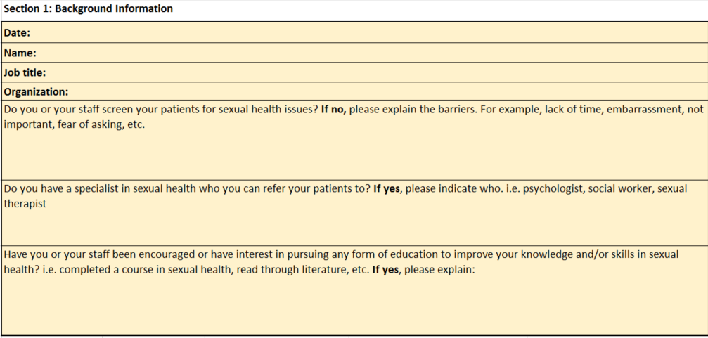
Section 1: Background Information
Section 1 of Template

Slide 5




DEMOGRAPHICS
26 Scans were returned
WHO RESPONDED:
Counsellor (1)
Doctors (2)
Managers (5)
Navigator (1)
Nurses (7)
Patient Educators (2)
Physiotherapist (1)
Program/ Clinic Coordinators (3)
Psychiatrist (1)
Psychologists (2)
Radiation Therapist
Social workers (4)
FROM WHERE:
Ontario
Nova Scotia
Quebec
Alberta
Northwest Territories
New York
11 out of 14 Regional Cancer Centres participated
Notes:
Please note some responses were handed in as a group. 21/27 Scans were from Ontario.

Slide 6
SCREENING FOR SEXUAL HEALTH ISSUES
Do you or your staff screen for sexual health issues?
YES
NO
OTHER
20
4
1
Of the 20 respondents who said yes, 7 had qualifying statements which indicated yes but:
  Only at initial consult
  For certain populations i.e. AYA, prostate, GU, etc.
  Screening is inconsistent
  Only by certain staff members
  Variation in how often screening is completed
  Feel their screening tool is not reliable (Screening For Distress)
  Not all patients reached or screened
Notes:
Certain HCPs feel it is part of their scope of practice i.e. those working in prostate, gynecological cancers, etc. while others do not
What is other: person gave context to what the barriers were but did not specify if they did or did not screen for issues.

Slide 7

BARRIERS TO SCREENING
Major Barriers to Screening
Other Identified Barriers
  No formalized assessment/tool in place
  No systematic approach in place for sexual health screening
  Staff discomfort
  Time constraints and competing priorities i.e. other demanding side effects
  Considered out of scope of practice
  Screening inconsistency between staff
  Lack of knowledge or lack of confidence in their knowledge to address concerns
  Culture issue – not considered as key component of cancer care/treatment
  Lack of resources
  Lack of clarity on whose role this is
  Assumption it is done by someone else
  Lack of training
  Side affects occur post-treatment and therefor missed
  Wait for patients to initiate
  Assume patients will be uncomfortable
Notes:
Left hand column has major themes which were mentioned 4-7 times and the other identified barriers were mention 1-2 times
7 people
4 people
4 people
5 people
4 people
5 people
Suggested it could be called out on ESAS

Slide 8
REFERRALS
Do you have a specialist in Sexual Health who you can refer patients to?
YES
NO
OTHER
17
6
2
Respondents identified a variation of practitioners for referral with different levels of expertise and education
3 centres reported having a sexual health clinic their for referrals
5 respondents of the 17 who do referrals utilize specialists in the community
Specialists identified included:
  Nurses
  Social workers
  Physicians
  Counsellors
  Psychologists
  Psychotherapists
  Sexual Therapists
  Physiotherapist
  Patient Educators and more

Slide 9

SEXUAL HEALTH EDUCATION
Have you or your staff been encouraged or have interest in pursuing any form of education to improve your knowledge and/ or skills in sexual health?
Inconsistency on how respondents understood and replied to this question
Respondents who indicated that sexual health education was encouraged and of interest at their centre, further specified that:
  Funding was dedicated to sexual health education for staff
  Rounds and in-services are held for staff education
  Sexual health education is a requirement for certain staff members
  The PLISSIT model was implemented at their centre to aid in screening and more
4 respondents felt they were not encouraged to pursue education at there centre, but noted they are still encouraged to screen for sexual health issues.
Many respondents listed individuals who have completed education or education opportunities they were aware of
Notes:
Many respondents spoke to specific individuals who pursued and completed education in sexual health

Slide 10
2. RESOURCES: SCREENING/ASSESSMENT AND REFERRALS
Section 2 of Template

Slide 11
2. RESOURCE TYPE & SUMMARY
Screening & Assessment
(Used by >2 of the respondents).
Resource Type (right click to access link)
Summary
Expanded Prostate Cancer Index Composite for Clinical Practice (EPIC-CP). Authors: Chang, P. et. Al.
Canadian Problem Check-list (Part of the Screening for Distress Tool). Author: the Canadian Partnership Against Cancer.
Adolescent and Young Adult Screening Tool (Active and Survivorship). Author: Youth Cancer Service (Australia)
IIEF questionnaire - International Index of Erectile Function (IIEF).
Instrument that enables patient-reported HRQOL to be measured efficiently and accurately at the point of care
A valid tool for reportable screening measurements, located in the Partnership’s Screening for Distress tool, as per the CAPO/Partnership guideline Assessment of Psychosocial Health Care Needs of the Adult Cancer Patient.
A psychosocial screening tool including a distress scale and problem check-list to measure and investigate AYA specific needs.
Questionnaire that reviews quality, frequency, and characteristics of sexual activity.

Slide 12
2. RESOURCE TYPE & SUMMARY
Screening & Assessment continued.
(Used by >2 of the respondents).
Resource Type (right click to access link)
Summary
ESAS
Female Sexual Function Index (FSFI)
SHIM - Sexual Health Inventory for Men
Distress Assessment and Response Tool DART
Author: Princess Margaret Cancer Centre (PM)
A tool built to assist in the assessment of nine symptoms common in cancer patients: tiredness., pain, tiredness, nausea, depression, anxiety, drowsiness, appetite, wellbeing and shortness of breath.
A questionnaire examining the sexual functioning in women. Informs relevant interventions.
A scale for screening erectile dysfunction (ED) and the severity of ED in clinical practice and research.
A tool to detect distress in cancer patients as a harm reduction method.

Slide 13
2. RESOURCE TYPE & SUMMARY
Interventions
(Used by >2 of the respondents).
Resource Type (right click to access link)
Summary
Vaginal dilators and booklet
Gyne Gals - Randomized Controlled Trial of an Online Support Group for Sexual Problems due to Gynaecological Cancer. Author: Agota Drozd.
Sensate Focus Exercise
An intervention designed to reduce vaginal shortening or discomfort following treatment.
Online support group for sexual problems due to gynaecological cancer. Offered to every patient with gynecologic cancer who is disease free and meets cut off criteria for sexual distress. Self-Administered by patient and given to receptionist at initial intake to sexual health clinic.
Therapeutic activities designed to help overcome anxiety surrounding sexual intimacy.

Slide 14
3. SUPPLEMENTAL RESOURCES (PROVIDER FACING)
Screening/Assessment
Questionnaire to help understand how patients’ medical illness or treatment affects yourself and your body
A scale used to identify the quality of body image and issues in management.
Tool to help clinicians compare patient's' Quality of Life in relation to prostate utility to norms for similar patients, and track Quality of Life over time.
A holistic assessment of health indicators and risks, involving 15 diagnostic tests.
Exercise facilitated during counselling by social workers
SFQ - Sexual Function Questionnaire
Body Image Scale Author: Hopwood et. al.
Patient-Oriented Prostate Utility Scale (PORPUS) - a prostate cancer specific QoL questionnaire.
Comprehensive Health Assessment. Author: Medcan.
Sexual Values Exercise. Authors: Beck et. al.

Slide 15

2. BARRIERS TO USE AND IMPLEMENTATION
Barriers for implementation identified across sexual health and cancer educational resources.
Major Barriers
Interdependence: Patients complete these routinely, but are often reliant on staff to identify concerns and make referrals.
Example: Canadian Problem Checklist
Accessibility: Language and frequency of appointments are identified as a barrier to accessibility and effective implementation of tools.
Comfort: Resources need to be adaptable to patient’s comfort level to ensure accuracy in responses captured in screening/assessment tools.
Funding: The effective implementation of some interventions can be constrained by funding limitations.
Example: The vaginal dilators, whose provision of PTS is influenced by lack of funding.
Consistency: Self-administered assessment surveys is not consistently completed by patients or responded to by health care providers/physicians in clinic.
Example: ESAS
Efficiency: The efficiency of use is identified as a barrier across resources. Timing and length of tool use presents a barrier to usability by patients and engagement.
Example: The SHIM (Sexual Health for Men Inventory) and the Expanded Prostate Cancer Index Composite (EPIC).
Human resources: Issues in staff time and skill in following up when a patient indicates they have a concern.

Slide 16
2. SUMMARY: ADMINISTRATION & USE
How provider-facing sexual health & cancer resources are administered & utilized.
Administration of Resources/Tools
Use
When?
Resources/tools most often administered either at first appointment or group session, at in-take, and later following treatment and/or during survivorship.
By whom?
Patients: Questionnaires and assessments (i.e. problem check-list, IIEF questionnaire, DART) self-administered by patient.
Social Workers: Administer assessment tools and group therapy. After social workers administer assessment, results are used to tailor counselling.
RN/NP: Review results from patient’s self-administered screening/assessment and forward to clinicians. Administers tools at intake.
Clinicians: Clinicians assess results from screening tools (i.e. items of distress, sexual functioning) and refer as appropriate.
Screening & Assessment: Information following screening and assessment is used for both referral purposes and to better tailor the clinical resources and staff support to address the patient’s emerging sexual health and intimacy concerns.
Screening & Assessment: Helps guide surgical decisions and leads patient education and patient decision making.
Screening & Assessment: Results following screening using tools that assess sexual functioning and quality are used to advance effective referral and triage to appropriate PSO or NP support.
Interventions:
(A) Gyne-Gals: Self-Administered by patient and given to receptionist at initial intake Use: Informs assessment and planned interventions.
(B) Vaginal Dilators: Reviewed by NP/MD (ongoing). Use: (1) Patients are triaged to the appropriate provider; (2) Contributes to development of a treatment plan.

Slide 17
Section 3: Patient Education Materials
Section 3 of Template

Slide 18
3. DISEASE SITE SPECIFIC RESOURCES
Resource Type
Summary
Breast Cancer: Your emotions, body image and sexual health
Coping with Estrogen Loss
How to use a vaginal dilator
Sexual Health after Testicular Cancer
United Ostomy Associations of America's Intimacy After Ostomy Surgery Guide
Educational publication overviewing the impact of treatment on the emotional and sexual aspects of the patient’s lived experience, and their care options.
Support resource for premenopausal women receiving chemotherapy or women receiving Tamoxifen, Exemestane, Anastrazole or Letrozole.
Support resource for Pelvic Cancers Female Radiation Therapy interventions.
Pamphlet on the impact of testicular cancer on sexual health.
Educational publication on sexual health and intimacy following ostomy surgery.

Slide 19
3. NON-SITE SPECIFIC RESOURCES
Resource Type
Summary
Sexuality and Cancer - Canadian Cancer Society
American Cancer Society's (1) Sexuality for the Woman with Cancer and (2) Sexuality for the Man with Cancer.
Managing Body Image Concerns after Cancer Treatment Author: UHN.
Book(s): (1) Woman Cancer Sex; and (2) Man Cancer Sex. Author: Dr. Anne Katz.
Overview of sexuality and cancer, from sexual response to arousal.
Guide to patients and their partners for how to sustain sexually active lives despite treatment, and how to manage their bodies during and after treatment.
Provides information regarding how the body changes as a result of cancer and how to manage body image and identity.
Self-help guide for women and men with cancer and the long standing issues related to sexuality

Slide 20
3. SUPPLEMENTAL RESOURCES (PATIENT FACING)
Sexual Health after Testicular Cancer A scale used to identify the quality of body image and issues in management.
America's Intimacy After Ostomy Surgery Guide. Author: United Ostomy Associations of America's Intimacy After Ostomy Surgery Guide
Non-Disease Site Specific
Disease Site Specific
Erectile dysfunction- Treatment options- Canadian Urological Association
Vaginal Dryness- North American Menopause Society.
Treating Hot Flashes- North American Menopause Society.
This Should Not Be Happening. Author: Anne Katz.
Sex and Intimacy Class ELLICSR. Author/Host: PMH.

Slide 21
5. SUMMARY: PATIENT FACING RESOURCES
Disease-Site Specific:
  Common disease sites discussed in the support publications include breast cancer, colon cancer, testicular and pelvic cancers. Minimal resources identified addressing other disease sites.
  Treatment specific items feature publications and educational resources targeting women receiving chemotherapy or medications inducing estrogen loss.
  Across the disease-site patient resources, loss of intimacy following treatment demonstrated a common topic for self-help.
Non-Site Specific:
  Across the publications, body and identity were common themes present in self-help guidelines and books, ensuring that patients can effectively manage body image during and after treatment, contributing to improve sexual health.

Slide 22
Contact Information
If you have any questions, please contact:
Colleen Fox
Group Manager, Psychosocial Oncology, Nursing and Patient Education
Colleen.fox@cancercare.on.ca

