Slide 1



It’s Time to Talk:
Starting the Conversation Around Sexual Health in Cancer
Health care provider resource
February 2017

Slide 2
Learning Objectives
Significance of Quality of Life (QoL) for Cancer Patients
Sexual Health is an Important Component of Quality of Life
Barriers to Conversation and Ways to Overcome Them
Why it Matters – Patient Experience
How Healthcare Providers (HCPs) Can Make a Difference
Recommendations on How HCPs can Start the Conversation
Overview of the CCO Sexual Health Clinical Guideline
Available Resources

Slide 3
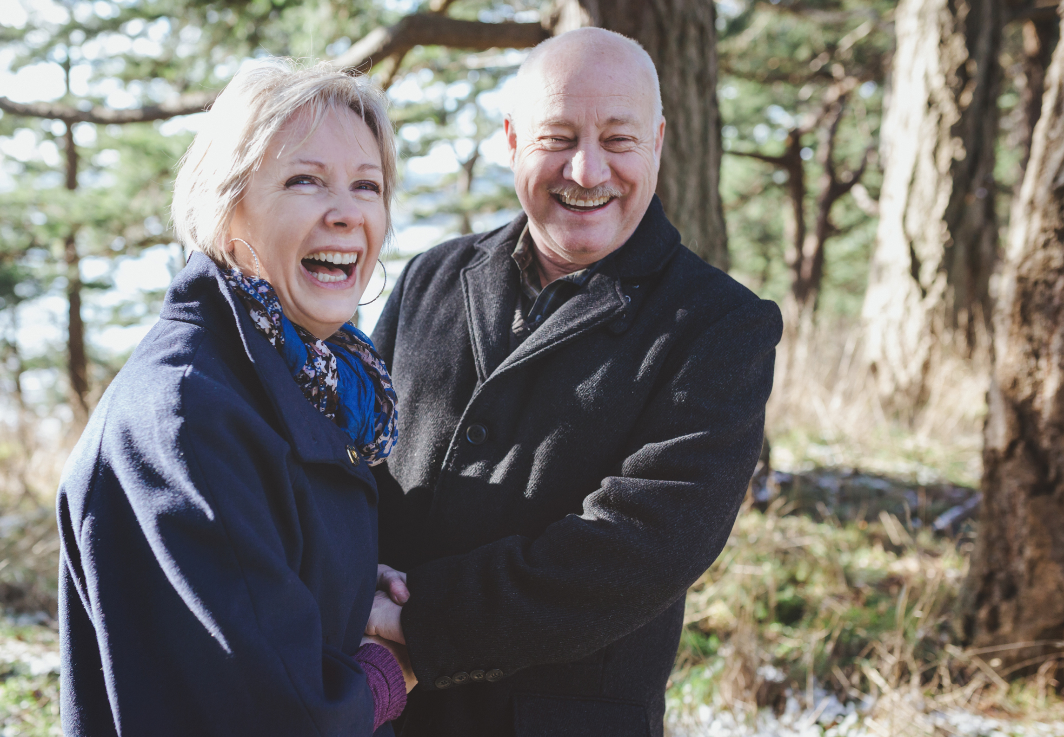
Cancer and Quality of Life
Scientific & Technological Advances
Quality of Cancer Treatment
Life Expectancy for Cancer Patients
Cancer is now considered to be a
chronic disease.
With cancer patients living longer, quality of life has become very important to both patients and healthcare providers.
Notes:
There have been advances made in science and technology over time, which has improved the quality of cancer treatment available for patients. This improved quality of treatment has increased the life expectancy for cancer patients, so that more patients are living longer with cancer. Cancer is now considered to be a chronic disease, and as a result, quality of life has become increasingly important to both patients and healthcare providers.

Slide 4


Cancer and Quality of Life
“In chronic
conditions,
adding life to
years instead of
years to life is an
important task.”
- Montazeri et al.
Notes:
Survivorship is an important topic, and the focus on quality of life during survivorship is important.
Quote reference: Montazeri et al. (1996). Measuring quality of life in oncology: is it worthwhile? I. Meaning, purposes and controversies European Journal of Cancer Care. Volume 5, Issue 3. pp. 159–167.

Slide 5
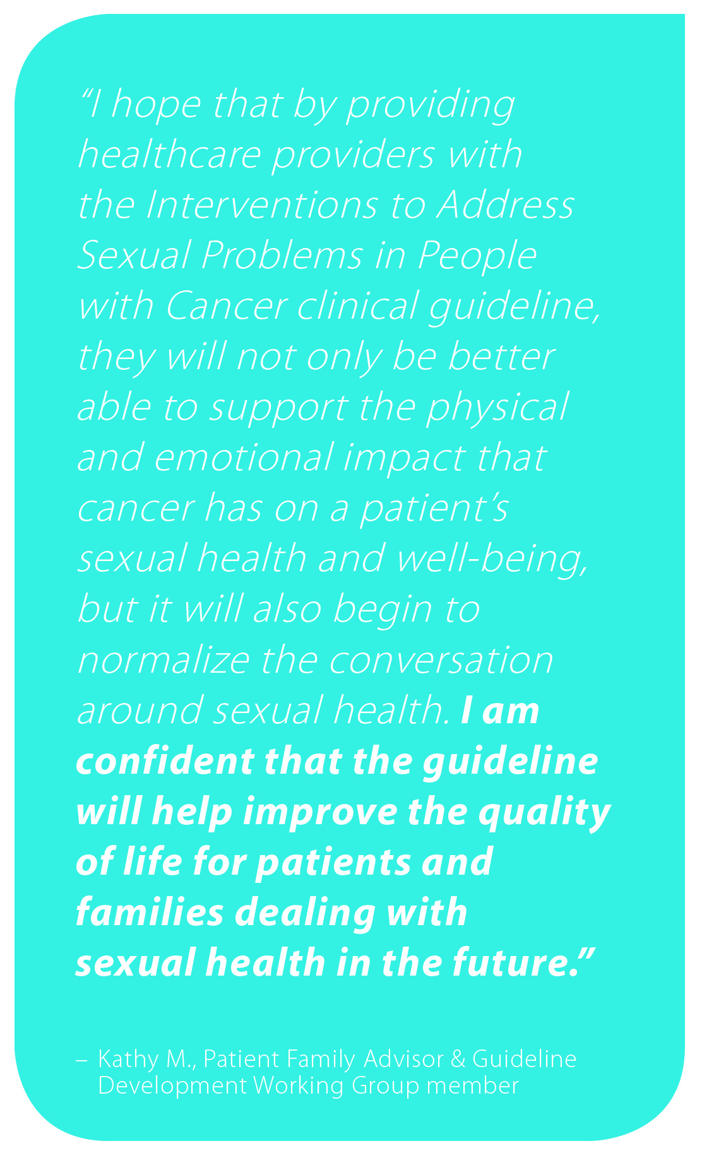
One Component of QoL: Sexual Health
Body
Image
Quality of Life
Intimacy / Relationships
Sexual Health
Sexual Response
Notes:
Patients may have concerns in mind related to body image, intimacy, and sexual response, all of which are issues related to both sexual health and the patient’s quality of life.
Body image is something widely understood as affecting QoL for cancer patients, but it affects QoL in more ways than we may think. Feeling good about yourself is positively correlated with improved QoL.
Maintaining intimacy/close relationships is also correlated with better QoL. The important thing here between sexual health and QoL is that it can enable people to maintain intimacy and closeness with their partners or potential partners in the future. In our society, sex and intimacy are almost inextricably linked and although we can encourage people to be intimate in other ways, for many it has always been about sex and it is difficult for them to change. Conversations should include how to try to maintain function and ability to have sex.
Sexual response refers to desire, arousal, and orgasm, which will affect QoL for those to whom sexual performance is important.

Slide 6
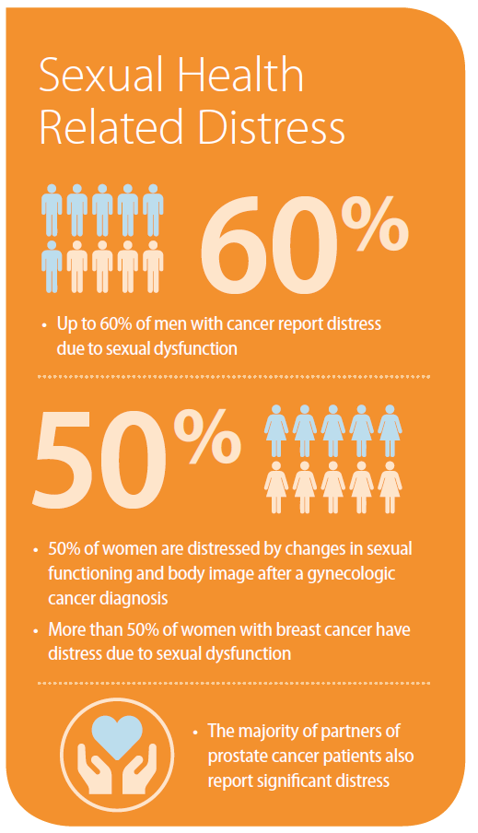
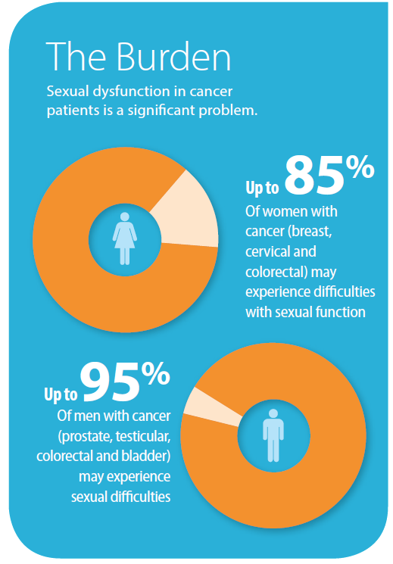
Prevalent and Important
Sexual dysfunction in cancer patients is a significant problem.
Notes:
Initiating the conversation around sexual health for cancer patients can help identify psychological as well as chronic physical side effects of treatment. For example, medically-induced menopause can lead to vaginal atrophy, and incontinence may affect one’s body image. Conversing about sexual health can thus be useful for identifying these chronic side effects of treatment. Furthermore, depression and anxiety could potentially be mitigated by treating the chronic issues earlier, or helping patients maintain intimacy so that they don’t feel alone and isolated. Normalizing the conversation around sexual health thus offers an opportunity to improve the patient’s quality of life while potentially saving health care dollars by recognizing and treating side effects at an earlier stage before they become chronic or untreatable.

Slide 7






Barriers to Conversation
Environment – Want to converse in a private area
Time – There’s not enough time for conversations
Training – Sexual health regarding cancer patients is not included in many training programs
Resources – Lack of awareness about available resources and access to services
Comfort Level – Personal areas of discomfort
Notes:
Environment –the topic of sexual health is such that HCPs feel they need to provide privacy so that patients are comfortable to talk openly .This might sometimes be a challenge in busy workspaces.
Time-HCPs already feel pressure of time in the busy schedules.
Training – HCPs may feel they need specific training to give them confidence to initiate conversations.

Slide 8
Stereotypes and Misconceptions
Single people don’t need information on sexual health.
Older individuals are not interested in having sex.
People who are not sexually active don’t need this information.
Cancer patients care about the effectiveness of cancer treatment, not quality of life.
Notes:
There are a number of stereotypes we may believe or misconceptions we may have, potentially without being aware of them. This impacts how patients are treated and influences the type of information the HCP chooses to share with the patient.

Slide 9
Stereotypes and Misconceptions
Single people don’t need information on sexual health.
Older individuals are not interested in having sex.
We need to focus on
PERSON-CENTRED CARE
by seeking to determine what is important to the patient
People who are not sexually active don’t need this information.
Cancer patients care about the effectiveness of cancer treatment, not quality of life.
We don’t know until we ask
Notes:
Each individual is unique and may have different views as to what they consider to be important. Some cancer patients may believe that their quality of life is more important than their life expectancy, thus they may prefer to live a shorter life but maintain the quality of their life. It is crucial to find out what is important to the patient, and if they are interested in discussing sexual health, regardless of any preconceived notions we may have. We don’t know until we ask.

Slide 10
Overcoming Barriers
HCP and patient-facing resources are available
Engage in reflective practice
Training programs are available
Use resources to start the conversation and follow-up with the patient at a later time
Environment
Time
Training
Resources
Comfort Level
Speak in a private room; Let team members know the conversation will be initiated
Barriers to discussing sexual health
Notes:
Environment – Can be adapted to have these conversations in the same way that clinicians do for other personal topics of a sensitive nature. Wait until you are in a private space (e.g. clinic room or treatment/procedure room) and let your team know that you are going to initiate the conversation so that they know to wait until the questions have been answered before entering the room. Alternatively, one team member could be appointed to initiate the conversation in clinic each day. Most clinics have private areas that can be used. Consider speaking with your department about creating spaces to make your work area more private if you do not have designated areas.
Time – HCPs have the skills to start these conversations at a basic level, and that doesn’t take much time. Bring up the topic by giving the patient written resources/information on the topic they are interested in or concerned about. Follow-up at a later time (e.g. next clinic or radiation treatment) or invite the patient back if possible for continued discussion. Most patients are seeking simple, practical information and to have their questions answered.
Training – HCPs already have skills in patient communication and supportive care through their regular training. Specific training can be carried out as part of professional continuing education requirements to increase their knowledge and skills (e.g. there are some training programs available – see resources at end of slide deck).
Resources – Both HCP-facing and patient-facing resources are available, as well as the CCO Guideline and Resource Hub (soon to be released). Knowing what resources are available and referring patients to specific resources if they need further support beyond the HCP’s scope or time is a good way to support patient care. Referrals to specialized HCPs should be made for more intensive follow-up.
Comfort Level – HCPs should engage in reflective practice to determine areas of personal discomfort to overcome

Slide 11
Patient Experience
“It wouldn’t have mattered when I got the information because I would have had the treatment anyhow...but it would have been good to be more prepared about what was going to happen so that it wasn’t a surprise...I asked myself, ‘This as well, what next? What else haven’t they told me about?’”
Prostate cancer patient at a follow-up clinic appointment commenting on his experiences with erectile dysfunction after surgery.
Notes:
Not giving evidence-based information to patients increases the likelihood of reliance on unreliable sources. It also decreases the patient’s confidence in HCPs if they feel that HCPs have filtered the information before sharing it with them.
Thus, being willing to initiate and engage in these conversations can help improve the patient experience throughout the cancer journey.

Slide 12

So what can we do to help?
Open the Dialogue
Recognize barriers
Initiate the conversation as part of regular patient care
Ask questions and/or use tools to start the discussion
Be familiar with patient-focused resources
Initiating a conversation about sexual health with cancer patients is the first essential step that should be taken by healthcare providers so that further support can be given.
Notes:
HCPs are trained and can communicate with patients / partners etc. on difficult and personal topics. It is key to use the skills HCPs already have to incorporate sexual health.

Slide 13
Provide a Team-Based Approach
An optimal patient experience can be achieved when HCPs throughout the care pathway initiate the conversation.
Initial consultation
Radiation treatment
Survivorship
Chemotherapy treatment
Near the end of treatment
Notes:
Health care providers in different roles should initiate the conversation regarding sexual health in cancer throughout the treatment trajectory.

Slide 14
Create a Supportive Culture
Patient Tool: Checklist of Questions
Will this treatment affect me sexually?
Will this treatment affect my hormones?
Will the changes be permanent?
When will I feel like having sex again?
When is it safe to have sex again?
How soon can I masturbate or have sex?
What sort of problems could we have during intercourse?
It hurt when we had intercourse. Why?
What kind of birth control should I use?
Will I be able to have children after treatment?
If I’ve had a sexually transmitted disease or infection, will it come back with cancer treatment?
Will I ever feel normal again?
Where can I get more information or find a sexual counsellor or sex therapist?
Ask questions to start the conversation
Include “sexual health” as a component of the patient intake form
Use screening tools (e.g. EPIC) and leverage them as a way to initiate the conversation
Provide the patient with a list of questions they can ask
Notes:
Eventually all clinics will have screening tools that include sexual health and intimacy. The EPIC screening tool is being used throughout the province in some cancer centres and has one section related to sexual health. It will be used throughout Ontario by the end of 2017.
Using written materials is beneficial for both the healthcare provider and the patient. Providing these materials is one way to make it easy to start the conversation around sexual health in cancer patients. It also gives the patient a resource that they can look at to help them think about questions for the next visit, if they aren’t ready to discuss during the initial conversation.
Checklist of Questions Reference: Canadian Cancer Society. (2012). Sexuality and Cancer. p. 13.

Slide 15
Use the PLISSIT Model
Seek permission to talk about the topic
Mention written materials as a way to start the conversation
Permission
Limited Information
Specific Suggestions
Intensive Therapy
Clearly state how cancer treatment can affect sexual health
Offer materials for the patient to learn more
Offer suggestions from the clinical guidelines regarding how to improve sexual function and prevent issues from occurring
Consider referring the patient to another health professional who can help
Notes:
Any HCP can initiate a conversation with patients using the Permission and Limited Information components of PLISSIT, while the Specific Suggestions and Intensive Therapy steps would be best discussed by a HCP with the appropriate specialization or training. All team members should be willing to start the conversation, and the team should identify local contacts to refer patients to when patients have more specific questions or need counselling.
Additionally, it is important that HCPs record key points from their conversations with patients in the patient’s chart, to help facilitate continuity of care along the treatment trajectory.
Permission
It’s about seeking permission to converse about sexual health with patients, and giving them permission to talk about it with you.
Example: “Some of the side effects of X-ray treatment may affect sexual health. Is that something you are concerned about?”
Example: Offer pamphlets regarding sexual health or dysfunction
Normalize the issue by acknowledging common side effects and validate the patient’s feelings
Limited Information
Be concise and offer materials for the patient to learn more (to avoid information overload)
Specific Suggestions
Offer specific suggestions as outlined in the guidelines, such as ways to improve sexual function and how to prevent issues from occurring. For example, using vaginal dilators or engaging in prostate rehabilitation activities can help prevent issues that may more negatively impact quality of life.
Intensive Therapy
Intensive Therapy is usually beyond the scope of healthcare providers, so a HCP could refer the patient to sex therapists, couples and relationship counselors, psychiatrists, or psychologists so they can provide more detailed information to the patient.

Slide 16

Initiate the Conversation: An Example
“The treatment you are going to receive may affect sexual intimacy. For example, this chemo drug often causes vaginal dryness or decreased libido and that is normal. When you have concerns with changes, please let us know and we can provide some suggestions and resources. I also will be including the opportunity to discuss this further at various times when you are here for your appointments with us.”
Time
“Have you noticed any changes in your sexual functioning since you started treatment? Do you have any sexual health concerns that you would like to discuss?”
Time
“Last time, we talked about your hot flashes. Did any of the suggestions I gave you help?”

Slide 17
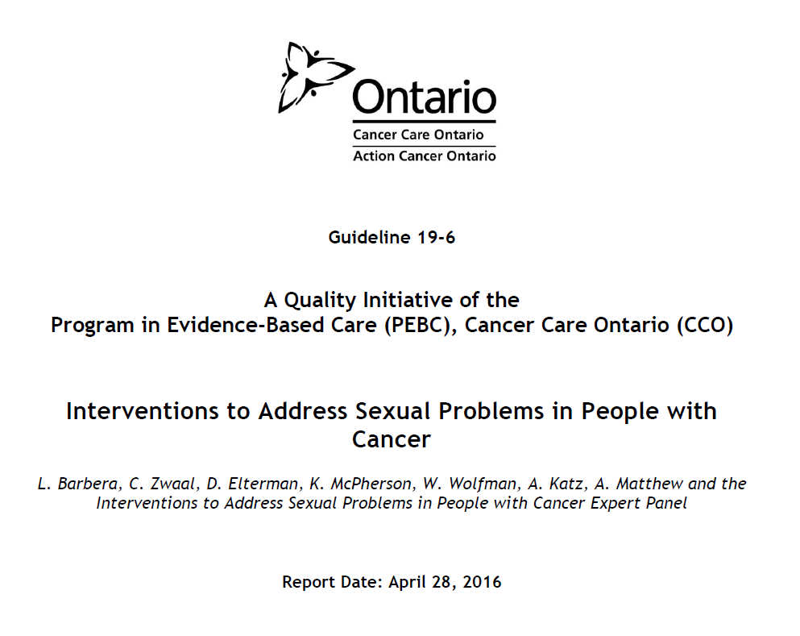
Become Familiar with the Clinical Guideline

Slide 18

An Overview: Recommendations for All People with Cancer
Healthcare providers should initiate a discussion with the patient regarding sexual health and dysfunction
  Engage with patient and partner (if partnered)
  Raise issue at time of diagnosis
  Re-assess the issue periodically throughout follow-up
Provide access to resources or referral information for the patient (and partner)
Notes:
These next few slides showcase recommendations from the guidelines, based on how they are split up in the guideline: The 3 categories are “for all people with cancer”, “for women”, and “for men”.

Slide 19
An Overview: Recommendations for Women
Sexual Response
Offer psychosocial counselling and recommend regular stimulation, including self-stimulation
Body Image
Offer psychosocial counselling with couples-based interventions when appropriate
Intimacy/Relationships
Offer psychosocial counselling with couples-based interventions when appropriate
Overall Sexual Functioning and Satisfaction
Offer psychosocial counselling and consider physical exercise or pelvic floor physiotherapy
Vasomotor Symptoms
Recommend hormone therapy or alternatives and offer psychosocial counselling
Genital Symptoms
Recommend vaginal moisturizers, lubricants, vaginal estrogen, and/or vaginal dilators
Notes:
Lisa is presenting on guideline in detail at PCC Rounds in fall, which will go more in depth.

Slide 20
An Overview: Recommendations for Men
Sexual Response
Offer psychosocial counselling, recommend PDE5i medications or alternate interventions, and recommend regular stimulation, including self-stimulation
Genital Changes
Recommend using a vacuum erectile device daily and consider PDE5i medications
Intimacy/Relationships
Offer individual or couples counselling
Overall Sexual Functioning and Satisfaction
Offer psychosocial counselling and consider
pro-erectile agents and devices
Vasomotor Symptoms
Offer medication or acupuncture for symptomatic improvements

Slide 21

It’s Time to Talk – Let’s Start the Conversation
Visit cancercare.on.ca to access the Interventions to Address Sexual Problems in People with Cancer guideline:
https://www.cancercare.on.ca/psoguidelines
Notes:
Link to the guideline: https://www.cancercare.on.ca/toolbox/qualityguidelines/clin-program/psychonc/

Slide 22
Acknowledgements
Cancer Care Ontario would like to thank the following individuals for their contributions:
Angela Turner, MRT(T), MHSc.
CSRT Supportive Care & Sexual Health, Odette Cancer Centre, Toronto
Lecturer, University of Toronto Department of Radiation Oncology
Kaitlynn Almeida, BScH, MPH
Coordinator, Regional Programs and Performance Management, Cancer Care Ontario
MPH Practicum Student, Ottawa Public Health Sexual Health Centre
Lisa Skelding, MSW, RSW
Certified Emotionally Focused Couple Therapist & Registered Sex Therapist (BESTCO)
Joyce M. McManus, BA M.Div, BSW, RSW
Social Worker, Windsor Regional Cancer Program

Slide 23
Additional Resources
CCO Resource Hub for sexual health and cancer
CCO Patient Symptom Management Guide for sexual health
IPODE Project Courses “Sexual Health in Cancer”
Part 1: Sexual Health in Cancer
Part 2: Sex Counseling in Cancer
Canadian Cancer Society’s “Sexuality and Cancer” booklet
Includes a list of relevant questions for patients to consider asking their health care team
Coming
Soon!
Coming
Soon!
Notes:
A more detailed list of resources will be included in the CCO Resource Hub for sexual health and cancer, once the webpage is live.

