Slide 1



Implementing
The Management of Depression in Patients with Cancer
Guideline
Health care provider resource
February 2017

Slide 2
Learning Objectives
To describe the presentation of depression in cancer
To apply the 8 recommendations from
The Management of Depression in Patients with Cancer guideline
To utilize the guideline’s practical toolkit in clinical care

Slide 3
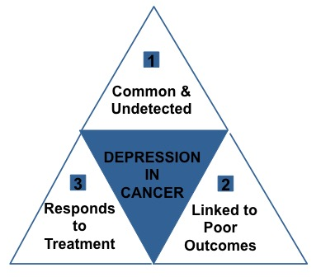
Depression in Cancer
1
Depression is prevalent in cancer (Miller et al., 2011)
Major Depression: 5-16%
Other Depressive Disorders: 25-32%
2
Associated with poor outcomes (Massie & Poplin, 1998, Pirl & Roth, 1999, Llyod-Williams et al, 2009)
Reduced coping with physical symptoms (e.g. pain)
Worsened quality of life
Increased health care utilization
Non-compliance with treatment
Increased likelihood of suicide
A predictor of early death in some studies with cancer patients
3
Depression is treatable
  Pharmacological treatments
  Psychological treatments
  Collaborative care interventions
Notes:
3

Slide 4
Depression as a Final Common Pathway of Distress
Cancer-Related
Stressors
Continuum of
Depression
Individual Factors
Biological
Tumour burden
Treatment morbidity
Pain and physical symptoms
Neurobiological changes
Stage of disease
Psychosocial
Diagnosis, relapse
Proximity to death
Disability
Altered role functioning
Changes in identity
Changes in appearance
Altered life trajectory
Uncertainty
Medical communication
Major
Depression
Sub-threshold
Adjustment Disorder, Minor Depression, Dysthymia
Life stage
Demographics
Coping strategies
Self esteem
Spirituality/Religiosity
Social support
Attachment style
Previous trauma
Psychiatric history
Genetic vulnerability
Normal
Sadness
Requires individual bio-psycho-social approach to treatment
Notes:
Although depression is often regarded as a discrete disorder, it can also be considered as a final common pathway of distress that arises from the interaction biological, psychological and social factors. In cancer, biological factors may include the neurobiological impact of the disease and the treatment, as well as the impact of pain and physical symptoms. These interact with the psychological impact of the disease and its effect on identity and role functioning. The extent to which depression may occur depends on a variety of individual and interpersonal strengths and vulnerabilities and the depression which results may range from normal sadness on the one hand to major depressive disorder on the other.

Slide 5
DSM-5 Diagnostic Criteria for Major Depression
DSM-5 diagnostic criteria for a major depressive episode (A and B criteria only)
At least five of the following symptoms, present during the same two-week period, representing a change from previous functioning, each present nearly every day; and at least one of the symptoms is either (1) or (2). Note: Do not include symptoms that are clearly attributable to another medical condition. Depressed mood most of the day Markedly diminished interest or pleasure in almost all activities most of the day Significant weight loss or gain (change of >5% in a month), or decrease or increase in appetite Insomnia or hypersomnia Psychomotor agitation or retardation Fatigue or loss of energy Feelings of worthlessness or excessive or inappropriate guilt Diminished ability to think or concentrate, or indecisiveness Recurrent thoughts of death (not just fear of dying), recurrent suicidal ideation, or a suicide attempt or plan Symptoms cause clinically significant distress or impairment in social, occupational, or other important areas of functioning.

Slide 6
Challenges in the Diagnosis of Depression
What is depression vs cancer?
  Clinical depression vs. the normal dysphoric response
  Overlap between physical symptoms of disease vs. depression
  Distinguishing loss of enjoyment from cancer-related loss of function
  Similar medical conditions such as hypoactive delirium
Recognizing atypical presentations in cancer patients
  Amplified somatic symptoms, treatment non-compliance or refusal, extreme recurrence fear
Distinguishing suicidality from desire for hastened death or rational thoughts about assisted dying

Slide 7
Challenges in the Diagnosis of Depression
Normalizing or rationalizing the depression
Patient discomfort in expressing emotional pain
Caregiver discomfort or time constraints in exploring emotional issues
As a result of these issues depression in cancer tends to be underdiagnosed and undertreated but can sometimes be over-diagnosed

Slide 8
The Continuum of Depression
Normal Sadness | Sub-threshold or Minor Depression | Major Depression
Maintains intimacy and connection Believes that things will get better Can enjoy happy memories Sense of self-worth fluctuates with thoughts of cancer Looks forward to the future Retains capacity for pleasure Maintains will to live | Shows similar low mood presentation as in major depression but does not meet full criteria for symptom number, severity or duration Includes persistent depressive disorder (dysthymia) if > 2 years duration Includes episodes lasting < 2 weeks Includes adjustment disorder which includes marked distress or functional impairment, but is often self-limited, and does not meet other criteria for major depression | Feels isolated Feeling of permanence Excessive guilt and regret Self-critical ruminations or loathing Constant, pervasive and nonreactive sadness Sense of hopelessness Loss of interest in activities Suicidal thoughts
Notes:
This slide shows the continuum of depression ranging from normal sadness on one end to major depression at the other end of the continuum of severity. Major depression is characterized by a cluster of psychological and vegetative symptoms that are present most of the day, nearly every day, for more than 2 weeks. In subthreshold depression there is a similar presentation of low mood, but the symptoms are fewer in number, duration or severity. Subthreshold depression can include adjustment disorder in which there is marked distress or functional impairment, but in which the other criteria for major depression are not met. This continuum blends into normal sadness, in which patients may experience considerable distress, but they still typically retain optimism, the capacity for pleasure and the will to live.

Slide 9
The CCO Management of Depression in Patients with Cancer Guideline
A quality initiative carried out with PEBC
Released May 2015
Update on the field since 2007 guideline identifying 2 new pharmacologic, 7 new psychologic, and 8 new collaborative care RCTs published in the last 10 years
Clinical Practice Guideline: J Oncol Pract. 2016 Aug;12(8):747-56
Systematic Review and Meta-analysis: Psycho-oncology. 2016 Sept 19. doi: 10.1002/pon.4286
M Li, E Kennedy, N Byrne, C Gerin-Lajoie , E Green, M Katz, H Keshavarz, S Sellick and the Management of Depression in Cancer Patients Expert Panel

Slide 10
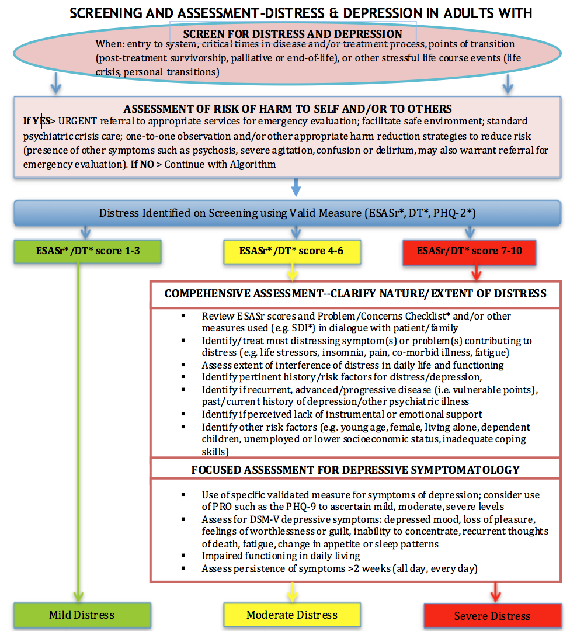
Recommendation 1:
Screening for Depression
ESAS depression item > 2-4
PHQ-9 ideation question
➔ suicidal intent question
Are other symptoms more urgent right now?
Distress risk factors and psychosocial contributors
PHQ-9 for depression
Severity
Persistence
Functional impairment
Source: CAPO SMG: goo.gl/Dp01ni; CAPO Webinar Nov 25, 2015: goo.gl/Oq5STO
Notes:
Identifying depression is the first step in management, and depression screening is one means of increasing the detection of depression in cancer patients.
Most care cancer guidelines recommend Screening for Distress as a standard of care. Screening for depression is commonly included as part of distress screening. The CCO anxiety and depression symptom management guidelines recommend screening using ESAS, and then using a validated PROM such as PHQ-9 as part of the focused assessment. This full guideline is available at the link shown.
Describe right side boxes- PHQ-9 can help distinguish sub-threshold from major depression
It is clear from the literature that in order to improve patient health outcomes, depression screening must be linked to effective interventions.

Slide 11
Depression Severity by PHQ-9
PHQ-9 score | Functional interference | Likely Major Depressive Episode severity
>5 | Not difficult | Sub-threshold
>10 | Somewhat difficult | Mild
>15 | Very difficult | Moderate
>20 | Extremely difficult | Severe
Notes:
Using PROM data to evaluate depression severity, moderate depression is characterized by a persistent PHQ-9 score >10 and “very difficult” functional interference, while severe depression occurs with scores >15 and “extremely difficult” functional interference. The presence of depression risk factors and complex psychosocial needs can place a patient with moderate depression into the severe depression care pathway.

Slide 12
Recommendation 2:
General Management Principles
Provide psychoeducation about the nature of depression
Inform about the negative impact of depression on cancer outcomes
Many do not have psychiatric history, may require destigmatizing of depression
Investigate medical contributors to depression which can include anemia, hypothyroidism or cancer treatments like steroids, hormone blocking therapies (eg tamoxifen, lupron)
Notes:
There are 8 general management principles to be considered before initiating any specific intervention for depression in cancer patients.
The first is to provide psycho-education about the nature of depression, which can be done by providing patient education materials such as handouts from the MacArthur Depression Management Tool Kit, the Mood Disorders Society of Canada, or the American Psychiatric Association. Examples of these are found within the CCO Resource Hub for Depression. CCO has also produced a patient facing self-management pamphlet on depression which is available at all cancer centres
Secondly, it is important to inform the patient about the potential impact of depression on cancer outcomes, including reduced quality of life, worsening of physical symptoms, longer hospital stays, and even reduced survival. Survival impacts of depression reflect all cause mortality and may not be cancer-specific, but meta-analyses have shown the increased mortality risk to be independent of disease burden. The risk may be related to lifestyle factors, suicide risk, reduced adherence to treatment, increased complications, or immunological effects.
3. Many cancer patients do not have a history of psychiatric disorders and may benefit from being advised of the medical model of depression to destigmatize illness. The medical model draws an analogy to diabetes, where illness is the result of a chemical imbalance in an organ of the body, and patients are urged to adopt the sick role, permitting themselves to be ill. The goal is to help them understand that depression in the context of cancer is not a failure to cope, but can be like pain, or any other medical complication of cancer and cancer treatment. For some patients it is important to both normalize depression (you’re not crazy; its understandable that you ar depressed, many people in your situation get depressed) and emphasize the importance of treating it to improve quality of life (pain is normal too and we treat that aggressively, it’s the same thing with cancer-related depression when the symptoms are severe enough to affect your life)

Slide 13
Recommendation 2:
General Management Principles
Assess and optimize cancer-related physical symptom control
Encourage family support and involvement, education and communication
Discuss treatment options attending to patients’ preferences and previous treatment experiences
Consider use of a validated depression rating scale to monitor change over time -e.g. PHQ-9, HADS, BDI-II (Mitchell 2012)
Notes:
A fourth general management principle is to ensure that distressing and burdensome cancer-related physical symptoms, such as pain or nausea, are well controlled, as there is clear a bidirectional relationship between symptom burden and depression in cancer patients.
Clinicians should consider the use of a validated depression rating scale to assess depression severity and monitor change over time. Several tools, such as the PHQ-9, HADS, or the BDI-II have been well validated in cancer patients. Consistency of use is more important than which tool to select. Alex Mitchell has published a comprehensive meta-analysis of several validated depression measures in cancer patients.
Lastly, it is important to discuss the available depression treatment options and support shared decision making, through understanding patient’s past experiences of depression treatment and eliciting their current preferences.

Slide 14
Quick Reference Management Algorithm
Clinical reality…
Notes:
Clinical reality would suggest that referral to psychosocial professional often occurs after step one; we are the ones who establish the depressive disorder not the front line oncologist or nurse especially when psychosocial professionals are available

Slide 15
Recomendation 3:
Interventions
Patients with cancer and major depression may benefit from pharmacologic or psychosocial intervention, either alone or in combination
  The effectiveness of psychosocial and pharmacological interventions for moderate depression is thought to be equal
  Pharmacologic interventions are most effective for more severe depression
  Combined psychosocial and pharmacologic interventions should be considered for moderate to severe depression in patients with cancer (see stepped care approach)

Slide 16
Recommendation 4:
Stepped Care Approach
Psychological interventions should be considered first for mild to moderate depression
Antidepressant medication should be reserved for:
  moderate to severe depression
  subthreshold or mild depressive symptoms persisting after initial interventions
Notes:
Psychological interventions should be considered first for
mild to moderate depression
Antidepressant medication should be reserved for:
moderate to severe depression
subthreshold or mild depressive symptoms persisting after initial interventions

Slide 17
Low intensity psychological interventions
Patient self-management:
Structured group physical activity programme
Group-based peer support (self-help) programme
Individual or group self-help programmes
**For more information on patient self-management resources see CCO website and Depression Resource Hub

Slide 18
High intensity psychological interventions
Psychosocial Specialist Interventions:
Individual psychotherapies
  Cognitive Behavioral (CBT)
  Behavioral Activation (BAT)
  Interpersonal (IPT)
  Problem Solving Therapy (PST)
  Psychodynamically-informed therapies
    Supportive Expressive (eg CALM therapy)
    Core conflictual relationship theme (CCRT)
  Meaning Centered or Existential
  Dignity Therapy
Behavioural couples therapy
Group Coping Skills Training eg MBSR

Slide 19
Recommendation 5: Collaborative Care
Model of care involving active collaboration between:
  primary care physician or oncologist who prescribes and follows
  patient care manager (RN, SW) providing psychoeducation about depression, PST or BAT
  psychiatrist who prescribes antidepressants as needed or supervises prescribing and psychotherapy; psychologist may supervise psychotherapy
Measurement based care (eg PHQ-9) to monitor progress
Weekly supervision/case conferences to adjust treatment plan as needed
Flexible treatment plans with range of treatment intensity (psychosocial treatment, antidepressants or both depending on patient situation) based on stepped care model
  should be considered for cancer patients diagnosed with Major Depression
  useful for mild, moderate and severe cases because of flexibility

Slide 20
Collaborative Care Model for Depression
Potential advantages to the Collaborative Care model for depression in cancer care delivery:
Ensures timely follow up and compliance with treatment; eg enhanced uptake and compliance with antidepressants
Often involves algorithm-based approach for medication and manualized psychosocial intervention which enhances outcomes
Collaborative care studies were better designed and powered, and of higher quality than the psychopharmacologic and psychological treatment studies reviewed
Particularly useful where primary depression care by psychiatrist or psychologist not feasible because of staffing availability issues
This may imply a significant restructuring of care delivery, which may be a challenge for institutions

Slide 21
Recommendation 6:
Specialist Referral
When to refer to psychosocial specialists in a stepped care model:
When there is risk of harm
In complex psychosocial cases
  ie. numerous social difficulties, substance abuse, cognitive impairment, psychosis, absence of social supports, personality disorders, etc.)
Where the patient experiences persistent symptoms after initial intervention
When diagnosis is unclear (this may be early depending on comfort level of the front-line staff (eg. Oncologist) in diagnosing and initiating treatment
For delivery of specific psychotherapies requiring specialized training

Slide 22
Recommendation 7:
Psychological interventions
Insufficient evidence exists to support one modality over another; choice should be based on patient factors and local resource availability
Psychological therapies (CBT,IPT, dynamic psychotherapies) should be delivered by health care professionals competent in the modality; non mental health specialists can be trained in basic psychosocial interventions like empathic communication, psychoeducation, PST or BAT
Tailor selection of psychotherapy to the patient
  CBT for patients wanting a symptom-based approach
  Supportive-expressive therapies for more psychologically minded patients
  Individual therapies may be more practical in patients who are in the palliative phase
Notes:
Psychologically minded - (i.e. patients with the capacity for self-reflection and introspection, and the ability to gain insight into their motivations and behaviours).

Slide 23
Cognitive Behavioral Therapy
CBT addresses negative thoughts about the self, world or future that are prominent in depression
Involves keeping thought records, recording connections between situations, moods and thoughts and teaches one how to critically evaluate one’s thoughts
Key intervention is ‘cognitive restructuring’ the reframing of negative thoughts through an analysis of the evidence for and against negative thoughts, and the correction of cognitive distortions
Recent interest in combining with mindfulness practice and delivering in group format (mindfulness based cognitive therapy)
Can be quite useful where patients misinterpret bodily sensations and overestimate likelihood of recurrence

Slide 24
Behavioral Activation
Focuses primarily on examining the consequences of depressed behaviors (reduce opportunities for positive reinforcement) and developing a gradual plan for becoming more mobilized and active
Activity scheduling emphasizing mastery and pleasure experiences
Avoiding avoidance behaviors
Evidence for equivalent effectiveness to problem solving therapy in depressed cancer outpatients (Hopko et al, 2009, 2011)

Slide 25
Problem Solving Therapy
Focuses on effective coping with stressors by teaching problem solving skills
Fosters adaptive attitudes and behaviours
8 treatment sessions delivered in person or by phone, individual or with support person
Can be delivered by non mental health professionals eg trained nurses
Most common therapy employed in collaborative care interventions

Slide 26
Problem Solving Therapy
Components of problem solving therapy involve:
  skills to enhance multitasking (externalization, visualization, simplification),
  skills to reduce emotional arousal that affects problem solving;
  problem solving tasks eg defining problem and goal setting;
  brainstorming,
  decision making,
  developing action plan,
  implementation and evaluation
(Source: Nezu et al, 2013)

Slide 27
Supportive-Expressive Therapy
  Therapeutic relationship
  Reflective space ( the creation of a safe space that encourages reflection and understanding
  Empathic understanding and validation (the attitude of the therapist fosters a sense of being understood and cared for)
  Affect regulation ( the relationship with the therapist has a calming effect and helps the patient manage symptoms)
  Mentalization i.e. distinguish facts from feelings; thinking about feelings and intentions
  Joint creation of meaning and new narratives (making sense of one’s life and the cancer diagnosis)
  Attention to the whole person
Notes:
Supportive-Expressive Therapy - also known as psychodynamic
A great series on doing psychotherapy for those interested is the “Psychotherapy Essentials to Go” series (2015) put out by several experts from University of Toronto. This is available at cavershambooksellers.com

Slide 28
Areas of Promise in Psychotherapy for Advanced Cancer
3 newer therapies targeting advanced cancer populations
Not yet reported in depressed subgroups
Dignity therapy (Chochinov et al, 2011)
An individual, legacy project intervention for palliative patients using a tape recorded interview based on a 9 question interview protocol. The dignity interview focuses on issues that matter most or that the patient would most want remembered. Edited transcripts of the interview are given to patients to share with family.
Meaning Centred Psychotherapy (Breitbart et al, 2012)
A brief intervention focusing on historical, attitudinal, creative and experiential sources of meaning developed for advanced cancer patients. Developed as either an 8 wk group or 7 wk individual intervention.

Slide 29
Areas of Promise in Psychotherapy for Advanced Cancer
CALM (Lo et al, 2014)
A brief, manualized, semi-structured individual and couple-based psychotherapy designed to alleviate distress in patients with advanced cancer.
3-8 sessions delivered over 6 months that addresses four broad domains: symptom management and communication with health care providers, changes in self and relations with close others, sense of meaning and purpose, and the future and mortality
supportive-expressive individual therapy shown to alleviate depressive distress and death anxiety and to improve the sense of meaning and peace (spiritual well-being).

Slide 30
Case Example: Mrs. J
Mrs. J is a 38 year woman, married with children aged 1 and 3. While still breast feeding, she was diagnosed with Stage IV breast cancer with metastases to liver and lung.
She presented with symptoms of sadness, existential distress, fatigue and difficulty initiating sleep. She was hopeful that chemotherapy would prolong her life and her symptoms did not meet diagnostic criteria for major depression. She had no personal psychiatric history, although she reported a history of depression in her mother and brother.
She actively engaged in metastatic breast cancer support groups, but found this unhelpful as no participants shared her life stage
Her nurse worked with her in problem solving techniques, focusing on her goal of producing legacy projects for her children, with some benefit for her mood although she continued to experience all daily activities as bitter-sweet

Slide 31
Recommendation 8:
Pharmacologic intervention
Recommendation 8 in the guideline contain clinical advice:
  When to use anti-depressants
  Which anti-depressant to use
  Drug interactions
  Issues with specific anti-depressants
  Starting, maintaining and discontinuing anti-depressants
  What to do when a patient is not improving, including combining and switching medications
Notes:
This slide is to be used by non-MD, non nurses who are delivering presentation in lieu of the detailed medication slides that follow.

Slide 32
Recommendation 8:
Pharmacologic intervention
Do not use antidepressants routinely for sub-threshold or mild depression
No antidepressant can be recommended as more effective than any other
Select based on clinical context
  Past personal and family psychiatric history (e.g., past positive treatment responses to an antidepressant)
  Concurrent medications (e.g., potential drug-drug interactions)
  Somatic symptom profile (e.g., sedating antidepressant for those with prominent insomnia; weight gaining antidepressant for cachectic patients)
  Potential for dual benefit (e.g., duloxetine and TCAs for neuropathic pain, venlafaxine for hot flashes)
  Type of cancer (e.g., avoid bupropion in those with central nervous system cancers)
  Comorbidities (e.g., avoid psychostimulants or TCAs in cardiac disease)
  Cancer prognosis (e.g., consider psychostimulants if very short life expectancy)

Slide 33
Common first line antidepressants in cancer

Slide 34
Potential drug interactions

Slide 35
Initiating an antidepressant
Screen for possible medical contributors to presenting conditions (e.g., TSH, vitamin B₁₂), as well as substance use
Start on lowest dose to minimize detrimental side effects and titrate up to therapeutic dose after first week
Discuss potential detrimental side effects (particularly initial gastrointestinal (GI) upset, headache, or anxiety) which should resolve within the first week
Explain that detrimental side effects occur before therapeutic benefit, which can take four to six weeks to reach full beneficial effect
Advise of need to take medications daily and continue even after remission of depressive symptoms
Counsel about potential discontinuation symptoms if medications are stopped abruptly
Reassure patients that dependence or tolerance does not occur
Discuss concerns related to antidepressants and potential increased suicidality

Slide 36
Managing Risk of Suicide
Advise risk of increased suicidality from antidepressants is small, most often associated with adolescents, and occurs early in the course of treatment; the risk of suicide from untreated depression is much greater
Explain that increased risk may arise from improved motivational activation, occurring before improvement in the depressed mood which underlies the suicidal thoughts, or as a result of anxiety/restlessness with treatment; occasionally antidepressant treatment can unmask a bipolar illness that can be destabilized by antidepressant (switching into mania or a mixed state)
Provide guidance on how to seek help
Note that suicidal thoughts can be common, but completed suicide accounts for <0.02% of cancer deaths (this is 1.5 times the general population’s risk), and overall suicide risk is decreased by treatment of depression
Inquire separately about suicidal ideation, intent, and plan
Distinguish suicidal ideation from rational thoughts of death, and desire for hastened death
Reassess adherence and mood after one week if suicidal ideation is present
Refer to mental health specialist urgently if considerable imminent risk

Slide 37
Maintaining an antidepressant
Provide support in first week when risk of nonadherence is greatest; follow up every two to four weeks until remission
Monitor agitation, increased anxiety, and insomnia. Consider short-term benzodiazepine for initial symptoms, if required
Assess response after three to four weeks at a therapeutic dose; increase dose if no response; switch medication if no response after six weeks
Regularly monitor for changes in medical status and cancer treatments and adjust accordingly
Continue at effective dose for at least six months after full remission
Patients with a history of recurrent depression should be advised to continue maintenance treatment for at least two years or indefinitely

Slide 38
Discontinuing an antidepressant
Be aware that discontinuation syndromes (malaise, dizziness, agitation, headache, nausea, paresthesia) may occur with abrupt termination or missed doses at high dosage levels
Understand that discontinuation syndromes are more common with antidepressants with a shorter half-life (i.e., venlafaxine, paroxetine); they do not occur with fluoxetine
Taper gradually over four weeks to minimize discontinuation syndromes; symptoms may be more prominent toward the end of the taper
Advise that symptoms are usually mild and self-limiting over approximately one week
If symptoms are severe, taper more slowly or consider switching to longer half-life SSRIs such as fluoxetine and then stopping
Monitor for possible depression relapse over the next few months

Slide 39
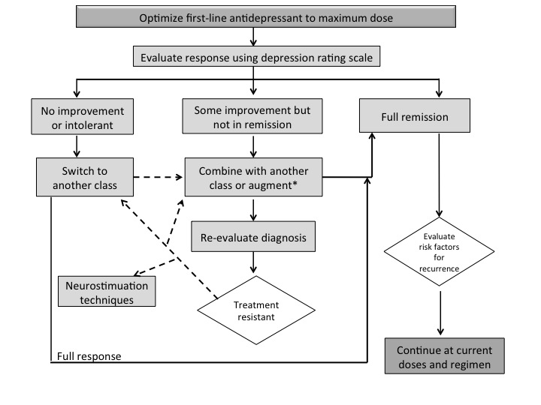
What to do when the patient is not improving?
Note:
no published evidence in cancer; recommendations extrapolated from general psychiatric literature

Slide 40
Augmentation and Switching:
Clinical context may be important
No research data on using combinations in cancer patients
The patient with residual fatigue, cognitive complaints, chemo brain on an SSRI or SNRI: consider psychostimulant (e.g. methylphenidate or lis-dexamfetamine), aripiprazole or bupropion XL
The patient with residual anxiety, insomnia, anorexia, extreme hypervigilance about recurrence
  consider olanzapine, quetiapine XR, aripiprazole, lurasidone or mirtazapine rather than benzodiazepine
The patient with residual cognitive complaints, poor functional recovery: consider vortioxetine (can also be used first line)

Slide 41
Case Example: Mrs. J
Mrs. J subsequently developed brain metastases, treated with brain radiation and steroids. She then reported significantly more insomnia, feelings of disengagement from her children, and losing interest in completing legacy projects. She was self-critical about her impatience and irritability with her family, felt persistently sad and hopeless, and had thoughts that she would be better off dead, although she denied suicidal intent.
She was started on venlafaxine because she was also experiencing severe hot-flashes with tamoxifen, with significant resolution of her depressive symptoms
As her steroids were tapered, Mrs J’s depression relapsed, with worsening insomnia, anergia and anorexia, as well as daily vomiting with meals. Increasing her venlafaxine resulted in an elevation in her blood pressure with no benefit to her mood. Olanzapine was added, with great benefit to her sleep, appetite, mood and nausea.
Ms J and her husband engaged in joint supportive-expressive psychotherapy. Although she experienced a brief upsurge in emotional distress while preparing her children for her death, she remained euthymic. Ms J completed all of her planned legacy projects and died peacefully.

Slide 42
Acknowledgements
Cancer Care Ontario would like to thank the following individuals for their contributions:
Dr. Mark Katz, MD, FRCP(C)
Provincial Head of PSO at CCO
Psychiatrist, Southlake Regional Cancer
Dr. Madeline Li, MD, PhD FRCP(C)
Psychiatrist, Department of Supportive Care
University Health Network - Princess Margaret Cancer Centre

