Slide 1


It’s Time to Move:
Exercise for People Living with Cancer
February 2017
Notes:
This slide deck is one of a number of tools available to HCPs in the CCO Psychosocial Oncology Guidelines Online Resource Hub.
We hope this PPT will communicate why it is important for HCPs to initiate conversations about exercise with patients with cancer, and understand the role of the CCO guideline in positively influencing patient care.
The slide deck will hopefully serve as a helpful and easy-to-use tool at leadership tables and staff meetings.

Slide 2
Slide Deck Purpose
A tool for clinicians and guideline champions to use on their own, in a group with other HCPs, and at leadership tables to promote and support exercise for people living with cancer
A tool to demonstrate the evidence of exercise’s safety and benefits, supporting discussions with patients and other HCPs
A tool to help HCPs support exercise programming for their patients, or facilitate access to online and/or regional exercise resources for cancer survivors / patients
Notes:
The purpose of this slide deck is to act as a tool…. (go through bullet points).

Slide 3
Learning Objectives
Describe the significance of quality of life (QoL) for people living with cancer
Outline the evidence of exercise-related benefits for people living with cancer
Describe the relationship between physical activity and QoL for people living with cancer
Describe the CCO evidence-based recommendations for physical activity type and volume
Identify barriers to exercise for people living with cancer
Apply strategies to support active lifestyles for people living with cancer
Notes:
This is an overview of the types of items we have included in the PPT, in order of progression.

Slide 4
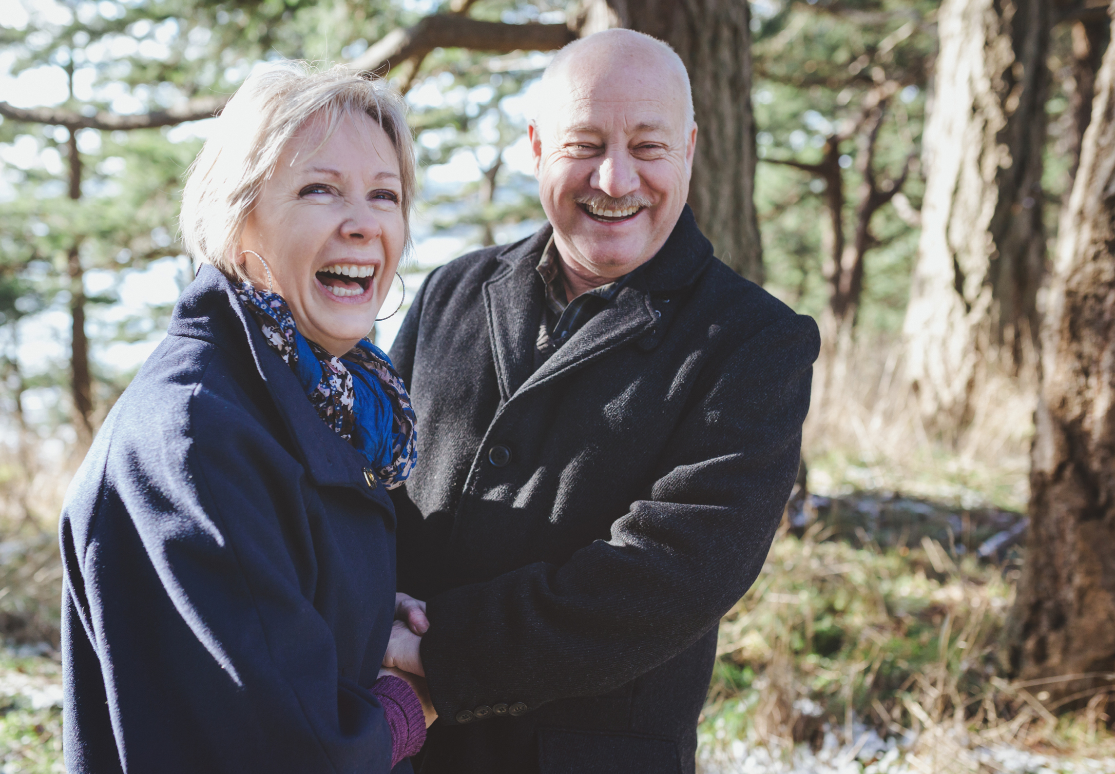
Cancer and Quality of Life
Scientific & Technological Advances
Quality of Cancer Treatment
Life Expectancy for Cancer Patients
With cancer patients living longer, quality of life has become very important to both patients and healthcare providers.
Notes:
Cancer patients are living longer. Cancer is considered to be a chronic disease now, which it wasn’t previously. Since people are living longer, quality of life (QoL) has become very important to both patients and HCPs.
“In chronic conditions, adding life to years instead of years to life is an important task.”

Slide 5
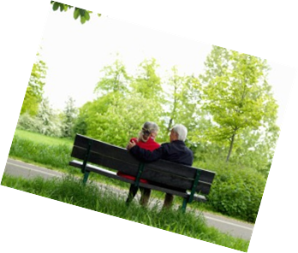
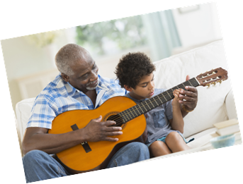
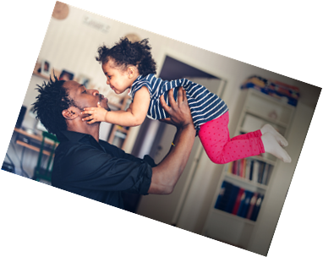
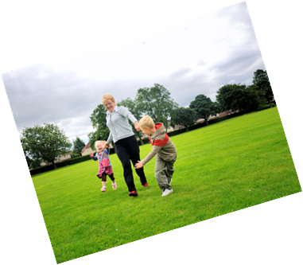
One Component of QoL: Physical Health
QoL
Physical Health
Activities of daily living
Participation in leisure and social activity
Body image
Treatment tolerance
Notes:
Quality of life (QoL) encompasses many domains of health, including physical, psychological, social health. People who experience physical health tend to be able to engage in their activities of daily living more fully, they have the energy to participate in leisure and social activities, they have a more positive body image, and specific to persons with cancer, are more likely to tolerate the effects of their cancer treatments.

Slide 6
Evidence of Exercise-Related Benefits for People Living with Cancer
A growing body of strong evidence describes numerous benefits for people living with cancer that engage in exercise
A recent systematic review by the Guideline Development group identified:
  3 guidelines (since 2005)
  18 systematic reviews (since 2005)
  And 29 recent RCTs (since 2011)
The evidence indicates QoL and physical fitness benefits for people living with cancer who exercise compared to controls
Epidemiological data support improved all-cause and cancer-specific survival for those who are active compared to those who are sedentary
Notes:
The benefits of exercise after a cancer diagnosis are confirmed by a growing body of evidence. Some refer to this evidence as ‘overwhelming’ and ‘convincing’. The CCO Guideline Development Group conducted a thorough review of the literature in 2016 and found that, for people with cancer, the strongest evidence describes benefits for QOL and physical fitness for those that exercise vs. those that do not. In addition to these outcomes, epidemiological evidence is emerging demonstrating improved all-cause and cancer-specific mortality for those who are most active. The relationship between exercise and cancer progression and survival is being further explored more definitively with multi-centre RCTs in several countries around the world.
While this evidence is compelling, it continues to grow rapidly.

Slide 7
Evidence of Exercise-Related Benefits for People Living with Cancer
4 Domains of QoL Represent Many Exercise-Related Benefits for People Living with Cancer
Physical Benefits
Psychological Benefits
Social Benefits
Clinical Benefits
Notes:
Ultimately, the research shows that exercise improves quality AND quantity of life in many cancers with emerging findings almost daily describing a new role for exercise during the cancer continuum / experience. These benefits span the domains of quality of life and is the main reason for why exercise is considered an essential part of comprehensive cancer survivorship care. Complementing the QoL evidence are studies describing various biological mechanisms that can partially explain improved survival, such as improved immune function and reduced aggravating biomarkers (e.g. inflammatory cytokines and growth-factors). Additionally, trials have shown that exercise may increase chemotherapy dose tolerance that may also improve cancer outcomes. Collectively, these findings support the clinical utility of exercise after a cancer diagnosis. Some other benefits include, but are not limited to:
QoL
Physical function
Appetite
Immune system function
Cardio-pulmonary function
Depression & anxiety
Sleep
Bone Health
Body Composition
Hospitalization
Treatment Completion
Treatment tolerance
Fatigue
Pain
Postoperative LOS
Social roles
Self-efficacy
Coping
Tumour cell growth
Insulin sensitivity
Concentration
Lymphedema
Functional mobility
Sexual function
Survival

Slide 8
The Research Perspective
“Exercise is a low-cost, low-toxicity intervention that improves health-related fitness and quality of life in cancer survivors. If exercise can be shown to improve cancer outcomes, even in a subset of patients, it would likely be adopted by cancer care organizations in Canada and around the world as standard clinical practice. And even if exercise does not improve survival, the message of the first Canadian exercise guidelines for cancer survivors is clear—don’t take cancer lying down!.”
– Kerry Courneya, Canada Research Chair in Physical Activity and Cancer
Current Oncology, 2017
Notes:
Historically, people with chronic diseases, like cancer, have been told to avoid physical activity because of a fear of the potential harm it may cause. Over time, research has demonstrated that exercise is safe and beneficial after a cancer diagnosis, and more and more people with cancer are becoming physically active. This quote captures the research perspective, that exercise during and after cancer treatments is a helpful intervention that just makes sense.

Slide 9
The Patient Perspective
“Cancer is becoming a chronic disease because people are living longer. Just because the active treatment may be over does not mean your journey has ended. The drugs that are formulated to save one life, can leave life long side effects that impede the ability to function. Exercise enabled me to increase physical functioning, decrease fatigue and improved my quality of life. Exercise helped me regain the confidence to be a better version of the old me.” – Debora, PFA
Notes:
This quote captures the patient’s experience in a nut shell. Exercise has empowered Debora to become more like the Debora before cancer – and possibly a ‘better version of her previous’ self.. An ACTIVE and healthier person.

Slide 10
CCO PEBC Guideline: Exercise Guidelines for People Living with Cancer
It is recommended, where possible, that people living with cancer perform exercise at a moderate intensity (three to six times baseline resting state) on an ongoing basis, as a part of their lifestyle so that improvements in QoL and muscular and aerobic fitness can be maintained for the long term.
People living with cancer can safely engage in moderate amounts of exercise while on active treatment or post completion of therapy.
Moderate amounts of exercise are recommended to improve QoL as well as the muscular and aerobic fitness of people living with cancer
Pre-exercise assessment for all people living with cancer before starting an exercise intervention is recommended to evaluate for any effects of disease, treatments and/or co-morbidities
It is recommended, where possible, that people living with cancer exercise in a group or supervised setting as it may provide a superior benefit/outcome in QoL and muscular and aerobic fitness.
Clinicians should advise their patients to engage in exercise consistent with the recommendations outlined by CSEP & ACSM
Moderate Intensity, 150 min/week
SAFE
Effective for QOL & Physical Fitness
Pre-Exercise Assessment
Supervised/Group
Recommend/Referral from Clinicians
Notes:
Based on the evidence, the CCO PEBC has created guidelines on exercise for people living with cancer. These guidelines are available on the CCO PEBC website and published in Current Oncology.
The published guidelines provide expanded detail and nuance, however; to summarize the 6 recommendations (use animation), moderate intensity exercise of 150 min/wk is safe and effective for improving QOL and fitness. Exercise prescriptions are best facilitated by a pre-exercise assessment and delivered in a supervised/group setting. An important element of effective programming are recommendations/referrals by their health care team.
There are 6 recommendations.

Slide 11

The HCPs’ Role
In comparison to other types of survivorship-relevant guidance and in comparison to individuals with other chronic diseases for which exercise is beneficial (e.g., diabetes), cancer survivors are less likely to receive exercise advice from a HCP (Barnes & Schoenborn, 2012)
However, patients who receive exercise advice from a HCP are more than 50% more likely to be active (Weidinger et al., 2008)
Thus, you have an influential role in facilitating active living among patients by starting the conversation!
Notes:
While these guidelines are a starting point, their presence alone does not guarantee patients will be active. As a health care professional, you play an important role in influencing patients’ behaviours, particularly with respect to exercise. Unfortunately, cancer survivors are less likely to receive exercise advice from a HCP compared to patients with other chronic diseases. Your recommendation to exercise will make your patient that much more likely to do it, so starting the conversation is important.
Promoting a physically active lifestyle often starts in the clinic. HCPs play a major role in emphasizing the importance of physical activity and initiating a change towards a more active lifestyle. Research supports the critical value of HCP recommendations for exercise in creating an active patient population. Clinicians need not be experts in physical activity or exercise to be able to endorse them as an important part of managing cancer and the challenges of treatment, but have the influence to impress upon patients the importance of it and potential resources that they may access.
Barnes & Schoenborn (2012). National Center for Health Statistics, 86:1-8
Weidinger, K. A., Lovegreen, S. L., Elliott, M. B., Hagood, L., Haire-Joshu, D., McGill, J. B., & Brownson, R. C. (2008). How to make exercise counseling more effective: Lessons from rural America. The Journal of Family Practice, 57(6), 394-402

Slide 12
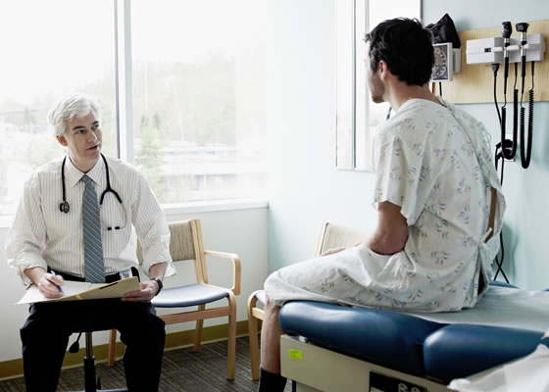


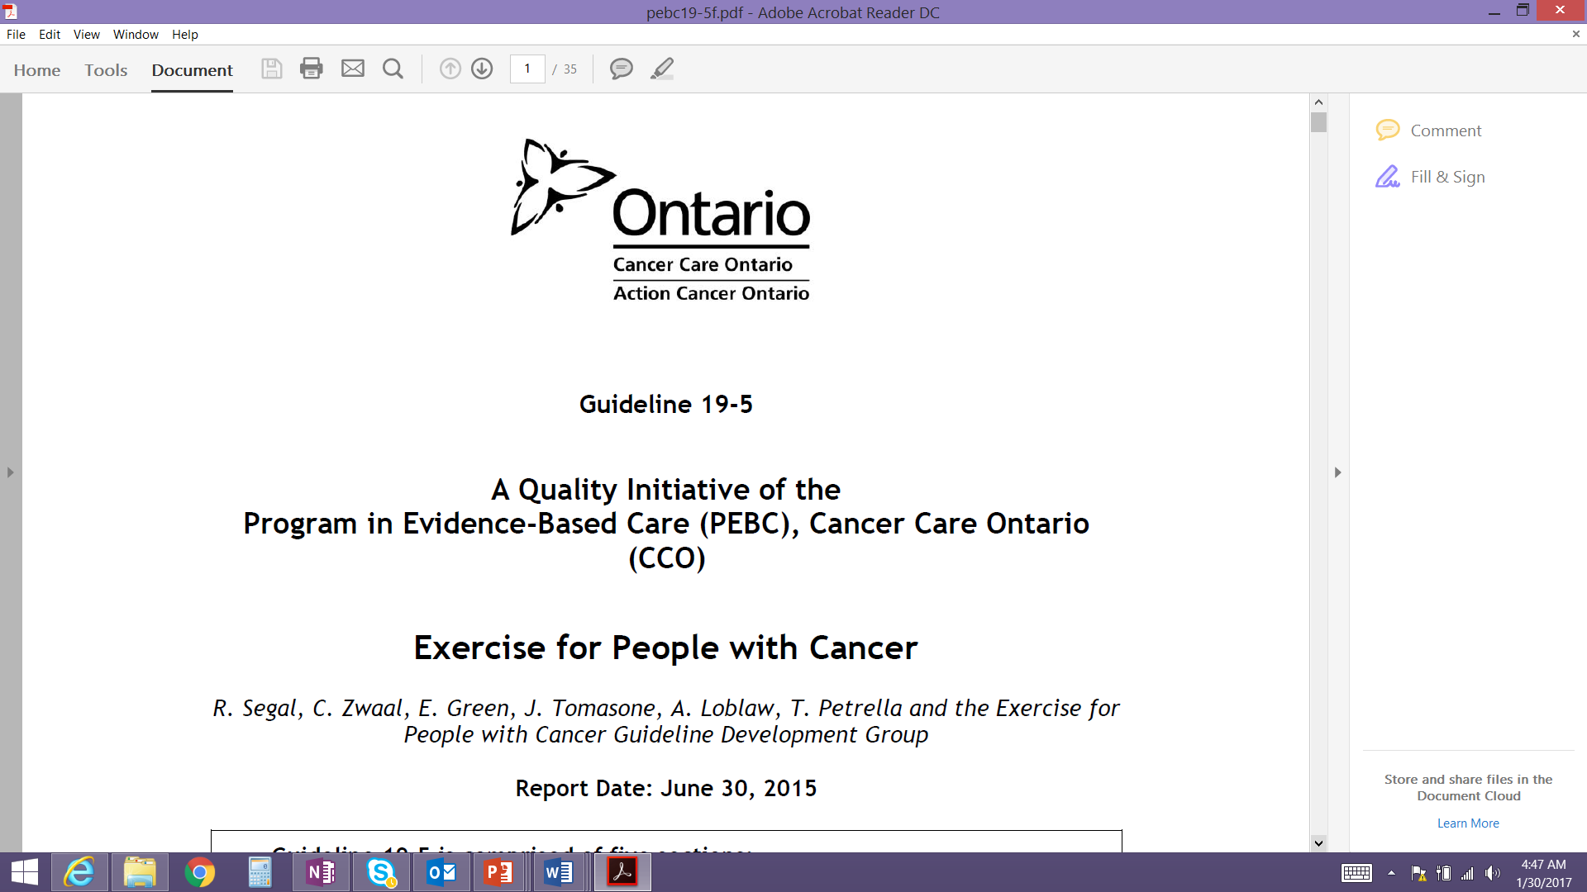
Barriers to Physical Activity and Exercise
Health – variable health and energy levels can interfere with exercise programs
Environment – Outdoor and indoor environments need to be conducive to safe activity
Equipment – some equipment is necessary for some forms of exercise, but it does not have to be extensive or expensive
Time (patient)– Patients have many competing concerns / interests that can interfere with routine exercise
Time (HCP)– Clinicians may not feel they have the knowledge or time to discuss, prescribe, and/or provide referrals for exercise
Training – Exercise specialists with expertise in oncology are still limited
Resources – Lack of awareness about available resources
Notes:
Of course the exercise conversation with patients is easier said than done.
There are a number of barriers that can effect the patient-provider conversation around exercise. These include: (go through slide)
It is to be expected that patients will describe a number of barriers to physical activity. People with cancer often face fluctuating well-being that can interfere with plans to exercise. It is important to note that the research suggests that even a little bit of exercise is better than none at all and that exercise can be tapered on days when they’re not feeling particularly energetic or well. Similarly there may be several environmental or geographic barriers, such as climate or proximity to a fitness/wellness facility. Similarly, availability of equipment or familiarity with equipment can undermine attempts to become active. Perhaps the most common barrier to exercise is time, something that limits the vast majority of the population. However, people with cancer often have to contend with several medical appointments that compete for their. Moreover, people with cancer may feel like they heave ‘less time’ because fatigue can shorten their days.
In addition to patient-related barriers, supporting exercise can be challenged by a lack of endorsement/support by the medical team due to either an absence of time or comfort with the subject, or simply unfamiliarity with the potential resources available to patients.

Slide 13
Overcoming Barriers/Strategies to Promote and Support Exercise for People Living with Cancer
Health
Environment
Equipment
Time (Patient)
Time
(HCP)
Training
Resources
Support adapted exercise and principles of auto-regulation
Indoor and outdoor exercises can accommodate preference, weather, or facility needs
Walking is a great exercise
Resistance bands are inexpensive and can facilitate resistance training
Physical activity can be built into one’s lifestyle, including walking, taking stairs, doing manual chores
HCPs can provide pre-prepared exercise prescriptions requiring little additional information, refer to exercise specialist
A growing number of exercise specialists are trained in oncology, consider Certified Exercise Physiologists, Registered Kinesiologists and Physiotherapists
Online and regional programs can support exercise programs for patients and provide information
Notes:
Changing behaviour can be complicated and difficult, so it is important to consider the barriers and some general strategies to overcome them. [review the list].
These are only a few examples, however, the potential barriers are endless and dynamic – one suggestion may work for some and not for others, so it’s important to consider the broader context and support creative and/or patient-initiated strategies to overcome barriers to physical activity.

Slide 14
Additional Resources
Additional resources, tools and information can be found on the CCO Exercise Resource Hub
http://www.cancercare.on.ca/ocs/clinicalprogs/psychosocialonc/psychosocial_oncology_guidelines_resources
Notes:
Changing the culture of care to include physical activity will take some time – but there are resources to help you. Some regions/centres have or are close to exercise programs that are appropriate for people with cancer. Other regions/centres may rely on online resources to promote PA and support patient self-management. Various resources are available at the CCO Psychosocial Oncology Guidelines Online Resource Hub in the exercise section.

Slide 15

It’s Time to Move – Let’s Start the Conversation
Visit cancercare.on.ca to access the Exercise for Persons with Cancer guideline:
https://www.cancercare.on.ca/psoguidelines

Slide 16
Acknowledgements
Cancer Care Ontario would like to thank the following individuals for their contributions:
The developers of this PowerPoint resource:
Daniel Santa Mina, Rkin, PhD
Jennifer Tomasone, PhD
Members of CCO’s Exercise in Cancer Clinical Advisory Committee for their clinical expertise and input:
Jim Chiarotto, MD
Nicole Culos-Reed, PhD
Sari Greenwood, MSW RSW
Renee Leahy, PT
Catherine Sabiston, PhD
Daniel Santa Mina, Rkin, PhD
Roanne Segal, MD FRCP(C)
Jennifer Tomasone, PhD

