Slide 1

Cervical Screening & the Ontario Cervical Screening Program (OCSP)

Slide 2
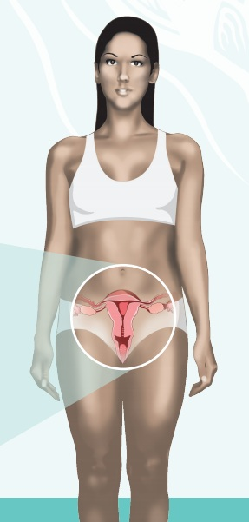
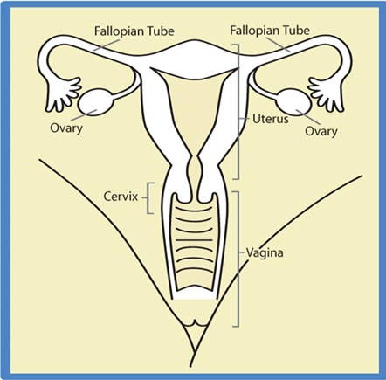
Where is the cervix?
Image source (right): Anishinaabek Cervical Cancer Screening Study, 2013.

Slide 3
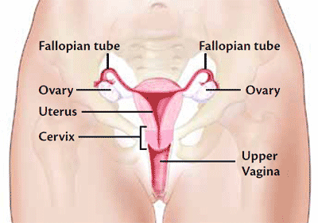
What is the cervix?
The cervix is located between the uterus and vagina.
Image source: National Cancer Institute

Slide 4


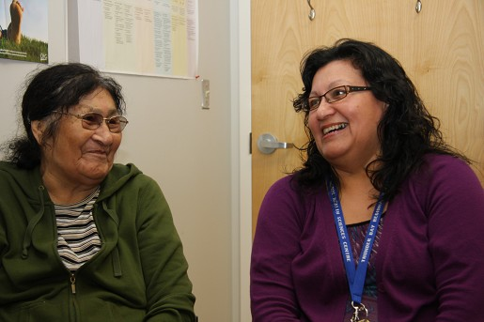
Cervical Cancer Screening
Cervical cancer is almost completely preventable.
Regular screening and follow up can protect you from cervical cancer.
Cervical cancer screening can detect early changes on the cervix that can lead to cancer.
Almost all of these changes are caused by persistent human papillomavirus (HPV) infection.
Image source (top to bottom): National Aboriginal Health Organization (NAHO), Canadian Foundation for Women’s Health, Thunder Bay Regional Health Sciences Foundation
Notes:
Cervical cancer is almost entirely preventable with regular screening, appropriate and timely follow-up of abnormal Pap test results and, recently, HPV immunization. Compared to most other cancers, cervical cancer is diagnosed about 10 years earlier.
While most women diagnosed with cervical cancer are either under or never screened, 40% of women diagnosed with cervical cancer have been regularly screened.
So, despite cervical cancer screening, cytology is limited in what it can do. This is part of the reason why there has been so much research on alternate tests.
References:
Ontario Agency for Health Protection and Promotion and the Institute for Clinical Evaluative Sciences. Ontario Burden of Infectious Disease (OBOID) Study. December 2010.
Canadian Cancer Society’s Steering Committee on Cancer Statistics. Canadian Cancer Statistics 2012. Toronto: Canadian Cancer Society; 2012.
Cancer Care Ontario. Ontario Cancer Fact: Long-term decline in cervical cancer incidence continues. December 2009. Available at http://www.cancercare.on.ca/ocs/csurv/ont-cancer-facts/. Accessed June 14, 2012.

Slide 5
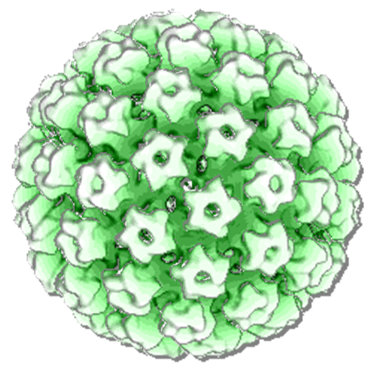
Human Papillomavirus (HPV)
HPV is the most common sexually transmitted infection. There are over 100 different types of HPV.
HPV is a virus that spreads by skin to skin sexual contact. It can be spread by oral sex and other kinds of sexual acts.
Many people who have HPV have no signs of infection.
Most HPV infections resolve (go way on their own) without causing harm
Some types of HPV can cause cancer of the cervix in women and other types can lead to genital warts and other genital (anal, penile, vaginal cancers) in men or women
HPV under a microscope
Image source: Ministry of Health and Long-Term Care (MOHLTC)
Notes:
Cervical cancer is almost entirely preventable with regular screening, appropriate and timely follow-up of abnormal Pap test results and, recently, HPV immunization. Compared to most other cancers, cervical cancer is diagnosed about 10 years earlier.
While most women diagnosed with cervical cancer are either under or never screened, 40% of women diagnosed with cervical cancer have been regularly screened.
So, despite cervical cancer screening, cytology is limited in what it can do. This is part of the reason why there has been so much research on alternate tests.
References:
Ontario Agency for Health Protection and Promotion and the Institute for Clinical Evaluative Sciences. Ontario Burden of Infectious Disease (OBOID) Study. December 2010.
Canadian Cancer Society’s Steering Committee on Cancer Statistics. Canadian Cancer Statistics 2012. Toronto: Canadian Cancer Society; 2012.
Cancer Care Ontario. Ontario Cancer Fact: Long-term decline in cervical cancer incidence continues. December 2009. Available at http://www.cancercare.on.ca/ocs/csurv/ont-cancer-facts/. Accessed June 14, 2012.

Slide 6
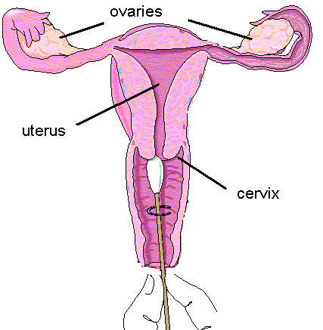
Cervical Screening: Pap Test
A Pap test is done in a doctor or nurse’s office.
An instrument, called a speculum, is gently inserted in your vagina so your cervix can be seen.
Cells are taken from the cervix and are sent to a laboratory to be examined under a microscope.
Regular Pap tests are designed to find early cell changes in the cervix that could lead to cancer.
PAP test diagram

Slide 7
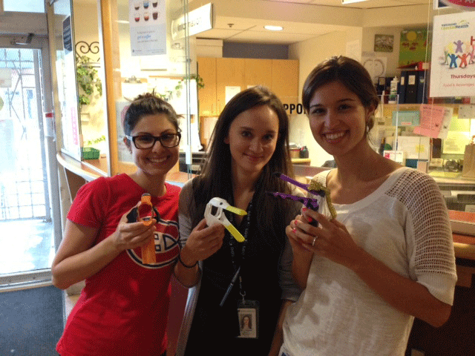
How often should you be screened?
Women who have ever had any sexual skin-to-skin contact, should have a Pap tests once every three years, starting at age 21.
Pap tests should be a part of your regular health check-up until you are 70 years old. The risk of getting cervical cancer does not decrease with age.

Slide 8
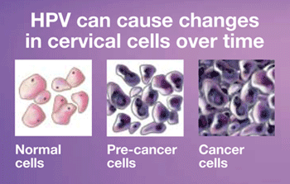
What does an abnormal result mean?
An abnormal Pap test result means that the cells taken from the cervix look different under the microscope than normal cells.
Abnormal cells can change back to normal, especially in young women. However, in some women, the abnormal cells change into cancer.
It takes many years for normal cells to develop into cancer
Sometimes if normal cells are found, you may require treatment to prevent cervical cancer

Slide 9
What happens after an abnormal Pap test?
Talk to your health care provider about your results and the follow-up testing you may need.
You may be asked to repeat your Pap test more often for a short period of time, for example every six months. Abnormal cell changes may return back to normal on their own.
Your health care provider may suggest an HPV test.
You may be referred for a special examination called a colposcopy.

Slide 10
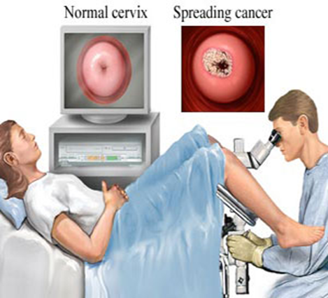
What is a colposcopy?
Colposcopy is an examination of the cervix using a special microscope.
Similar to a Pap test, the colposcopist will first insert the speculum to look at the cervix.
The cervix is then examined after a vinegar solution is applied.
If abnormal cells are suspected, a small biopsy (tissue sample) is taken.

Slide 11

HPV Causes Cervical Cancer. How can we prevent HPV?

Slide 12

What is HPV vaccination?
Anyone who has sexual contact can get HPV.
The HPV vaccination is safe. It will protect you from infection with the most important HPV types.
Health Canada recommends that all females aged 9 to 26 have the HPV vaccination.
The best protection is offered if vaccination occurs well before sexual contact.
The HPV vaccine is approved for males and females.
The HPV vaccine is administered in three doses (3 separate needles).

Slide 13
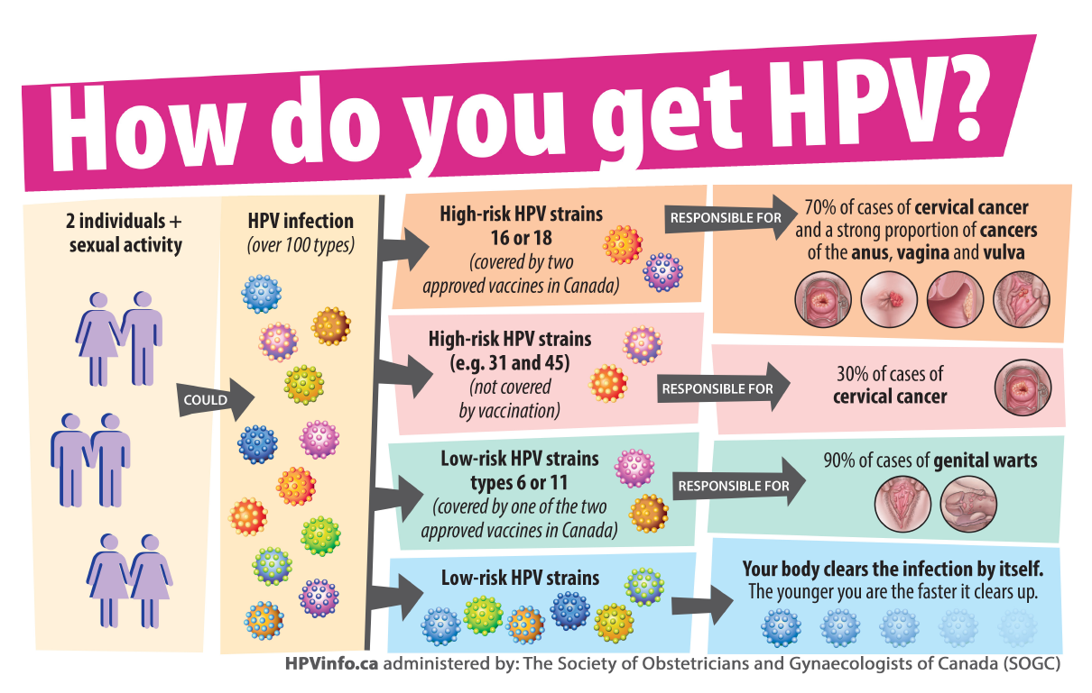

Slide 14
Ontario’s School Based Immunization Program
Vaccination is free for grade 8 girls in Ontario.
Starting in September 2012, girls in Grades 9–12 who did not receive or did not complete the three-dose HPV immunization in Grade 8 can now receive the vaccine free of charge, until the end of Grade 12.
Non-Insured Health Benefits (NIHB) does not cover HPV vaccines outside the school based immunization program.
For more information:
Contact your Public Health Unit for more details about the HPV school based immunization program.
Visit www.ontario.ca/hpv

Slide 15
If I get an HPV vaccine, should I still have Pap tests?
YES, it is very important to keep having Pap tests after receiving the vaccine.
If you get the vaccine, you will need regular Pap tests at 21 and older
The HPV vaccine does not replace pap tests, but may prevent HPV infection and lower your risk of getting cervical cancer.

Slide 16
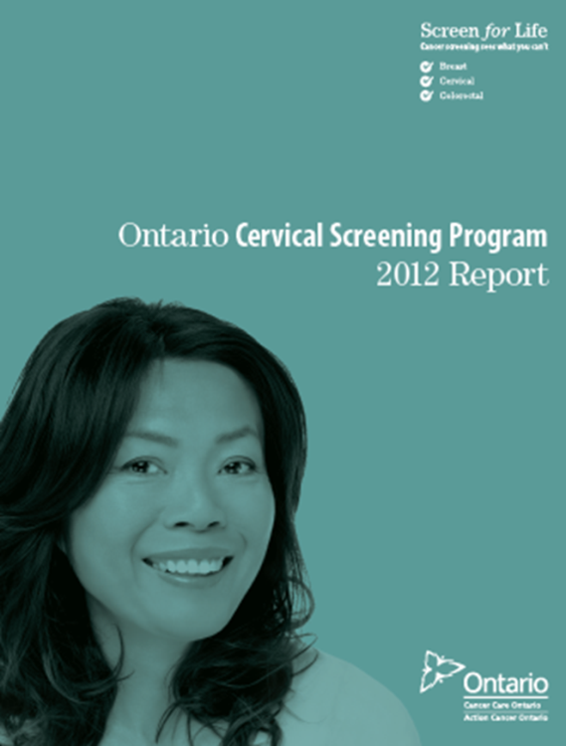
The Ontario Cervical Screening Program (OCSP)
Cancer Care Ontario (CCO) is the provincial agency responsible for continually improving cancer services.
CCO has screening programs for three diseases: cervical, breast, and colorectal.
The OCSP is a population-based screening program with the goal of reducing cervical cancer incidence (how often someone gets cancer) and mortality (how often someone passes away from cancer).
This program supports primary care providers so they can provide the best possible cervical screening for you.

Slide 17
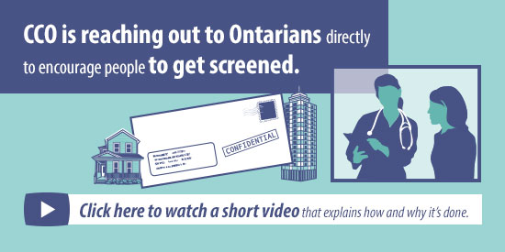
The OCSP Correspondence Program
Beginning in fall 2013, Ontario women eligible to be screened within the OCSP began getting a new benefit from Ontario’s cancer screening programs.
CCO will send letters to women to invite them to start Pap testing, advise them of their test results and remind them when it is time to return for screening.
These letters will help women stay on top of their cervical cancer screening appointments or possible follow-up visits.
You must be registered with OHIP

Slide 18
Want to know more about correspondence?
For more information:
Call toll-free at 1-866-662-9233
Email at screenforlife@cancercare.on.ca
Check out http://www.cancercare.on.ca/cms/One.aspx?portalId=1377&pageId=9536
Translation services are available when you call the above telephone number, and interpreters are on call for a limited number of Aboriginal languages.

Slide 19
How can you reduce your risk of cervical cancer?
Cervical cancer is one of the most preventable cancers.
Go for regular Pap tests and, if needed, return for follow-up of abnormal results.
Consider HPV vaccination.
Even if you are not currently sexually active, are in a same sex partnership, or have no family history of cervical cancer, consider getting screened.
Be tobacco-free and avoid secondhand smoke. Tobacco can weaken the immune system, which makes it difficult for your body to fight off an HPV infection.
“Recognizing there are challenges to access healthier foods like fruits and vegetable, it’s still important to make the most healthiest choice while getting exercise”….Check out Canada’s Food Guide for First Nation, Inuit and Métis at: http://www.hc-sc.gc.ca/fn-an/pubs/fnim-pnim/index-eng.php

Slide 20

Miigwetch
Qujannamiik
Merci
Thank You

