Slide 1
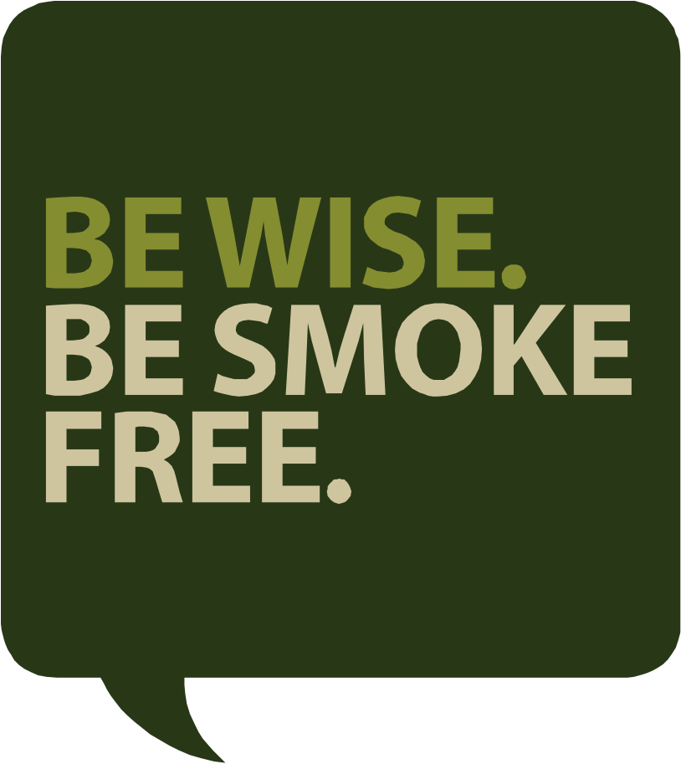
Learning about the
Risks of Commercial
Tobacco with
<Community Name>

Slide 2
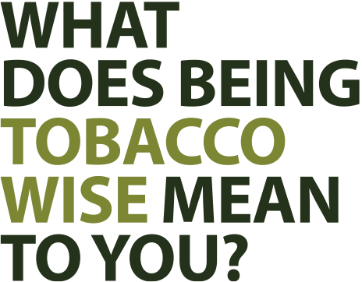
You have smoke-free spaces available to you.
There are policies on smoking in band-related buildings, pow wow grounds, communal areas, etc.
People refrain from smoking around children and other family and friends.

Slide 3


Is there significance around commercial tobacco and sacred tobacco in our community?

Slide 4
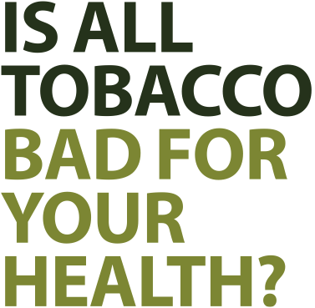
No. Traditional tobacco is used to:
Give thanks to the Creator
Honour all creatures
Seek protection and guidance
Help our thoughts and prayers reach the Creator
However, commercial tobacco is:
Sprayed with nicotine and up to
600 other chemicals
Extremely addictive and hard to quit
Harmful to the smoker and those around them

Slide 5
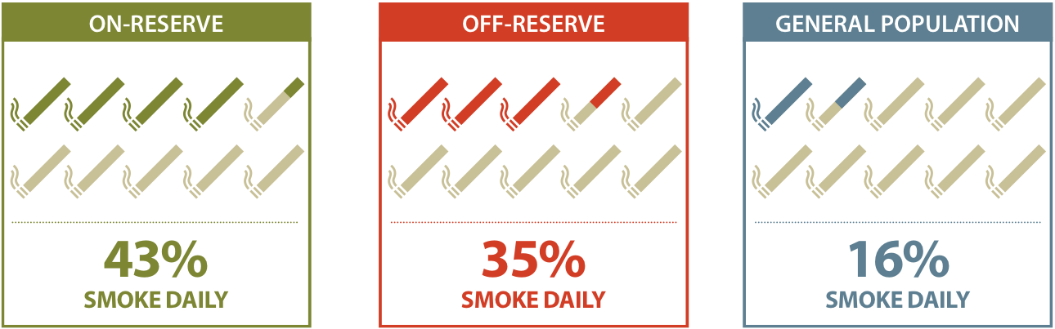
DID YOU KNOW:
The rate of smoking among First Nations populations is
three times higher than that of non-Aboriginal populations.

Slide 6
FACT:
Commercial cigarettes contain
43 ingredients known to cause cancer.
FACT:
37,000 Canadians die each year from
commercial tobacco use.
FACT:
The average smoker will lose 14 years of their life due to smoking.

Slide 7
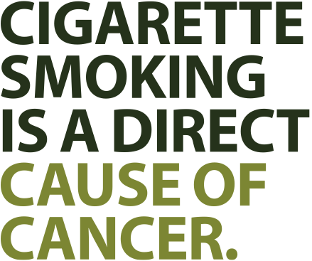
BUT YOU CAN REDUCE YOUR
CHANCES OF GETTING CANCER
BY QUITTING SMOKING!
More than 30% of cancer deaths
could be prevented through
lifestyle changes.
These include smoking, obesity, physical inactivity, inadequate
vegetable and fruit intake, and
alcohol consumption.
If cancer is detected early, it is
often treatable.

Slide 8
We are not seeking to create
“tobacco-free” communities.
Our goal is to create
“tobacco-wise” communities.

Slide 9
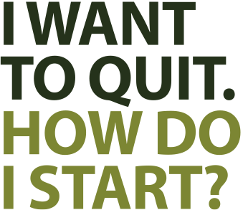
Set a quit date.
Pick a day, and write it down or circle it on a calendar.
Get support.
From family members, friends, or your local nurse or doctor.
Cut down before you cut out.
If you’re not comfortable cutting cold turkey, start by cutting down by a few cigarettes a day.
Create “smoke-free” zones.
Telling yourself “I will not smoke in my car” or “I will not smoke on my front steps” can help change bad habits.
Don’t be hard on yourself.
If you slip up and have a cigarette, get back on your program the next day.

Slide 10
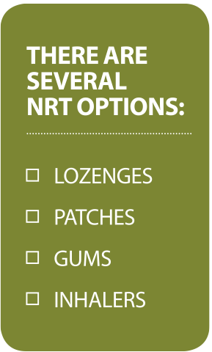
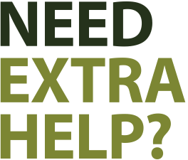
Nicotine Replacement
Therapy (NRT)
NRT can help make the transition
to non-smoking easier.
It helps minimize withdrawal
symptoms and cravings.
Best of all, it almost doubles
quit rates.

Slide 11
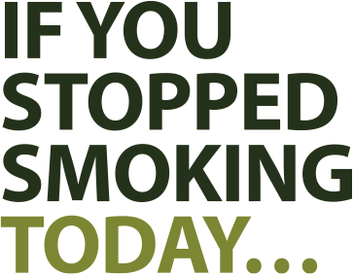
In 20 minutes your blood pressure
will drop to normal.
In 8 hours your blood oxygen levels
will drop to normal.
In 24 hours you reduce your risk of a heart attack.
In 48 hours your sense of taste and smell are sharpened.
In 2 weeks your circulation and lung function improve.
In 1 year your risk of heart attack is reduced to half.
In 5 years your risk of stroke is reduced.
In 10 years your risk of lung, mouth, throat, bladder, kidney and pancreas cancers drops.

Slide 12
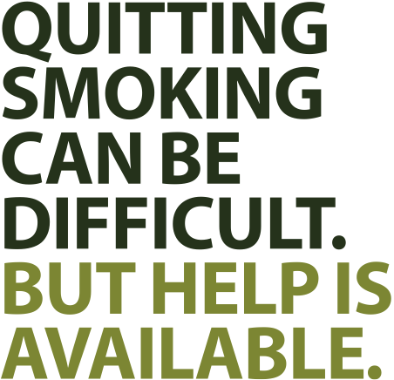
Local Contact Name:
<e.g. Local Health Director>
<e.g. Local Health Director>
<e.g. Local Health Director>
<e.g. Local Health Director>
Tobacco Wise
www.tobaccowise.com
Smokers’ Helpline
1-877-513-5333
www.smokershelpline.ca
National Native Addictions
Partnership Foundation
1-866-763-4714
www.nnapf.ca

