Slide 1

Volunteer Training Resources
September 2016

Slide 2
Importance and purpose of Symptom Screening
Throughout the cancer continuum, a patient can experience a myriad of side effects and symptoms
These symptoms, such as fatigue, pain, and anxiety, can have a significant impact on a patient’s quality of life
Symptom screening lets patients and their caregivers assess and track their symptoms online. This tool makes it easier for healthcare providers to identify those in need of care and monitor changes in their patients’ symptoms over time
Research has shown that routinely asking patients to self report their symptoms in a systematic way
  Helps identify symptoms that might not have been identified otherwise
  improves the communication between patients and their health care team
  improves patient satisfaction with care

Slide 3
Your Symptoms Matter (formally known as ISAAC) is an electronic platform and an easy-to-use tool that allows patients to assess and monitor their symptoms through an online computer program.
  Patients enter symptom severity scores electronically on a touch-screen computer kiosk that sits at their local cancer centre or regional partner site.
  Each kiosk contains self-report symptom screening tools that measure a number of common symptoms experienced by cancer patients.
  It can also be accessed through the patient’s internet-linked home computer.
  Is available in English and French
When logging into Your Symptoms Matter, patients can either complete the following tools:
  Your Symptoms Matter – General Symptoms (formerly known as ESAS)
  Your Symptoms Matter – Prostate Cancer (also known as EPIC)
  Your Symptoms Matter – Daily Activities (formerly known as pECOG/PFRS)

Slide 4
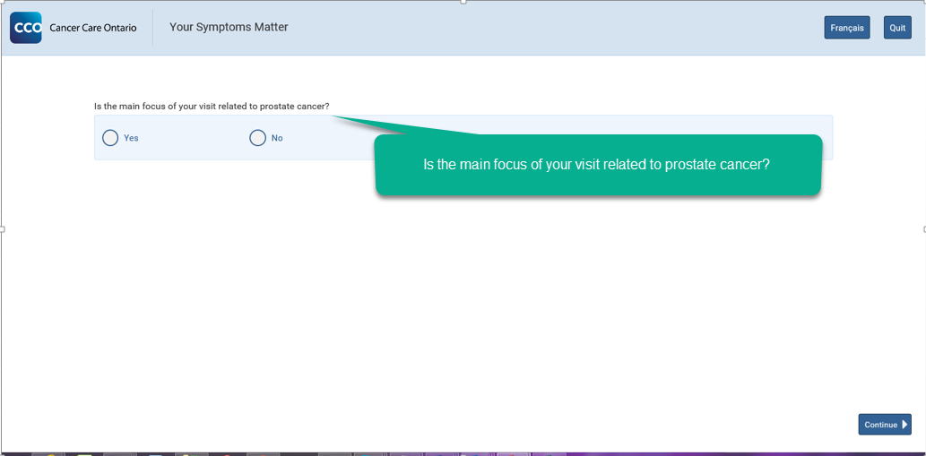
Self-selection questions
At the kiosk, male patients will be presented with a set of questions to ensure that they are receiving the correct questionnaire. The system has built-in logic to assist with this process.
The questions will appear as follows:
If patients select NO, they will be get Your Symptoms Matter – General Symptoms.
If patients select YES, they will be prompted with a follow-up question.

Slide 5
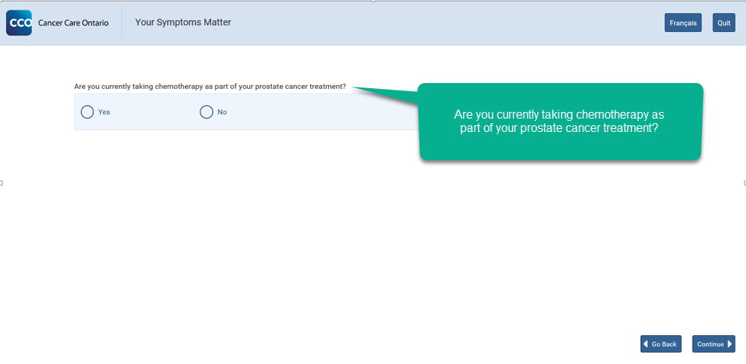
Self-selection questions
If patients select NO, they will be directed to Your Symptoms Matter – Prostate Cancer.
If patients select YES, they will be directed to Your Symptoms Matter – General Symptoms.
These questionnaires will be explained in the following slides.

Slide 6
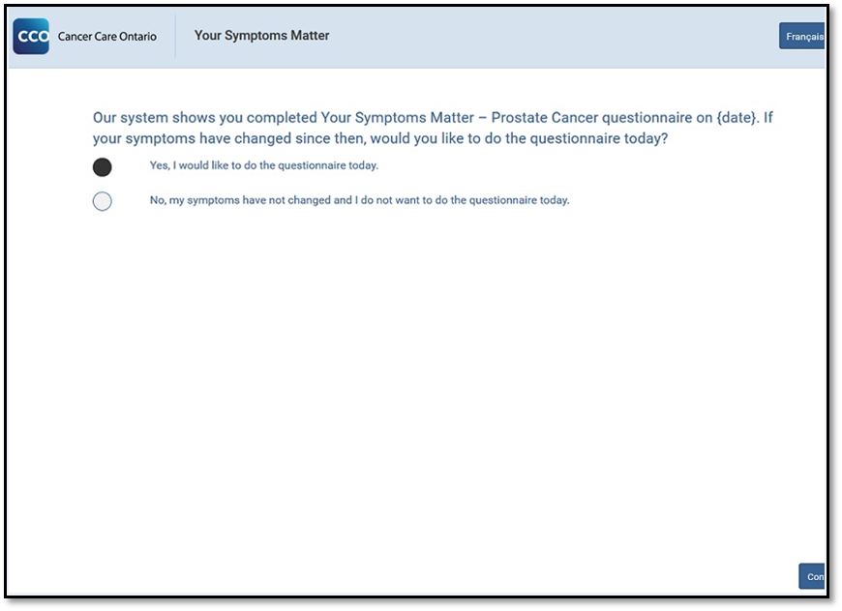
Self-selection questions
Should patients qualify to complete Your Symptoms Matter – Prostate Cancer questionnaire, they may be prompted with a third and final question that allows them to skip the questionnaire if their symptoms have not changed from a recent visit (within 13 days of last completed questionnaire):

Slide 7
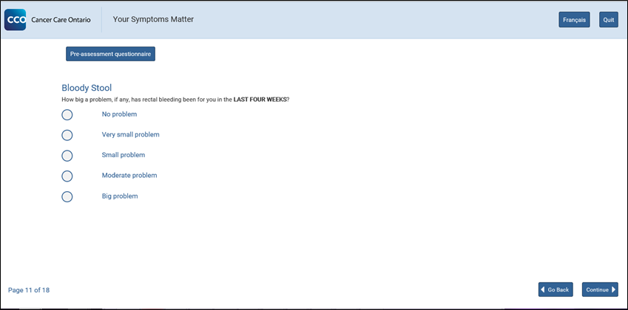
How can you help patients with the self-selection questions?
Explain to patients why these questions are in place:
  It is important that they are aware that these questions help to provide patients with the correct questionnaire and the one most relevant to them
  Eventually we hope to build a system that will know who should get which questionnaire without needing self-selection questions, but that is going to take some time
It is possible to go backwards if a question
is selected incorrectly
  There is a ‘Start Over’ button available
  if the wrong questionnaire is selected
Listen to their concerns and questions and assist in clarifying any terminology

Slide 8
Your Symptoms Matter – General Symptoms
Formerly known as esas

Slide 9
Your Symptoms Matter – General Symptoms
Most patients will complete Your Symptoms Matter – General Symptoms (formally known as ESAS) screening tool
  There are 10 multiple choice questions (9 related to specific symptoms and 1 “other” for any symptoms not asked) with each symptom rated on a scale of “0 to 10”
  A score of “0" means you do not have the symptom, whereas a score of "10" means that your symptom is at its very worst
  It is important for patients to answer the questions from their own perspective. Refrain from offering your own perspective (e.g. giving an example that stubbing your toe might be worth a 3)
The General Symptoms questionnaire is also available in paper form in over 30 different languages – it is advisable to have copies of each language nearby should they be required by patients for completion

Slide 10
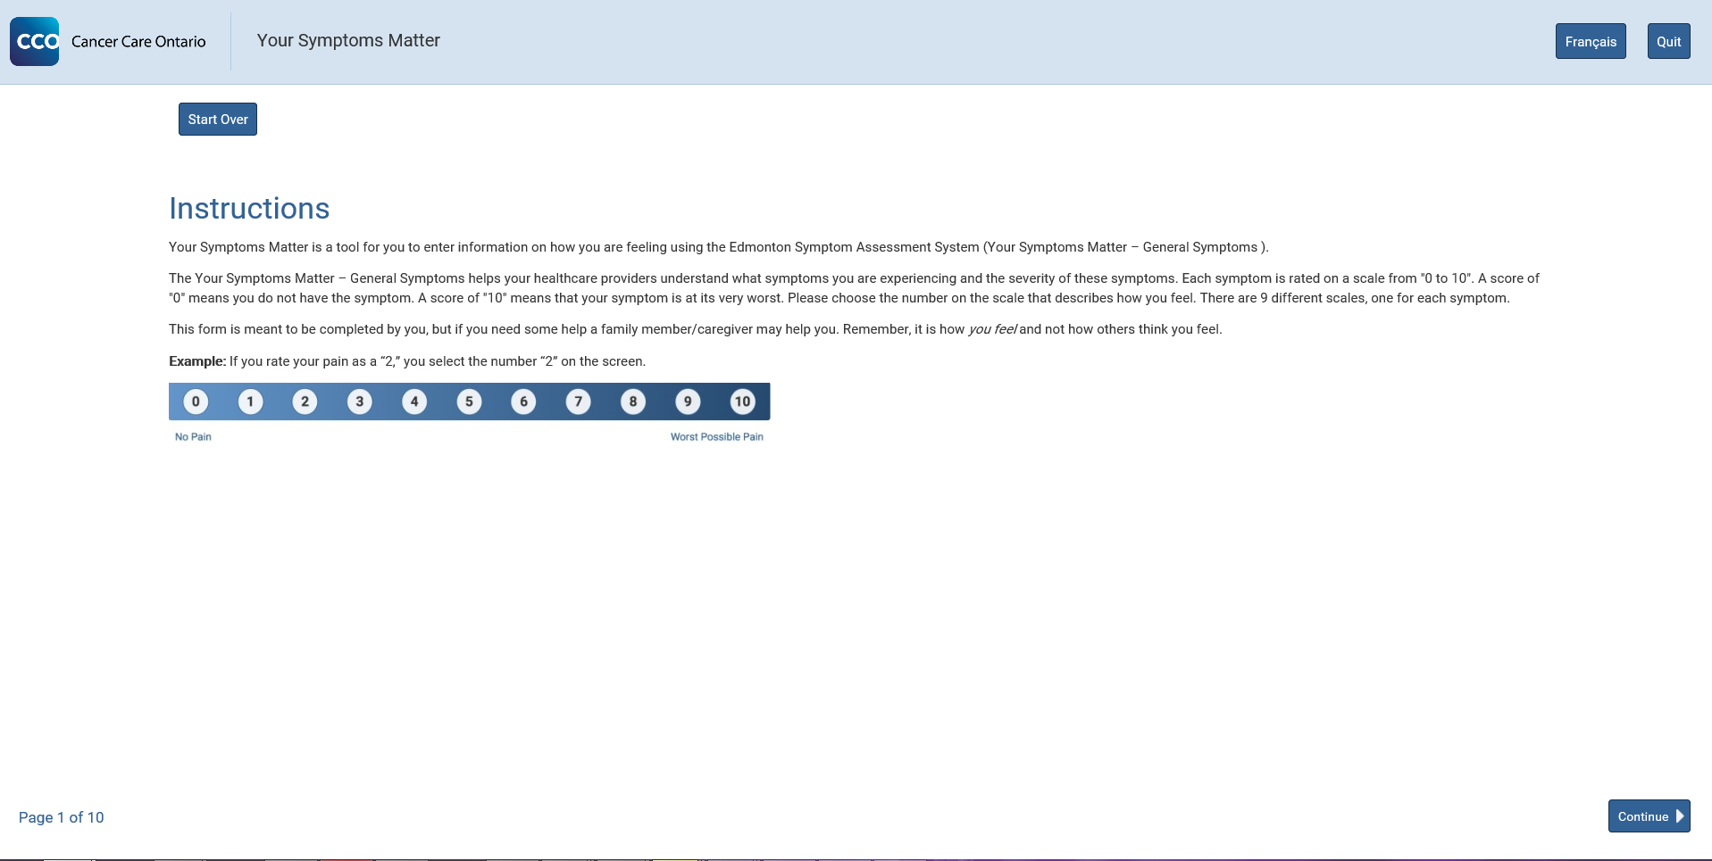
Screenshots: Your Symptoms Matter – General Symptoms
Instructions page

Slide 11
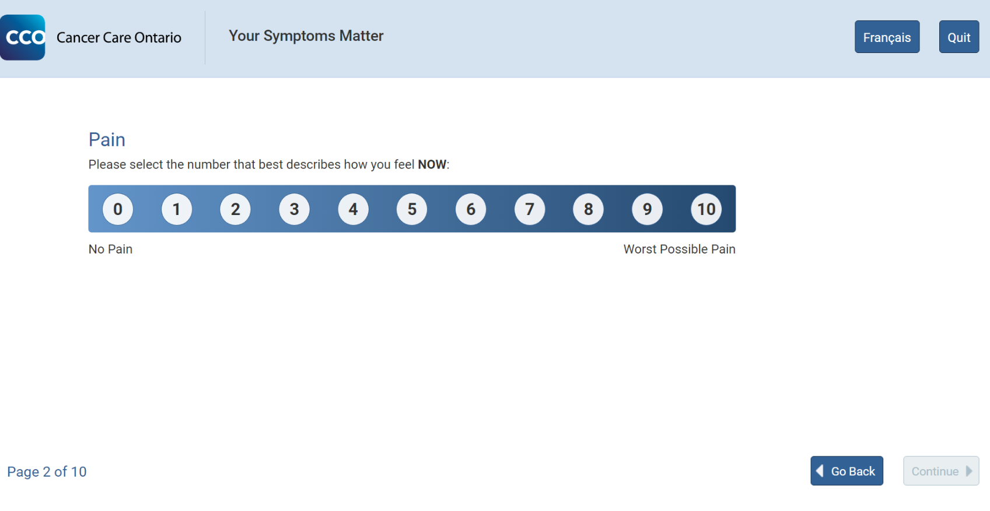
Screenshots: Your Symptoms Matter – General Symptoms
Example of question

Slide 12
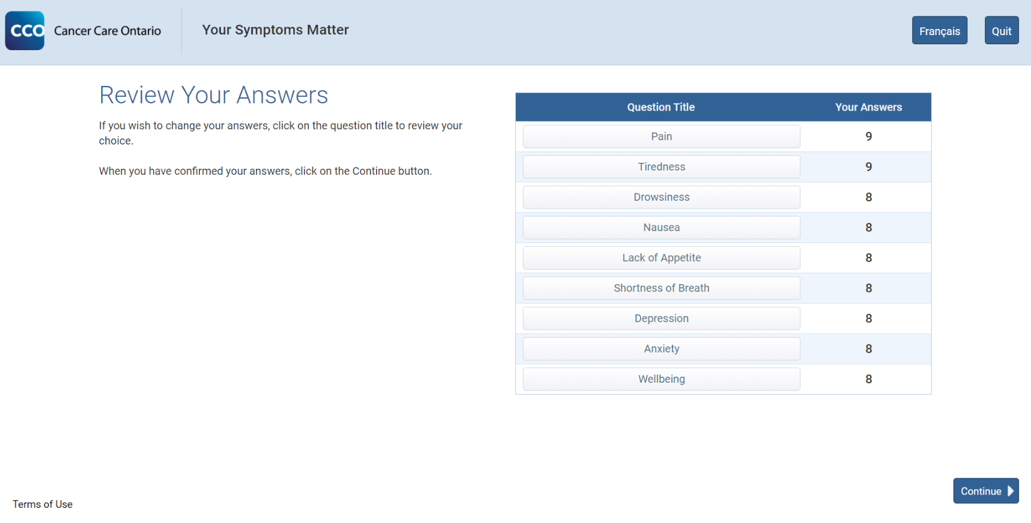
Screenshots: Your Symptoms Matter – General Symptoms
Example of summary page

Slide 13
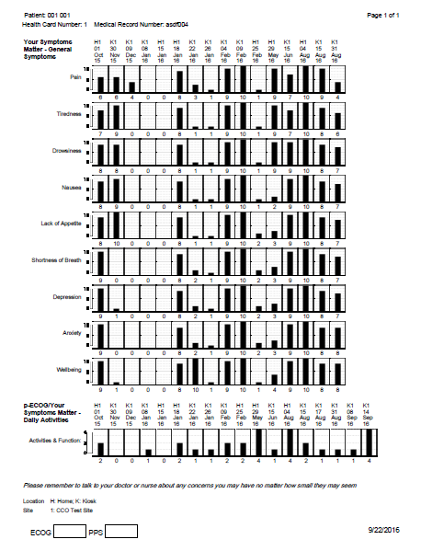
Screenshots: Your Symptoms Matter – General Symptoms
Report Output

Slide 14
Your Symptoms Matter – Prostate Cancer
Also known as epic

Slide 15
Your Symptoms Matter – Prostate Cancer
Through the self-selection questions described previously, men with early stage prostate cancer will be selected to complete the Your Symptoms Matter – Prostate Cancer questionnaire
  There are a total of 17 multiple choice questions with four or five possible answers
The questionnaire discusses symptoms in the following domains:
  Bowel symptoms
  Urinary irritation/obstruction symptoms
  Urinary incontinence symptoms
  Vitality/hormone symptoms
  Sexual function symptoms
The Prostate Cancer questionnaire is also available in paper form in over 35 different languages – it is advisable to have copies of each language nearby should they be required by patients for completion

Slide 16
Sensitive nature of some questions
Your Symptoms Matter – Prostate Cancer
Since the Prostate Cancer questionnaire addresses sensitive topics like sexual function and vitality/hormone symptoms, it is important to be aware of the content of these questions
These questions cover topics such as:
  Orgasms
  Erections
  Hot flashes
  Urinary incontinence
It is important to be mindful that patients may feel uncomfortable having anyone close by while filling in the questionnaire
Patients may also feel uncomfortable asking questions

Slide 17
Sensitive nature of some questions
Your Symptoms Matter – Prostate Cancer
While these are sensitive topics, they are also very common experiences among men with prostate cancer
It is important for patients and health care teams to have the opportunity to discuss them
Without being too specific, you can help normalize some of these symptom for patients by saying something along these lines:
  “These symptoms are common in men with prostate cancer. Some of the questions are personal. Do your best to answer the questions honestly. There is an option to skip a question if you wish. I’m going step away to give you some privacy.”
This measure was pilot tested in 4 centres first and patients and health care teams found it very helpful

Slide 18
Sensitive nature of some questions
Your Symptoms Matter – Prostate Cancer
Tips about assisting patients with the Your Symptoms Matter – Prostate Cancer questionnaire:
  Offer support and comfort
  Do not read the question out loud
  Bring the patient aside to explain what the question is asking
  If patients are concerned with privacy, there are paper copies of the questionnaire available in 35 languages. They can fill this out on their own or with their provider.

Slide 19
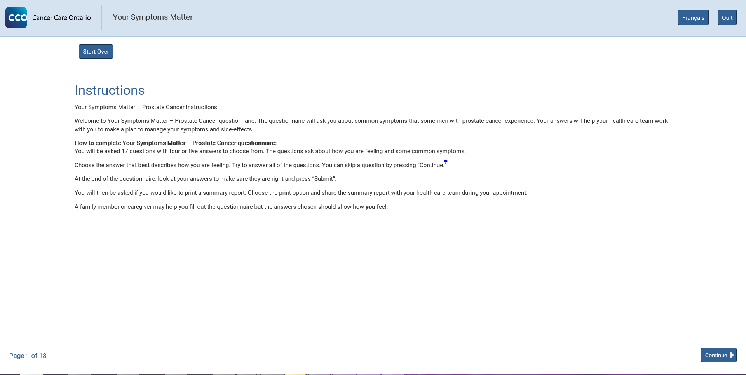
Screenshots: Your Symptoms Matter – Prostate Cancer
Instructions page

Slide 20
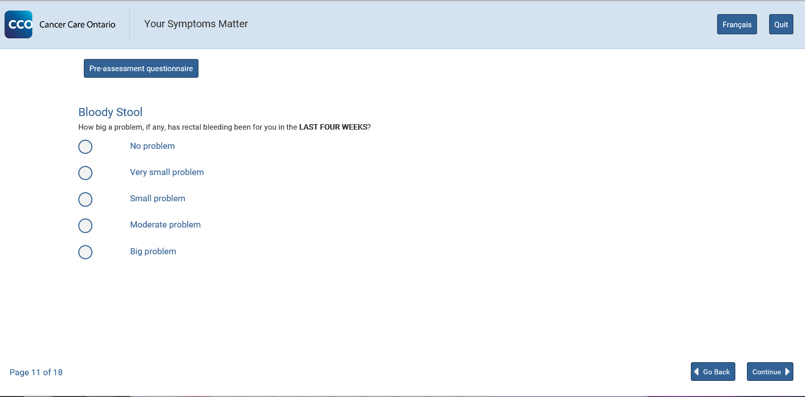
Screenshots: Your Symptoms Matter – Prostate Cancer
Example of question
Please note, should patients realize they have selected the wrong questionnaire, the “Start Over” button is available with all questions.

Slide 21
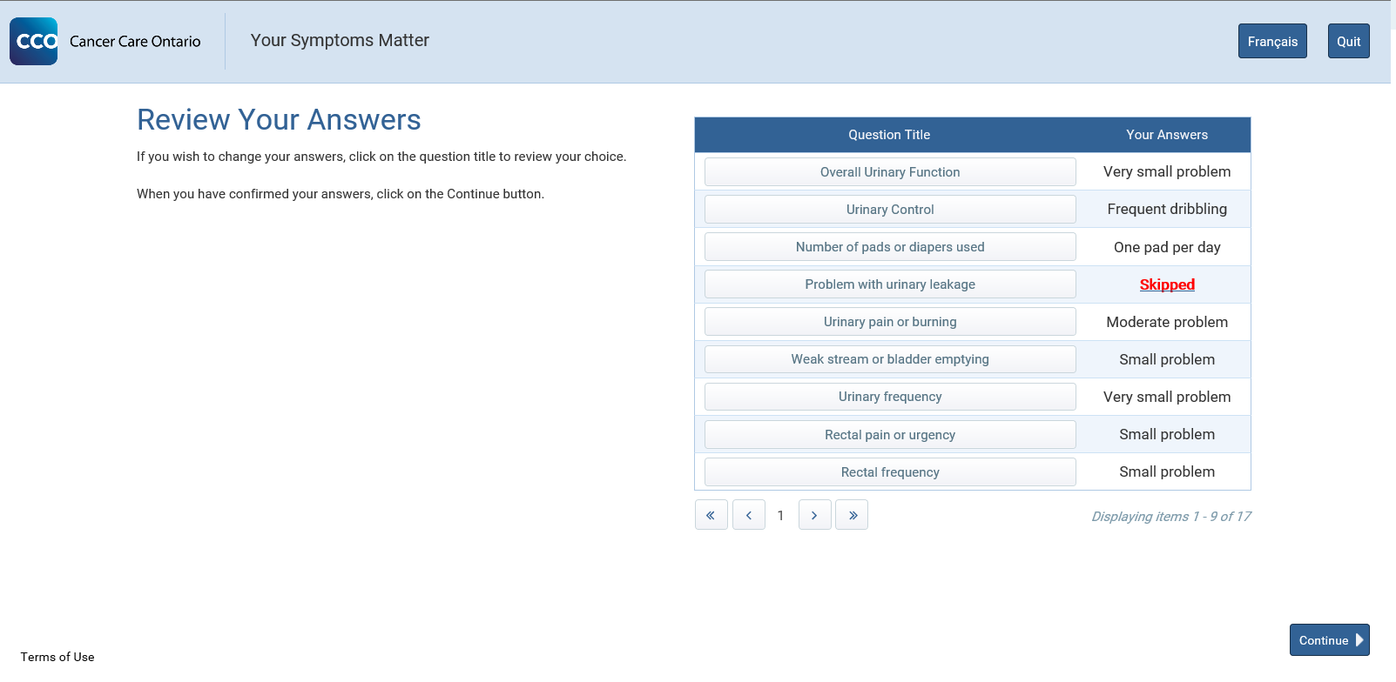
Screenshots: Your Symptoms Matter – Prostate Cancer
Example of summary page

Slide 22
Screenshots: Your Symptoms Matter – Prostate Cancer
Report Output

Slide 23
Your Symptoms Matter – Daily Functions
Also known as _{P}ecog/prfs

Slide 24
Your Symptoms Matter – Daily Activities
All patients will be asked to complete Your Symptoms Matter – Daily Activities (formerly known as pECOG or PFRS)
This questionnaire will be probed at the end of Your Symptoms Matter – General Symptoms and Your Symptoms Matter – Prostate Cancer
This questionnaire consists of one question and asks patients to rate their daily functions and activity levels

Slide 25
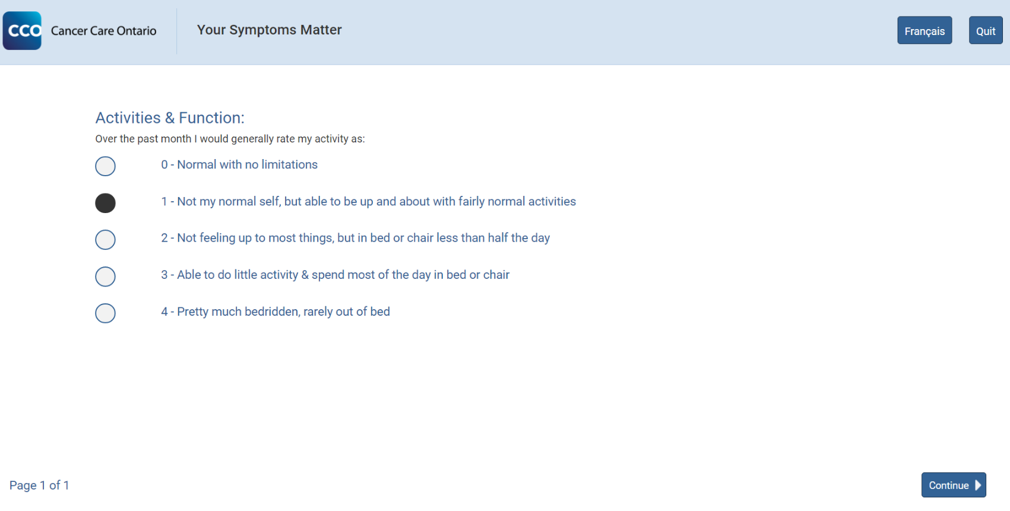
Your Symptoms Matter – Daily Activities
Question

Slide 26
Your Symptoms Matter – Daily Activities
Your Symptoms Matter –
Prostate Cancer Output
Your Symptoms Matter –
General Symptoms Output

Slide 27
Your Symptoms Matter – Prostate Cancer
Volunteer role

Slide 28
Your Symptoms Matter – Prostate Cancer
Volunteer Role
Your Symptoms Matter is completed by patients prior to their appointments with volunteer assistance
Your role is to help patients complete the assessment by providing support and education
Reports are generated in real-time
Symptom scores are flagged for patients who need extra assistance

Slide 29
Your Symptoms Matter – Prostate Cancer
Volunteer Role: How to be a good listener
EMPATHIZE: Put yourself in the other person’s shoes, this is different then sympathy.
STAY IN THE MOMENT: Focus on listening vs. formulating your response.
MAKE UNDERSTANDING YOUR GOAL: Allow people to elaborate and explain themselves as needed. Focus on understanding what the patient/family is saying, meaning and feeling and why it is important to them. Really make understanding your primary goal.
LISTEN ACTIVELY: Check your understanding by repeating back the main points as you’ve heard them.
BE AWARE of ASSUMPTIONS: Avoid assuming, check it out.
LISTEN FOR WHAT IS MISSING: What information or emotion has been left out that could give you a clearer picture?
Reference: UHN DART volunteer resources

Slide 30
Your Symptoms Matter – Prostate Cancer
Volunteer Role: How to be a good listener
DON’T RUSH IN TO: soothe, fix, and advise.
BE AWARE OF YOUR IMPACT: Notice patient’s responses to your interactions and feedback and adapt accordingly.
DON’T offer false reassurance (everything will be all right…), defend (but Dr./Nurse/Social Worker X is very skilled).
DON’T tell people what to do or how to feel i.e. “Think positive”; “Don’t worry”.
Reference: UHN DART volunteer resources

Slide 31
How do we ensure privacy?
All volunteers assisting in Your Symptoms Matter specially trained
Avoid situations of reading questions out loud (provide paper forms)
Offer a private room where possible
Privacy barrier
Educational handouts

Slide 32
How patients are directed to Your Symptoms Matter kiosks
Patients check in with reception and are directed to the kiosks
Greet patients by the computer and introduce Your Symptoms Matter
  ‘Your Symptoms Matter helps your health care team know how you are coping’
Patients will then swipe their health card at the kiosk, where male patients will be directed to the self-selection process

Slide 33
Completion of Your Symptoms Matter
Remind them to take their print out or scores to their health care provider
Remind them to not forget their health card
Offer hand sanitizer

Slide 34
FAQs for Your Symptoms Matter
What happened to ESAS?
The ESAS name has been changed to Your Symptoms Matter – General Symptoms to avoid the use of acronyms, as suggested by the Patient and Family Advisory Committee. The change in name does not affect previous scores.
What happened to ISAAC?
The ISAAC name has been changed to Your Symptoms Matter. This technological platform will hold many present and future questionnaires for patients to assist in symptom management.
Why are only males asked the self-selection questions?
Since the only questionnaires currently available on the Your Symptoms Matter platform are for General Symptoms or Prostate Cancer, the Prostate Cancer survey does not apply to women. The self-selection questions are designed to see what questionnaires males should be completing. At the moment, women will always get Your Symptoms Matter-General Symptoms.

Slide 35
FAQs for Your Symptoms Matter
If I complete the Prostate Cancer questionnaire, do I also have to complete the General Symptoms?
No, it is necessary to only complete the Prostate Cancer questionnaire.
How come I don’t fill in the Prostate Cancer questionnaire at each visit?
Depending on your visit frequency, it is not necessary to fill in the questionnaire at every visit. The system will prompt you to fill in the survey at certain intervals. Should you have any symptoms and want to fill in the survey, you can always request one for completion.

Slide 36
FAQs for Your Symptoms Matter
Do I mention only cancer symptoms? What if I have back pain from arthritis?
Mention all symptoms and concerns.
How long will this take?
It will take 5 minutes and your doctor knows you are here.
Why do I need to do this?
This is part of your assessment to improve your care.
Why complete these assessments on a computer?
All the information is confidential and stored within a secure network
Allows for easy creation of reports in real time
Results can be trended over time
Results will go directly into patients medical record

