Slide 1

Prevention System Quality Index
2016
Monitoring Ontario’s Efforts in Cancer Prevention

Slide 2
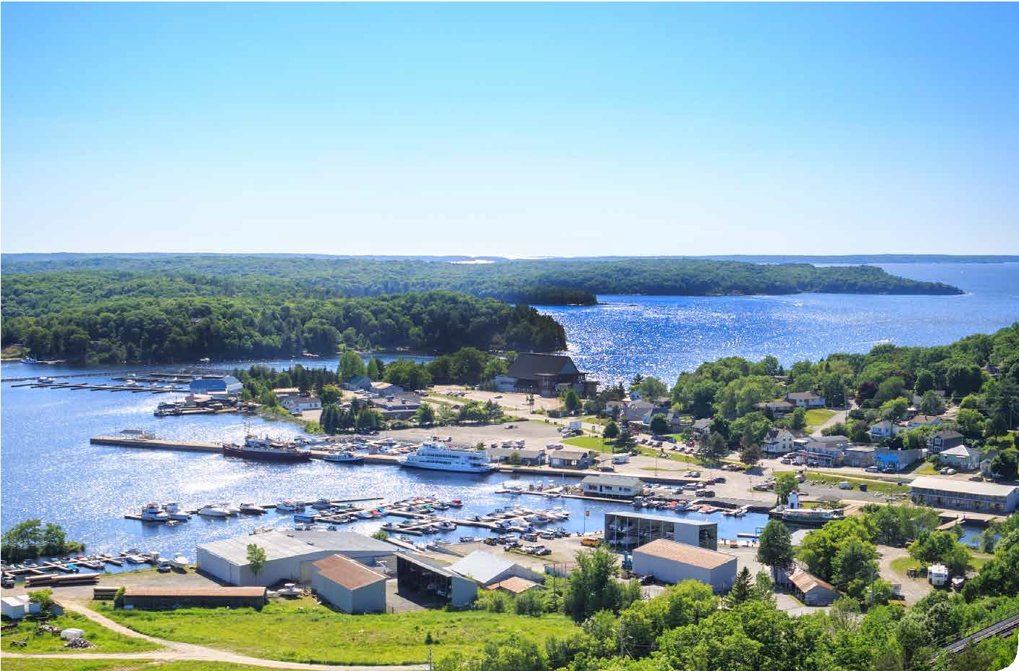
Introduction

Slide 3
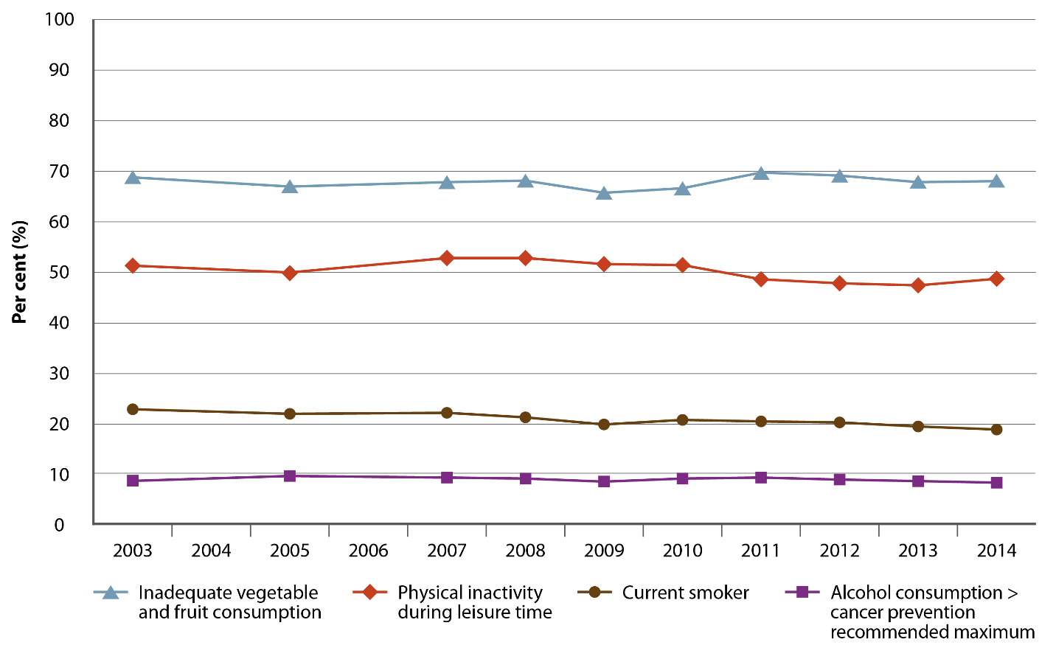
Percentage of adults in Ontario with selected modifiable risk factors, 2003–2014
Source: Canadian Community Health Survey, 2003, 2005, 2007–2014 (Statistics Canada)
Note: Estimates are adjusted to the age distribution of the 2011 Canadian population.

Slide 4
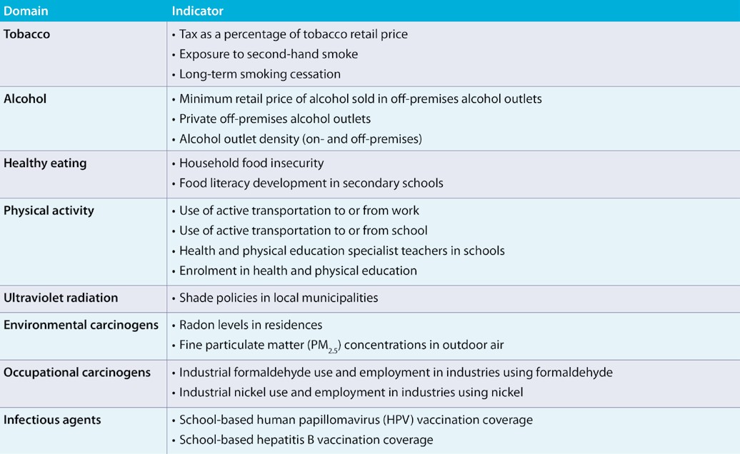
2016 Prevention System Quality Index risk factor and exposure domains and indicators

Slide 5
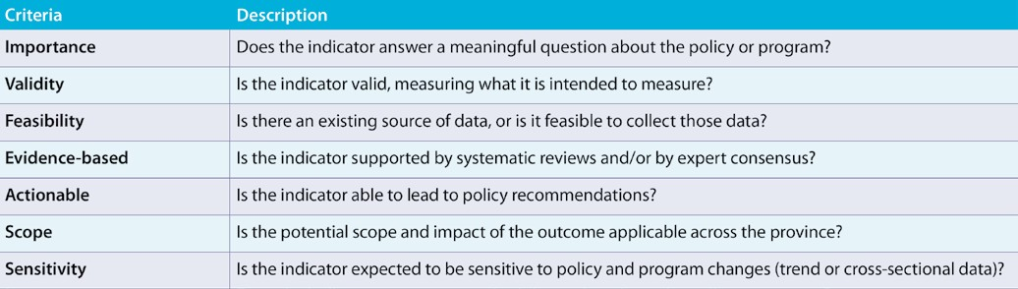
2016 Prevention System Quality Index indicator criteria

Slide 6
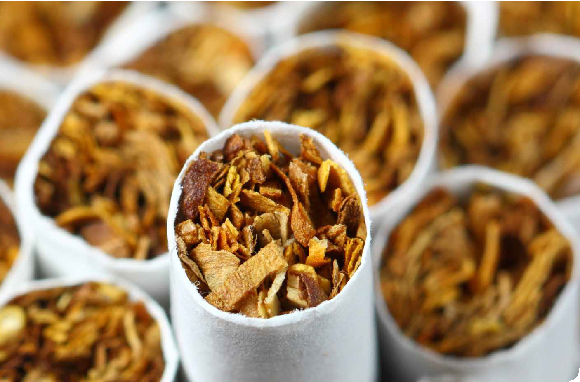
Tobacco

Slide 7
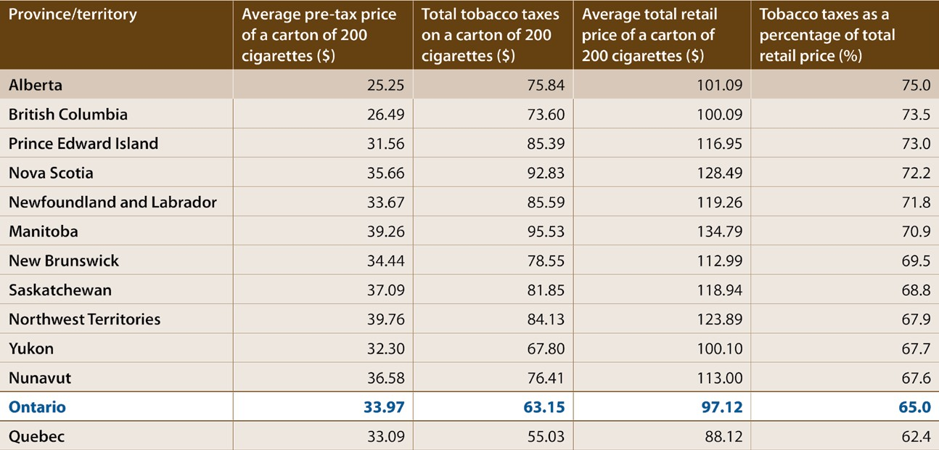
Tobacco taxes as a percentage of total retail price per carton of 200 cigarettes, by province/territory, April 2016
Source: Federal and Provincial/Territorial Tobacco Tax Rates, April 2016 (Non-Smokers’ Rights Association/Smoking and Health Action Foundation)
7

Slide 8
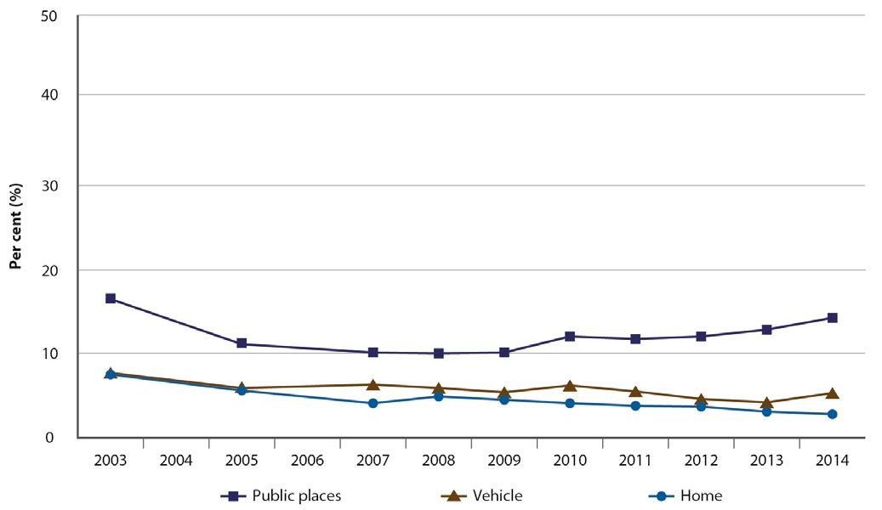
Percentage of non-smoking adults (age 20+) in Ontario who were exposed to second-hand smoke in the past month, by location of exposure, 2003–2014
Source: Canadian Community Health Survey, 2003, 2005, 2007–2014 (Statistics Canada)
Note: Estimates are adjusted to the age distribution of the 2011 Canadian population.
8

Slide 9
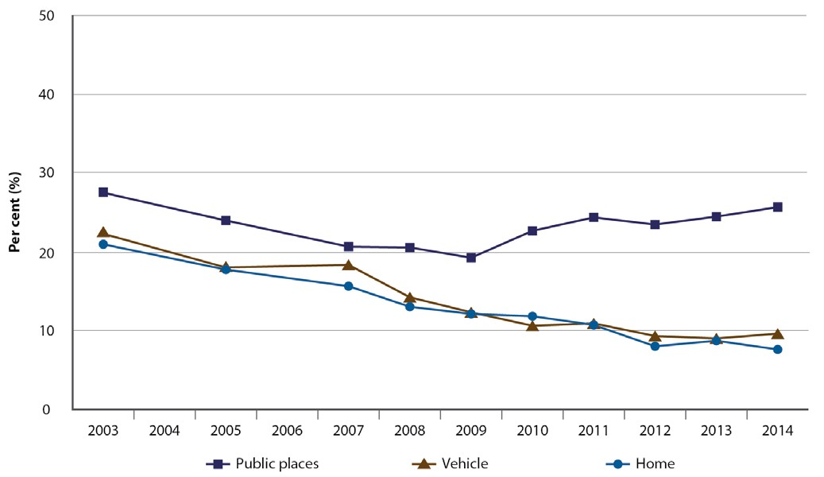
Percentage of non-smoking adolescents (ages 12–19) in Ontario who were exposed to second-hand smoke in the past month, by location of exposure, 2003–2014
Source: Canadian Community Health Survey, 2003, 2005, 2007–2014 (Statistics Canada)
9

Slide 10
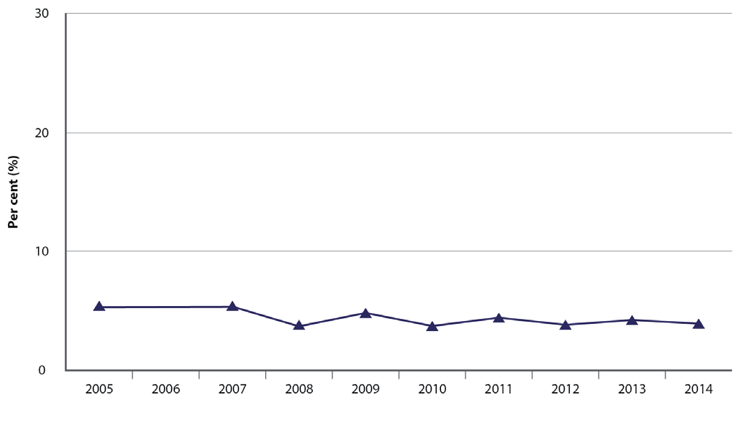
Percentage of recent daily smokers (age 20+) in Ontario who have quit smoking for at least one year, 2005–2014
Source: Canadian Community Health Survey, 2005, 2007–2014 (Statistics Canada)
Notes: Estimates are adjusted to the age distribution of the 2011 Canadian population. Recent daily smokers: smokers who were smoking daily 1 to 2 years ago.
10
Tobacco

Slide 11
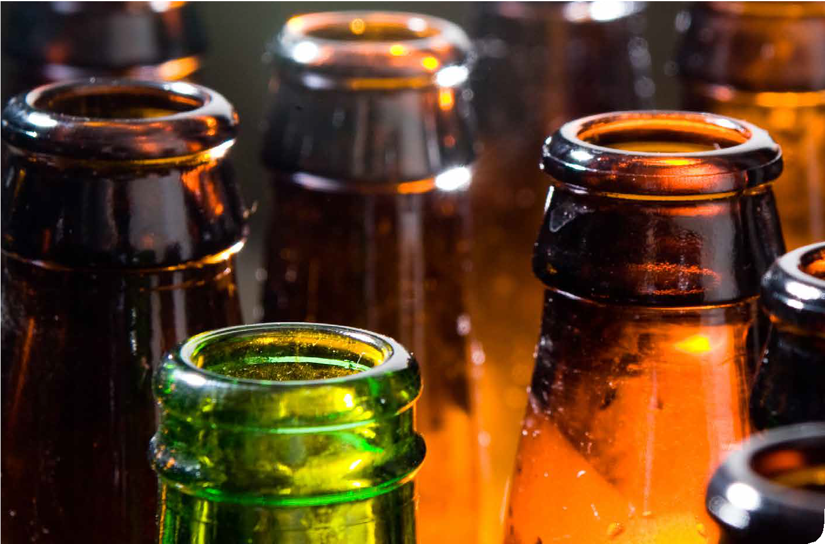
Alcohol

Slide 12
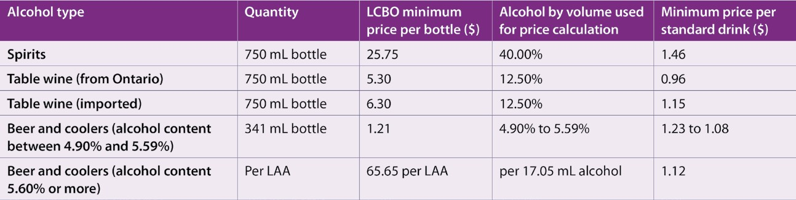
Minimum retail price of alcohol sold in off-premises alcohol outlets set by the Liquor Control Board of Ontario (LCBO) in Ontario, by alcohol type, 2016
Source: MRP Index Factor, 2016 (Liquor Control Board of Ontario)
Notes: Minimum retail prices effective as of March 1, 2016. Minimum retail prices in this table include taxes and container deposit. Alcohol type: selected types listed. LAA: litre of absolute alcohol. Standard drink: 17.05 mL of alcohol.

Slide 13
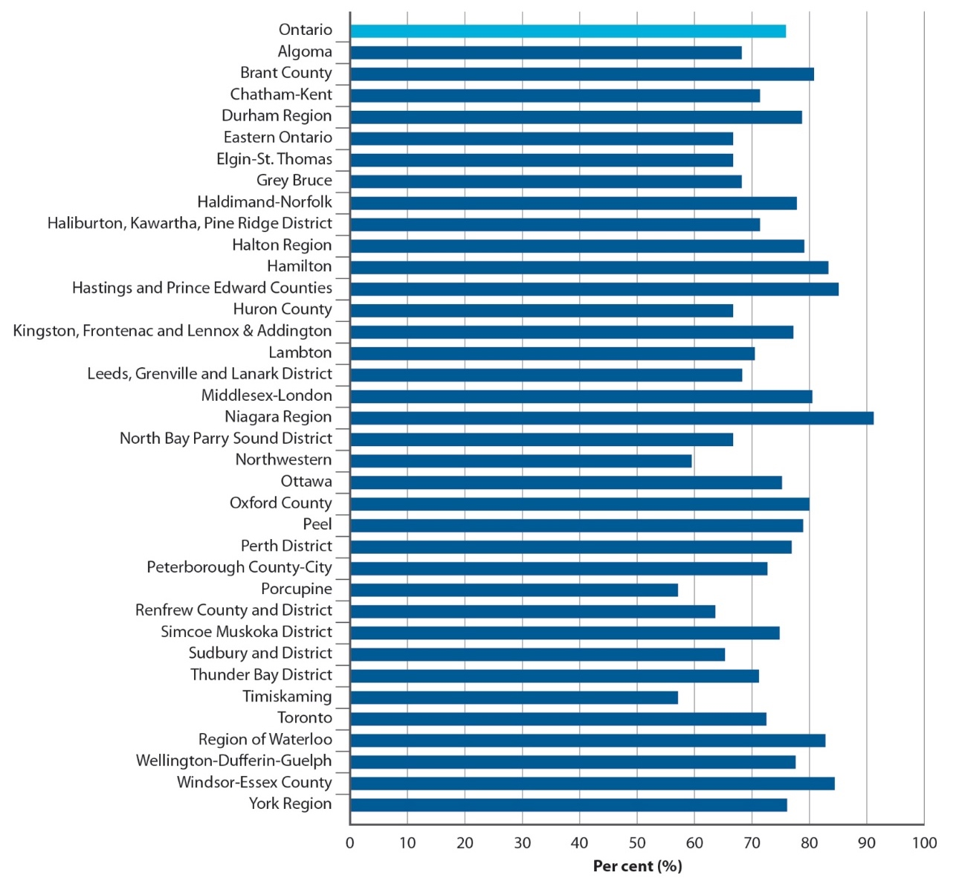
Percentage of off-premises alcohol outlets in Ontario that are privately owned, by public health unit, as of December 2015/January 2016
Sources: Lists of Brewers Retail (The Beer Store), farmers’ markets, ferment-on-premise locations,
off-site wineries, on-site wineries, on-site breweries, on-site distilleries and grocery stores, 2015–2016 (Alcohol and Gaming Commission of Ontario); Lists of Agency Stores and LCBO stores, 2016 (Liquor Control Board of Ontario)

Slide 14
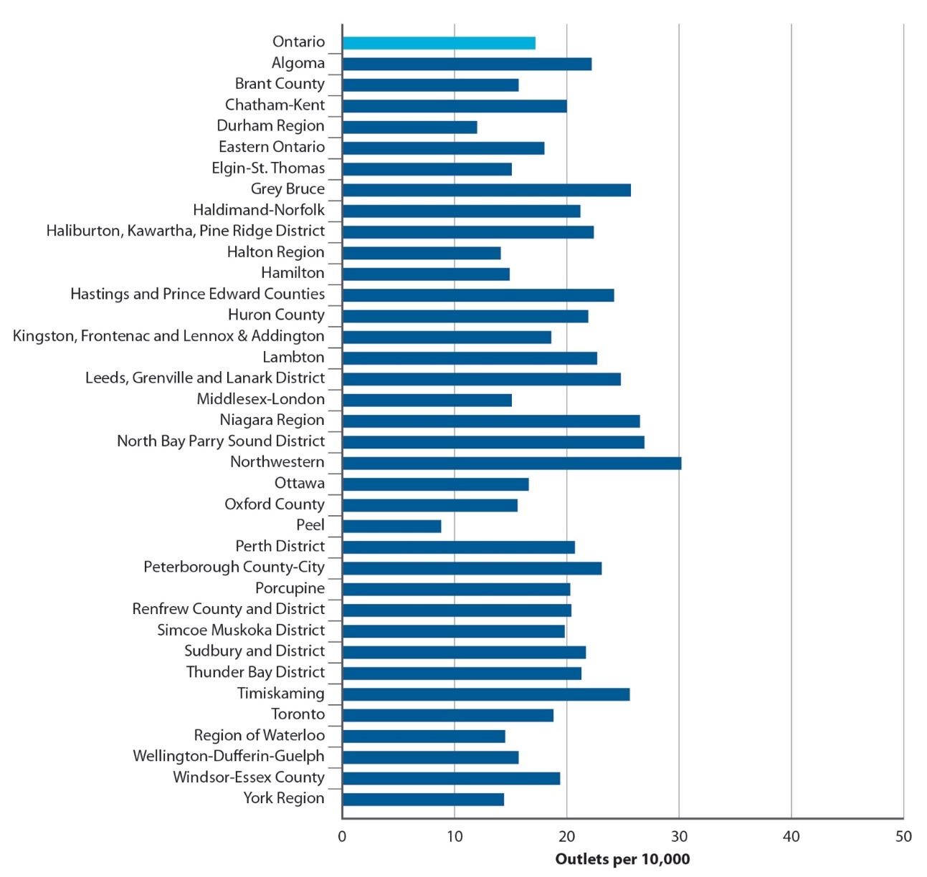
Number of on- and off-premises alcohol outlets per 10,000 population (age 15+) in Ontario, by public health unit, as of December 2015/January 2016
Sources: Lists of Brewers Retail (The Beer Store), farmers’ markets, ferment-on-premise locations,
off-site wineries, on-site wineries, on-site breweries, on-site distilleries, grocery stores and on-premises locations, 2015–2016 (Alcohol and Gaming Commission of Ontario); Lists of Agency Stores and LCBO stores, 2016 (Liquor Control Board of Ontario); Population estimates, Ministry of Finance Population Projections, 2011 (Statistics Canada)
Note: Includes private and publicly owned alcohol outlets.

Slide 15

Healthy eating

Slide 16
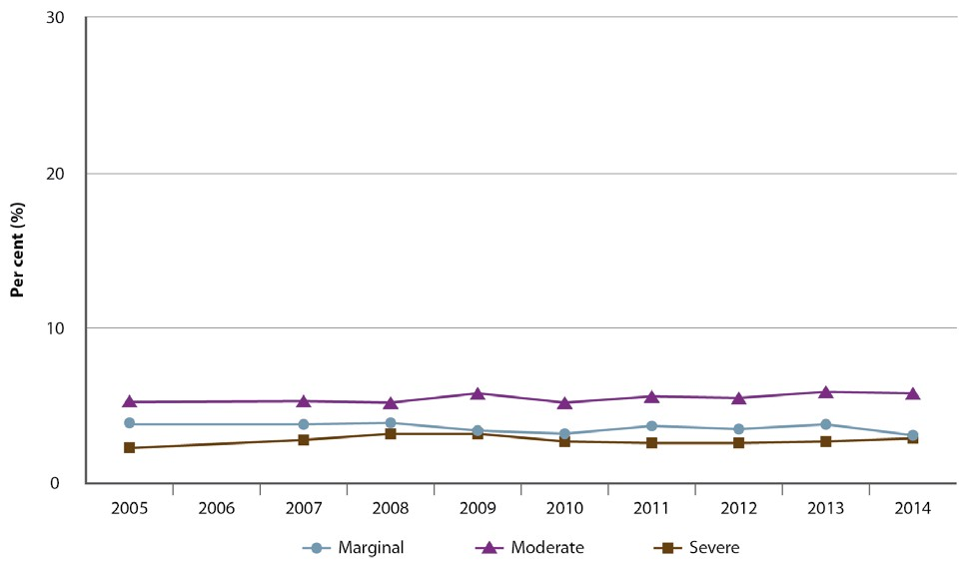
Percentage of Ontario households that were food insecure in the past year, by level of food insecurity, 2005–2014
Source: Canadian Community Health Survey, 2005, 2007–2014 (Statistics Canada)

Slide 17
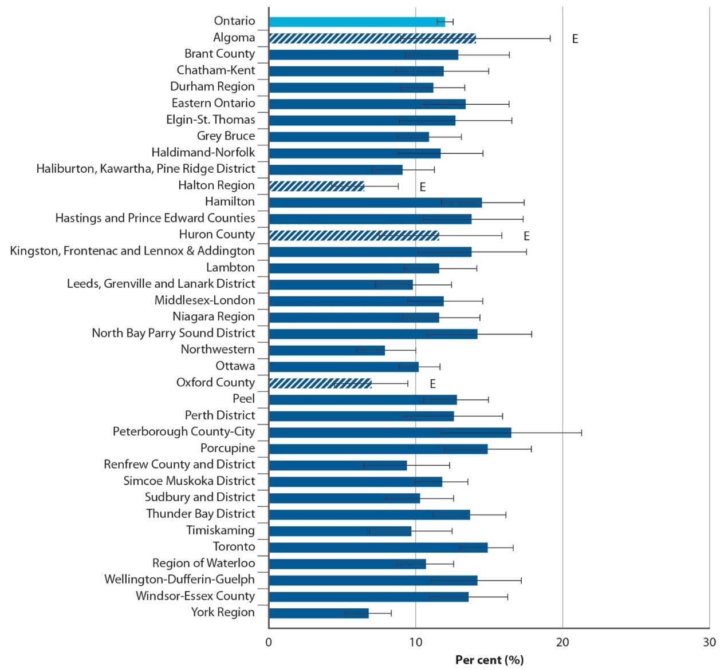
Percentage of Ontario households that were food insecure (marginal, moderate and severe combined) in the past year, by public health unit, 2012–2014 combined
Source: Canadian Community Health Survey, 2012–2014 (Statistics Canada)
Notes: represents 95% confidence intervals.
E: Interpret cross-hatched estimates with caution due to high sampling variability.

Slide 18
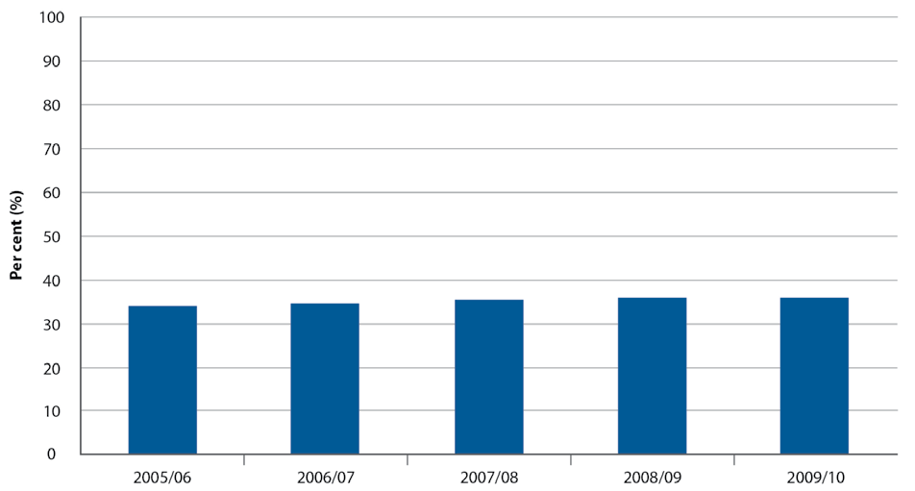
Percentage of students in publicly funded secondary schools in Ontario who earned at least one credit in a course that included a food literacy component during their secondary school education, 2005/06 to 2009/10 cohort
Source: Ontario School Information System, 2005/06–2013/14 (Ministry of Education)
Prepared by: Cancer Care Ontario, Prevention and Cancer Control (Population Health and Prevention), based on analytic results provided by the Dissemination and Reporting Unit, Ministry of Education
Note: Cohort year refers to the school year a student begins Grade 9.

Slide 19
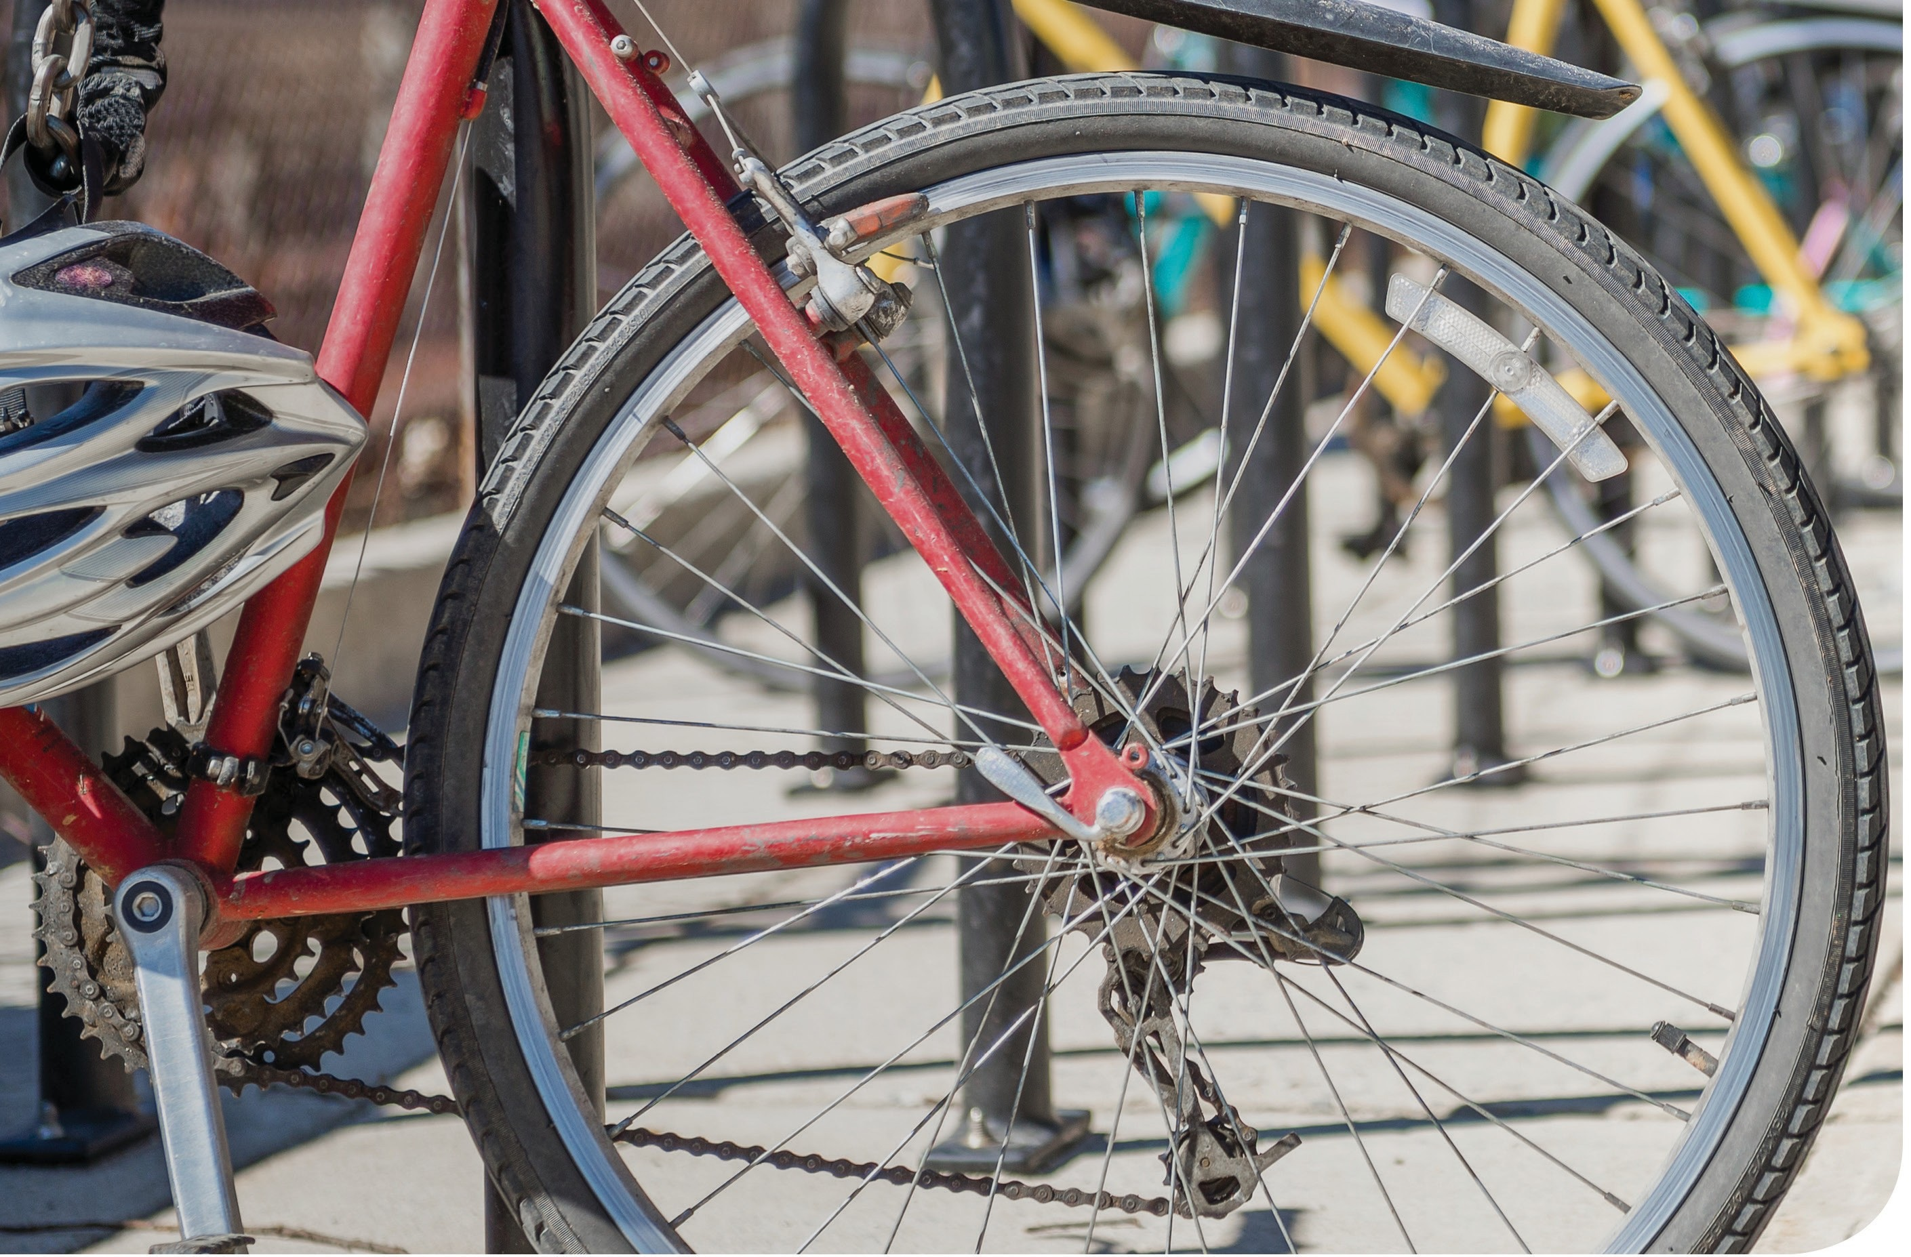
Physical activity

Slide 20
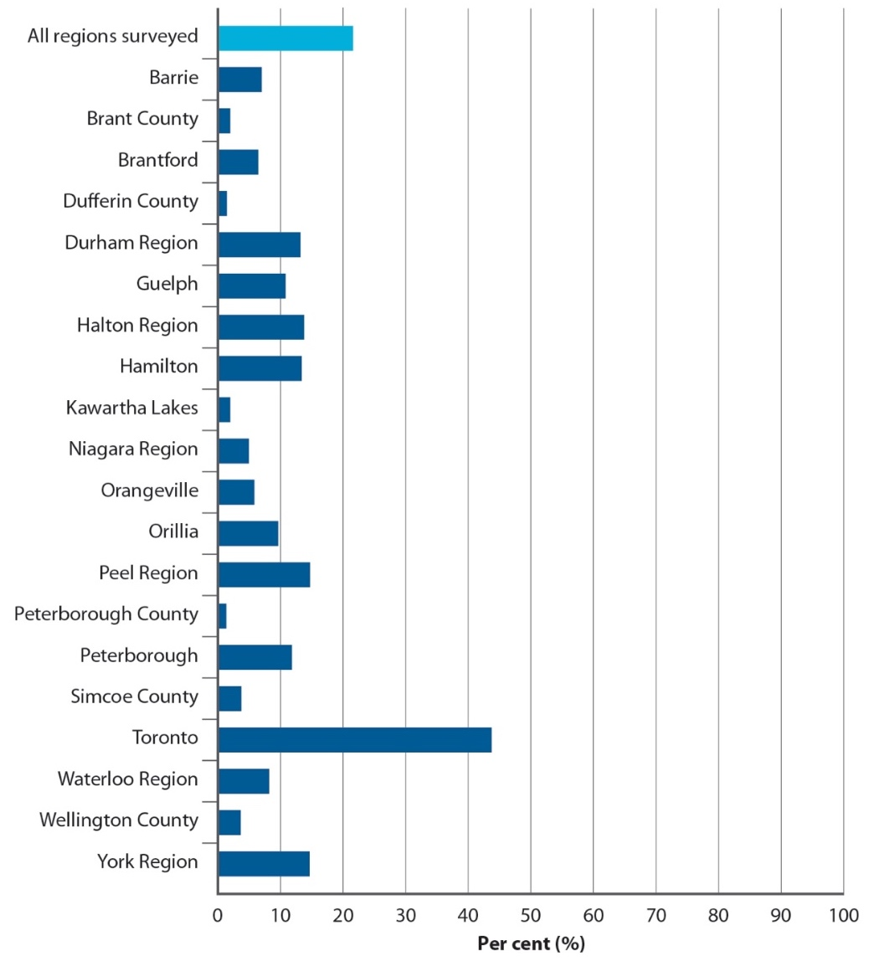
Percentage of trips taken to or from work by adults (age 19+) that included active transportation, Greater Golden Horseshoe regions in Ontario, 2011
Source: Transportation Tomorrow Survey, 2011 (Data Management Group,
University of Toronto)
Note: Active transportation: walking or cycling used as the only mode of transportation to or from work, and to or from public transit.
20

Slide 21
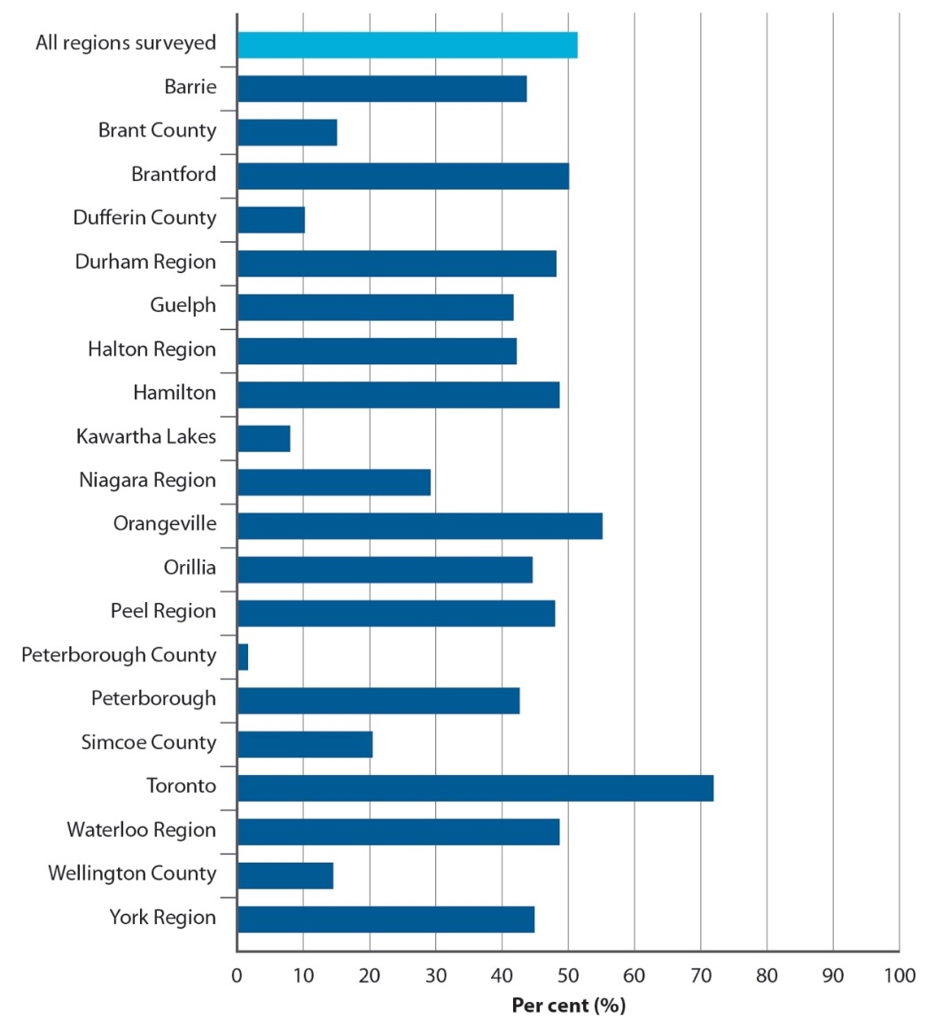
Percentage of trips taken to or from school by youth (ages 11–18) that included active transportation, Greater Golden Horseshoe regions in Ontario, 2011
Source: Transportation Tomorrow Survey, 2011 (Data Management Group,
University of Toronto)
Note: Active transportation: walking or cycling used as the only mode of transportation to or from school, and to or from public transit.
21

Slide 22
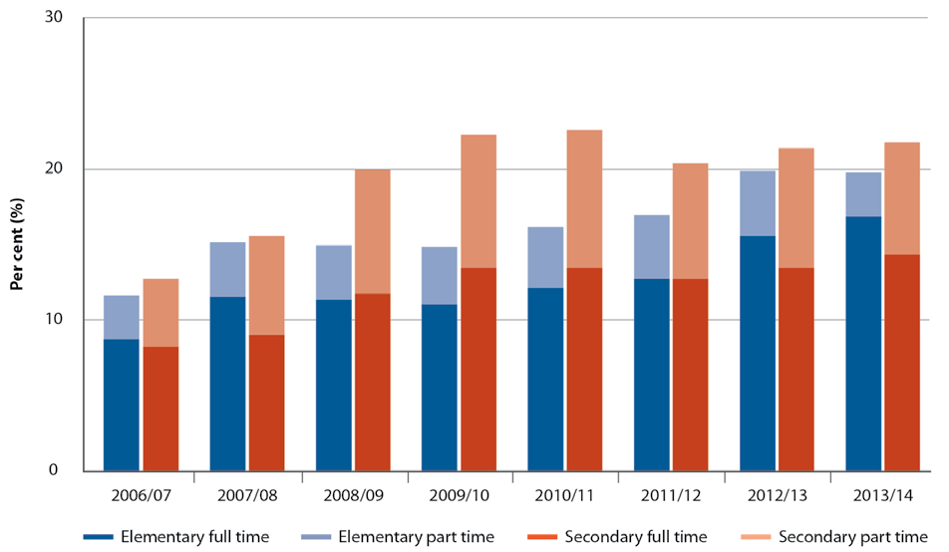
Percentage of publicly funded elementary and secondary schools in Ontario with full- and/or part-time specialist teachers assigned to teach health and physical education, 2006/07 to 2013/14 school year
Source: Ontario School Information System, 2006/07–2013/14 (Ministry of Education)
Notes: Full time: ≥1.0 full-time equivalent (FTE); note that ≥1.0 FTE does not necessarily mean there are 1 or more full-time specialist teachers because 2 or more part-time specialist teachers may account for ≥1.0 FTE. Part time: >0 and <1.0 FTE.

Slide 23
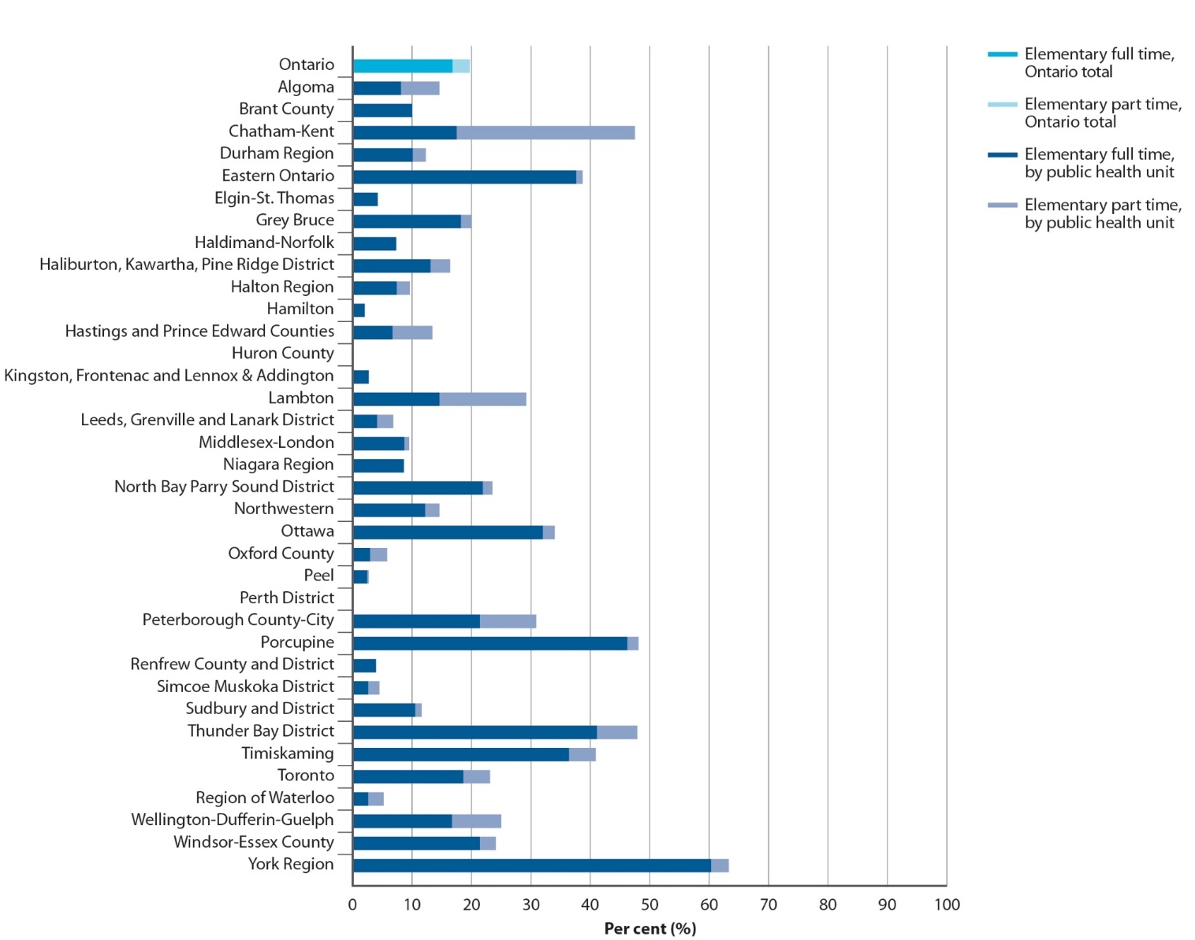
Percentage of publicly funded elementary schools in Ontario with full- and/or part-time specialist teachers assigned to teach health and physical education, by public health unit, 2013/14 school year
Source: Ontario School Information System, 2013/14
(Ministry of Education)
Notes: Full time: ≥1.0 full-time equivalent (FTE); note that ≥1.0 FTE does not necessarily mean there are
1 or more full-time specialist teachers because 2 or more part-time specialist teachers may account for
≥1.0 FTE. Part time: >0 and <1.0 FTE.

Slide 24
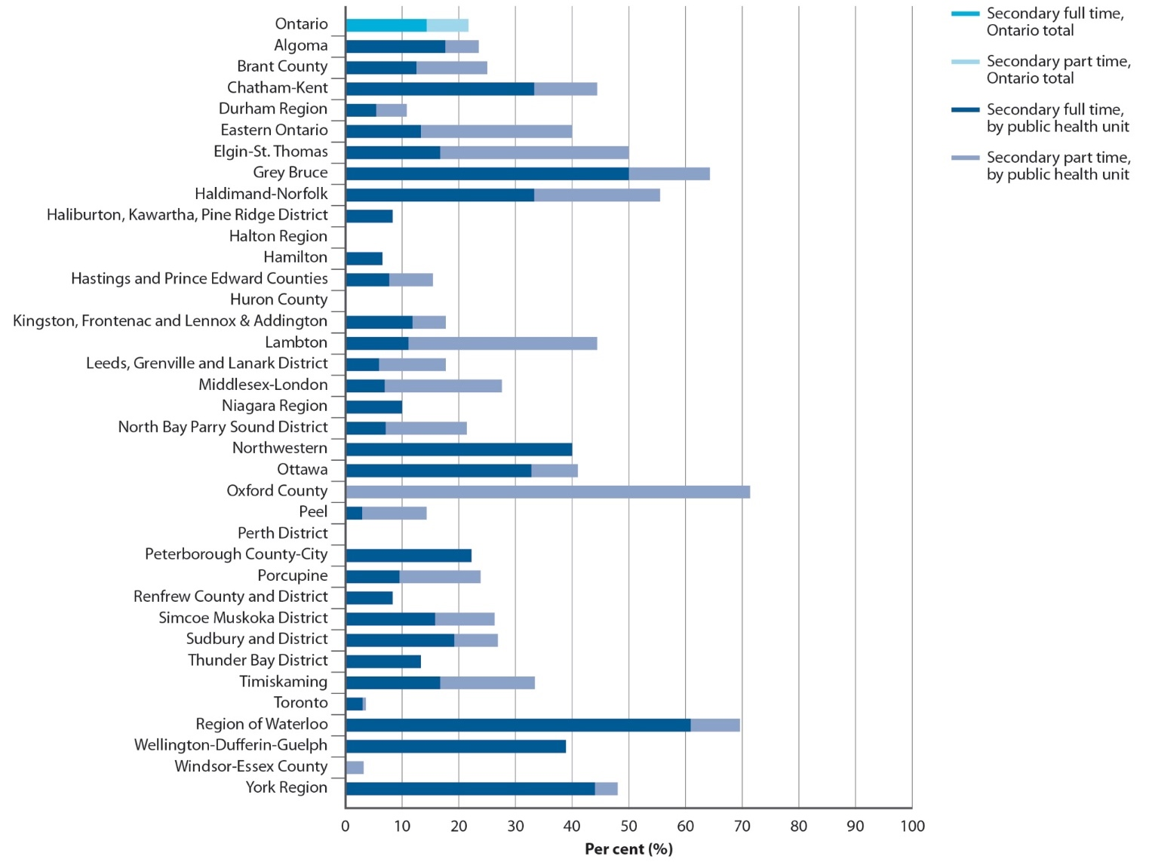
Percentage of publicly funded secondary schools in Ontario with full- and/or part-time specialist teachers assigned to teach health and physical education, by public health unit, 2013/14 school year
Source: Ontario School Information System, 2013/14
(Ministry of Education)
Notes: Full time: ≥1.0 full-time equivalent (FTE); note that ≥1.0 FTE does not necessarily mean there are
1 or more full-time specialist teachers because 2 or more part-time specialist teachers may account for
≥1.0 FTE. Part time: >0 and <1.0 FTE.

Slide 25
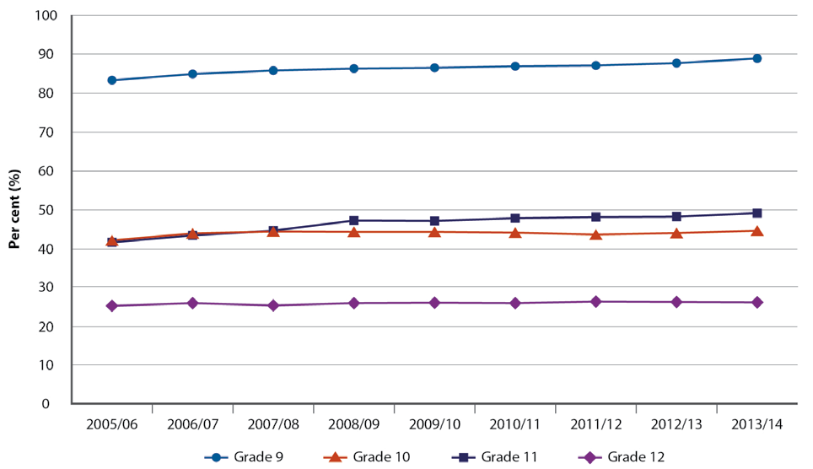
Percentage of students in publicly funded secondary schools in Ontario who earned one or more health and physical education credits, by grade, 2005/06 to 2013/14 school year
Source: Ontario School Information System, 2005/06 to 2013/14 (Ministry of Education)
Prepared by: Cancer Care Ontario, Prevention and Cancer Control (Population Health and Prevention), based on analytic results provided by the Dissemination and Reporting
Unit, Ministry of Education

Slide 26

Ultraviolet radiation

Slide 27
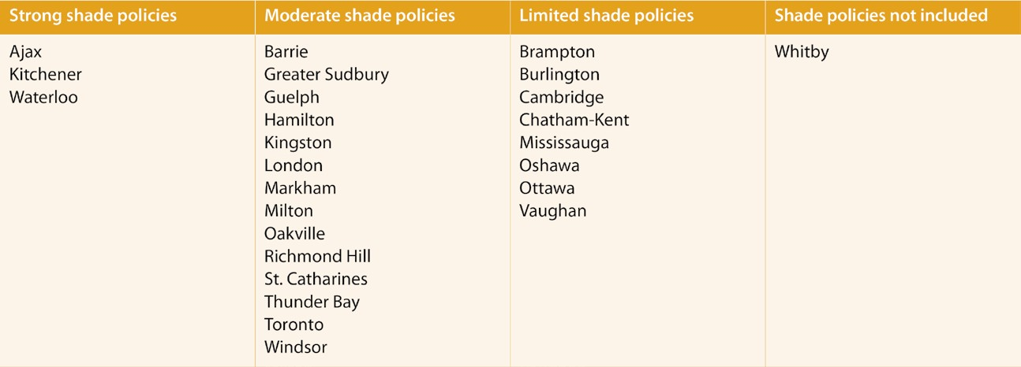
Strength of shade policies in the planning policy documents of local municipalities in Ontario with populations of 100,000 or more, as of March 2016
Sources: Municipal planning policy documents (e.g., official plans, urban design guidelines, site plan control bylaws) posted on the web and/or additional documents sent via email from the municipality for each of the 26 Ontario local municipalities with populations of 100,000 or greater, 2016
27

Slide 28
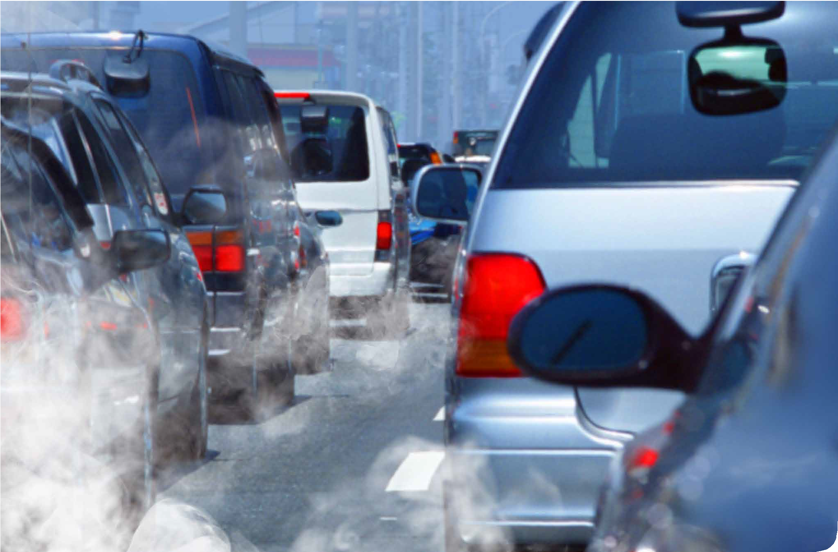
Environmental carcinogens

Slide 29
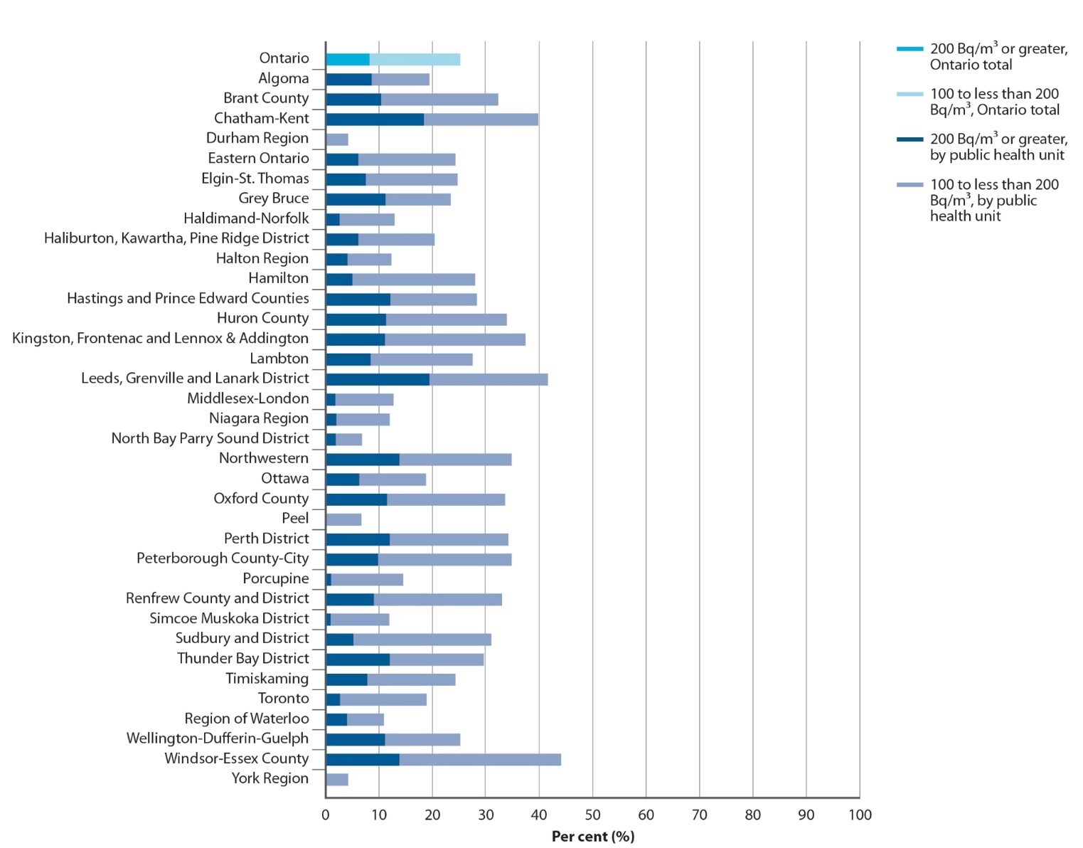
Percentage of tested homes in Ontario with radon concentrations of 100 Bq/m³ or greater, by public health unit, 2009–2013
Source: Cross-Canada Survey of Radon Concentrations in Homes, Final Ontario Dataset, 2013 (Health Canada)
Note: The minimum detection limit for a three-month radon test is 15 Bq/m³ and for data points below
15 Bq/m³, a value of 8 Bq/m³ (roughly half the detection limit) was substituted to allow calculation of medians to be performed; a total of 662 homes in Ontario (16.7% of all samples) had radon concentrations below 15 Bq/m³.

Slide 30
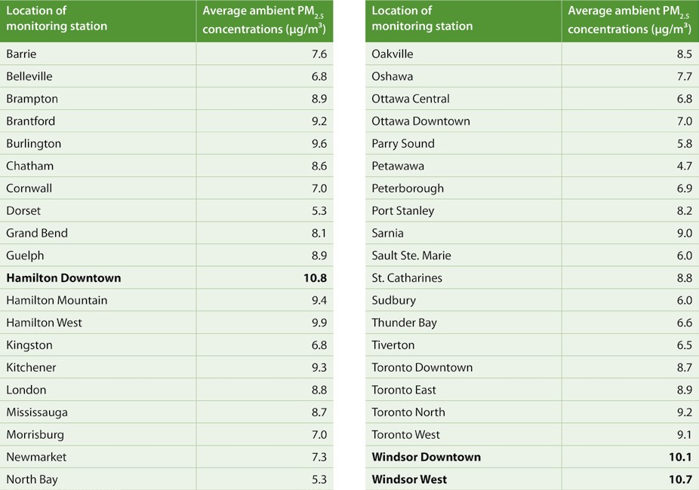
Average annual ambient fine particulate matter (PM_{2.5}) concentrations in Ontario, by monitoring station, 2014
Source: Air Quality in Ontario Report, 2014 (Ministry of the Environment and Climate Change)
Prepared by: Cancer Care Ontario, Prevention and Cancer Control (Population Health and Prevention), based on analytic results presented in the Air Quality in Ontario Report, 2014
Note: Bolded values are in exceedance of 10 μg/m³, the PM reference level set by the Canadian Ambient Air Quality Standards and the World Health Organization’s Air
2.5
Quality Guidelines.

Slide 31
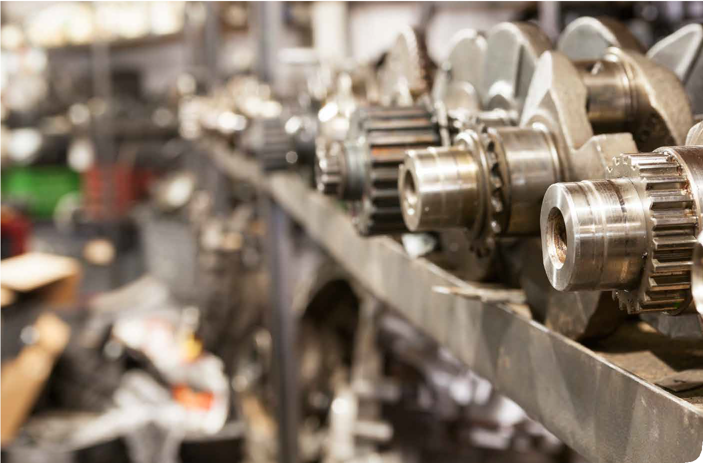
Occupational carcinogens

Slide 32
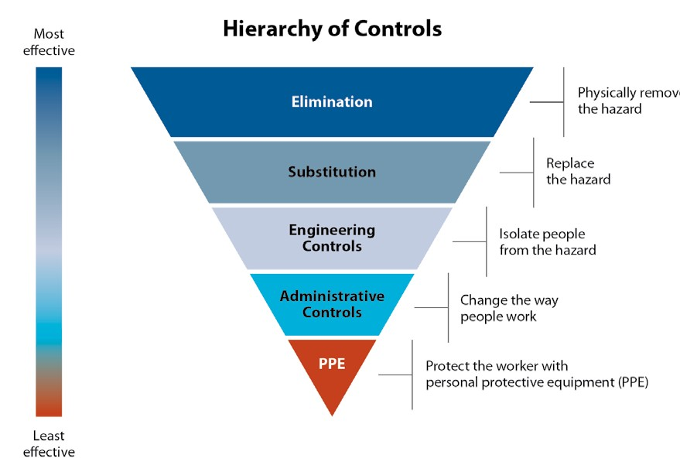
Hierarchy of Controls used to protect workers from exposures to hazardous substances
Source: Available for public use without permission from cdc.gov/niosh/topics/hierarchy
32

Slide 33
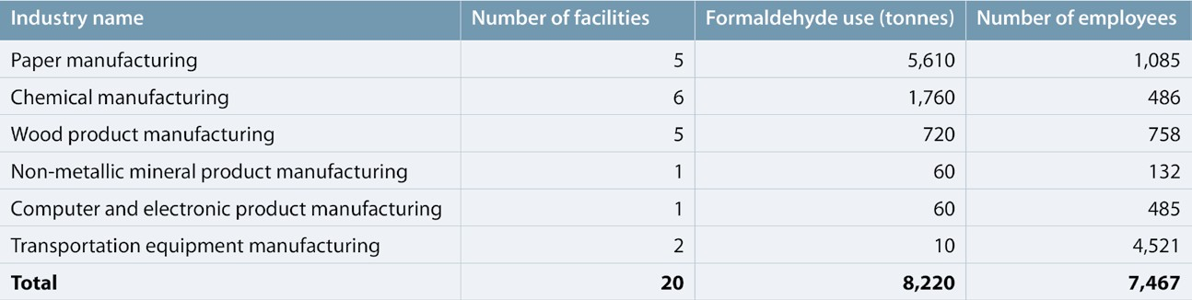
Amount of formaldehyde used (in tonnes) and number of employees working at facilities using formaldehyde in Ontario, by industry, 2013
Source: Ontario Toxics Reduction Program, 2013 (Ministry of the Environment and Climate Change)
Notes: Excludes facilities that are exempt from the Ontario Toxics Reduction Program (i.e., use or release formaldehyde in quantities below the legislated thresholds). Formaldehyde use (tonnes): estimated by selecting the mid-point value for each facility’s reported range of use, summing these values across all facilities for each sector and rounding to the nearest 10.
33

Slide 34
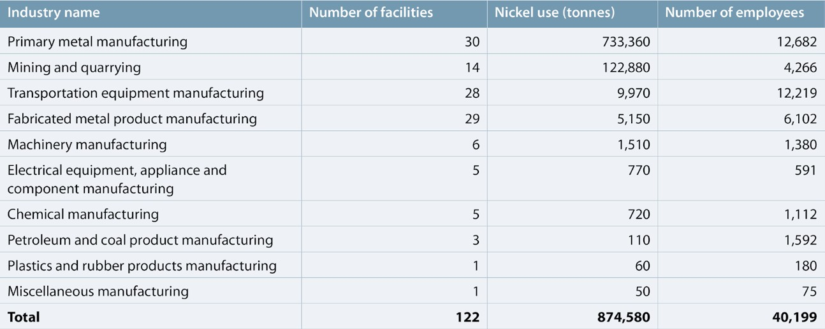
Amount of nickel used (in tonnes) and number of employees working at facilities using nickel in Ontario, by industry, 2013
Source: Ontario Toxics Reduction Program, 2013 (Ministry of the Environment and Climate Change)
Notes: Excludes facilities that are exempt from the Ontario Toxics Reduction Program (i.e., use or release nickel in quantities below the legislated thresholds).
Nickel use (tonnes): estimated by selecting the mid-point value for each facility’s reported range of use, summing these values across all facilities for each sector and rounding to the nearest 10.

Slide 35
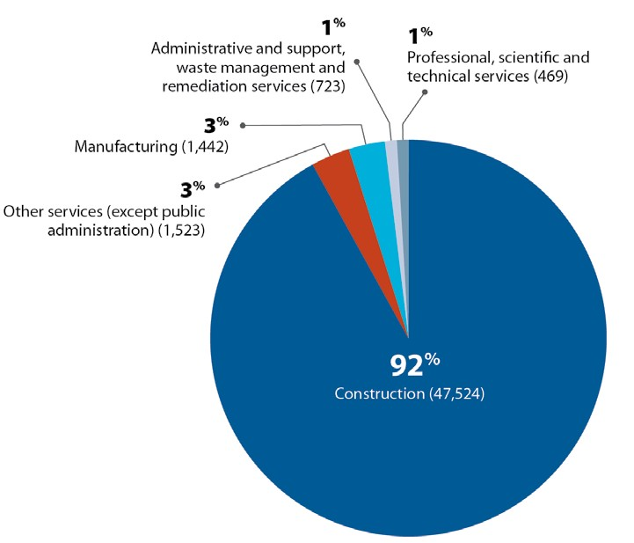
Distribution of occupational exposure to asbestos in Ontario, by industry, 2006
Source: eWORK Online, 2006 (CAREX Canada)
Note: Number of employees displayed in brackets.
Occupational carcinogens

Slide 36
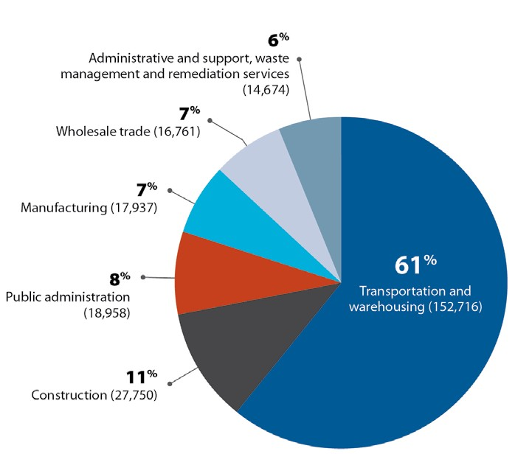
Distribution of occupational exposure to diesel engine exhaust in Ontario, by industry, 2006
Source: eWORK Online, 2006 (CAREX Canada)
Note: Number of employees displayed in brackets.
Occupational carcinogens

Slide 37
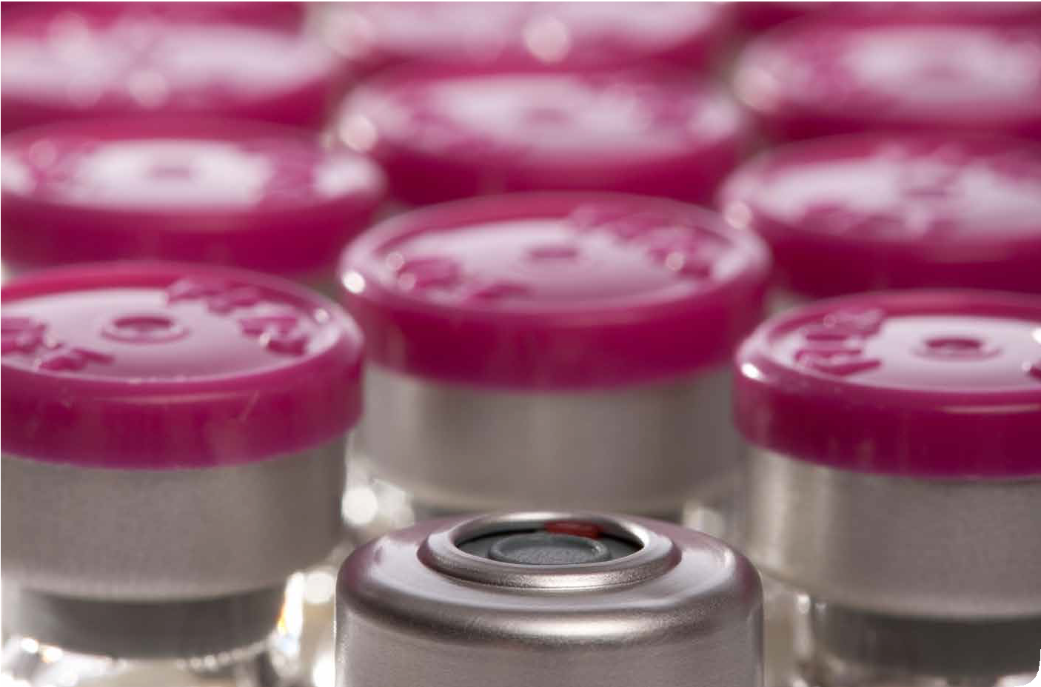

Infectious agents

Slide 38
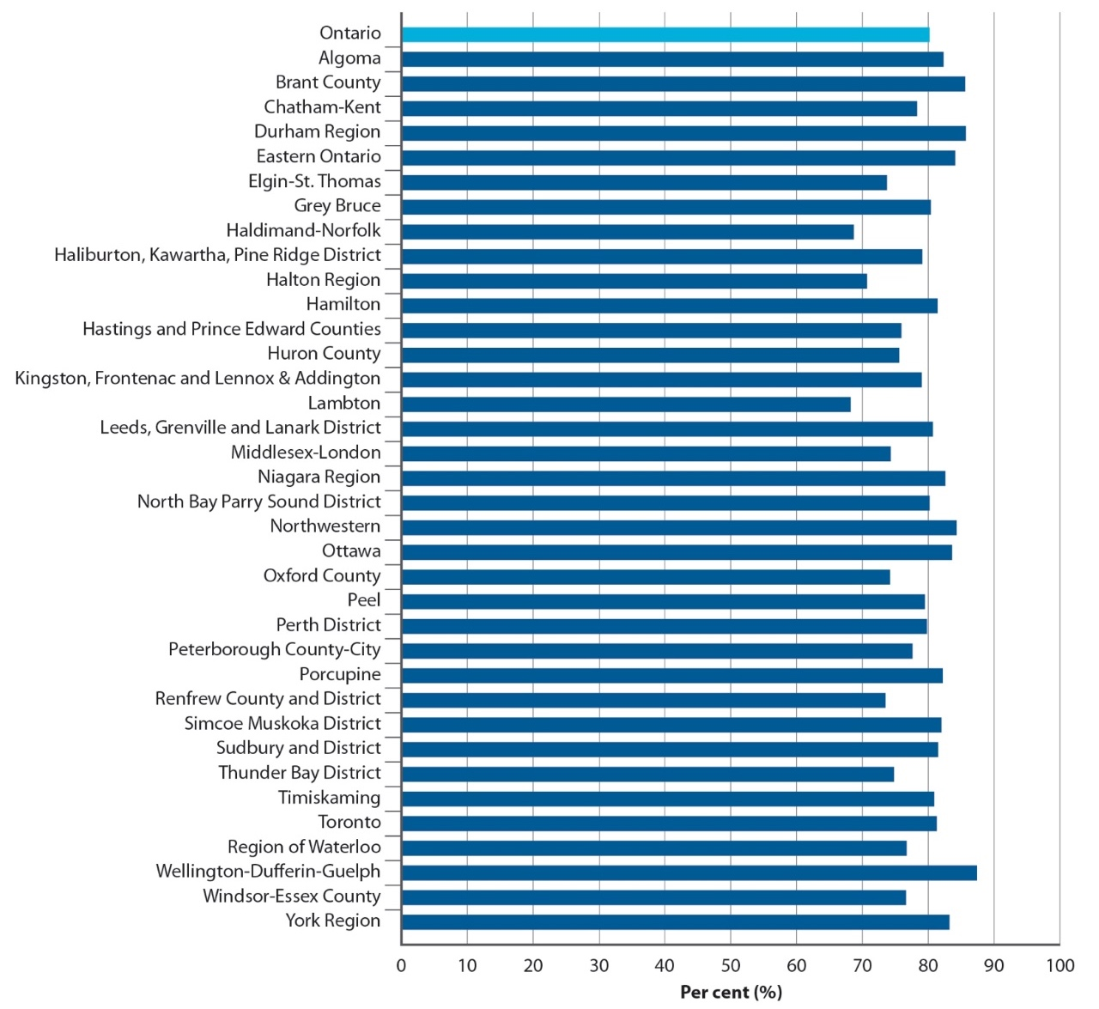
Vaccination coverage (%) for the school-based HPV vaccination program in female Grade 8 students in Ontario, by public health unit, 2012/13 school year
Source: Immunization Records Information System,
2012–2013 (Ministry of Health and Long-Term Care) Prepared by: Cancer Care Ontario, Prevention and Cancer Control (Population Health and Prevention), based on analytic results provided by Immunization and Vaccine Preventable Diseases, Public Health Ontario

Slide 39
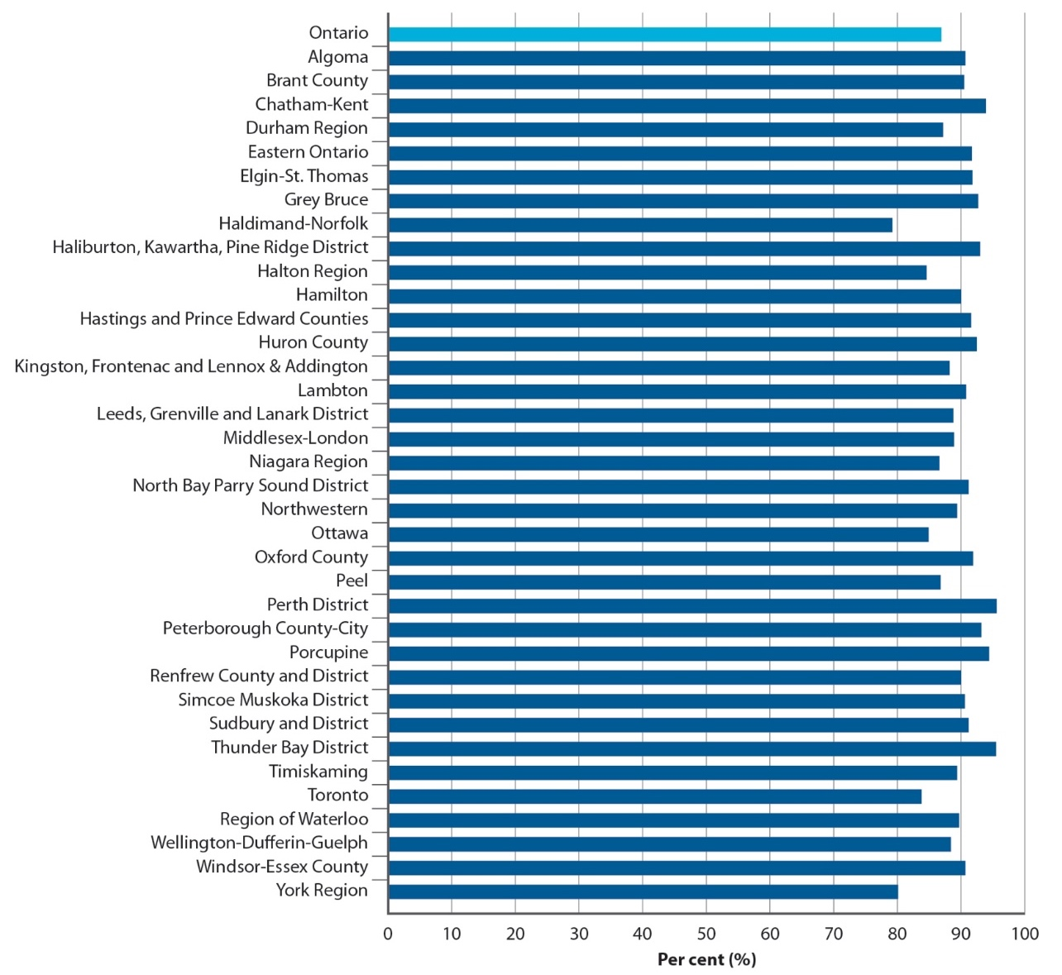
Vaccination coverage (%) for the school-based hepatitis B vaccination program in Grade 7 students in Ontario, by public health unit, 2012/13 school year
Source: Immunization Records Information System,
2012–2013 (Ministry of Health and Long-Term Care) Prepared by: Cancer Care Ontario, Prevention and Cancer Control (Population Health and Prevention), based on analytic results provided by Immunization and Vaccine Preventable Diseases, Public Health Ontario

Slide 40
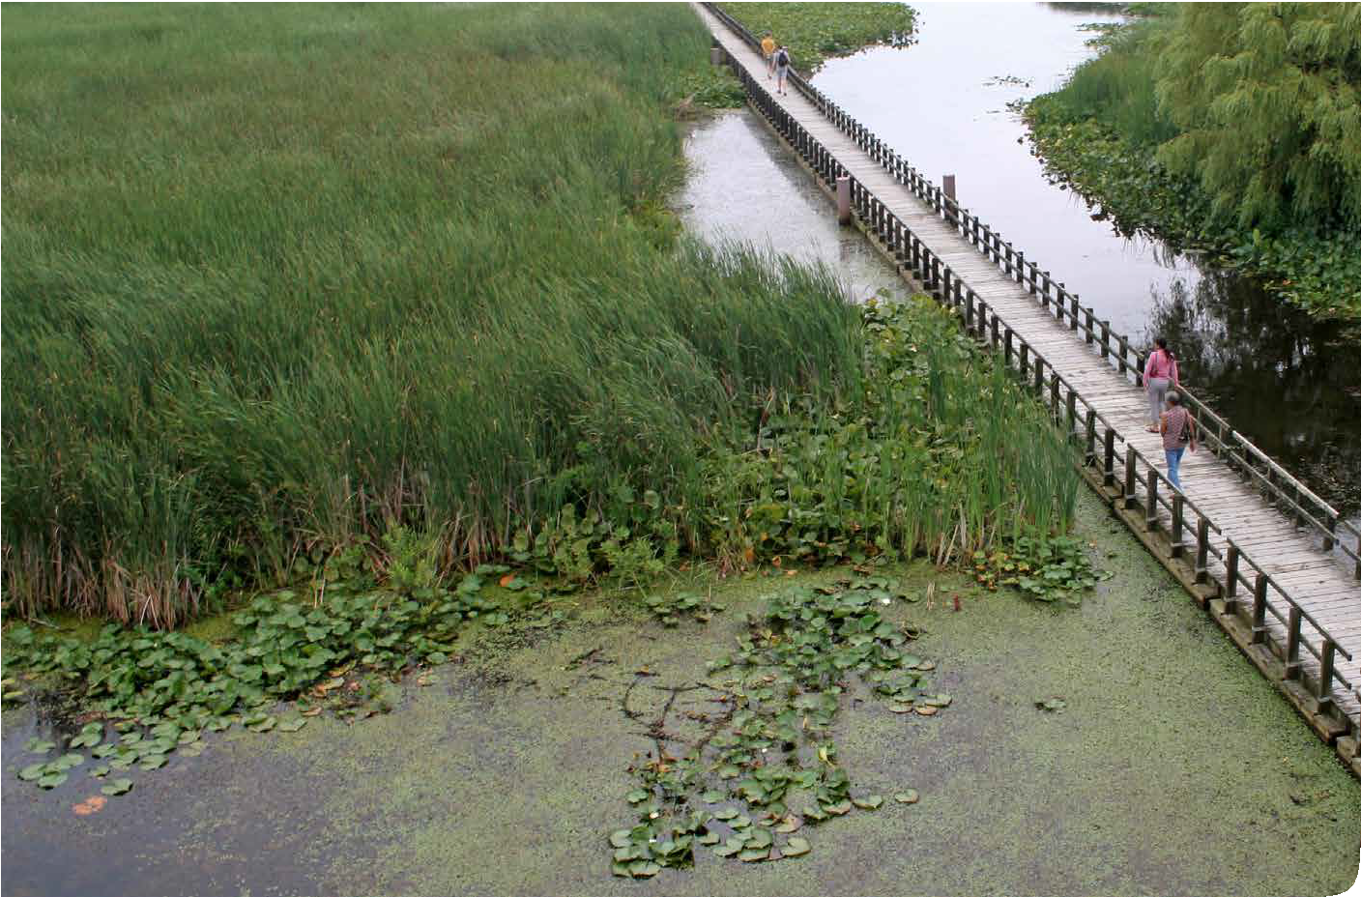
Conclusion

Slide 41
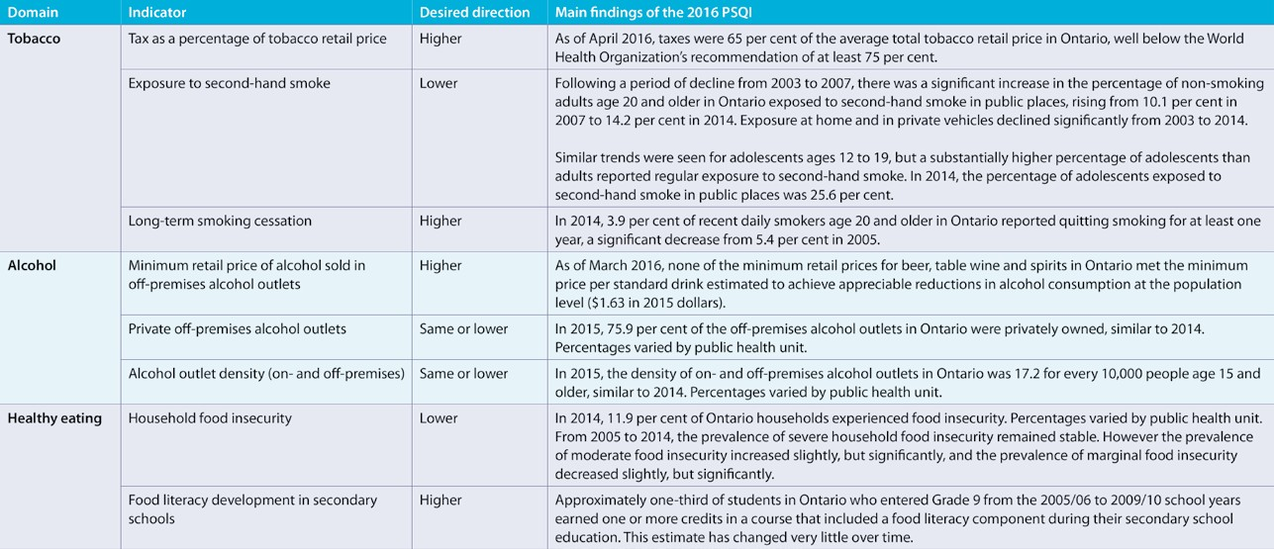
Main findings of the 2016 Prevention System Quality Index (PSQI) indicators

Slide 42
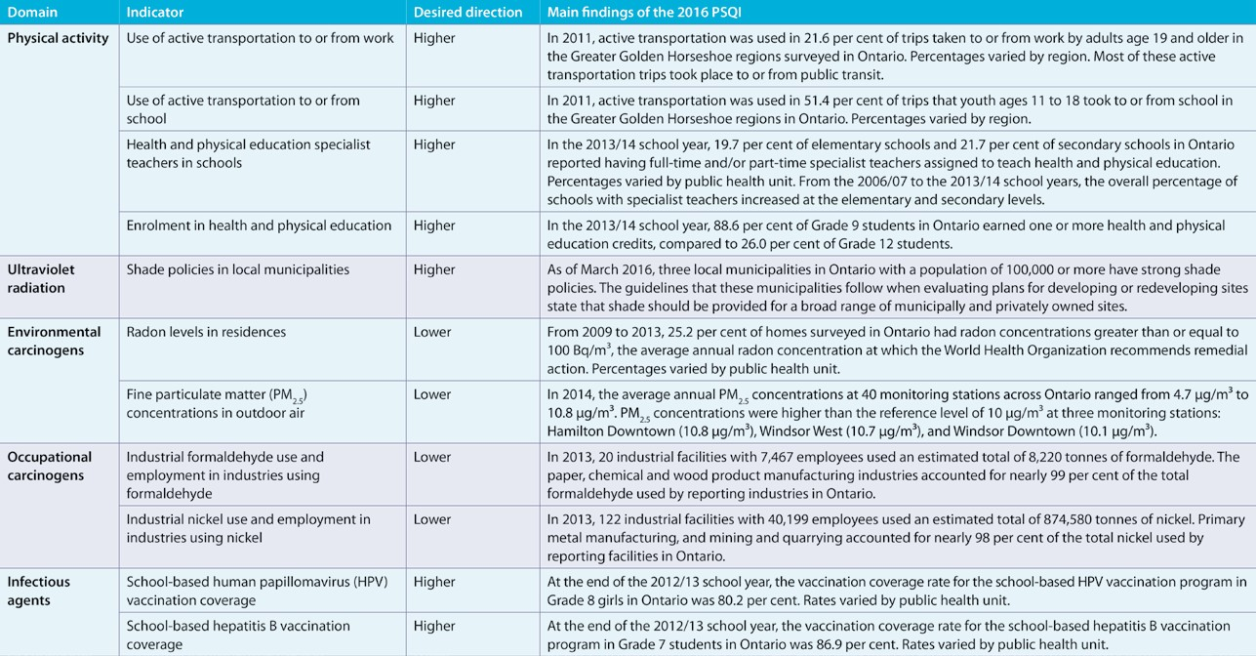
Main findings of the 2016 Prevention System Quality Index (PSQI) indicators

