Slide 2
4
Relative survival
Ontario Cancer Statistics 2016
Chapter 4: Relative survival

Slide 3
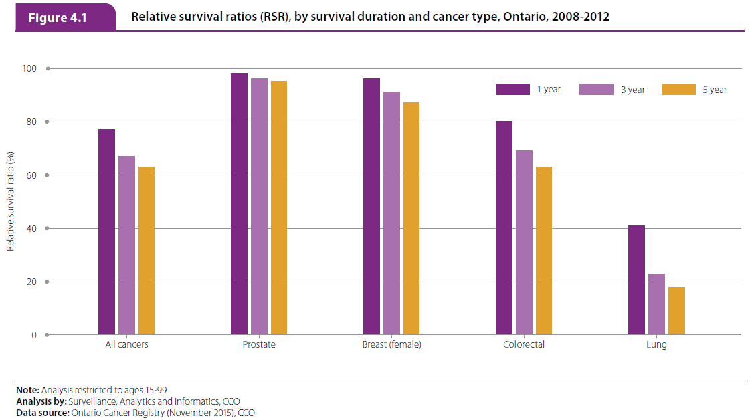
Ontario Cancer Statistics 2016
Chapter 4: Relative survival
Notes:
Figure 4.1 - Relative survival ratios (RSRs), by survival duration and cancer type, Ontario, 2008-2012
The RSR for all cancers combined between 2008 and 2012 was 76.8% after one year, 67.0% after three years and 63.1% after five years. As with most individual cancers, overall cancer survival declined most during the first year after diagnosis, followed by progressively smaller decreases in survival as the time from diagnosis increased.
Between 2008 and 2012, the following was observed for the four most common cancers:
Prostate cancer had the highest RSR over all three survival durations. The one-year RSR was 97.5%, and there was no significant difference between the three-year RSR (95.8%) and the five-year RSR (95.2%).
Female breast cancer survival declined from 96.0% at one-year to 91.1% after three years, and then to 87.2% after five years.
Colorectal cancer survival declined even more as time from diagnosis increased, with a one-year RSR of 80.5%, a three-year RSR of 68.8 % and a five-year RSR of 63.2%.
Lung cancer had the lowest relative survival of the four most common cancers. The one-year RSR was 40.8%, the three-year RSR was 22.7% and the five-year RSR was 18.0%. Not only did lung cancer have the lowest survival ratios across all three survival periods, it also had the greatest decrease in survival between one and three years after diagnosis, with an absolute survival difference of almost 20%.

Slide 4
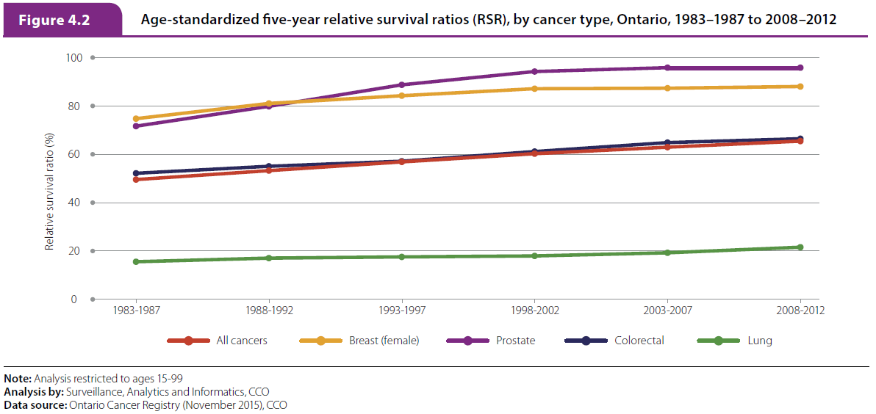
Figure 4.2
Ontario Cancer Statistics 2016
Chapter 4: Relative survival
Notes:
Figure 4.2 - Age-standardized five-year relative survival ratios (RSRs), by cancer type, Ontario, 1983–1987 to 2008–2012
The age-standardized five-year RSR for all cancers combined increased over time, from 47.6% for cases diagnosed between 1983 and 1987 to 62.5% for the years 2008 to 2012.
In addition, survival for people diagnosed with the four most common cancers also increased over the same time period:
Prostate cancer had the greatest RSR increase (24.2 percentage points). It rose from 69.7% for the period 1983–1987 to 93.9% for 2008–2012. While female breast cancer survival was higher than prostate cancer between 1983 and 1987, a decade later (1993 to 1997) the prostate cancer RSR was higher than the breast cancer RSR. Between 2008 and 2012 the RSR for prostate cancer was almost eight percentage points higher than for breast cancer.
The RSR for female breast cancer also increased over time, but not to the same extent as the RSR for prostate cancer. Between 1983 and 1987, the RSR for female breast cancer was 72.8%. It rose 13.3 percentage points to 86.1% for the period 2008–2012. Similar to prostate cancer, the rate of increase for female breast cancer slowed from the diagnosis years 1998–2002 onward.
Between the periods 1983–1987 and 2008–2012, colorectal cancer survival increased by 14.3 percentage points and lung cancer survival increased by 6.0 percentage points. The absolute increase in survival for lung cancer was the smallest among the most common cancers, but this increase was still substantial because survival was so low for lung cancer. Lung cancer consistently had the lowest RSR of the top four cancers for all periods examined.

Slide 5
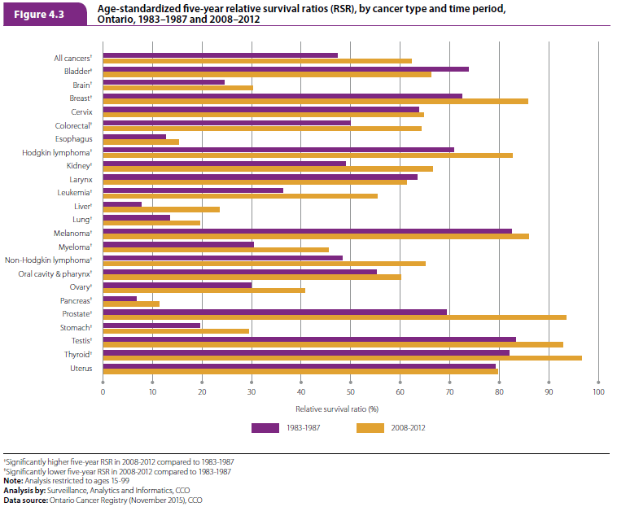
Figure 4.3
Ontario Cancer Statistics 2016
Chapter 4: Relative survival
Notes:
Figure 4.3 - Age-standardized five-year relative survival ratios (RSRs), by cancer type and time period, Ontario, 1983–1987 and 2008–2012
The five-year RSR improved, to varying degrees, for all other cancer types during the periods 1983–1987 and 2008–2012 with the following exceptions:
There was no significant change in survival for cervical, esophageal, uterine and laryngeal cancers between the two time periods.
The RSR for bladder cancer experienced a significant decrease, declining from 74.2% for the period 1983–1987 to 66.5% for the period 2008–2012.
Although all other cancers had significant increases in survival, some increases were particularly notable. Between the periods 1983–1987 and 2008–2012:
The RSR for liver cancer tripled from 7.8% to 23.6%.
The RSR for pancreatic cancer almost doubled from 6.8% to 11.4%. Despite this increase, survival ratios for pancreatic cancer remain among the lowest of all cancer types.
The RSR for stomach cancer increased by about half from 19.6% to 29.6%.
The RSR for leukemia increased by almost half from 36.5% to 55.6%.
The RSR for myeloma increased by about half from 30.6% to 45.8%.

Slide 6
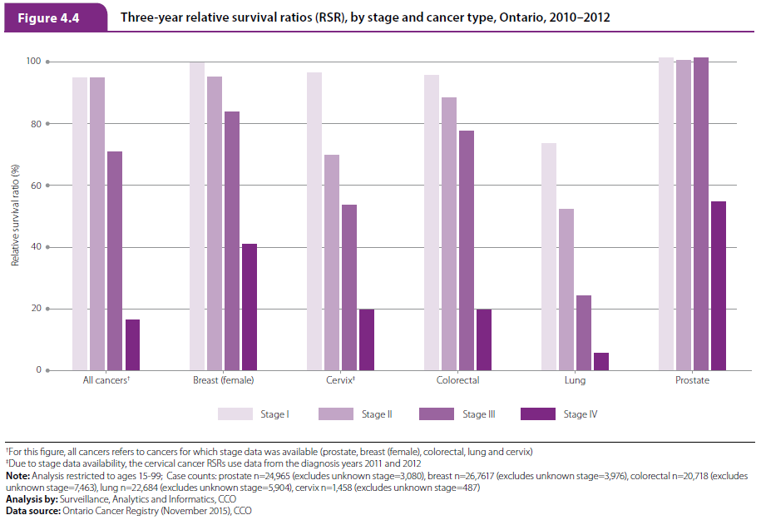
Figure 4.4
Ontario Cancer Statistics 2016
Chapter 4: Relative survival
Notes:
Figure 4.4 - Three-year relative survival ratios (RSRs), by stage and cancer type, Ontario, 2010–2012
For all cancers for which stage data was available (prostate, female breast, colorectal, lung and cervix), the three-year RSR was 94.9% for cases diagnosed at stage I. Survival declined non-significantly to 94.7% for cases diagnosed at stage II, and significantly to 70.9% for stage III and 16.5% for stage IV. In other words, while individuals diagnosed at stage I or II had less than a 6% reduction in the probability of surviving another three years compared to their counterparts in the general population, those diagnosed at stage IV had a reduction of almost 85%.
While stage at diagnosis is an important prognostic factor for most cancers, the impact was less pronounced for prostate cancer. The three-year RSR for prostate cancer was over 100% for stages I, II and III. This means that men diagnosed with prostate cancer at these stages were just as likely (or more likely) to survive three years after their diagnosis compared to similar men in the general population. However, the three-year survival for stage IV prostate cancer was only 54.7%.
The three-year RSRs for the other cancers for which data are available are as follows:
The RSR for breast cancer was high for those diagnosed in stage I (99.8%) and stage II (95.3%) but fell to 83.7% for stage III and 40.9% for stage IV.
The colorectal cancer RSR declined substantially from a high of 95.7% at stage I to 19.6% at stage IV.
The RSR for lung cancer declined significantly at every stage: 73.6% at stage I, 52.4% at stage II, 24.2% at stage III and 5.6% at stage IV.
The RSR for cervical cancer was high for those diagnosed in stage I (96.4%), but declined by almost 30 percentage points to 69.8% for stage II. The RSRs were even lower for diagnoses at stage III (53.6%) and stage IV (19.8%).

