Slide 2
5
Prevalence
Ontario Cancer Statistics 2016
Chapter 5: Prevalence

Slide 3
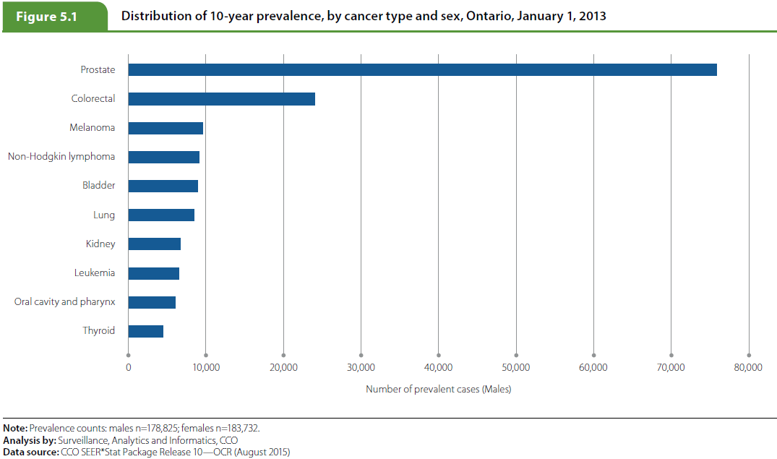
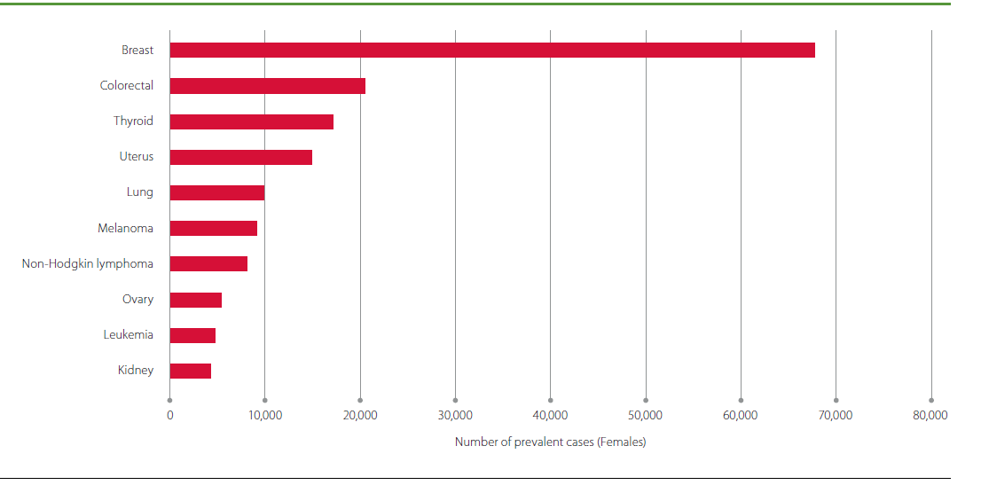
Ontario Cancer Statistics 2016
Chapter 5: Prevalence
Notes:
Figure 5.1 - Distribution of 10-year prevalence, by cancer type and sex, Ontario, January 1, 2013
Among males, those diagnosed with prostate cancer (75,945 cases) formed the largest proportion of 10-year prevalent cases, which reflects the high incidence and survival for this cancer. Colorectal cancer (24,065) was the second most prevalent cancer among males, followed by melanoma (9,572) and non-Hodgkin lymphoma (9,083).
Among females, those diagnosed with breast cancer (67,779) formed the largest proportion of 10-year prevalent cases. Like prostate cancer, the high prevalence of breast cancer reflects both high incidence and high survival. As with males, colorectal cancer (20,494) was the second most prevalent cancer. The next most prevalent cancers in females were thyroid (17,180) and uterus (14,930).
For both males and females, lung cancer was not among the four most prevalent cancers despite being the second most commonly diagnosed cancer for each sex in 2012. This reflects the low survival ratios for lung cancer. As a result, less commonly diagnosed cancers (melanoma and non-Hodgkin lymphoma in males and thyroid and uterus in females) were more prevalent in the population.
There were some notable differences in 10-year prevalence between the sexes:
Bladder cancer accounted for 8,951 prevalent cases among males and 2,794 among females.
The prevalence of head and neck cancers was higher among males than among females. Oral cavity and pharynx cancer accounted for 5,999 prevalent cases among males compared to 3,062 among females, while there were 1,945 prevalent cases of laryngeal cancer among males and 374 among females.
On the other hand, thyroid cancer was more prevalent among females (17,180) than among males (4,439).

Slide 4
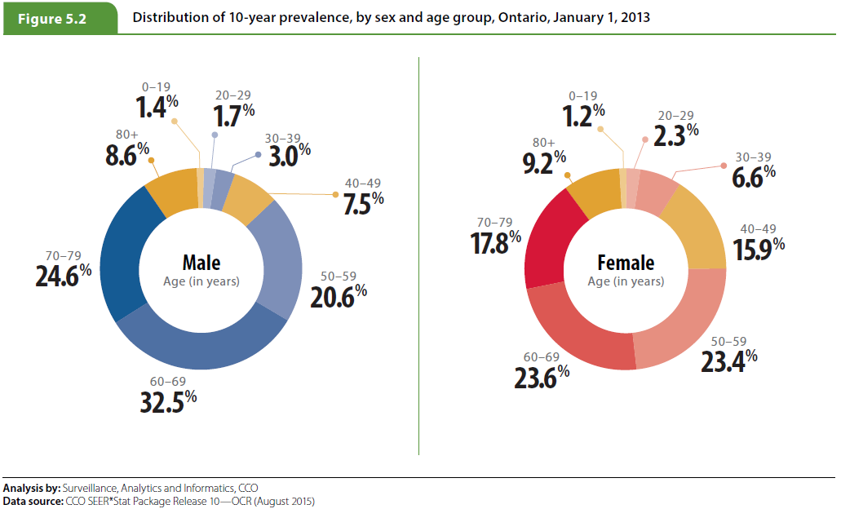
Ontario Cancer Statistics 2016
Chapter 5: Prevalence
Notes:
Figure 5.2 - Distribution of 10-year prevalence, by sex and age group, Ontario, January 1, 2013
Between the sexes, there were some notable differences in 10-year prevalence:
While the age group with the most prevalent cases for both sexes was 60 to 69 years, a larger percentage of prevalent cases was found among males in this age group at 32.5% than among females at 23.6%.
Prevalent cases were more likely to have been diagnosed at younger ages among females than males. For males, 6.1% of 10-year prevalent cases were diagnosed in people under the age of 40. For females, 10.1% were diagnosed in this age group. In addition, 33.2% of cases were diagnosed after the age of 70 among males compared to 27.0% of cases among females. This is likely due to the high prevalence of breast cancer in females, which has a wide age distribution at diagnosis, and the high prevalence of prostate cancer in males, which is more commonly diagnosed at older ages.

