Slide 2
3
Mortality
Ontario Cancer Statistics 2016
Chapter 3: Mortality

Slide 3
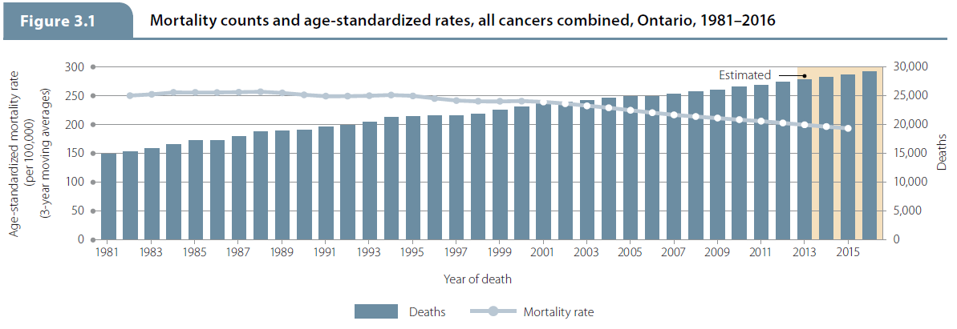
Ontario Cancer Statistics 2016
Chapter 3: Mortality
Notes:
Figure 3.1 - Mortality counts and age-standardized rates, all cancers combined, Ontario, 1981–2016
Although the number of cancer deaths has been increasing since 1981, the age-standardized mortality rate (ASMR) for all cancers decreased between 1981 and 2016 for both sexes combined.

Slide 4
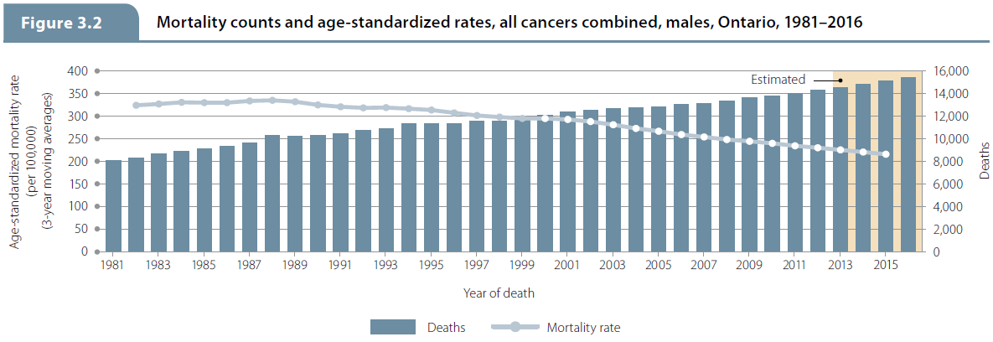
Ontario Cancer Statistics 2016
Chapter 3: Mortality
Notes:
Figure 3.2 - Mortality counts and age-standardized rates, all cancers combined, males, Ontario, 1981–2016
Although the number of cancer deaths has been increasing since 1981, the ASMR for all cancers decreased between 1981 and 2016 for males.

Slide 5
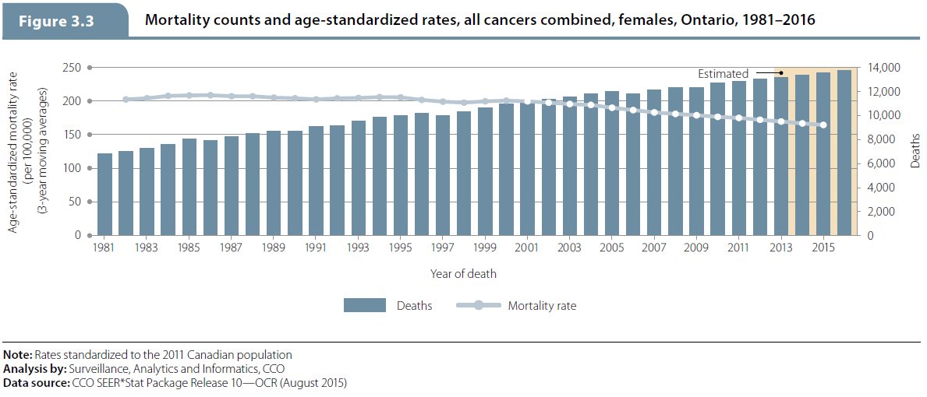
Mortality
Ontario Cancer Statistics 2016
Chapter 3: Mortality
Notes:
Figure 3.3 - Mortality counts and age-standardized rates, all cancers combined, females, Ontario, 1981–2016
Although the number of cancer deaths has been increasing since 1981, the ASMR for all cancers decreased between 1981 and 2016 for females.

Slide 6
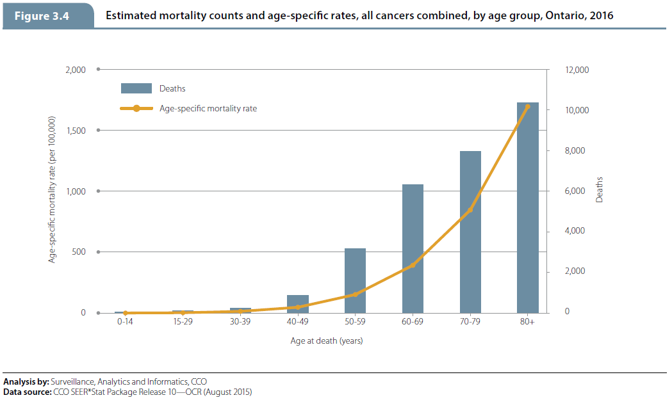
Mortality
Ontario Cancer Statistics 2016
Chapter 3: Mortality
Notes:
Figure 3.4 - Estimated mortality counts and age-specific rates, all cancers combined, by age group, Ontario, 2016
Mortality projections for the year 2016 estimate that more than 60% of all cancer deaths in Ontario will occur in people 70 years of age and older. Mortality by age group is projected as follows:
35.6% of all cancer deaths will occur in people 80 years of age or older.
27.4% of all cancer deaths will occur in people 70 to 79 years of age.
21.7% of all cancer deaths will occur in people 60 to 69 years of age.
10.9% of all cancer deaths will occur in people 50 to 59 years of age.
3.0% of all cancer deaths will occur in people 40 to 49 years of age.
1.4% of all cancer deaths will occur in people younger than 40 years of age.

Slide 7
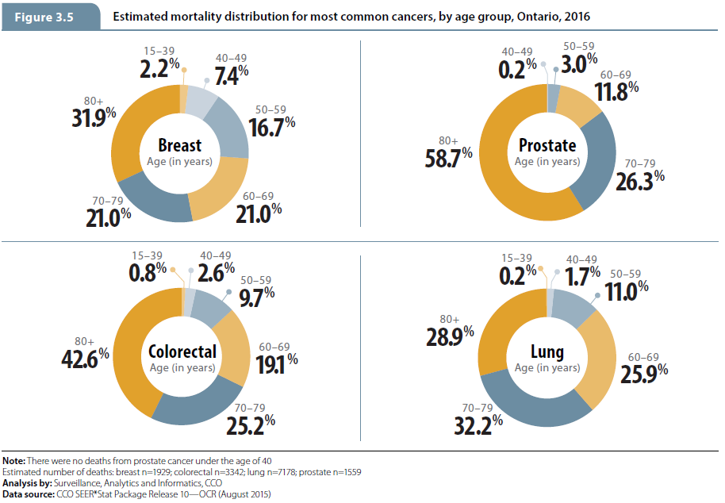
Mortality
Ontario Cancer Statistics 2016
Chapter 3: Mortality
Notes:
Figure 3.5 - Estimated mortality distribution for most common cancers, by age group, Ontario, 2016
The greatest proportion of female breast cancer deaths (31.9%) will occur among women 80 years of age and older. However, 2.2% of all breast cancer deaths will occur in females under the age of 40, meaning that, of the four most common cancers, breast cancer will cause the most mortality in younger people.
While prostate cancer will be diagnosed most frequently in males 65 to 74 years of age in 2016, most deaths from prostate cancer will occur in males 80 years and older.
Deaths from lung cancer will peak in people 70 to 79 years of age.
The majority of cancer deaths due to colorectal cancer will occur in Ontarians 70 to 79 years of age (25.2%) and 80 years of age and older (42.6%).

Slide 8
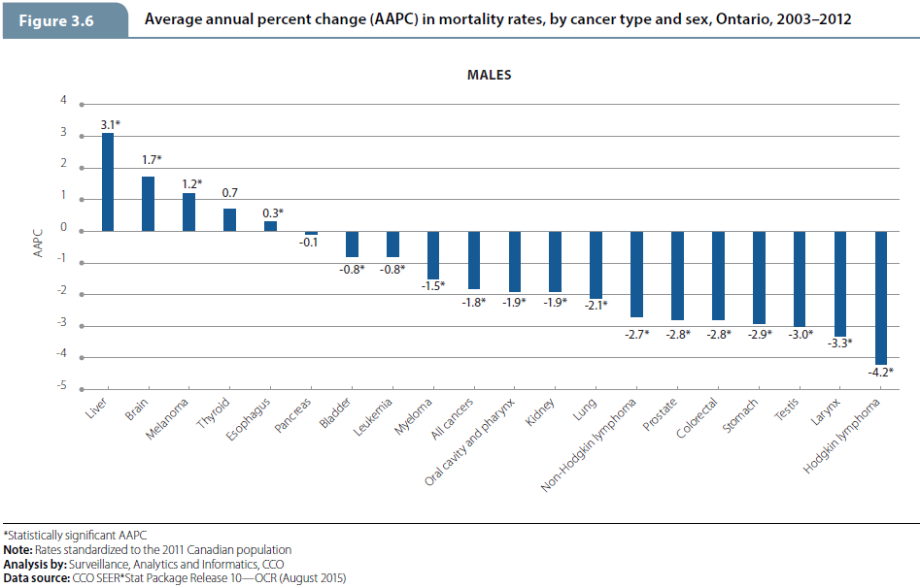
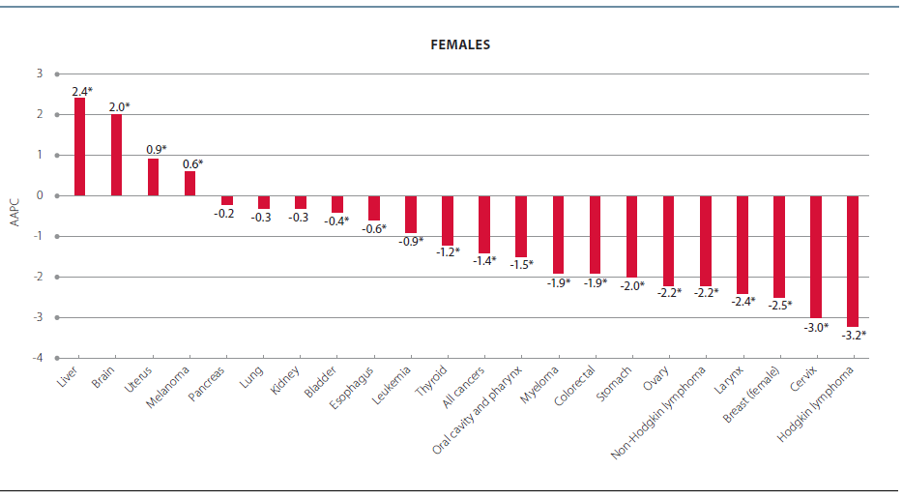
Mortality
Ontario Cancer Statistics 2016
Chapter 3: Mortality
Notes:
Figure 3.6 - Average annual percent change (AAPC) in mortality rates, by cancer type and sex, Ontario, 2003–2012
Over the most recent 10-year period of 2003 to 2012 the average annual percent change (AAPC) in the ASMR for males:
decreased for most types of cancer, including Hodgkin lymphoma (4.2% per year), laryngeal cancer (3.3%) and testicular cancer (3.0%);
increased for liver cancer (3.1%), brain cancer (1.7%), melanoma (1.2%) and esophageal cancer (0.3%); and
was stable for thyroid and pancreatic cancers.
Over the most recent 10-year period of 2003 to 2012, the AAPC in the ASMR for females:
decreased for most types of cancer, including Hodgkin lymphoma (3.2% per year), cervical cancer (3.0%) and breast cancer (2.5%);
increased for liver cancer (2.4%), brain cancer (2.0%), uterine cancer (0.9%) and melanoma (0.6%); and
was stable for pancreatic, lung and kidney cancers.

Slide 9
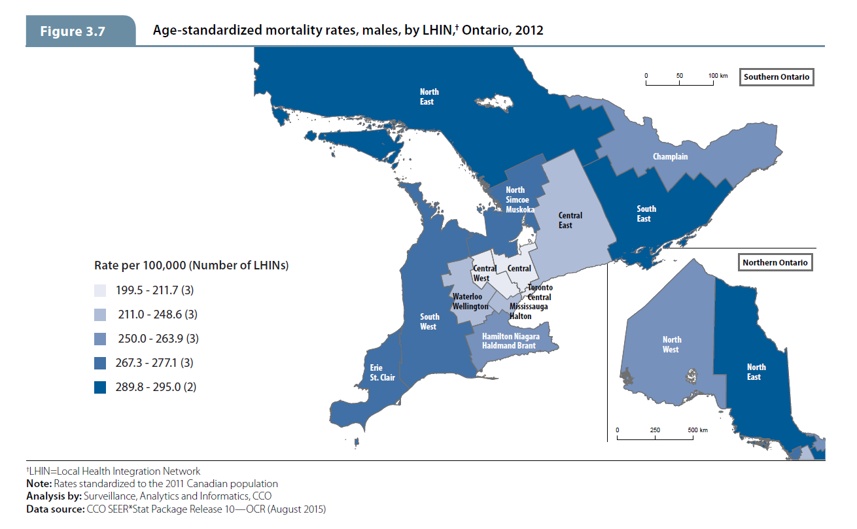
Mortality
Ontario Cancer Statistics 2016
Chapter 3: Mortality
Notes:
Figure 3.7 - Age-standardized mortality rates, males, by LHIN, Ontario, 2012
Among males:
The Local Health Integration Networks (LHINs) with the lowest ASMR were were Central, Central West and Toronto Central. Additionally, the mortality rates were significantly lower than the Ontario ASMR in the Mississauga Halton and Central East LHINs. Therefore, lower mortality rates occurred around the south-central Ontario region, somewhat coincident with lower incidence rates.
Corresponding to the male incidence rates, the North East and the South East LHINs had the highest ASMR, both of which were significantly higher than the Ontario rate. Mortality rates were also significantly higher in the Erie St. Clair, the South West and the Hamilton Niagara Haldimand Brant LHINs.
Similar to the incidence rates, the ASMR varied substantially across the LHINs in northern Ontario.

Slide 10
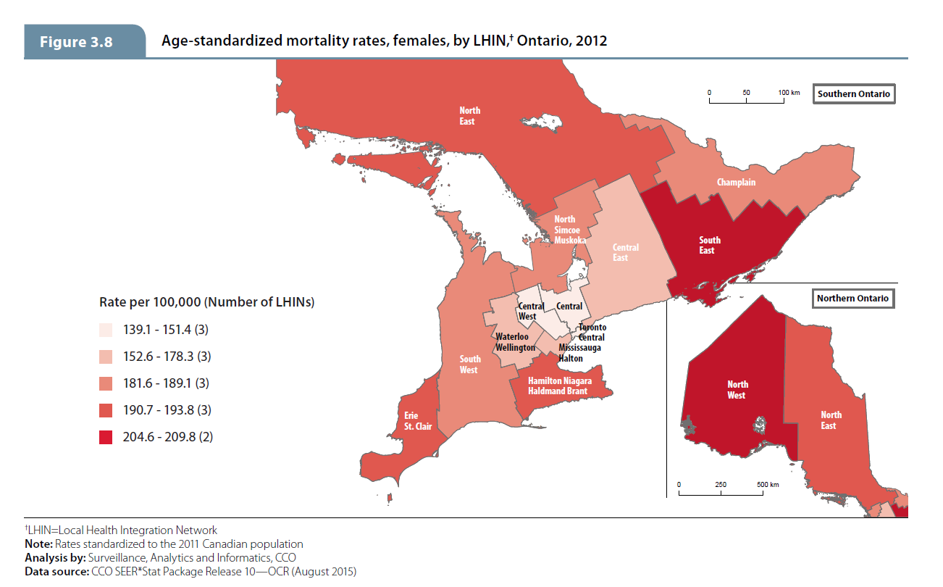
Mortality
Ontario Cancer Statistics 2016
Chapter 3: Mortality
Notes:
Figure 3.8 - Age-standardized mortality rates, females, by LHIN, Ontario, 2012
Among females:
The Central, Central West, Mississauga Halton and Toronto Central LHINs recorded ASMR significantly lower than the Ontario ASMR.
The North West, North East and South East LHINs recorded the highest ASMR among females. Rates were significantly higher than the Ontario rate in these LHINs, and the Erie St. Clair and Hamilton Niagara Haldimand Brant LHINs.
In general, female mortality rates paralleled male mortality rates across the LHIN's, with two exceptions. The North West LHIN's ASMR for females was significantly higher than the Ontario rate, but there was so significant difference in rates among males. The South West LHIN's ASMR for males was significantly higher than the Ontario rate, but there was no significant difference in rates among females

Slide 11
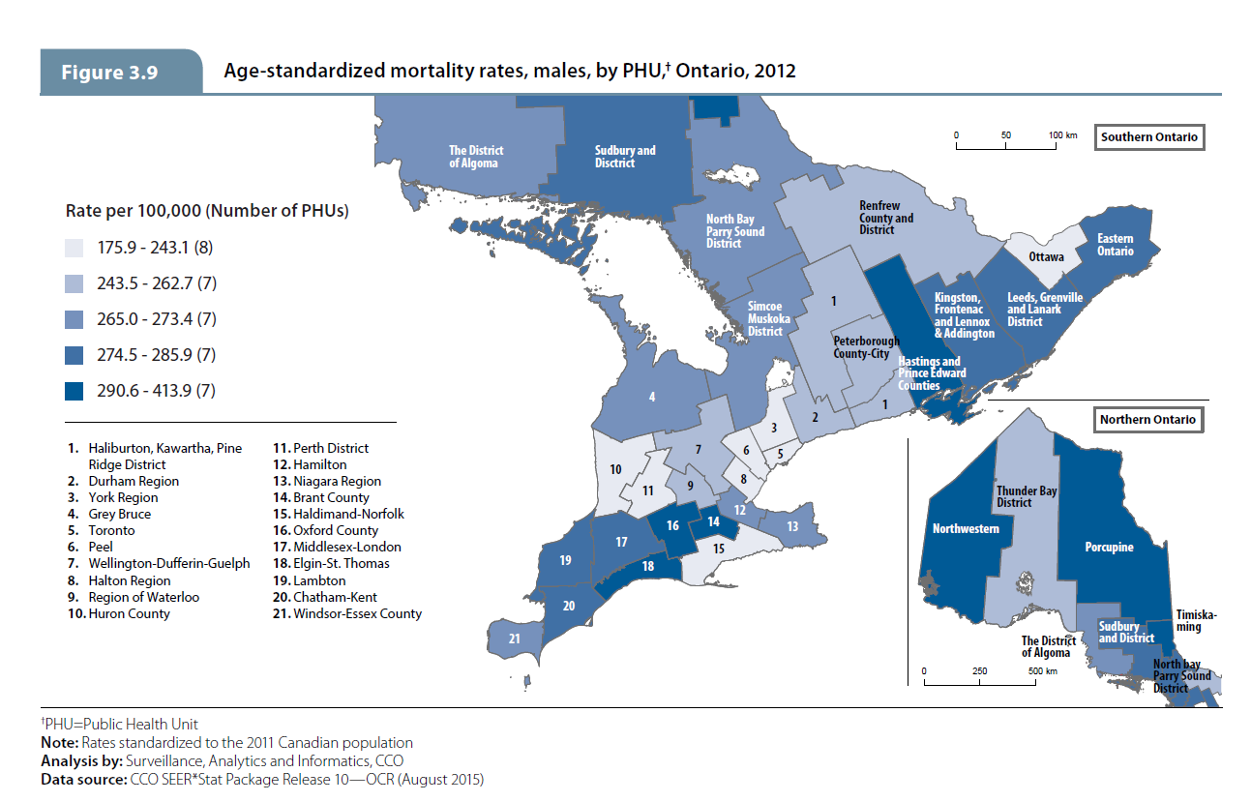
Mortality
Ontario Cancer Statistics 2016
Chapter 3: Mortality
Notes:
Figure 3.9 - Age-standardized mortality rates, males, by PHU, Ontario, 2012
The smaller geographical unit of Public Health Units (PHUs) allow for more detailed patterns to be analyzed. Among males:
The Greater Toronto Area PHUs (Peel, Toronto and York Region) had ASMR significantly lower than the Ontario ASMR.
Thirteen PHUs had significantly higher ASMR among males compared to the Ontario rate: Brant County; City of Hamilton; Eastern Ontario; Elgin-St. Thomas; Hastings and Prince Edward Counties; Kingston, Frontenac and Lennox & Addington; Leeds, Grenville and Lanark District; Middlesex-London; Oxford County; Porcupine; Simcoe Muskoka District; Timiskaming; and Windsor-Essex County. Generally, higher rates tended to be found in small groups of adjacent PHUs across Ontario.
Within the remaining south Ontario PHUs, the male ASMR were not significantly different than the Ontario rate and were geographically dispersed.
High variability in ASMR among males was found in northern Ontario PHUs, and the pattern did not correspond to incidence rates found among males.

Slide 12
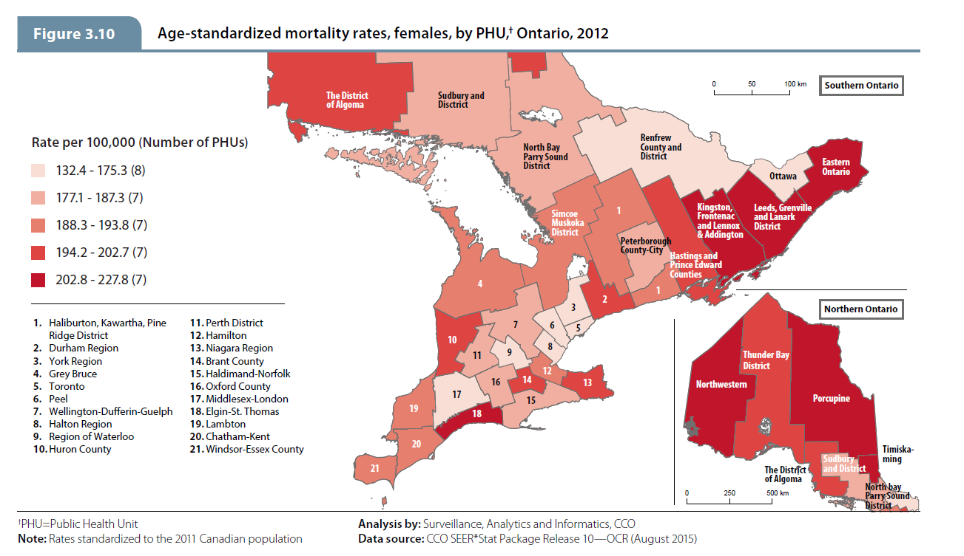
Mortality
Ontario Cancer Statistics 2016
Chapter 3: Mortality
Notes:
Figure 3.10 - Age-standardized mortality rates, females, by PHU, Ontario, 2012
Among females:
The same PHUs that had significantly lower ASMR compared to the Ontario ASMR for males also had lower ASMR for females: Peel, Toronto and York Region.
Several of the PHUs that had significantly higher mortality rates compared to the Ontario rate for males also had higher mortality rates for females: City of Hamilton; Eastern Ontario; Elgin-St. Thomas; Kingston, Frontenac and Lennox & Addington; and Leeds, Grenville and Lanark District.
However, the following PHUs also had female mortality rates that were significantly higher than the Ontario rate: Durham Region; Niagara Region; and Northwestern. In general, the PHUs in south-eastern Ontario had higher mortality rates among females compared to Ontario.
The pattern of high mortality rate variability across the northern Ontario PHUs was different compared to the distribution of incidence rates among females in that region, particularly in the Northwestern PHU where the female incidence rate was significantly lower than Ontario while the female mortality rate was significantly higher than Ontario.

