Slide 2
2
Incidence
Ontario Cancer Statistics 2016
Chapter 2: Incidence

Slide 3
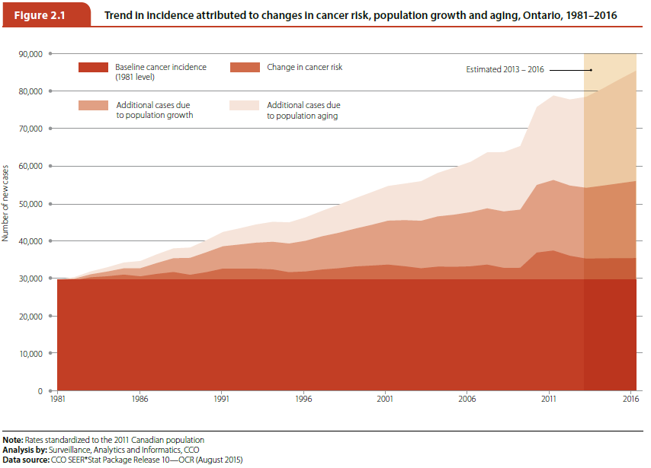
Ontario Cancer Statistics 2016
Chapter 2: Incidence
Notes:
Figure 2.1 - Trend in incidence attributed to changes in cancer risk, population growth and aging, Ontario, 1981–2016
Over the past three decades, aging of the population and population growth contributed far more to the number of new cancer cases than actual changes in cancer risk and cancer control practices. In 2016, approximately 85,648 new cases of cancer are expected to be diagnosed, representing a 188.9% increase over the 29,649 cancer cases diagnosed in 1981. Of this 188.9% increase, 89.2% will be attributable to aging of the population, 80.2% to population growth, and only 19.5% to changes in cancer risk and cancer control practices.

Slide 4
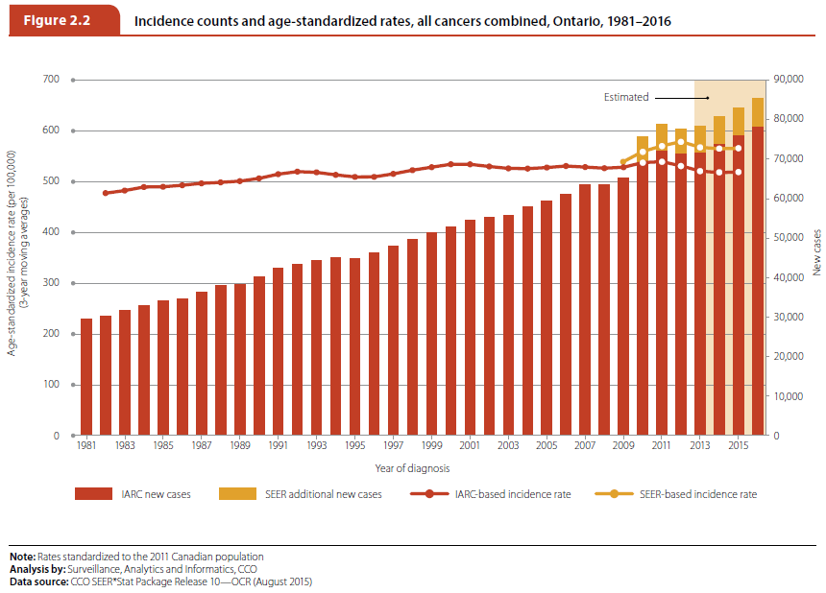
Ontario Cancer Statistics 2016
Chapter 2: Incidence
Notes:
Figure 2.2 - Incidence counts and age-standardized rates, all cancers combined, Ontario, 1981–2016
This figure shows the annual counts and age-standardized incidence rates (ASIR) for all cancers combined using the International Agency for Research on Cancer/International Association of Cancer Registries (IARC/IACR) rules for counting multiple primary cancers and, for more recent years, the Surveillance, Epidemiology and End Results (SEER) Program rules. The figure also includes projected counts and rates for the years 2013–2016. The SEER multiple primary rules were implemented for Ontario data starting with the diagnosis year 2010. The rates and counts using both methods of counting multiple primaries are presented here to illustrate the impact of the new rules. The SEER rules are more liberal than the IARC/IACR in what is considered a new primary case of cancer. As a result, the SEER rules lead to higher counts and rates.

Slide 5
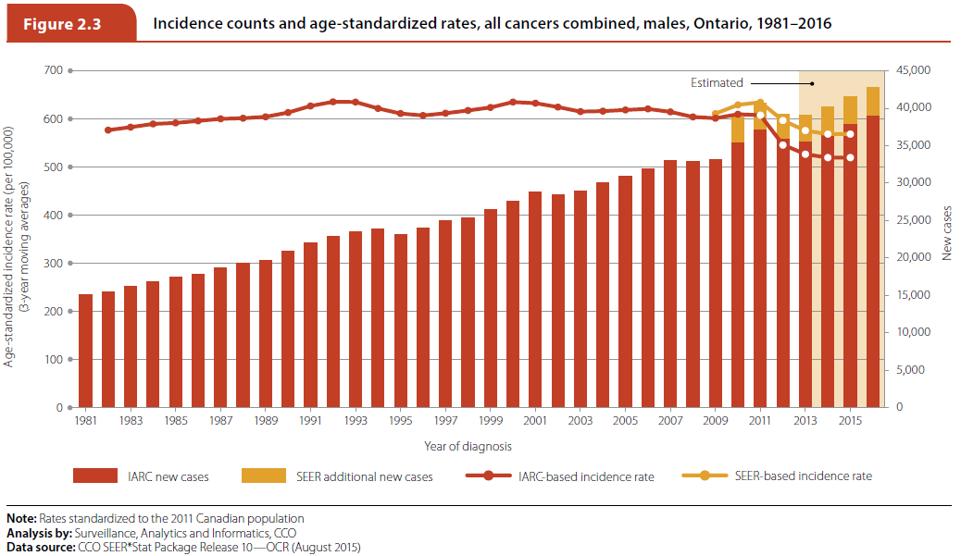
Ontario Cancer Statistics 2016
Chapter 2: Incidence
Notes:
Figure 2.3 - Incidence counts and age-standardized rates, all cancers combined, males, Ontario, 1981–2016
This figure shows the annual counts and age-standardized incidence rates (ASIR) for all cancers combined for males using the International Agency for Research on Cancer/International Association of Cancer Registries (IARC/IACR) rules for counting multiple primary cancers and, for more recent years, the Surveillance, Epidemiology and End Results (SEER) Program rules. The figures also include projected counts and rates for the years 2013–2016. The SEER multiple primary rules were implemented for
Ontario data starting with the diagnosis year 2010. The rates and counts using both methods of counting multiple primaries are presented here to illustrate the impact of the new rules. The SEER rules are more liberal than the IARC/IACR in what is considered a new primary case of cancer. As a result, the SEER rules lead to higher counts and rates.

Slide 6
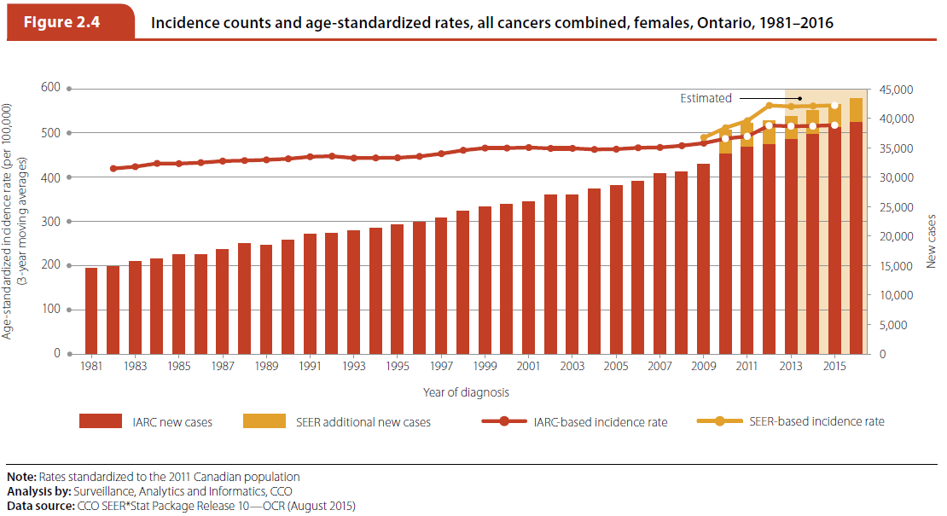
Ontario Cancer Statistics 2016
Chapter 2: Incidence
Notes:
Figure 2.4 - Incidence counts and age-standardized rates, all cancers combined, females, Ontario, 1981–2016
This figure shows the annual counts and age-standardized incidence rates (ASIR) for all cancers combined for females using the International Agency for Research on Cancer/International Association of Cancer Registries (IARC/IACR) rules for counting multiple primary cancers and, for more recent years, the Surveillance, Epidemiology and End Results (SEER) Program rules. The figures also include projected counts and rates for the years 2013–2016. The SEER multiple primary rules were implemented for Ontario data starting with the diagnosis year 2010. The rates and counts using both methods of counting multiple primaries are presented here to illustrate the impact of the new rules. The SEER rules are more liberal than the IARC/IACR in what is considered a new primary case of cancer. As a result, the SEER rules lead to higher counts and rates.

Slide 7
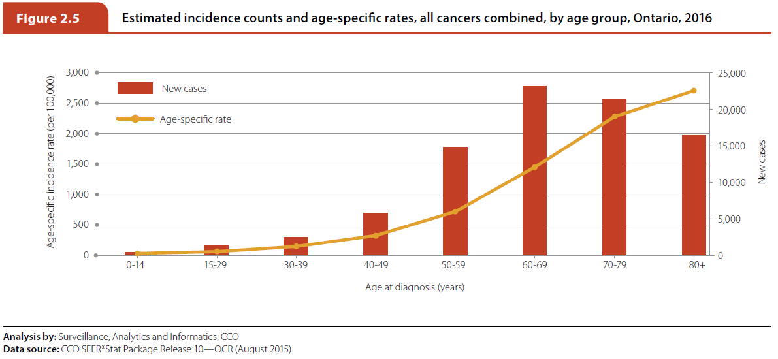
Ontario Cancer Statistics 2016
Chapter 2: Incidence
Notes:
Figure 2.5 - Estimated incidence counts and age-specific rates, all cancers combined, by age group, Ontario, 2016
Cancer primarily affects Ontarians over the age of 50. In 2016, 88.4% of all new cases will be diagnosed in people in this age group. Incidence by age group is projected as follows:
19.2% of all new cases will occur in people 80 years of age or older.
24.9% of all new cases will occur in people 70 to 79 years of age.
27.1% of all new cases will occur in people 60 to 69 years of age.
17.2% of all new cases will occur in people 50 to 59 years of age.
9.6% of all new cases will occur in people between 30 and 49 years of age.
Less than 3% of all new cases will occur in people under the age of 30.

Slide 8
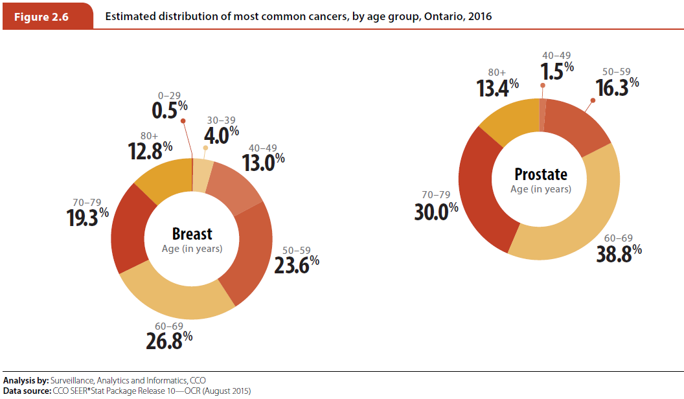
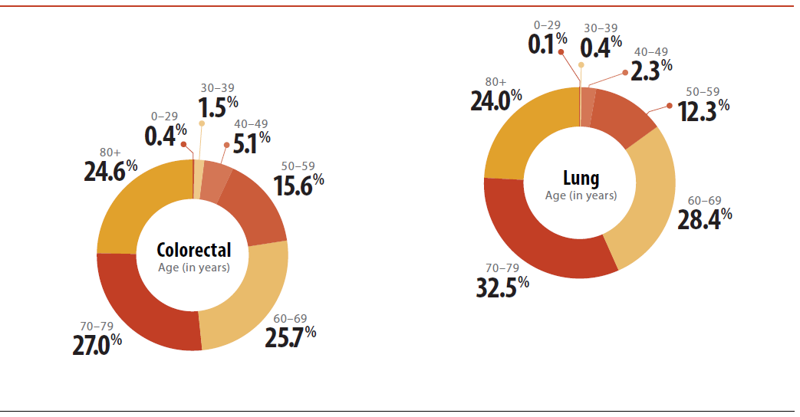
Ontario Cancer Statistics 2016
Chapter 2: Incidence
Notes:
Figure 2.6 - Estimated distribution of most common cancers, by age group, Ontario, 2016
In 2016, the greatest proportion of new cases of female breast and prostate cancers are projected to occur in people 60 to 69 years of age. This age group will account for 26.8% of all new cases of female breast cancer and 38.8% of all new cases of prostate cancer. Lung and colorectal cancer incidence rates will peak in people 70 to 79 years of age, with 32.5% of all new lung cancer cases and 27.0% of all new colorectal cancer cases occurring in this age group. More than half of all new lung and colorectal cancer cases will be in people 70 years of age and older.

Slide 9
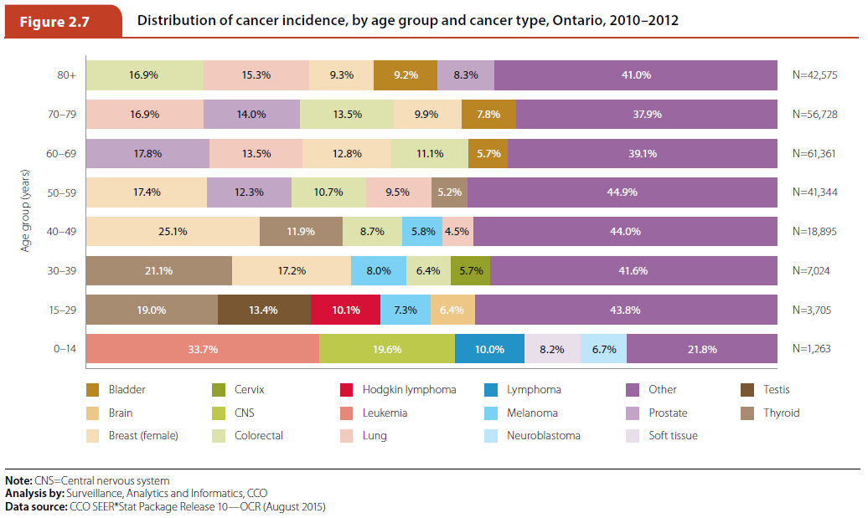
Ontario Cancer Statistics 2016
Chapter 2: Incidence
Notes:
Figure 2.7 - Distribution of cancer incidence, by age group and cancer type, Ontario, 2010–2012
Between 2010 and 2012, the most common childhood cancers were leukemia (33.7%) and central nervous system (CNS) cancers. These cancer types accounted for more than half of all the cancers in children 0 to 14 years of age. Lymphomas, soft tissue cancers and neuroblastomas were also among the more common childhood cancers. The most common cancers in adolescents and young adults (15 to 29 years of age) were thyroid cancer (19.0%), followed by testicular cancer, Hodgkin lymphoma, melanoma and brain cancer. Thyroid and female breast were the two most commonly diagnosed cancers among people 30 to 49 years of age, representing more than one third of all the cancers in these age groups. Among people 50 to 59 years of age, female breast (17.4%) and prostate (12.3%) were the most common cancers. Prostate cancer (17.8%) was also the most commonly diagnosed cancer among those 60 to 69 years of age, followed by lung cancer (13.5%). For people 80 years of age and older, the most commonly diagnosed cancers were colorectal (16.9%) and lung (15.3%).

Slide 10
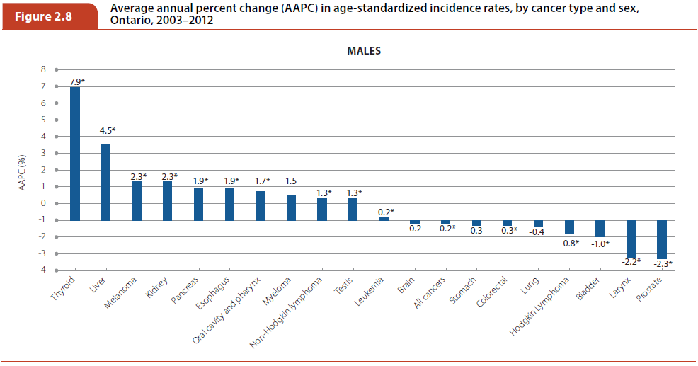
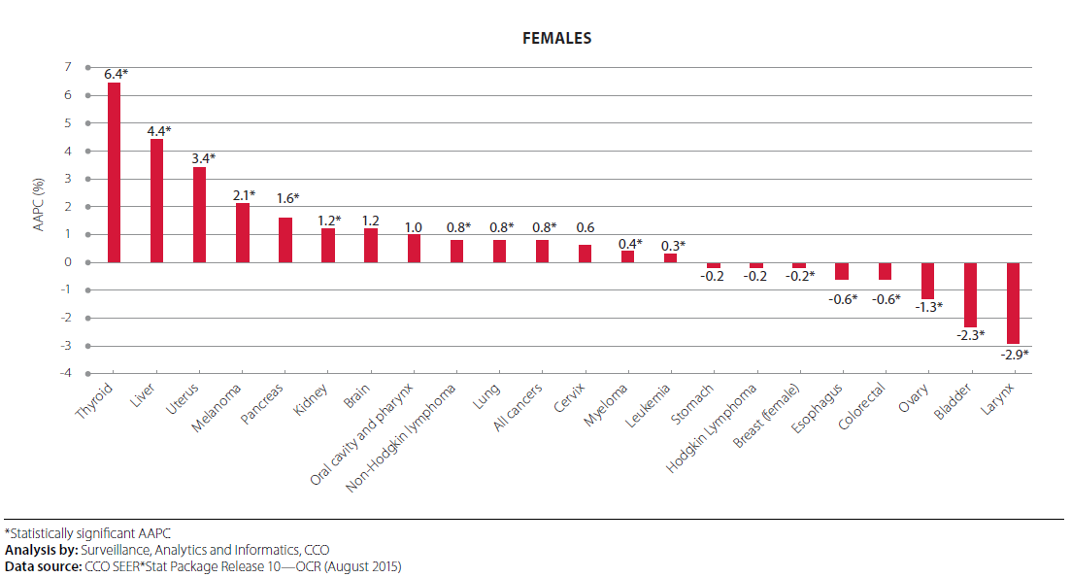
Ontario Cancer Statistics 2016
Chapter 2: Incidence
Notes:
Figure 2.8 - Average annual percent change (AAPC) in age-standardized incidence rates, by cancer type and sex, Ontario, 2003–2012
Over the most recent 10-year period of 2003 to 2012, the average annual percent change (AAPC) in ASIR for males:
Decreased most for prostate (2.3% per year), laryngeal (2.2%) and bladder (1.0%) cancers;
Increased most for thyroid (7.9%) and liver (4.5%) cancers and melanoma (2.3%); and
Was stable for lung, stomach and brain cancers and myeloma.
Over the most recent 10-year period of 2003 to 2012, the AAPC in ASIR for females:
Decreased most for laryngeal (2.9% per year), bladder (2.3%) and ovarian (1.3%) cancers;
Increased most for thyroid (6.4%), liver (4.4%) and uterine (3.4%) cancers; and
Was stable for oral cavity and pharynx, brain, cervical and stomach cancers and Hodgkin lymphoma.

Slide 11
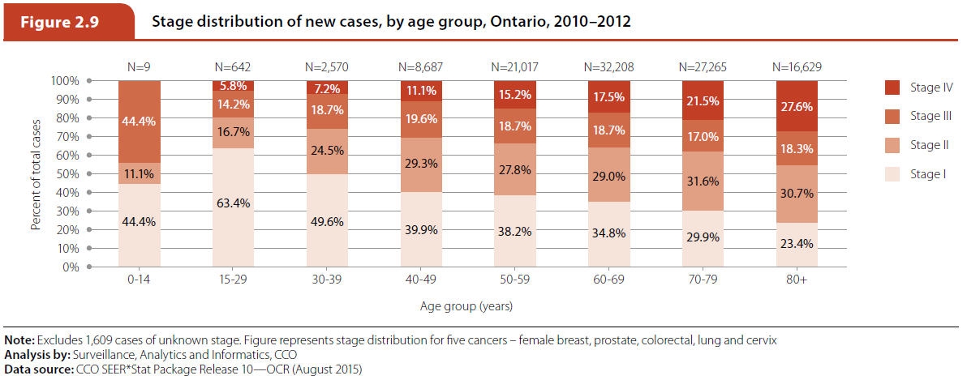
Ontario Cancer Statistics 2016
Chapter 2: Incidence
Notes:
Figure 2.9 - Stage distribution of new cases, by age group, Ontario, 2010–2012
Between 2010 and 2012 the majority of new cancer cases were diagnosed at stage I or II in every age group. The greatest proportion of staged cancers in those aged 69 and younger were diagnosed at stage I. The proportion of cancers diagnosed at stage IV increased with age.

Slide 12
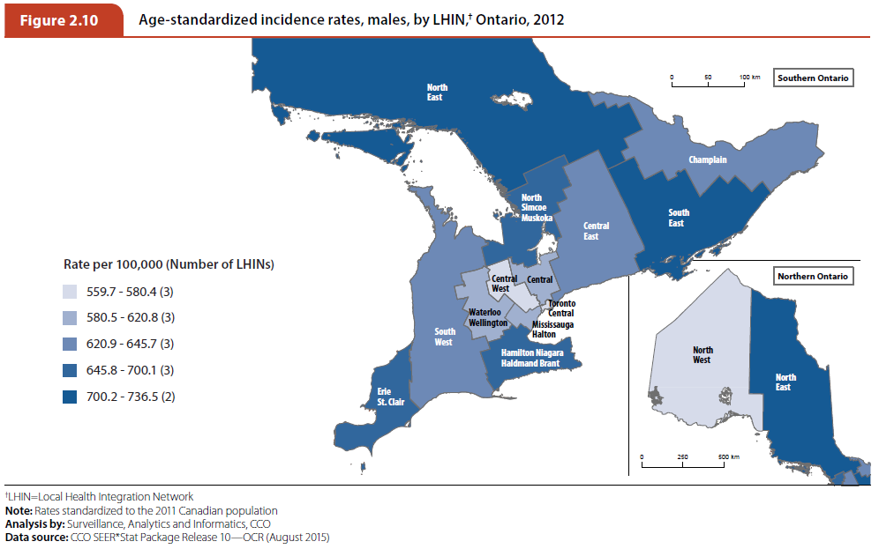
Ontario Cancer Statistics 2016
Chapter 2: Incidence
Notes:
Figure 2.10 - Age-standardized incidence rates, males, by LHIN, Ontario, 2012
Among males:
The Local Health Integration Networks (LHINs) with the lowest ASIR were in the south-central region of Ontario, which includes the Toronto area. The ASIR in the Central, the Central West, the Mississauga Halton and the Toronto Central LHINs were all significantly lower than the Ontario ASIR. The North West LHIN also had one of the lowest incidence rates.
The North East and the South East LHINs had the highest male ASIR, both of which were significantly higher than the Ontario ASIR. Additionally, the incidence rates recorded at the Erie St. Clair and the North Simcoe Muskoka LHINs were significantly higher than the Ontario average rate.
The rates varied substantially across the northern Ontario LHINs.

Slide 13
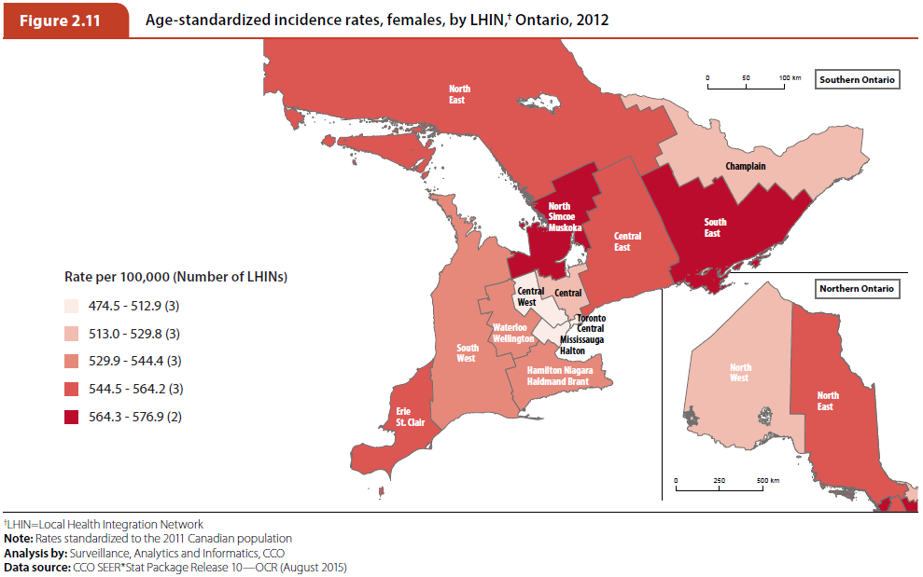
Ontario Cancer Statistics 2016
Chapter 2: Incidence
Notes:
Figure 2.11 - Age-standardized incidence rates, females, by LHIN, Ontario, 2012
Among females:
Similar to the incidence rates among males, the LHINs with the lowest ASIR among females were in the south-central region of Ontario, which is made up of the Central, the Central West, the Mississauga Halton and the Toronto Central LHINs. All of these LHINs recorded significantly lower rates than the Ontario ASIR.
The North Simcoe Muskoka and the South East LHINs recorded the highest ASIR among females. However, only the South East LHIN had a rate significantly higher than the Ontario ASIR.

Slide 14
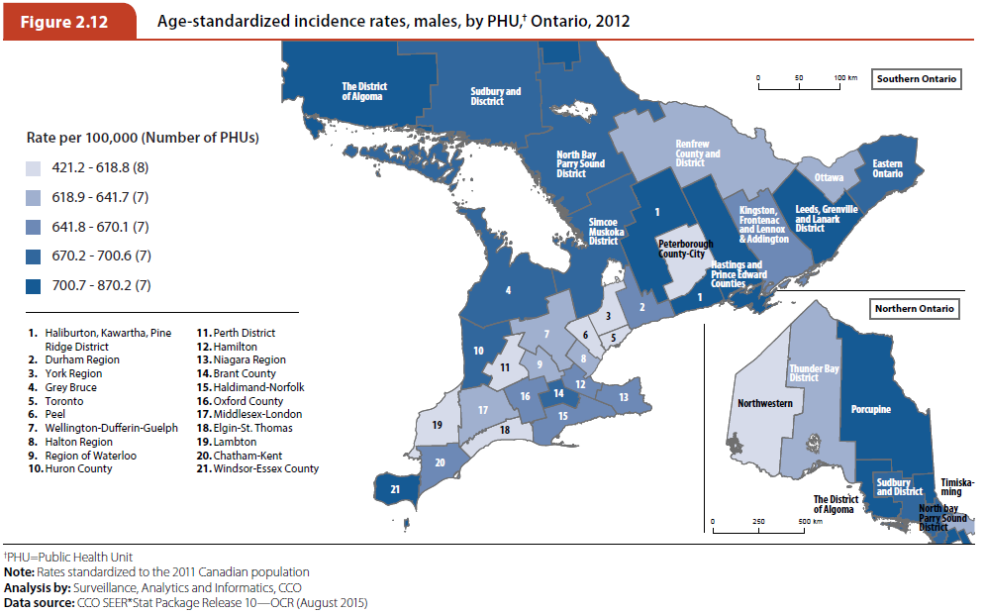
Ontario Cancer Statistics 2016
Chapter 2: Incidence
Notes:
Figure 2.12 - Age-standardized incidence rates, males, by PHU, Ontario, 2012
The additional granularity of the Public Health Units (PHUs) provides further details for the patterns observed by the LHINs. For example, among males:
The lowest ASIR occurred in the Northwestern, Peel, Toronto and York Region PHUs, which all had significantly lower incidence rates than the Ontario ASIR. Incidence rates within the remaining southern Ontario PHUs were not significantly lower than the Ontario ASIR and were geographically dispersed.
The highest ASIR were observed within nine PHUs located throughout the province: Timiskaming; the District of Algoma; Hastings and Prince Edward Counties; Haliburton, Kawartha, Pine Ridge District; Porcupine; Leeds, Grenville and Lanark District; Sudbury and District; Windsor-Essex County; and Simcoe Muskoka. The rates in all these PHUs were significantly higher than the Ontario ASIR with the exception of Porcupine, which had a high variance in the ASIR because of its small population.
There was an increasing west to east gradient in male ASIR across northern Ontario, giving additional detail to the disparate incidence rates evident by LHIN.

Slide 15
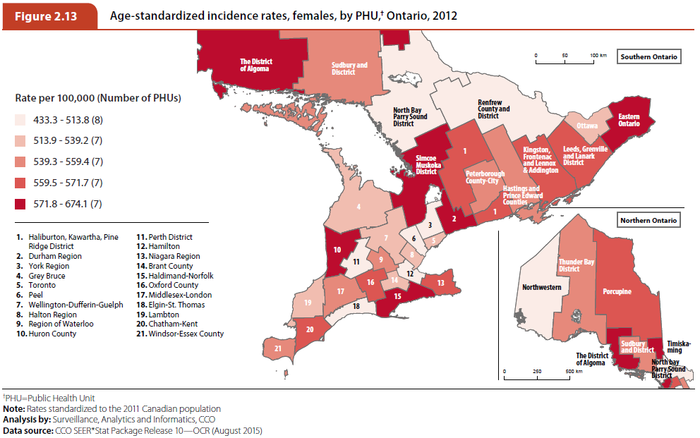
Ontario Cancer Statistics 2016
Chapter 2: Incidence
Notes:
Figure 2.13 - Age-standardized incidence rates, females, by PHU, Ontario, 2012
Among females:
The Northwestern, Peel, Toronto and York Region PHUs had significantly lower ASIR. (These same PHUs had lower incidence rates for males.) Other PHUs also had low rates (e.g., Perth District and Hamilton), but they were not significantly different from the Ontario ASIR.
The female ASIR were significantly higher than the Ontario ASIR in three of the same PHUs that had higher incidence rates for males: District of Algoma, Simcoe Muskoka District and Timiskaming. However, incidence rates for females were also significantly higher within the Durham Region, Haldimand-Norfolk, Niagara Region and Eastern Ontario PHUs compared to the Ontario rate.
High variability in female ASIR across northern Ontario was also evident by PHU. However, higher incidence rates among females were recorded in the Algoma and Timiskaming PHUs, rather than in the Porcupine PHU (which had high incidence rates for males).

