Slide 1
6
Cancer survival
Ontario Cancer Statistics 2018
Chapter 6: Cancer survival

Slide 2
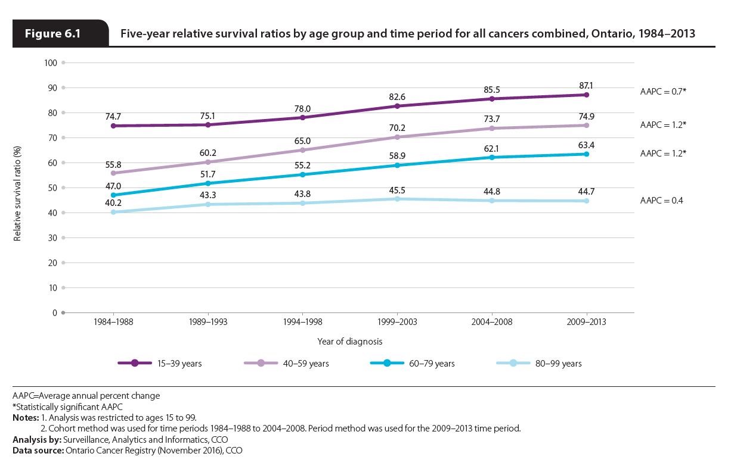
Notes:
The five-year RSR for all cancers combined decreased with age. For 2009–2013, the five-year RSR was 87.1% for people diagnosed between the ages of 15 and 39 but just 44.7% for those diagnosed between 80 and 99 years of age.
Since the 1984–1988 period, people ages 15 to 79 have seen significant increases in five-year survival, with the greatest increase occurring in the 40 to 59 age group (with an average annual percent change [AAPC] of 1.2%) and the 60 to 79 age group (with an AAPC of 1.2%).
People diagnosed between the ages of 15 and 39 also had a significant increase in survival; however, the increase was approximately half that of the two older age groups (an AAPC of 0.7%). The smaller improvement in survival among people ages 15 to 39 likely reflects the fact that the most common cancers in this age group (e.g., testicular, thyroid) already have high survival, meaning there is less room for improvement.
The increase in survival that did occur in this age group may be partially an artifact of increased early detection. This is evidenced by the increase in incidence that occurred in this age group—especially after 2001 (Figure 4.2).
People diagnosed between the ages of 80 to 99 have seen no significant improvement in five-year survival since the 1984–1988 period. As a result, the gap in survival between this age group and the younger age groups has widened over time. During the 1984–1988 period, those diagnosed between the ages of 60 and 79 had a five-year RSR that was seven percentage points greater than those diagnosed at age 80 or older. By the 2009–2013 period, this disparity had increased to almost 20 percentage points. The greater improvements in survival among people ages 40 to 79 may be the result of greater participation in screening programs (e.g., mammography) by this age group and improved treatments.

Slide 3
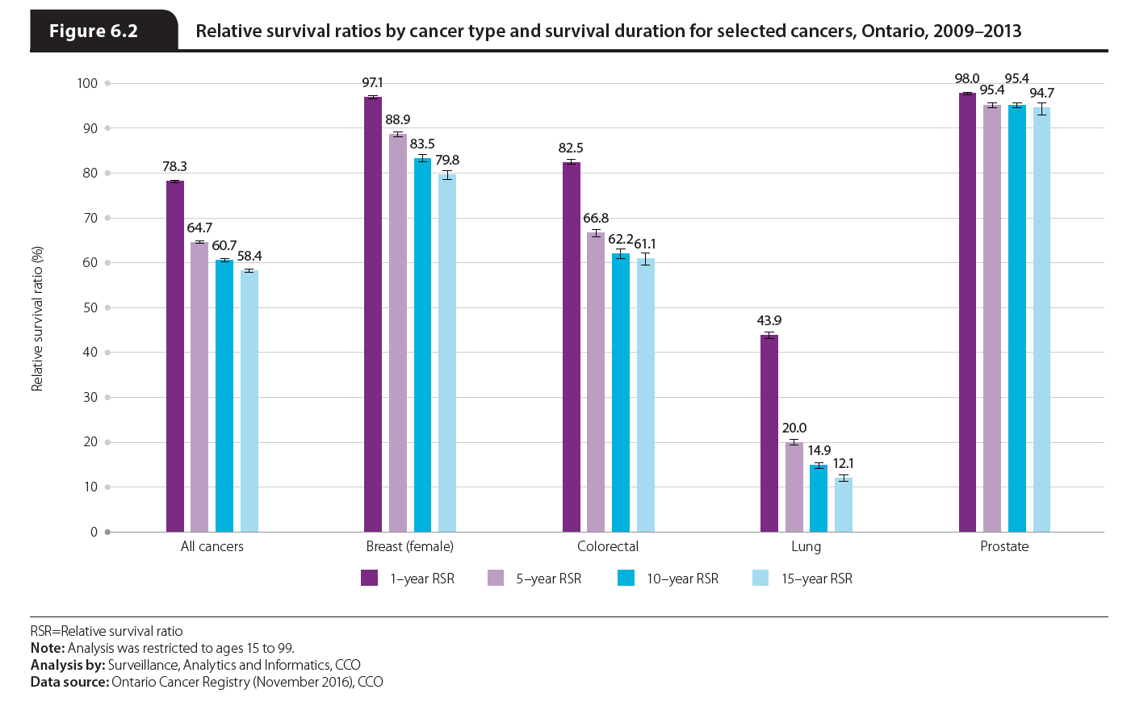
Notes:
For 2009–2013, the RSR for all cancers combined was 78.3% after one year, 64.7% after five years, 60.7% after 10 years and 58.4% after 15 years. As with most individual cancers, overall cancer survival declined most during the first year after diagnosis, followed by progressively smaller decreases in survival as the time from diagnosis increased. For the four most common cancers, the following was observed for relative survival by duration:
For breast cancer, the RSR one year after diagnosis was very high at 97.1%. After five years, the RSR fell by almost 10 percentage points to 88.9%. It then fell by approximately five percentage points between five and 10 years post-diagnosis and by another five percentage points between 10 and 15 years post-diagnosis.
For colorectal cancer, the RSR one year after diagnosis was 82.5% but fell to 66.8% after five years—a greater decrease than for breast cancer. There was no significant difference between the 10 and 15-year RSR for colorectal cancer.
The greatest decrease in survival between one and five years post-diagnosis was for lung cancer, which fell from 43.9% to 20.0%. Survival decreased significantly at 10 years (14.9%) and 15 years (12.1%).
Prostate cancer survival decreased by a small, but significant amount between one year and five years post-diagnosis, but there was no significant difference between five-year, 10-year and 15-year survival. In fact, the five-year and 10-year RSRs were exactly the same (95.4%). Survival for prostate cancer was so high that the 15-year RSR was higher than the five-year RSR for all major cancer types except testis and thyroid.

Slide 4
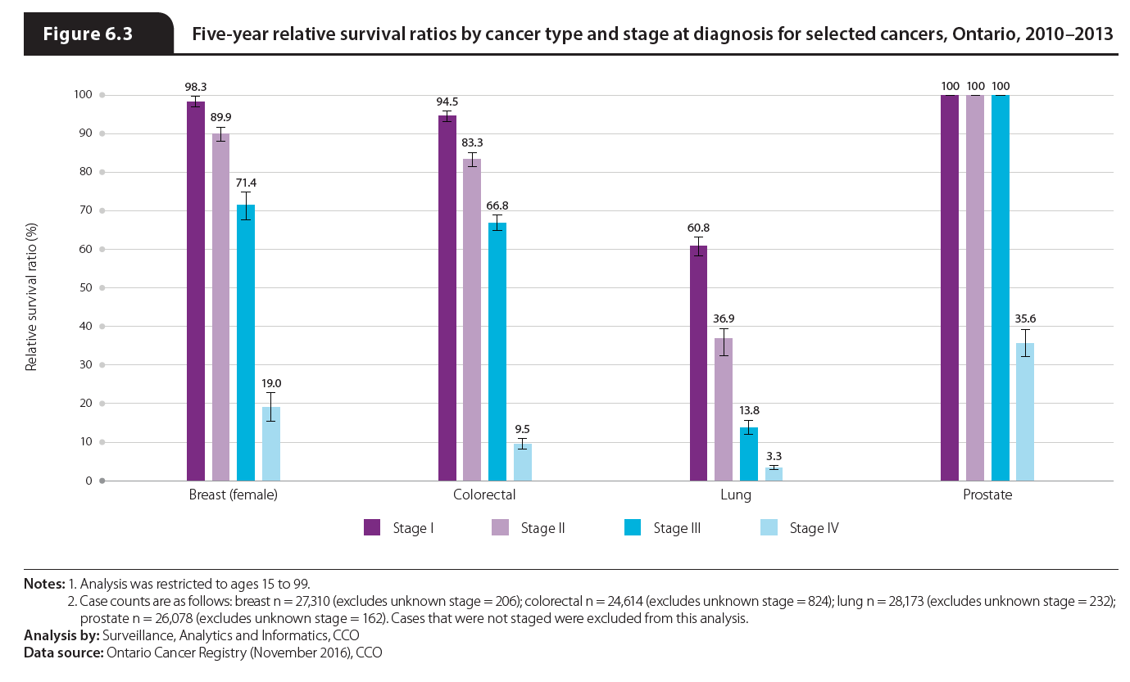
Notes:
Five year relative survival for 2010–2013 tended to decrease as stage at diagnosis increased; however the level of decrease varied by cancer type. Specifically:
While breast cancer cases diagnosed at stage I had a five-year RSR of 98.3%, the RSR decreased to just 19.0% for cases diagnosed at stage IV. Breast cancer was most commonly diagnosed at stage I in 2013 while only 5.3% of cases were diagnosed at stage IV.
Colorectal cancer cases diagnosed at stage I had a five-year RSR of 94.5%, which declined to 83.3% for cases diagnosed at stage II, 66.8% at stage III and just 9.5% at stage IV. A considerable amount of colorectal cases were stage IV cancers, with 19.1% of cases diagnosed at this stage.
Of the four most common cancers, lung cancer had the lowest survival at every stage. Even at stage I, five-year survival was just 60.8%, declining to 3.3% at stage IV. This low RSR is particularly concerning because 51.6% of lung cases were diagnosed at stage IV in 2013.
Stage at diagnosis had the least effect on prostate cancer. Five-year survival for stages I to III was 100%; however, survival dipped to 35.6% for cases diagnosed at stage IV—which accounted for 10.8% of prostate cases in 2013.

