Slide 1
8
Cancer statistics by public health unit
Ontario Cancer Statistics 2018
Chapter 8: Cancer statistics by public health unit

Slide 2
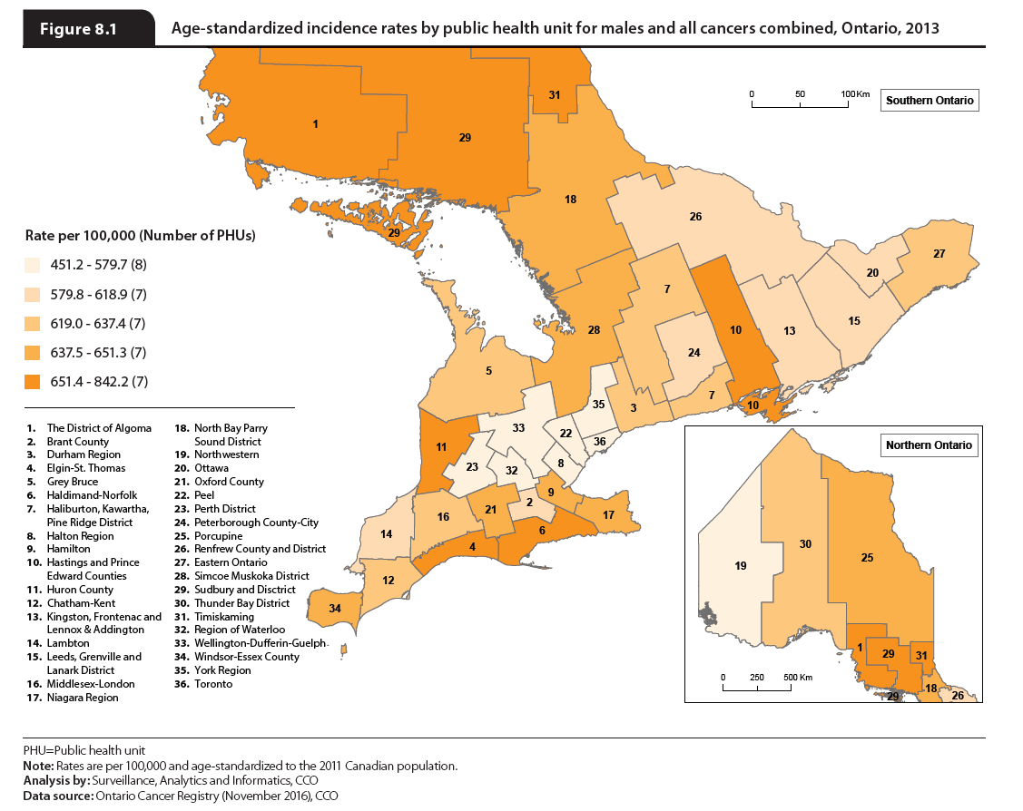
Notes:
There was an increasing west-to-east gradient in male ASIR across northern Ontario (Table DA.1 in the Data appendix). For southern Ontario, no significant ASIR pattern was observed. Lower incidence rates in the western part of Ontario may be caused by people in these areas traveling to Manitoba for healthcare due to geographical convenience, and therefore not being captured in the Ontario registry.
PHUs with an ASIR significantly higher than Ontario (males):
Algoma
Durham Region
Hamilton
Hastings and Prince Edward Counties
Haldimand-Norfolk
Huron County
Niagara Region
Simcoe Muskoka District
Sudbury and District
Timiskaming
Windsor-Essex County
PHUs with an ASIR significantly lower than Ontario (males):
Halton Region
Northwestern
Perth District
Peel
Toronto
Wellington-Dufferin-Guelph
York Region

Slide 3
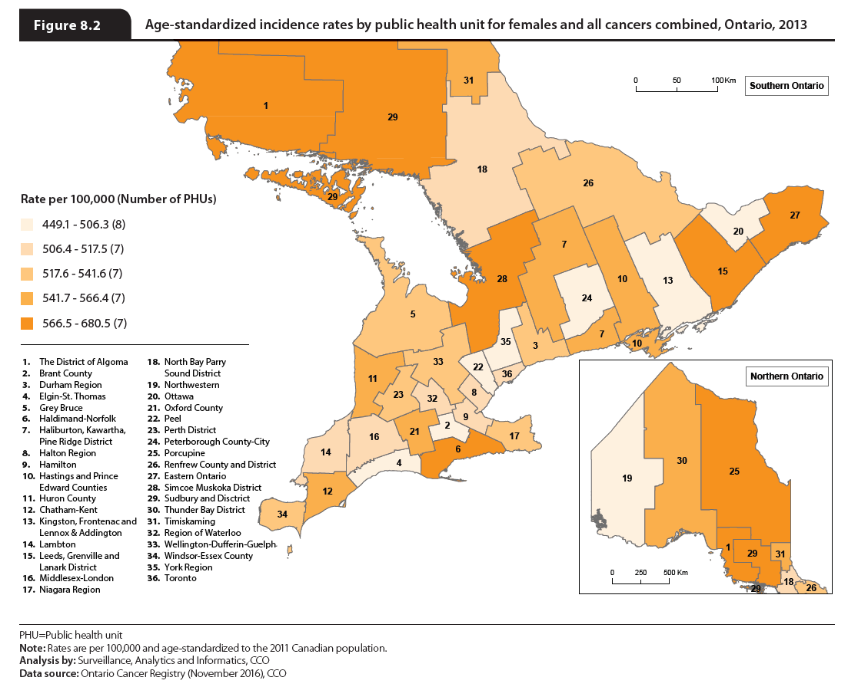
Notes:
The same west-to-east gradient in northern Ontario that was seen in the male rates was also present in the female rates (Table DA.2 in the Data appendix).
PHUs with an ASIR significantly higher than Ontario (females):
Algoma
Eastern Ontario
Leeds, Grenville and Lanark District
Simcoe Muskoka District
Sudbury and District
PHUs with an ASIR significantly lower than Ontario (females):
Northwestern
Peel
York Region

Slide 4
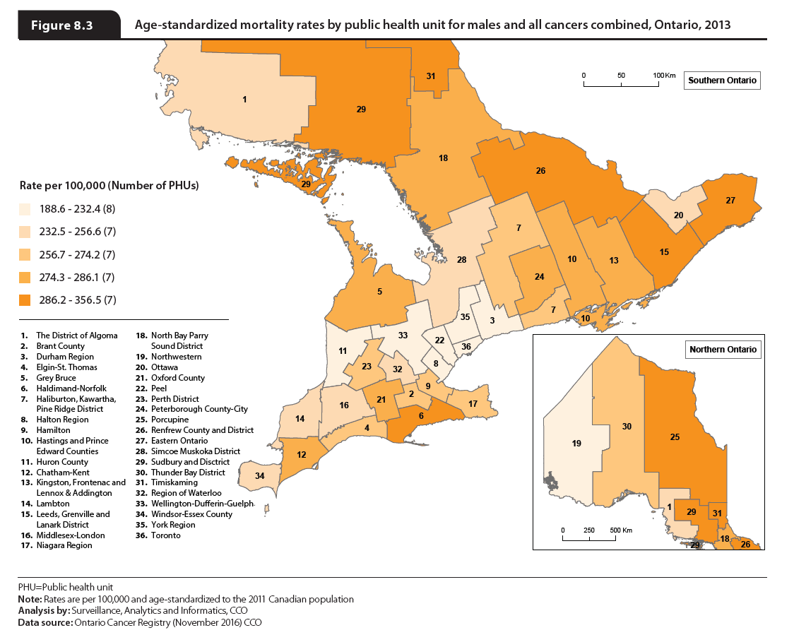
Notes:
Cancer mortality rates were lowest in PHUs in Toronto and the surrounding area, while the highest rates were found throughout the province.
For males and females (Tables DA.3 and DA.4 in the Data appendix) the same west-to-east gradient in northern Ontario that was seen in the incidence rates was also observed in the mortality rates.
PHUs with an ASMR significantly higher than Ontario (males):
Eastern Ontario
Grey Bruce
Haldimand-Norfolk
Hamilton
Hastings and Prince Edward Counties
Kingston, Frontenac and Lennox & Addington
Leeds, Grenville and Lanark District
Niagara Region
North Bay Parry Sound District
Oxford County
Peterborough County-City
Porcupine
Renfrew County and District
Sudbury and District
Timiskaming
PHUs with an ASMR significantly lower than Ontario (males):
Peel
Toronto
York Region

Slide 5
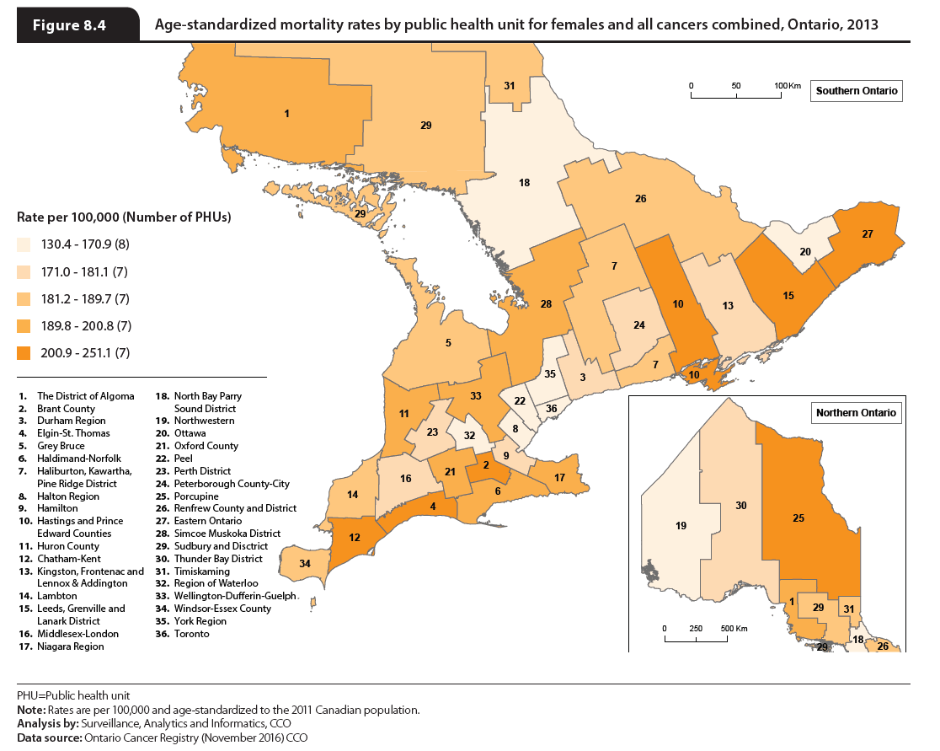
Notes:
Cancer mortality rates were lowest in PHUs in Toronto and the surrounding area, while the highest rates were found throughout the province.
For males and females (Tables DA.3 and DA.4 in the Data appendix) the same west-to-east gradient in northern Ontario that was seen in the incidence rates was also observed in the mortality rates.
PHUs with an ASMR significantly higher than Ontario (females):
Algoma
Brant County
Chatham-Kent
Eastern Ontario
Elgin-St. Thomas
Hastings and Prince Edward Counties
Leeds, Grenville and Lanark District
Niagara Region
Porcupine
Simcoe Muskoka District
Wellington-Dufferin-Guelph
PHUs with an ASMR significantly lower than Ontario (females):
Peel
Toronto
York Region

