Slide 1
2
Estimated current cancer mortality
Ontario Cancer Statistics 2018
Chapter 2: Estimated current cancer mortality

Slide 2
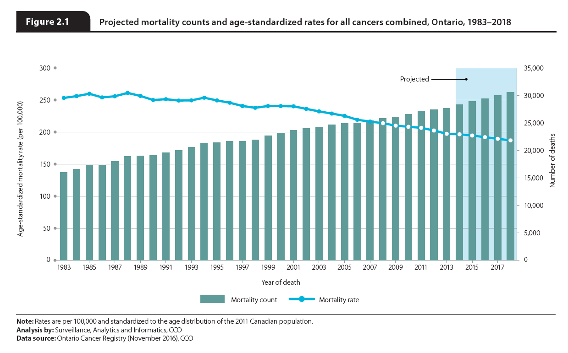
Notes:
In 2018, an estimated 30,574 deaths from cancer (excluding non-melanoma skin cancer) are expected to occur in Ontario, resulting in an age-standardized mortality rate (ASMR) of 186.9 per 100,000 people. While the number of cancer deaths has increased each year since 1983, the ASMR peaked in 1988 and has decreased every year since 1999.

Slide 3
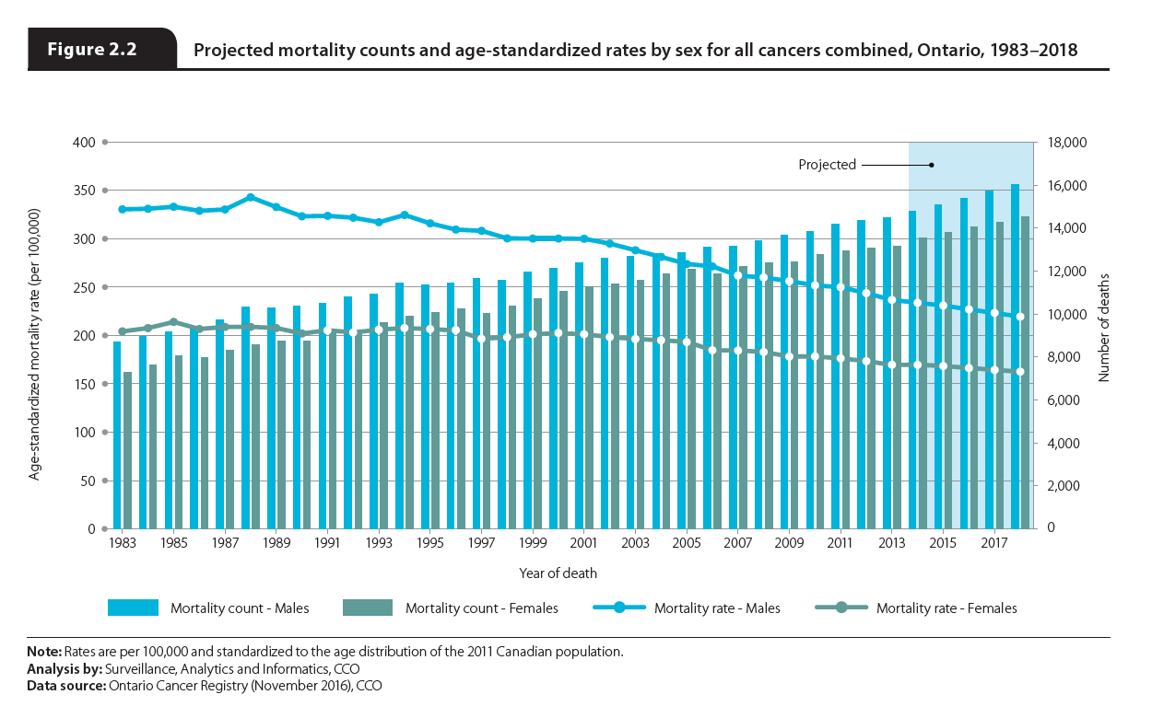
Notes:
Among males, 16,039 deaths are expected to be caused by cancer in 2018, resulting in an ASMR of 219.5 per 100,000. As with cancer incidence, the numbers are expected to be lower for females, with 14,535 deaths expected to occur for an ASMR of 162.5 per 100,000. Males are projected to account for 52.5% of all cancer deaths in 2018. This number has stayed remarkably stable over time; in 1983, males accounted for 54.4% of all cancer deaths.
While the number of cancer deaths has increased over time, the ASMR has declined for both males and females. The male ASMR started declining with each year in 1995; the female rate did not start declining in the same way until 2001. The later decline in the female ASMR is probably due to lung cancer mortality. The lung cancer mortality rate for females did not start to decline until 2000—more than 10 years after the male rate started to decline.

Slide 4
5
Cancer mortality rates
and trends
Ontario Cancer Statistics 2018
Chapter 5: Cancer mortality rates and trends

Slide 5
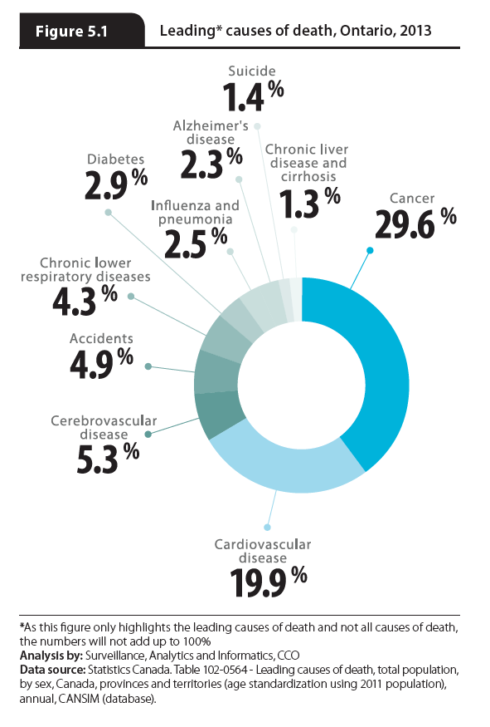
Notes:
In 2013, 29.6% of all deaths in Ontario were attributable to cancer, making it the province’s leading cause of death. Cancer caused almost as many deaths as the next three leading causes of death combined: cardiovascular disease, cerebrovascular disease and accidents.

Slide 6
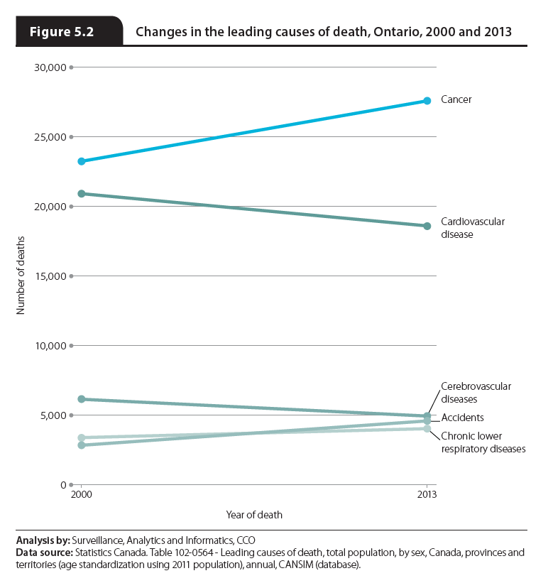
Notes:
From 2000 to 2013, the number of deaths caused by cancer increased by nearly 19%. In comparison, the number of deaths caused by cardiovascular disease and cerebrovascular disease—the next two leading causes of death in 2013—decreased over the same time period, by 11.1% and 19.7% respectively.

Slide 7
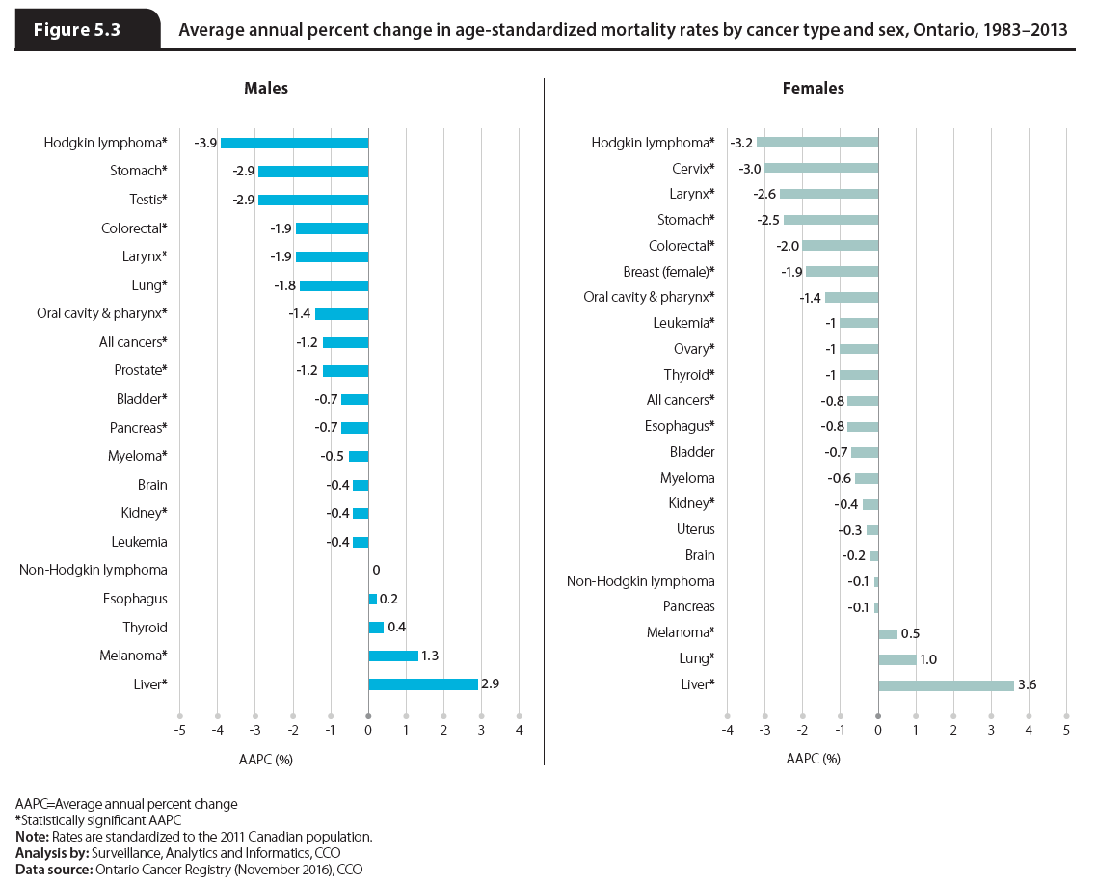
Notes:
Over the most recent 30-year period — 1983 to 2013 — the average annual percent change (AAPC) in the ASMR for males:
decreased for most types of cancer, including Hodgkin lymphoma (3.9% per year), stomach cancer (2.9%) and testicular cancer (2.9%);
increased for liver cancer (2.9%) and melanoma (1.3%); and
was stable for thyroid, brain and esophageal cancers as well as non-Hodgkin lymphoma and leukemia.
Over the same period, the AAPC in the ASMR for females:
decreased for most cancer types, including Hodgkin lymphoma (3.2% per year) as well as cervical (3.0%) and laryngeal (2.6%) cancers;
increased for liver (3.6%) and lung (1.0%) cancers as well as melanoma (0.5%); and
was stable for pancreatic, brain, uterine and bladder cancers as well as non-Hodgkin lymphoma and myeloma.
For some cancers, such as liver cancer and melanoma, the increases in mortality rates are likely reflective of increases in incidence rates.

Slide 8
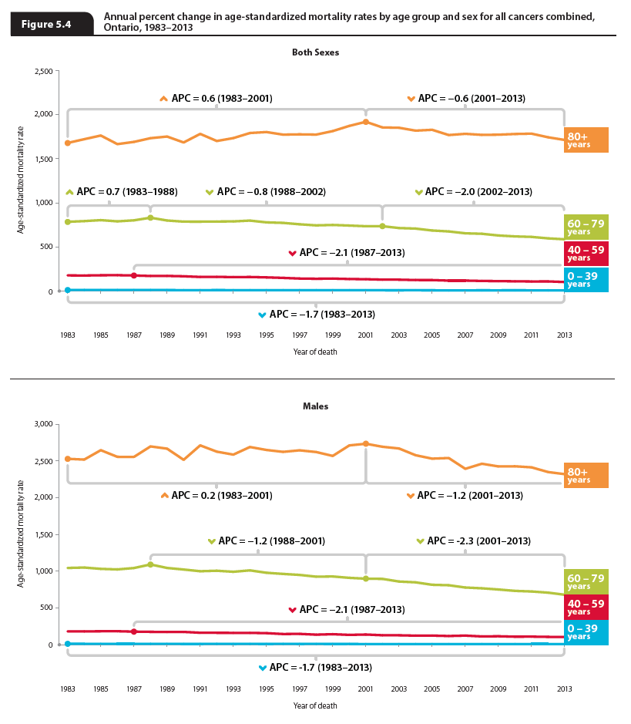
Notes:
NOTE: Female figure on the next slide
Mortality across all age groups has declined significantly over the last decade. While mortality declines in younger people have been fairly equal between the sexes, the declines among people ages 60 or older have been greater among males.
While incidence rates have been increasing among younger people, mortality rates have been falling. Among people under the age of 40, the mortality rate declined by 1.7% per year from 1983 to 2013.
For people ages 40 to 59, the mortality rate was stable until 1987, when it started to decline by 2.1% per year until 2013. Similar trends were seen for males and females separately.
Among those ages 60 to 79, the mortality rate increased until 1988, after which it decreased by 0.8% per year until 2002. From 2002 to 2013, the rate decreased by 2.0% per year. The rate of decrease was greater for males (2.3% per year) than females (1.8% per year).
Similar to people ages 60 to 79, mortality among those 80 or older increased by 0.6% per year between 1983 and 2001, followed by a decrease of 0.6% per year from 2001 to 2013. The decline in mortality was greater for males at 1.2% per year after 2001. Among females, the mortality rate was stable until 1992, after which it increased until 2001 before finally declining by 0.5% per year since.

Slide 9
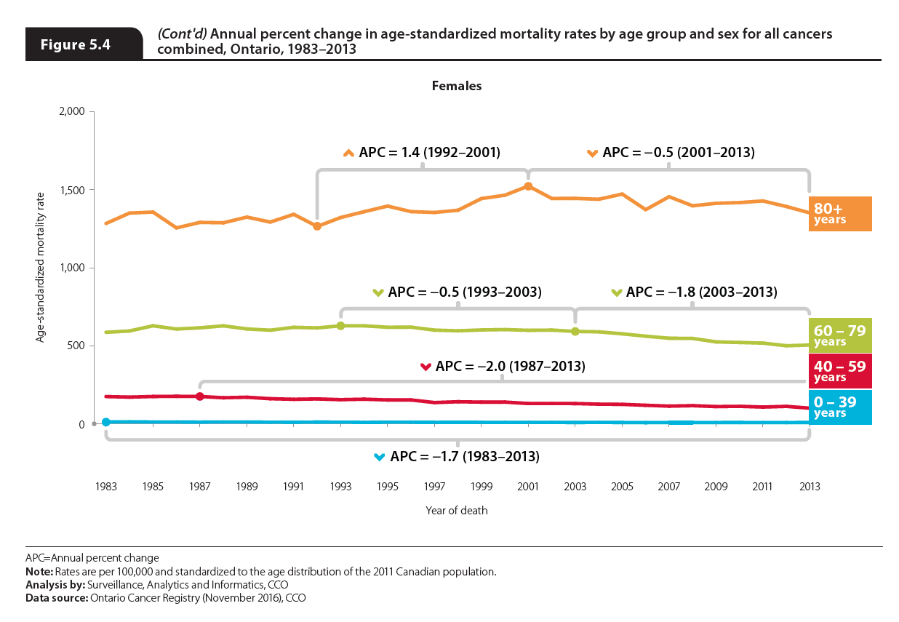
Notes:
Mortality across all age groups has declined significantly over the last decade. While mortality declines in younger people have been fairly equal between the sexes, the declines among people ages 60 or older have been greater among males.
While incidence rates have been increasing among younger people, mortality rates have been falling. Among people under the age of 40, the mortality rate declined by 1.7% per year from 1983 to 2013.
For people ages 40 to 59, the mortality rate was stable until 1987, when it started to decline by 2.1% per year until 2013. Similar trends were seen for males and females separately.
Among those ages 60 to 79, the mortality rate increased until 1988, after which it decreased by 0.8% per year until 2002. From 2002 to 2013, the rate decreased by 2.0% per year. The rate of decrease was greater for males (2.3% per year) than females (1.8% per year).
Similar to people ages 60 to 79, mortality among those 80 or older increased by 0.6% per year between 1983 and 2001, followed by a decrease of 0.6% per year from 2001 to 2013. The decline in mortality was greater for males at 1.2% per year after 2001. Among females, the mortality rate was stable until 1992, after which it increased until 2001 before finally declining by 0.5% per year since.

