Slide 2
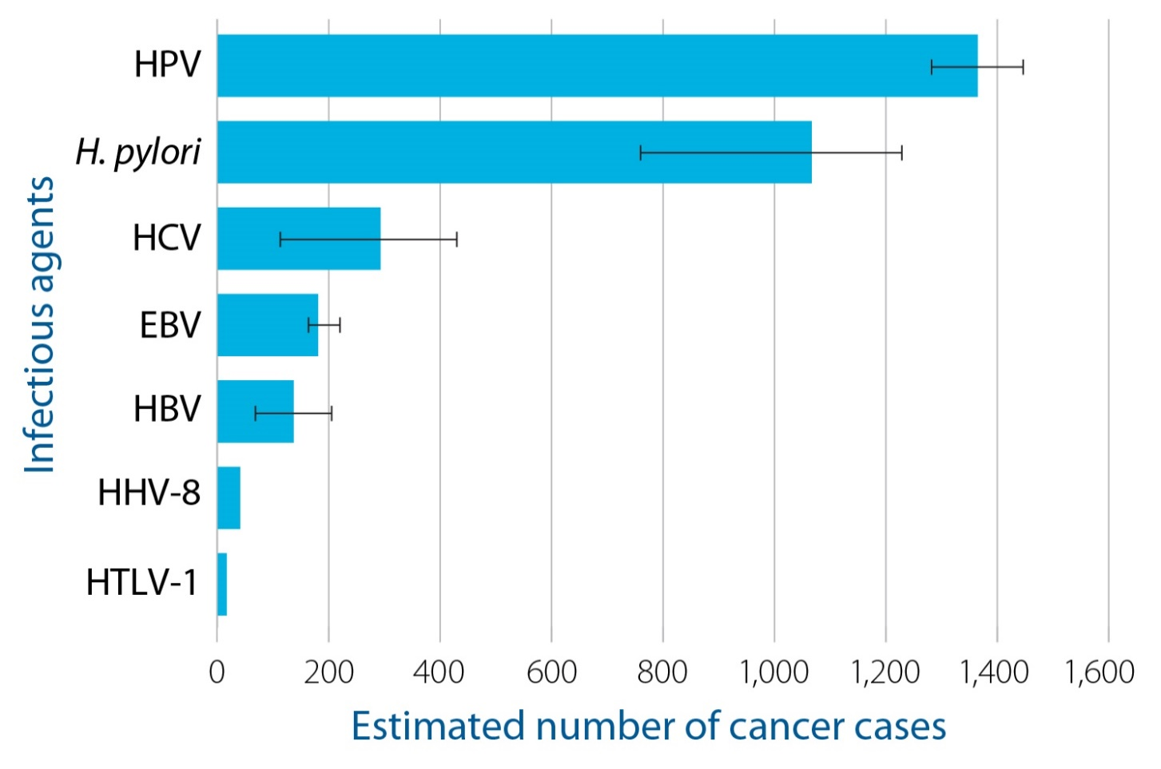
Estimated number of cancer cases attributable to infectious agents, Ontario, 2013
SOURCE: Ontario Cancer Registry, 2016 (Cancer Care Ontario)
NOTES: HPV = human papillomavirus; H. pylori = Helicobacter pylori; HCV = hepatitis C virus; EBV = Epstein-Barr virus; HBV = hepatitis B virus; HHV-8 = human herpesvirus 8; HTLV-1 = human T-cell lymphotropic virus, type 1. ı—ı represent plausible ranges (based on a range of studies or reports) for number of cancer cases attributable to each infectious agent, and no ı—ı for HHV-8 and HTLV-1 reflect necessary but not sufficient relationships with associated cancers (i.e., PAF = 100%).
Executive Summary

Slide 3
Infectious agents and their associated cancer types
SOURCE: IARC, 2012¹
NOTES: ª Indicates a causal relationship between the infectious agent and the cancer.
^{b} Indicates that a causal relationship between the infectious agent and the cancer is possible, but chance, bias and confounders cannot be ruled out with confidence.
Context

Slide 4
Estimated percentage and number of cancers cases attributable to human papillomavirus (HPV) infections, Ontario, 2013
NOTE: For data sources, see Table A6 in Appendix B in the full report.
Findings

Slide 5
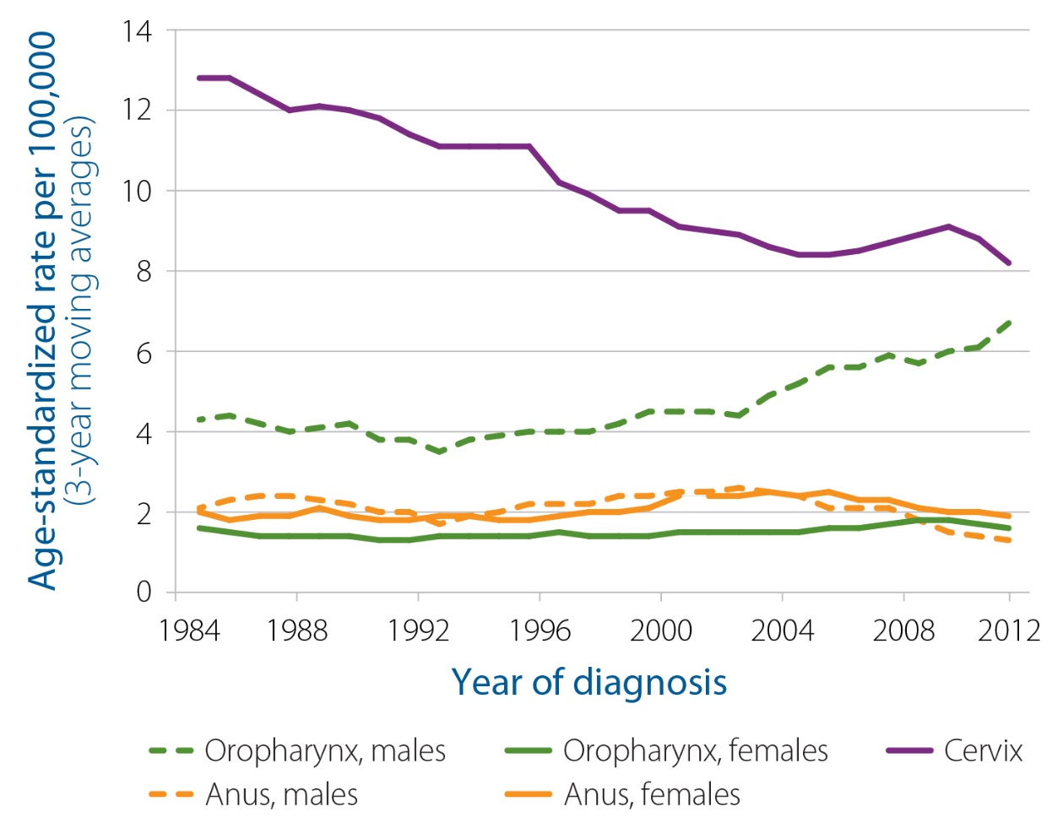
Incidence rates for selected cancer types associated with human papillomavirus (HPV), Ontario, 1984-2013
SOURCE: Ontario Cancer Registry, 2016 (Cancer Care Ontario)
NOTES: Incidence rates are standardized to the age distribution of the 2011 Canadian population. All oropharyngeal cancers, including HPV associated. For ICD-O-3 site and histology codes for cancer type, see Table A4 in Appendix A in the full report.
Findings

Slide 6
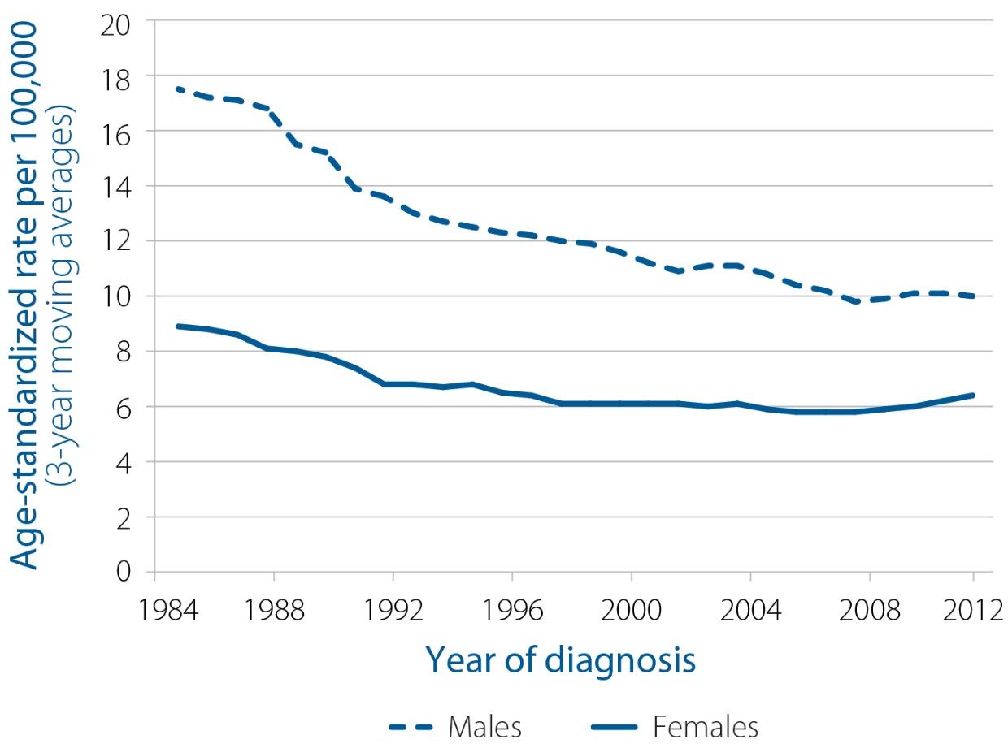
Non-cardia gastric cancer incidence rates, Ontario, 1984-2013
SOURCE: Ontario Cancer Registry, 2016 (Cancer Care Ontario)
NOTES: Incidence rates are standardized to the age distribution of the 2011 Canadian population. For ICD-O-3 site and histology codes for cancer type, see Table A4 in Appendix A in the full report.
Findings

Slide 7
Liver cancer incidence rates, Ontario, 1984–2013
SOURCE: Ontario Cancer Registry, 2016 (Cancer Care Ontario)
NOTES: Incidence rates are standardized to the age distribution of the 2011 Canadian population. Liver cancers exclude intrahepatic bile duct cancer. For ICD-O-3 site and histology codes for cancer type, see Table A4 in Appendix A in the full report.
Findings

Slide 8
Estimated percentage and number of cancer cases attributable to Epstein-Barr virus (EBV) infection, Ontario, 2013
NOTE: For data sources, see Table A6 in Appendix B in the full report.
Findings

Slide 9
Infectious agents and associated cancer types included in Ontario population attributable fraction estimates
NOTE: ª IARC, 2012¹
Appendix A

Slide 10
Data sources for prevalence estimates of infectious agents
NOTES: Reference numbers provided in the table correspond to the main reference list in this report.
ª Population attributable fraction assumed to be 100% on the basis of evidence suggesting a “necessary but not sufficient” relationship between the relevant agent and cancer type.
Appendix A

Slide 11
Data sources for prevalence estimates of infectious agents (cont’d)
NOTES: Reference numbers provided in the table correspond to the main reference list in this report.
ª Population attributable fraction assumed to be 100% on the basis of evidence suggesting a “necessary but not sufficient” relationship between the relevant agent and cancer type.
^{b} Liver cancer (hepatocellular carcinoma) prevalence value used for lower PAF estimate for the infectious agent.
^{c} Liver cancer (hepatocellular carcinoma) prevalence value used for upper PAF estimate for the infectious agent.
Appendix A

Slide 12
Data sources for relative risk estimates of infectious agents and associated cancer types
NOTES: Reference numbers provided in the table correspond to the main reference list in this report.
ª Population attributable fraction assumed to be 100% on the basis of evidence suggesting a “necessary but not sufficient” relationship between the relevant agent and cancer type.
^{b} No relative risk (RR) estimate required for these prevalence in cases, as RR value assumed to be very large, to the point that PAF can be assumed to equal the prevalence of an infectious agent in particular cancer cases.
Appendix A

Slide 13
Definition of cancer types associated with infectious agents
NOTES:
ª Cancer cases defined by SEER Site recode (see https://seer.cancer.gov/siterecode/icdo3_dwhoheme/index.html).
^{b} Third Edition of the International Classification of Diseases for Oncology (2000). ICD-0-3 site/histology codes were based on the Surveillance, Epidemiology and End Results (SEER) site recode definition.
See http://seer.cancer.gov/siterecode/icdo3_dwhoheme/index.html.
Appendix A

Slide 14
Population attributable fraction (PAF) formulas
NOTES: p_{p}=prevalence of exposure in general population; RR=relative risk associated with exposure; and p_{C}=prevalence in cancer cases.
Appendix A

Slide 15
Population attributable fractions (PAF) of infectious agents and associated cancer types—formulas, inputs, results and plausible ranges
Appendix B

Slide 16
Population attributable fractions (PAF) of infectious agents and associated cancer types—formulas, inputs, results and plausible ranges (notes)
NOTES:
p_{c}=prevalence in cancer cases; p_{p}=prevalence of exposure in general population; and RR=relative risk associated with exposure.
ª Causal association between infectious agent and associated cancer.
^{b} Prevalence estimate obtained from Nichols et al., 2013.¹⁷¹
^{c} Prevalence estimate obtained from Ouhoummane et al., 2013.¹⁷²
^{d} Prevalence estimate obtained from de Sanjosé et al., 2013.¹⁷³
^{e} Prevalence estimate obtained from de Vuyst et al., 2009.¹⁷⁴
^{f} Prevalence estimate obtained from Bethune et al., 2012.¹⁷⁵
^{g} Prevalence and relative risk values obtained from Plummer et al., 2016.⁹
^{h} Prevalence estimate obtained from Naja et al., 2007.⁵⁴
^{i} Prevalence estimates obtained from Rotermann et al., 2013.⁷⁹
^{j} Prevalence estimates provided by Dr. Morris Sherman (personal communication, Feb. 2, 2017).
^{k} Prevalence and relative risk values obtained from de San Jose et al., 2008.⁶⁹
^{l} Prevalence estimate obtained from Lee et al., 2014.¹⁷⁶
^{m} Prevalence estimate obtained from IARC, 2012.¹
^{n} Relative risk values obtained from Plummer et al., 2015.⁴⁶
º Relative risk values obtained from Cho et al., 2011.⁶⁸
^{p} PAF estimate based on the average of PAF results from: (1) Levin’s formula; and (2) Alternate formula 1.
^{q} Upper and lower PAF plausible ranges calculated using ±10 percent of prevalence and of relative risk, respectively.
^{r} Lower plausible range calculated using relative risk (5.9) from De Martel et al., 2012² based on ELISA method.
^{s} Lower PAF plausible range calculated using prevalence estimates from Rotermann et al., 2013.⁷⁹
^{t} Upper plausible range obtained from Plummer et al., 2016.⁹
^{u} Upper plausible range calculated using prevalence estimates provided by Dr. Morris Sherman (personal communication, Feb. 2, 2017).
Appendix B

Slide 17
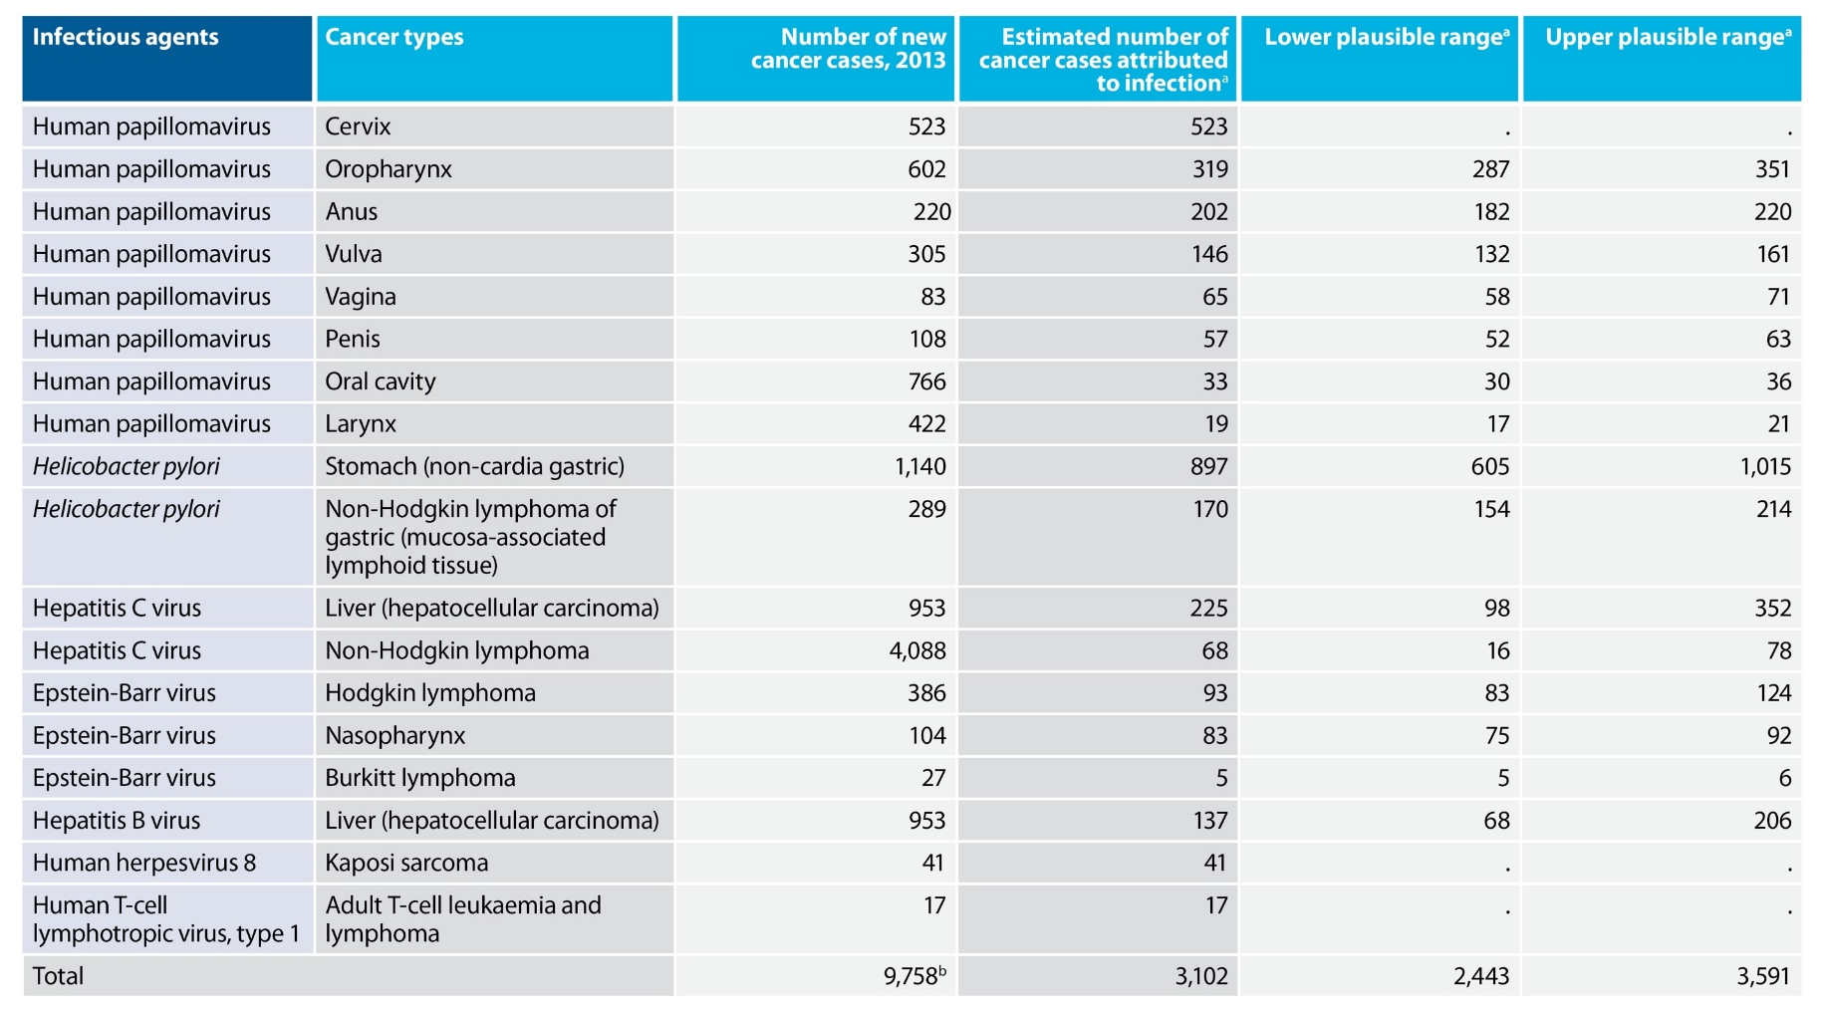
Estimated number of cancer cases attributable to infectious agents, Ontario, 2013
NOTES:
ª The population attributable fraction estimates from Table A6 above were applied to the number of each cancer type diagnosed in Ontario in 2013.
^{b} Total number of cancers cases in 2013 based on 15 cancer types, where liver cancer cases were counted once, and Burkitt lymphoma and non-Hodgkin lymphoma of gastric (mucosa-associated lymphoid tissue) cancer cases were considered part of non-Hodgkin lymphoma.
Appendix B

