Slide 2
1
Cancer in Ontario
An Overview
Ontario Cancer Statistics 2016 Chapter 1: Cancer in Ontario—An Overview

Slide 3
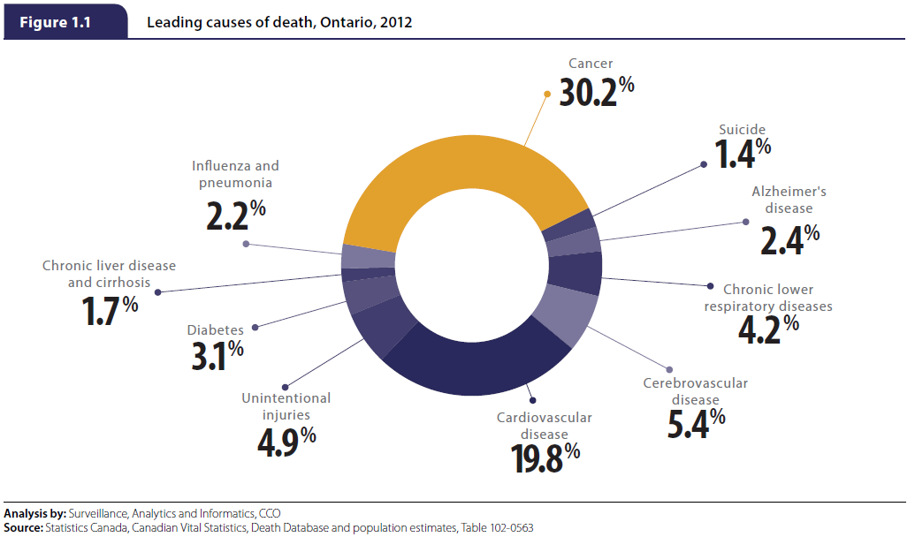
An Overview
Ontario Cancer Statistics 2016 Chapter 1: Cancer in Ontario—An Overview
Notes:
Figure 1.1 - Leading causes of death, Ontario, 2012
In 2012, 30.2% of all deaths in Ontario were attributable to cancer, making it the leading cause of death in this province. Cancer caused the same number of deaths as the next three leading causes of death combined—cardiovascular disease, cerebrovascular disease and unintentional injuries.(1)
References:
1. Statistics Canada. Leading causes of death, total population, by sex, Canada, provinces and territories, annual. CANSIM table 102-0563 [Internet]. Ottawa: Statistics Canada; 2015 [cited December 2015]. Available from: http://www5.statcan.gc.ca/cansim/a26?lang=eng&id=1020563

Slide 4
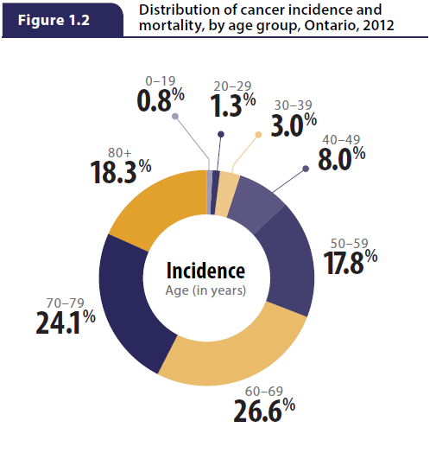
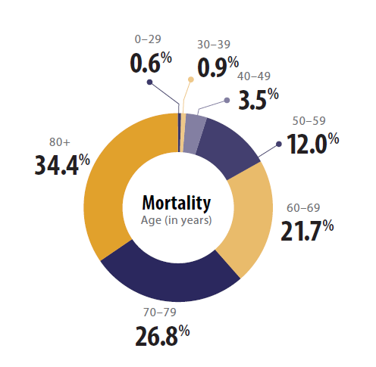
Ontario Cancer Statistics 2016 Chapter 1: Cancer in Ontario—An Overview
Notes:
Figure 1.2 - Distribution of cancer incidence and mortality, by age group, Ontario, 2012
The majority of new cancer cases were diagnosed in people 50 years of age and older in 2012 . The greatest proportion of cases were diagnosed in people between the ages of 60 and 69 (26.6% of new cases) and 70 and 79 (24.1%). Cancer was rare among children and adolescents, with less than 1% of all new cases diagnosed in people under the age of 20. In fact, almost 95% of all new cases were in people over the age of 40.
The majority of cancer deaths occurred in people 50 years of age and older. Cancer deaths increased with age, with the greatest proportion of mortality occurring in people 80 years of age and older (34.4% of deaths) followed by people between the ages of 70 and 79 (26.8%). Cancer deaths were rare in children, adolescents and young adults, with only 1.5% of deaths occurring in people under the age of 40.

Slide 5
In Focus
Spotlight on Specific Cancers
Ontario Cancer Statistics 2016 In Focus

Slide 6
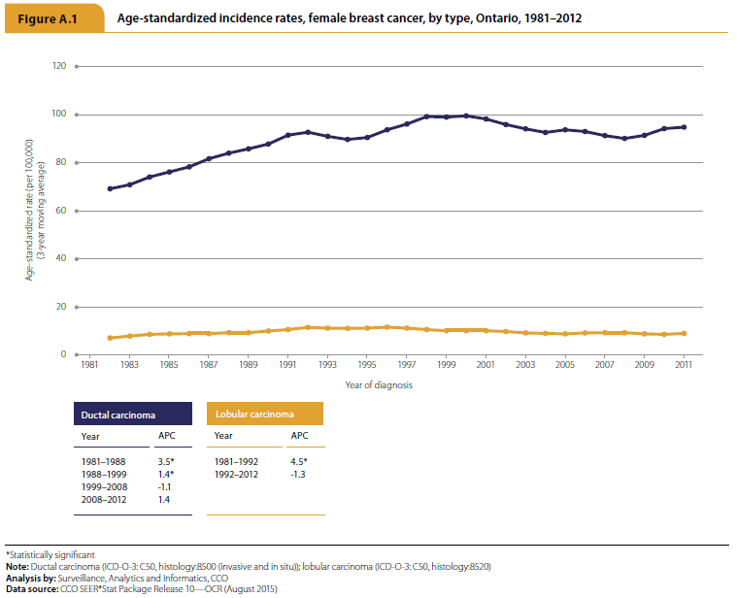
Female Breast Cancer
Ontario Cancer Statistics 2016 In Focus: Female Breast Cancer
Notes:
Figure A.1 - Age-standardized incidence rates, female breast cancer, by type, Ontario, 1981–2012
Between 1981 and 2012, the incidence rates of both ductal carcinoma and lobular carcinoma increased significantly in Ontario. The largest increases for both types occurred roughly during the first decade of this period.

Slide 7
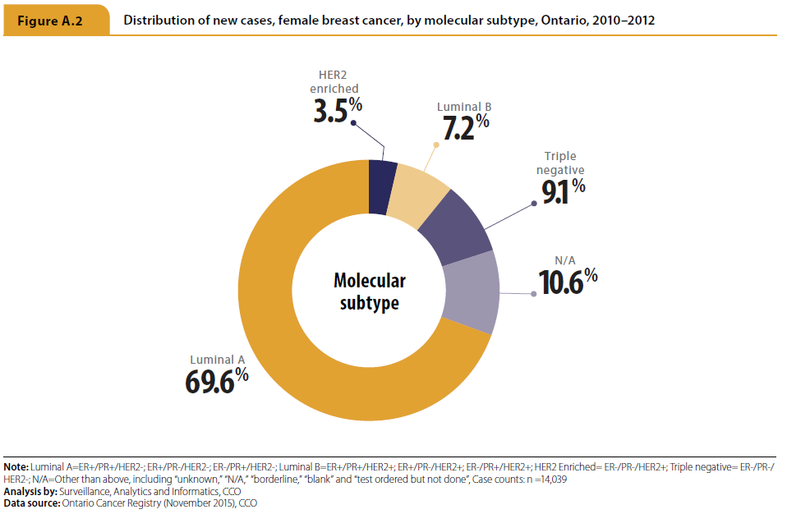
Female Breast Cancer
Ontario Cancer Statistics 2016 In Focus: Female Breast Cancer
Notes:
Figure A.2 - Distribution of new cases, female breast cancer, by molecular subtype, Ontario, 2010–2012
Luminal A was the most common molecular subtype among new cases in Ontario between 2010 and 2012, followed by the triple negative subtype.

Slide 8
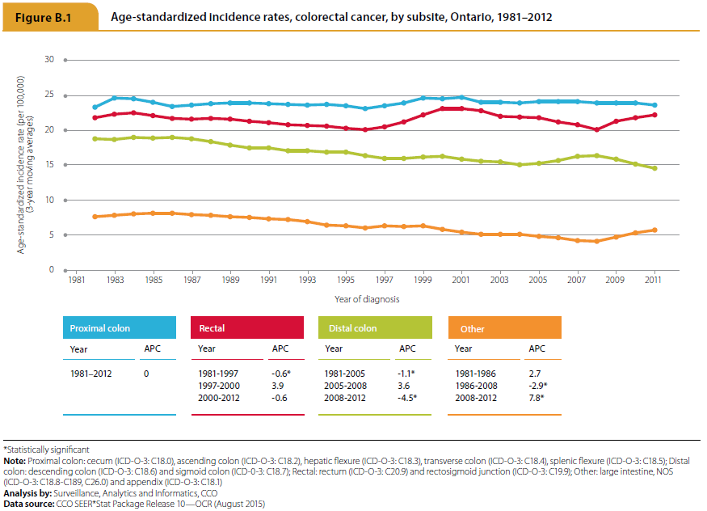
Colorectal Cancer
Ontario Cancer Statistics 2016 In Focus: Colorectal Cancer
Notes:
Figure B.1 - Age-standardized incidence rates, colorectal cancer, by subsite, Ontario, 1981–2012
From 1981 to 2005, and then again from 2008 to 2012, there was a significant decrease in the incidence rate for distal colon cancer. In contrast, the incidence rate for rectal cancer declined only slightly between 1981 and 1997. The incidence rate for proximal colon cancer did not change between 1981 and 2012.

Slide 9
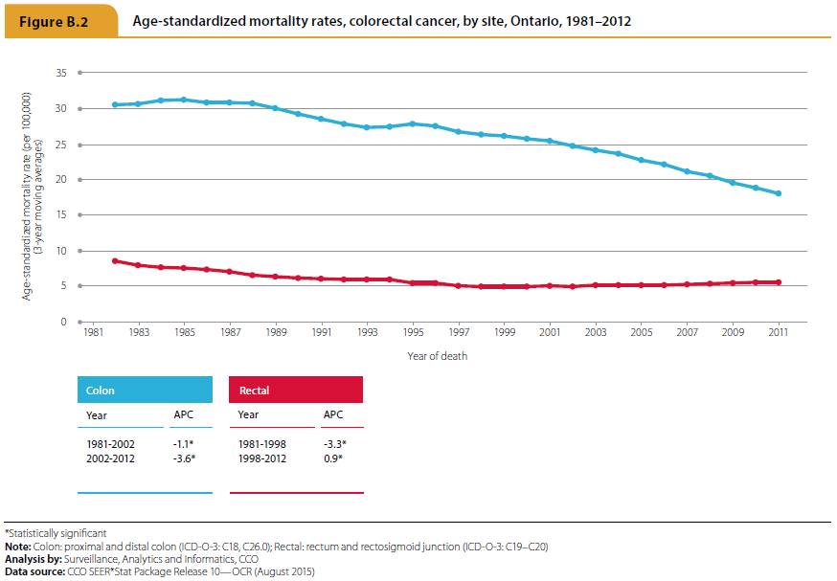
Colorectal Cancer
Ontario Cancer Statistics 2016 In Focus: Colorectal Cancer
Notes:
Figure B.2 - Age-standardized mortality rates, colorectal cancer, by site, Ontario, 1981–2012
The mortality rate for colon cancer has been decreasing in Ontario since the 1980s. The greatest decline of 3.6% per year occurred between 2002 and 2012. For rectal cancer, the greatest decline in the mortality rate occurred between 1981 and 1998 (3.3% per year). Since then the mortality rate has increased slightly.

Slide 10
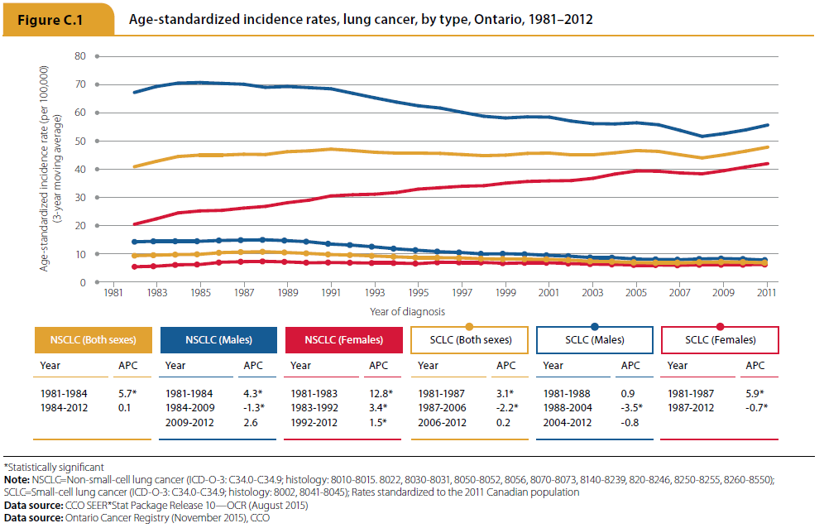
Lung Cancer
Ontario Cancer Statistics 2016 In Focus: Lung Cancer
Notes:
Figure C.1 - Age-standardized incidence rates, lung cancer, by type, Ontario, 1981–2012
For both sexes combined, the incidence rate of non–small cell lung carcinoma (NSCLC) increased by 5.7% per year from 1981 to 1984 and then stabilized. The rate of NSCLC declined or remained stable among males after 1984, but increased among females over the same period.
Small cell lung carcinoma (SCLC) incidence rates for both sexes stabilized later than NSCLC rates. The SCLC rate increased between 1981 and 1987 (3.1% per year), decreased between 1987 and 2006 (2.2% per year), and then remained stable from 2006 to 2012. SCLC incidence by sex declined or remained stable for males and females after 1987, but the decline was greater for males. The early 1980s, however, saw a difference in incidence rates for males and females. Among females, the incidence rate for SCLCs increased by 5.9% per year between 1981 and 1987, while it remained stable among males.

Slide 11
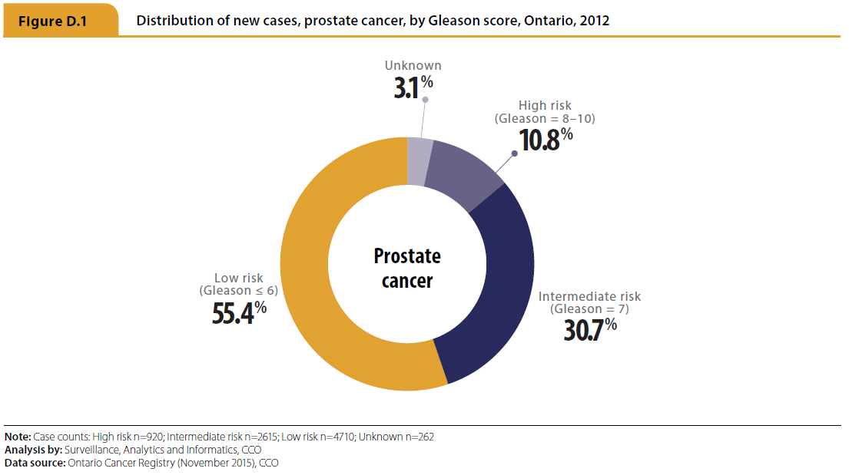
Prostate Cancer
Ontario Cancer Statistics 2016 In Focus: Prostate Cancer
Notes:
Figure D.1 - Distribution of new cases, prostate cancer, by Gleason score, Ontario, 2012
The majority of prostate cancer cases diagnosed in Ontario in 2012 were low risk cancers (55.4%) based on their Gleason score. High risk cancers made up only 10.8% of all diagnosed cases.

Slide 12
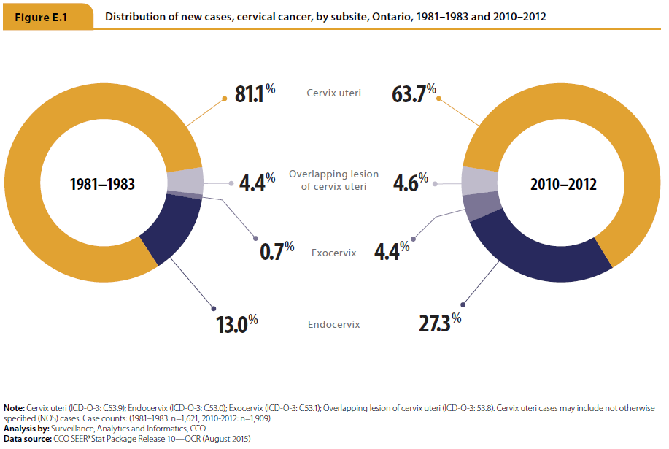
Cervical Cancer
Ontario Cancer Statistics 2016 In Focus: Cervical Cancer
Notes:
Figure E.1 - Distribution of new cases, cervical cancer, by subsite, Ontario, 1981–1983 and 2010–2012
While the majority of cases occur in the cervix uteri, the distribution of cases changed between 1981 and 2012. The proportion of cancers occurring in the cervix uteri decreased while the proportion occurring in the endocervix and exocervix cancers increased.

Slide 13
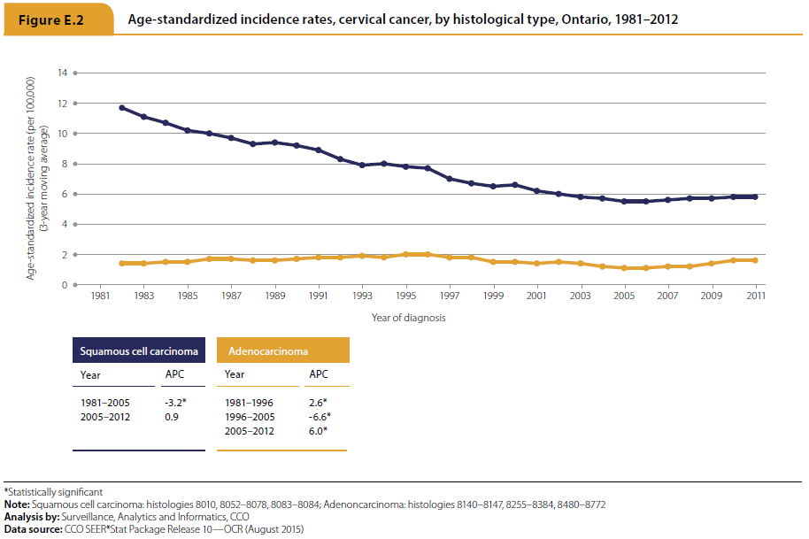
Cervical Cancer
Ontario Cancer Statistics 2016 In Focus: Cervical Cancer
Notes:
Figure E.2 - Age-standardized incidence rates, cervical cancer, by histological type, Ontario, 1981–2012
In 2012, 64.4% of cases of cervical cancer were squamous cell carcinomas and 28.1% were adenocarcinomas. These two most common histological types of cervical cancer had differing incidence trends over time. Between 1981 and 2005, the incidence rate for squamous cell carcinoma of the cervix decreased by 3.2% per year. Since then, the rate has remained stable. On the other hand, the incidence rate for adenocarcinoma of the cervix increased by 2.6% per year between 1981 and 1996 and 6.0% per year between 2005 and 2012. Between 1996 and 2005 the rate of adenocarcinoma decreased by 6.6% per year. As a result, the rate of adenocarcinoma in 2012 was similar to the rate in 1981, while the rate of squamous cell carcinoma was more than halved over the same time period.

Slide 14
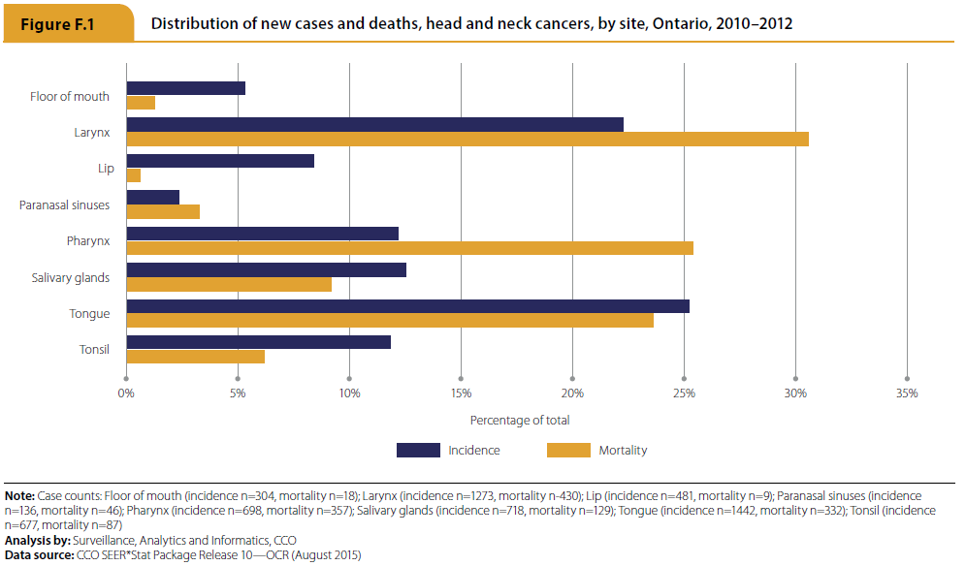
Head and Neck Cancers
Ontario Cancer Statistics 2016 In Focus: Head and Neck Cancers
Notes:
Figure F.1 - Distribution of new cases and deaths, head and neck cancers, by site, Ontario, 2010–2012
Between 2010 and 2012, cancer of the tongue accounted for the greatest proportion of head and neck cancer (HNC) incidence (25.2%), followed by laryngeal cancer (22.2%). In the same time period, laryngeal cancer was the greatest contributor to HNC mortality (accounting for 30.5% of all deaths) followed by pharynx (25.4%) and tongue cancers (23.6%). Pharynx cancer was responsible for 25.4% of all HNC mortality, but only 12.2% of HNC incidence. Lip cancer accounted for 8.4% of HNC incidence, but only 0.6% of HNC mortality.

Slide 15
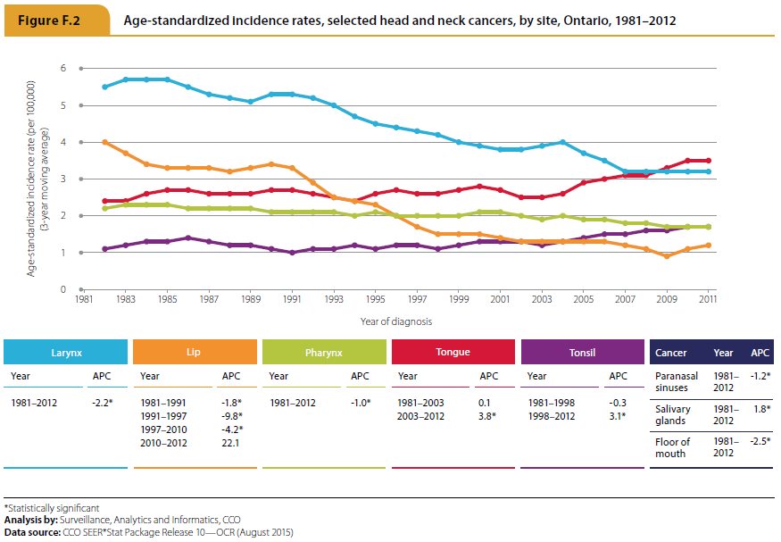
Head and Neck Cancers
Ontario Cancer Statistics 2016 In Focus: Head and Neck Cancers
Notes:
Figure F.2 - Age-standardized incidence rates, head and neck cancers, by site, Ontario, 1981–2012
There are several noteworthy trends in HNC incidence rates over time:
The incidence rate for cancer of the tongue increased by 3.8% per year between 2003 and 2012, after remaining stable between 1981 and 2003.
The rate of tonsil cancer was stable between 1981 and 1998 and then increased by 3.1% per year between 1998 and 2012.
Laryngeal cancer was the most commonly diagnosed HNC in Ontario in 1981. The incidence rate declined by 2.2% per year between then and 2012, when it became the second most commonly diagnosed HNC in Ontario.
The rate of pharynx cancer decreased by 1.0% per year between 1981 and 2012.
Lip cancer had the greatest decrease, declining by 1.8% per year between 1981 and 1991, 9.8% per year between 1991 and 1997 and 4.2% between 1997 and 2010.
Cancer of the salivary glands increased by 1.8% per year between 1981 and 2012.
Cancer of the paranasal sinuses decreased by 1.2% per year between 1981 and 2012.
Cancer of floor of the mouth decreased by 2.5% per year between 1981 and 2012.

Slide 16
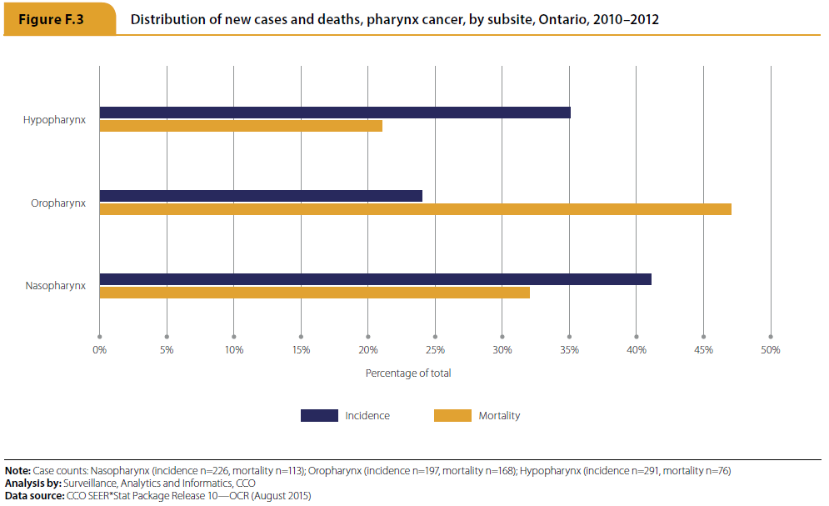
Head and Neck Cancers
Ontario Cancer Statistics 2016 In Focus: Head and Neck Cancers
Notes:
Figure F.3 - Distribution of new cases and deaths, pharynx cancer, by subsite, Ontario, 2010–2012
Notably, cancer of the nasopharynx accounted for most (40.8%) of the cases of pharynx cancer diagnosed between 2010 and 2012, while oropharynx cancer made up the greatest proportion (47.1%) of pharynx cancer deaths. In fact, oropharynx cancer accounted for a greater proportion of deaths than new cases, reflecting poor survival rates for this subsite. (1)
References:
1. Puglina F, Piccirillo J, Zequeria M, Emami B, Perez C. Clinical-severity staging system for oropharyngeal cancer: five-year survival rates. Arch Otolaryngol Head Neck Surg. 1997;123(10):1118-24.

Slide 17
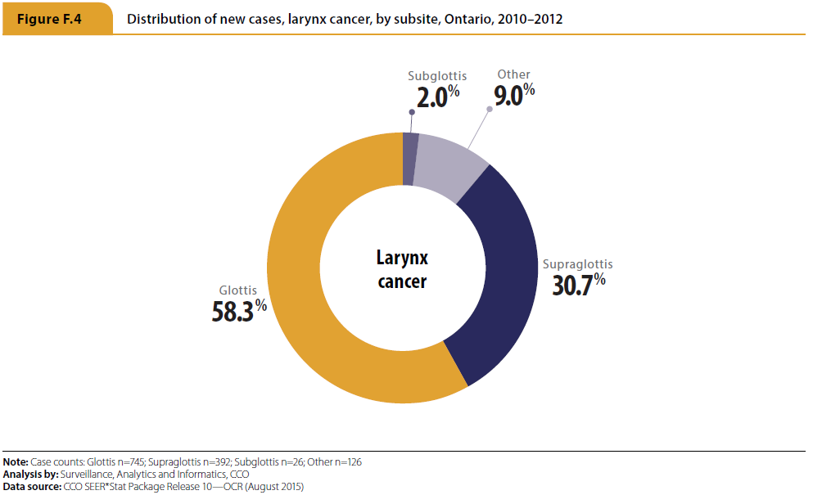
Head and Neck Cancers
Ontario Cancer Statistics 2016 In Focus: Head and Neck Cancers
Notes:
Figure F.4 - Distribution of new cases, larynx cancer, by subsite, Ontario, 2010–2012
Between 2010 and 2012, the majority of diagnosed laryngeal cancers were of the glottis (58.3%) or supraglottis (30.7%).

