Slide 1
3
In focus – Emerging issues in cancer control
Ontario Cancer Statistics 2018
Chapter 3: In Focus – Emerging issues in cancer control

Slide 2
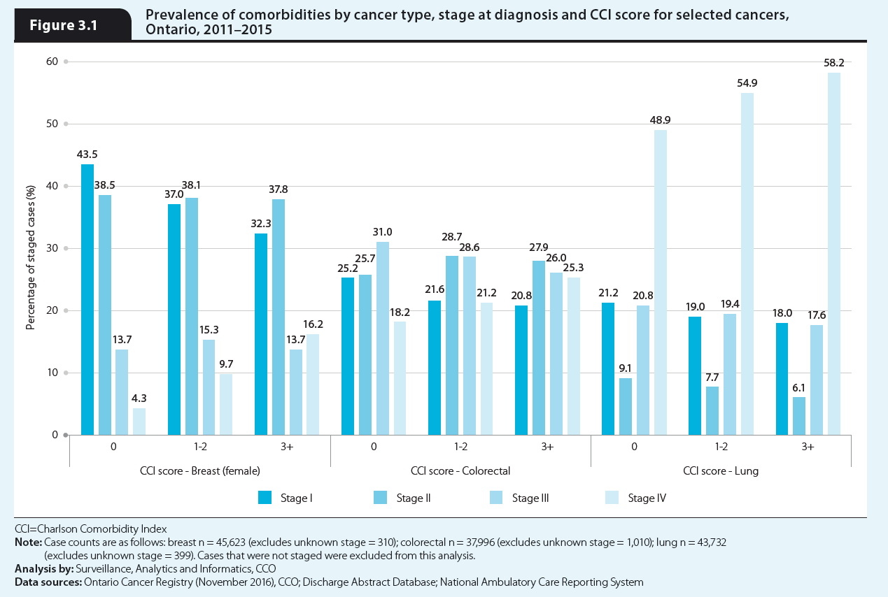
Notes:
The prevalence of comorbidities by stage for the cancers for which stage data was available are presented here. In general, for all three cancer types assessed, increasing level of comorbidity was associated with increasing likelihood of a stage IV diagnosis.
Among breast cancer patients with no comorbidity the largest proportion were diagnosed at stage I (43.5%), while 18.0% were diagnosed at an advanced stage (stage III or stage IV). Among those with moderate comorbidities, 25.0% were diagnosed at an advanced stage, while 29.9% of those with severe comorbidities were diagnosed at an advanced stage.
While 49.2% of colorectal cancer patients with no comorbidity were diagnosed at an advanced stage, the number was similar at 51.3% among those with severe comorbidities. However, the proportion of patients diagnosed at stage IV increased from 18.2% among those with no comorbidities to 25.3% among those with severe comorbidities.
Among lung cancer patients, the proportion of those diagnosed at an advanced stage increased with increasing prevalence of comorbidities. However, lung cancer tends to be diagnosed at more advanced stages regardless of the prevalence of comorbidity in the patient. In 2013, 71.0% of staged lung cancer cases were diagnosed at stage III or IV (see Chapter 4: Cancer incidence rates and trends). A similar number (75.8%) of lung cancer patients with severe comorbidities were diagnosed at an advanced stage.
It has been argued that patients with comorbidity are more likely to be diagnosed at more advanced stages because comorbidity may mask the early symptoms of cancer. Previous studies of comorbidity and stage at diagnosis have found differing results including that patients with comorbidity are more likely to be diagnosed earlier, later or at a similar stage as those without comorbidity, with the variations in findings attributed to cancer type, comorbidity type, different populations and different healthcare systems. In Ontario, at least, it appears that the possible positive implication of comorbidities (i.e., more frequent contact with the healthcare system) have not resulted in increased detection of cancer, and that those with comorbidities are more likely to be diagnosed at an advanced stage than those without comorbidities.

